Slide 1
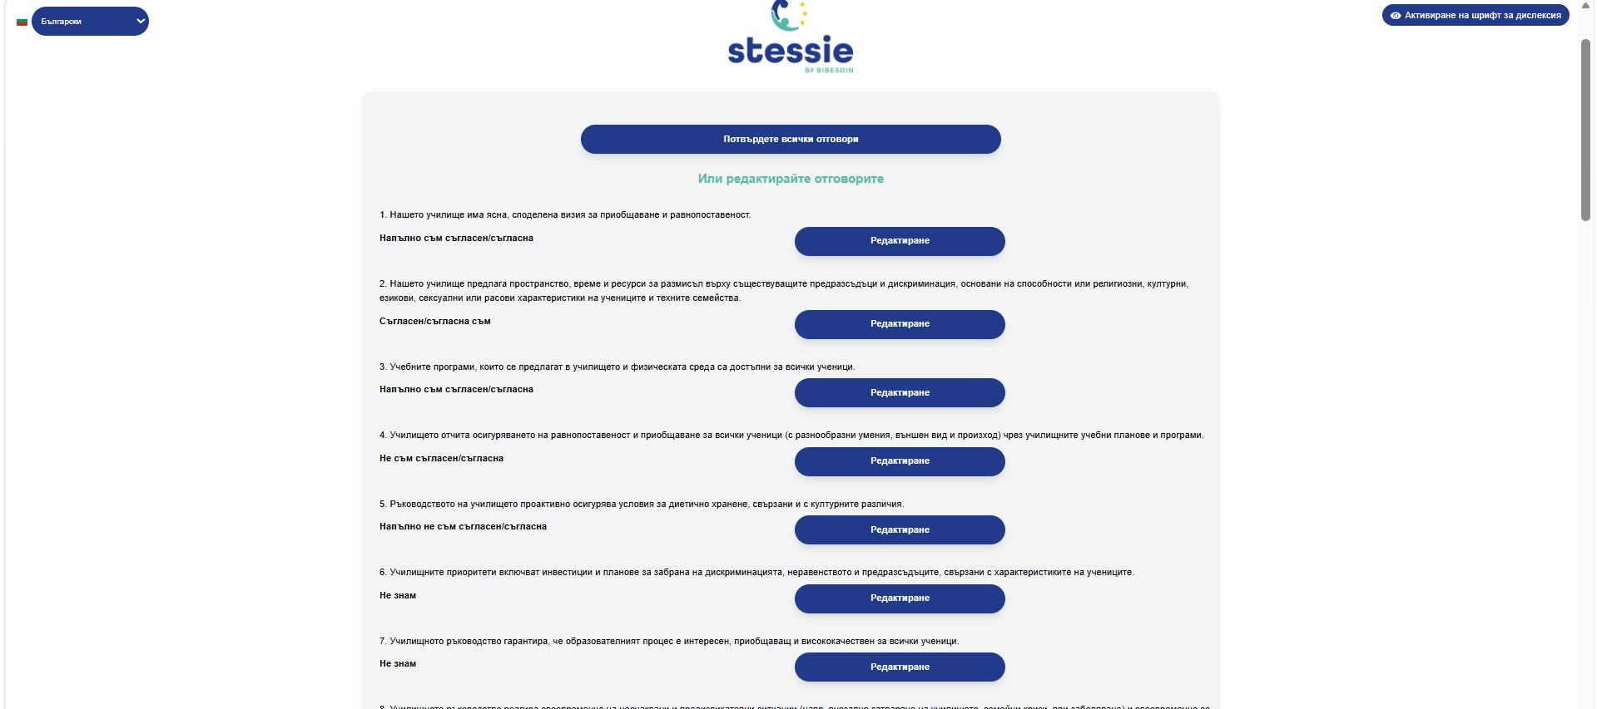
STESSIE METER
Registration Guide
Step by step – from the website to the survey

Slide 2
Registration Steps Overview
1
2
3
4
5
6
STESSIE Website
Registration
Email Confirmation
Confirm Your Email
Log In to Your Account
My Campaigns Dashboard
Visit stessieapp.eu and select your language
Fill in the form with your school details
A confirmation link is sent
Click the link in the received email
Sign in with email and password
Browse campaigns and surveys
7
8
9
10
11
Campaigns
Create a Survey
Send
Complete
Results
Optional: group surveys into a campaign
Set parameters and launch
Copy the link and send via e-register
Respondents answer the questions
Analyse results in real time

Slide 3

Step 1 – STESSIE Website
1/10
Visit stessieapp.eu – the site supports multiple languages (BG, EN, DE, FR, etc.)

Slide 4
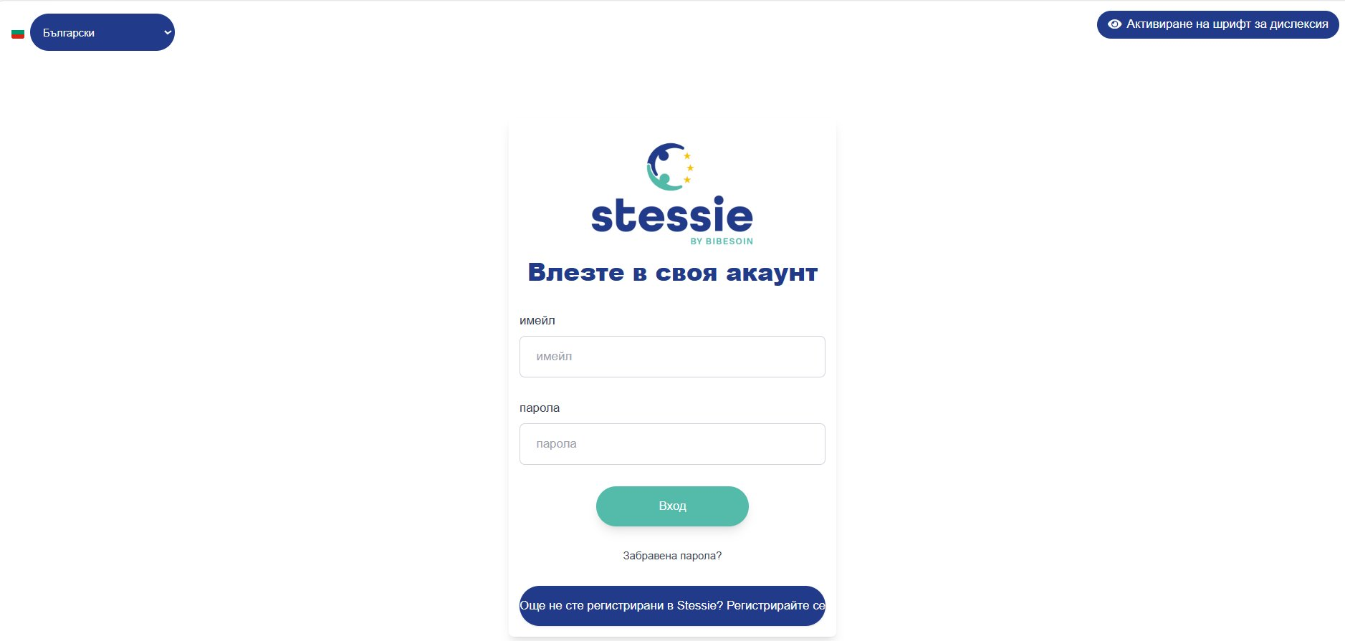
Step 2 – Opening the Application
2/10
Fill in the fields:
📧 General email of your school
🔒 Password (and confirmation)
🌍 Country
📍 Region and City
🏫 Name of the school
✅ CAPTCHA – "Аз съм човек"
Натиснете "Изпрати"

Slide 5
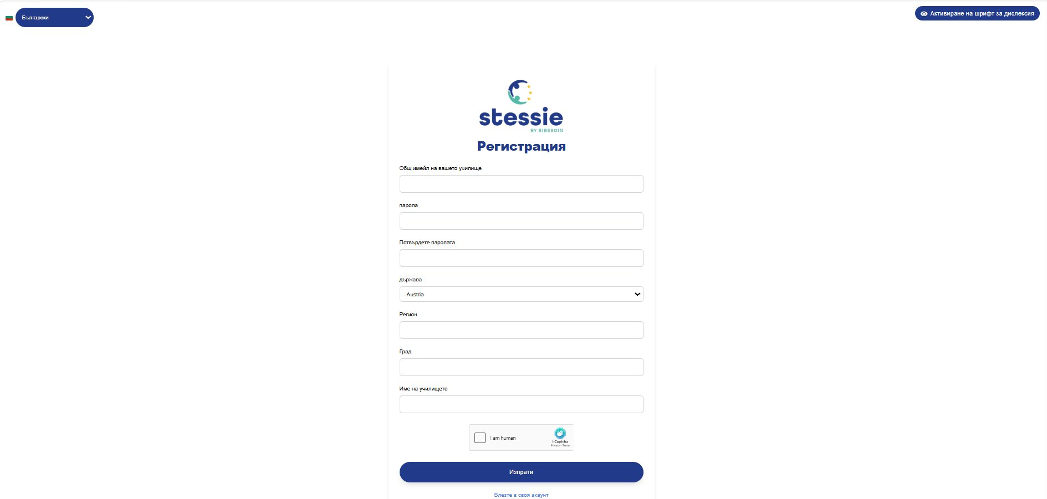
Step 3 – Registration
3/10
Пример: info-65420@edu.mon.bg, София, Изгрев, ОУ Васил Левски

Slide 6

Step 3 – Confirmation Link Sent
4/11
💡 Check your inbox and click the email confirmation link.

Slide 7
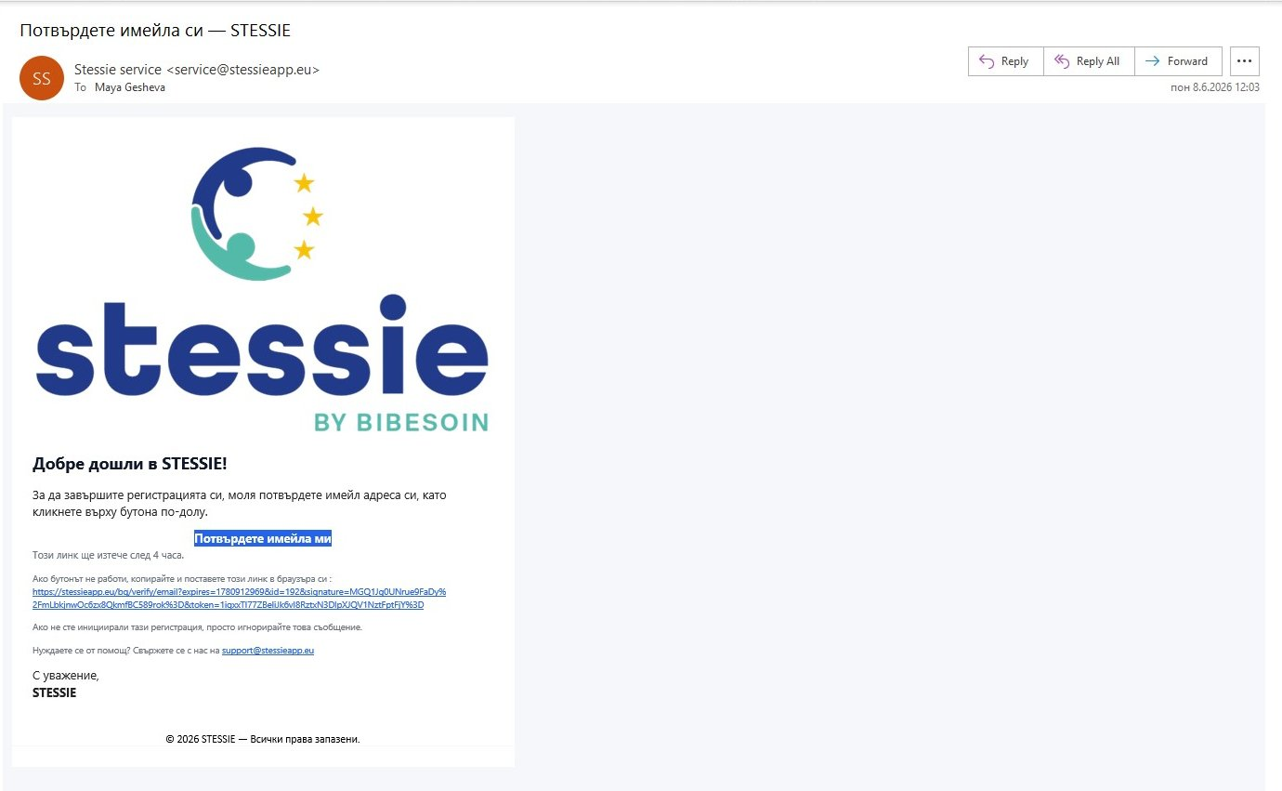
Step 4 – Confirm Your Email
4/10
📧 От: service@stessieapp.eu – Кликнете "Потвърдете имейла ми" (линкът е валиден 4 часа).

Slide 8
Step 5 – Log In to Your Account
5/10
🔐 Въведете имейл и парола и натиснете "Вход".

Slide 9
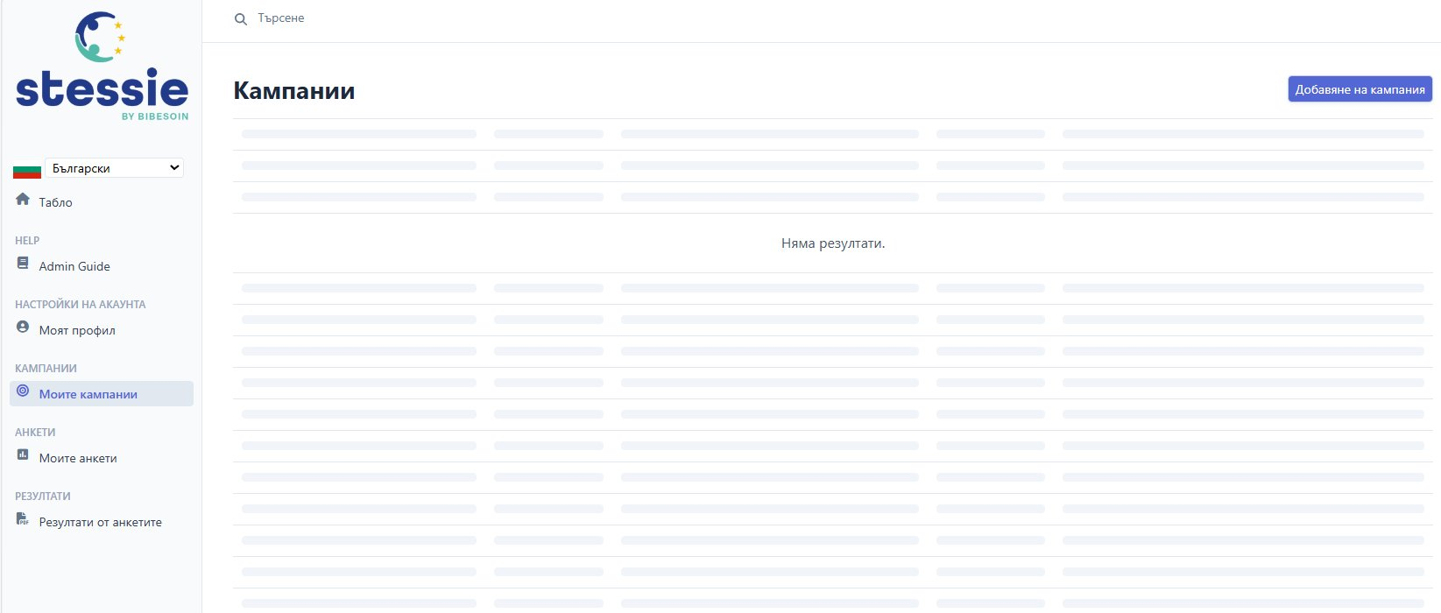
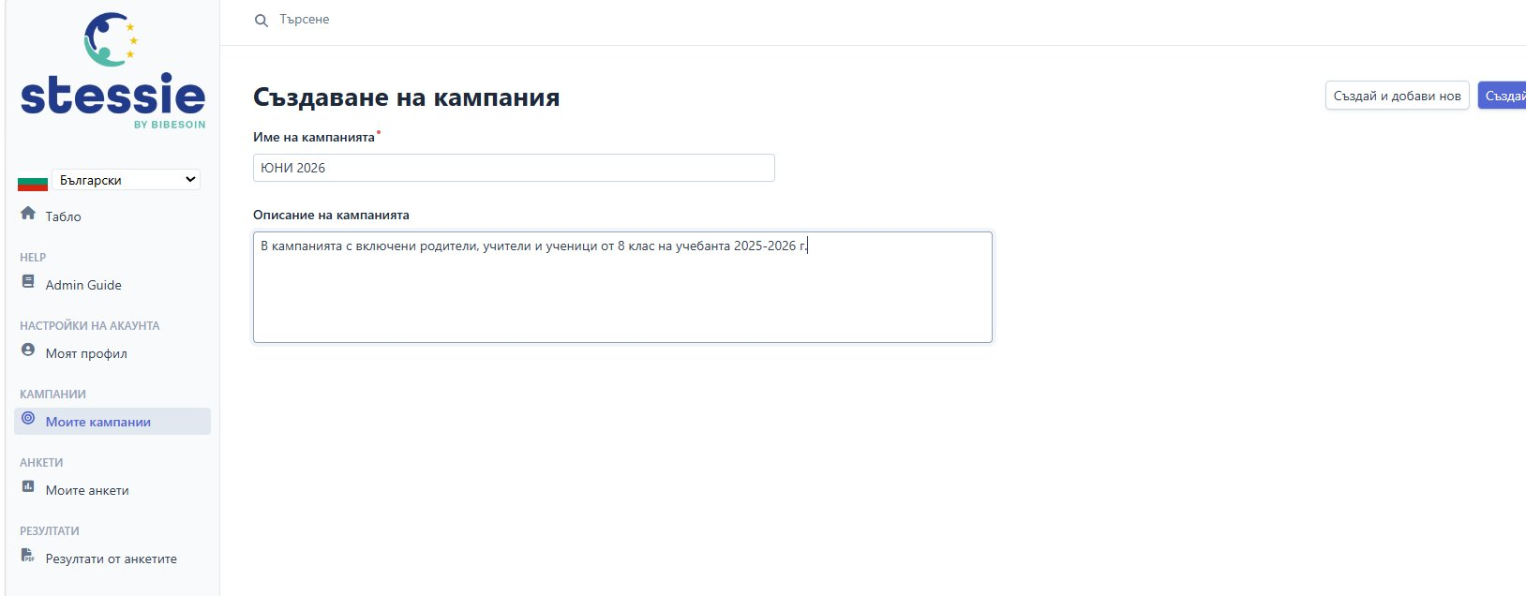
Стъпки 6 & 7 – Кампании
6-7/11
💡 Optional: create a campaign to group surveys (e.g. JUNE 2026 – parents, teachers, students).
Step 6 – My Campaigns Dashboard
Step 7 – Create a Campaign

Slide 10
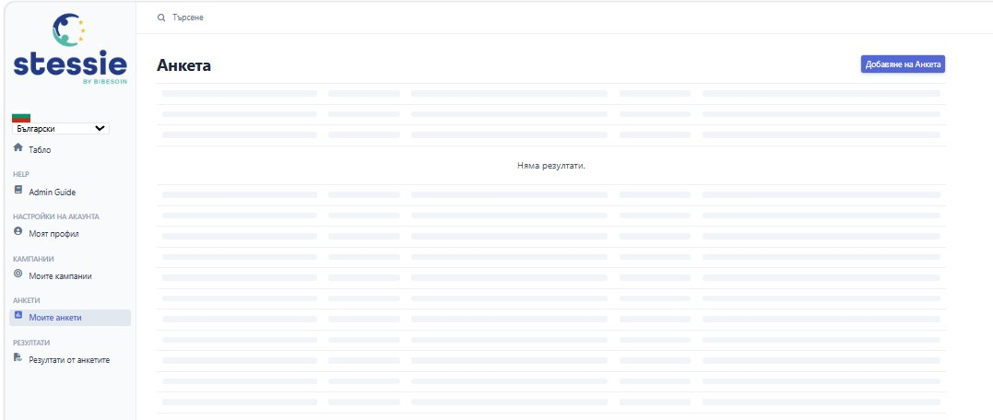
Step 6 – Create a Survey
8/11
➕ Попълнете полетата и натиснете "Създай" или "Създай и добави нов".

Slide 11
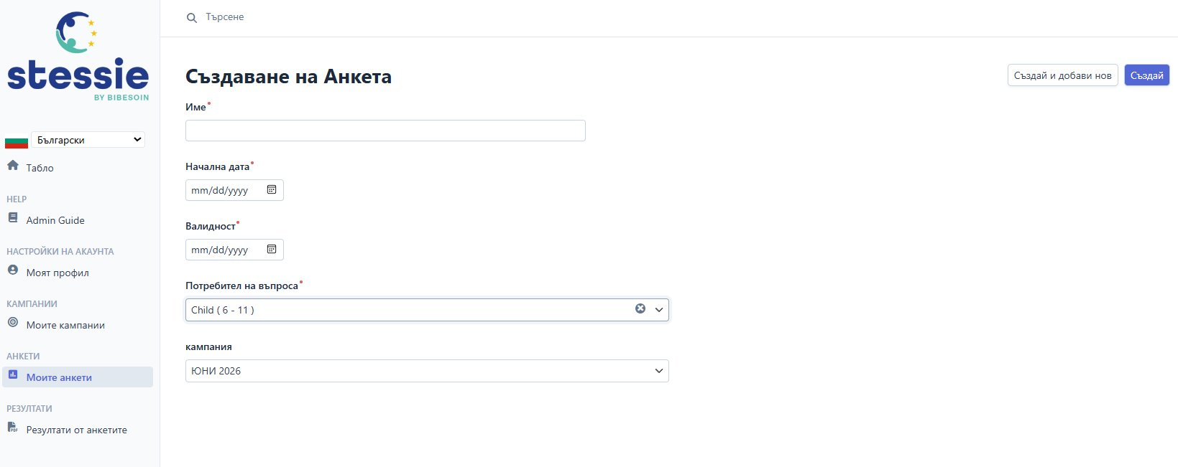
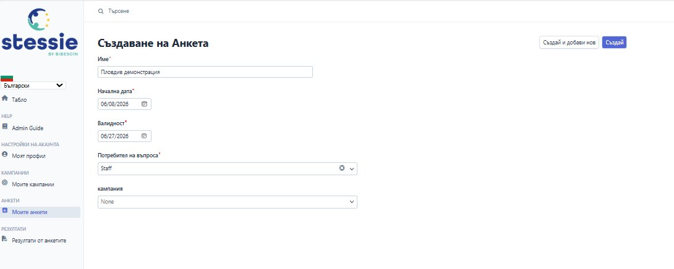
Step 7 – Create a Survey
8/11
📋 The created survey is now visible in the dashboard. Open it to copy the link.

Slide 12

Step 8 – Send the Survey
9/11
Survey landing page
Copy the link and send it

Slide 13
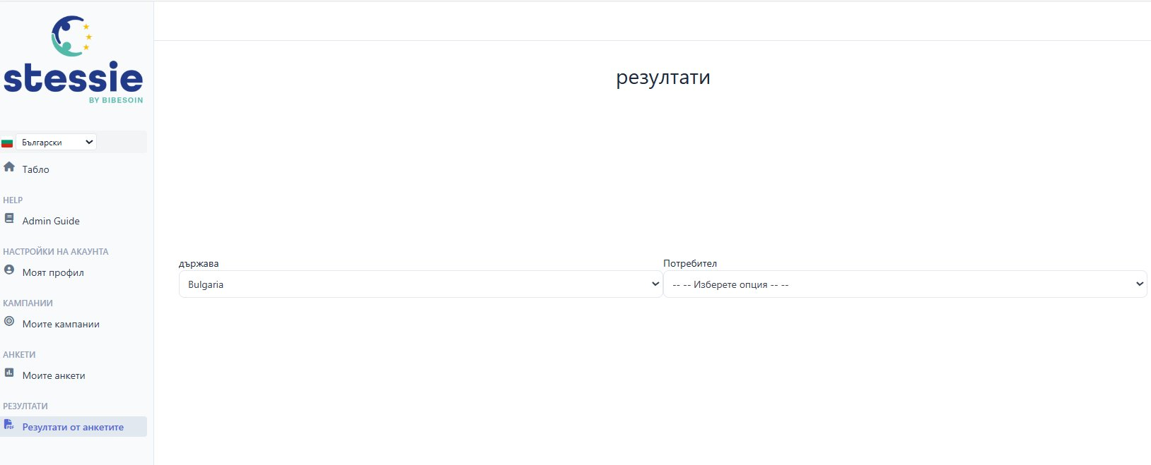
Step 11 – View Results
11/11
📊 Select country and user to view the aggregated survey results.

