Slide 1

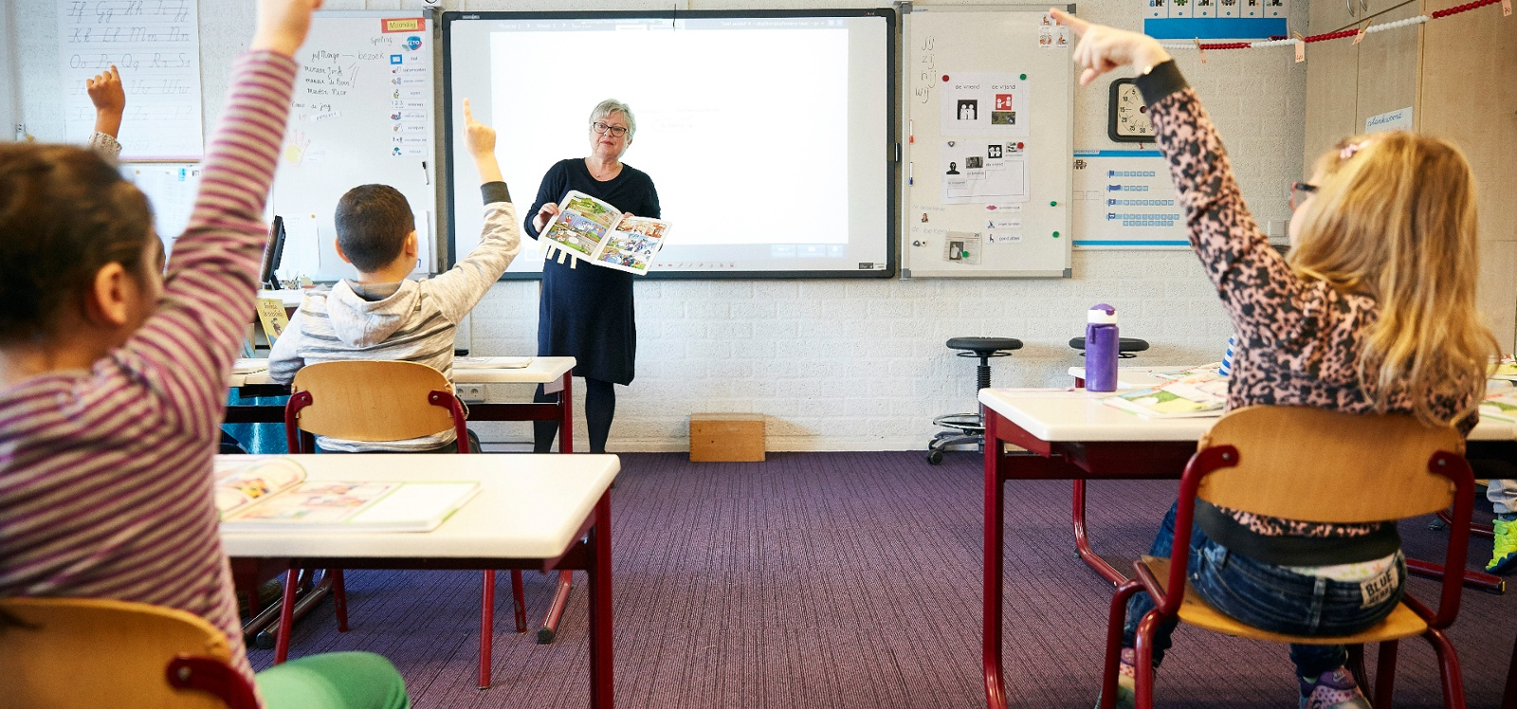
Future-proof inspection of Digital Resilience and Digital Safety in schools in the Netherlands

Slide 2
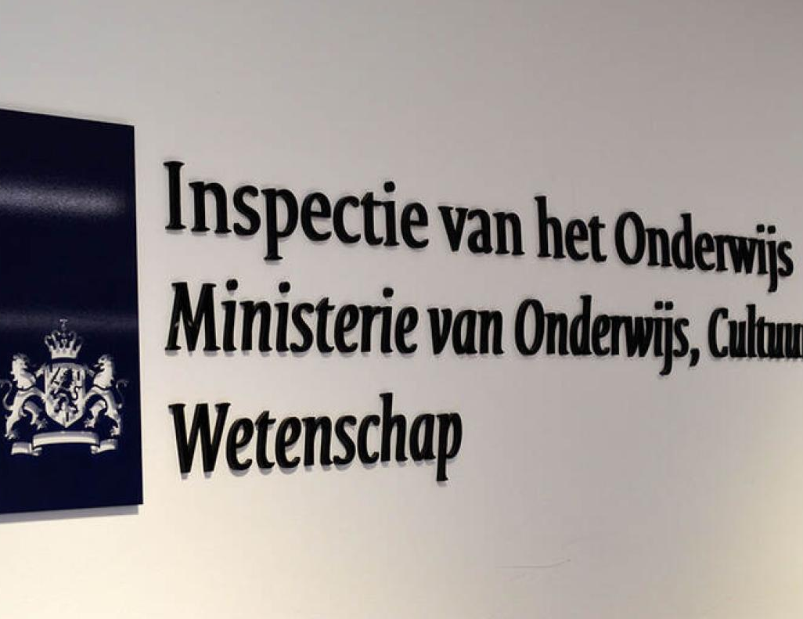
The Dutch Inspectorate
Mission: Effective oversight for better education
Early childhood education to higher education
In the Netherlands and abroad
Schools and school boards
Focus on educational quality and finances
Ultimately safeguarding:
    The continuity of education
    Safety in education
    The value of degrees and certificates

Slide 3
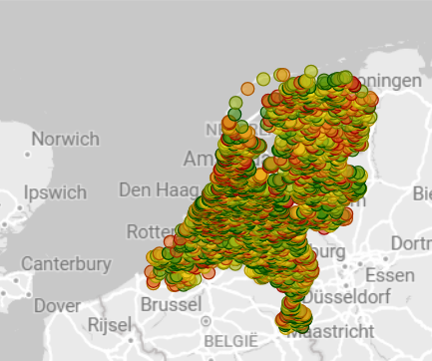
The Dutch Inspectorate in Numbers
Since 1801
In 2025: > 700 colleagues
In 2025: > 3,000 inspections per year, of which…
    1,800 school inspections
    1,400 school board inspections
    800 annual financial reports checked
    1 yearly State of Education
In 2025: > 20.000 civilian reports

Slide 4
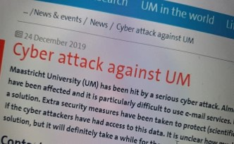
Cyber attacks at schools in The Netherlands
It started with Maastricht University
Several hacks followed:
  Scholengroep OS Hengelo (2023): ransomware
  Basispoort learning analytics and communications (2024): disruption
  Iddink Learning Materials (2024): ransomware
  University Eindhoven (2025): infostealer
  American IT supplier Powerschool (60 million students): ransomware, then extortion of schools.
In UK: 143 schools and childcare institutions
Examples in education in your country?
Notes:
Cyber attack Maastricht University
Scholengroep OS Hengelo wordt getroffen door ransomware en sluit uiteindelijk een deal met de kwaadwillende hackers.2
Ook de aanval op TU Eindhoven in de eerste maand van 2025 is volgens bronnen terug te leiden naar een infostealer.17 Door diefstal van gegevens van ten minste één medewerker en één student, kregen de aanvallers toegang tot de systemen van TU Eindhoven. Dit stelde hen in staat zich verder door de organisatie te bewegen, waardoor de universiteit zelf besloot om het volledige systeem offline te halen. Hierdoor kon er tijdelijk geen les worden gegeven en moesten tentamens worden uitgesteld.18
In april 2024 werd leermiddelendistributeur Iddink Learning Materials getroffen door een ransomwareaanval
De storingen van Basispoort in januari 2024 zorgden voor veel uitgestelde Cito-toetsen.1
De grote Amerikaanse IT-leverancier Powerschool levert voor ruim 60 miljoen leerlingen ICT en had te maken met een ransomwareaanval. Na betaling van het losgeld, gingen de hackers over op het afpersen van individuele scholen.1
Situatie in Groot-Britannië waarbij 143 scholen en kinderdagverblijven werden getroffen door ransomware op het onderwijssysteem van hun council.26
Foto van krantenkoppen van Maastricht oid.

Slide 5
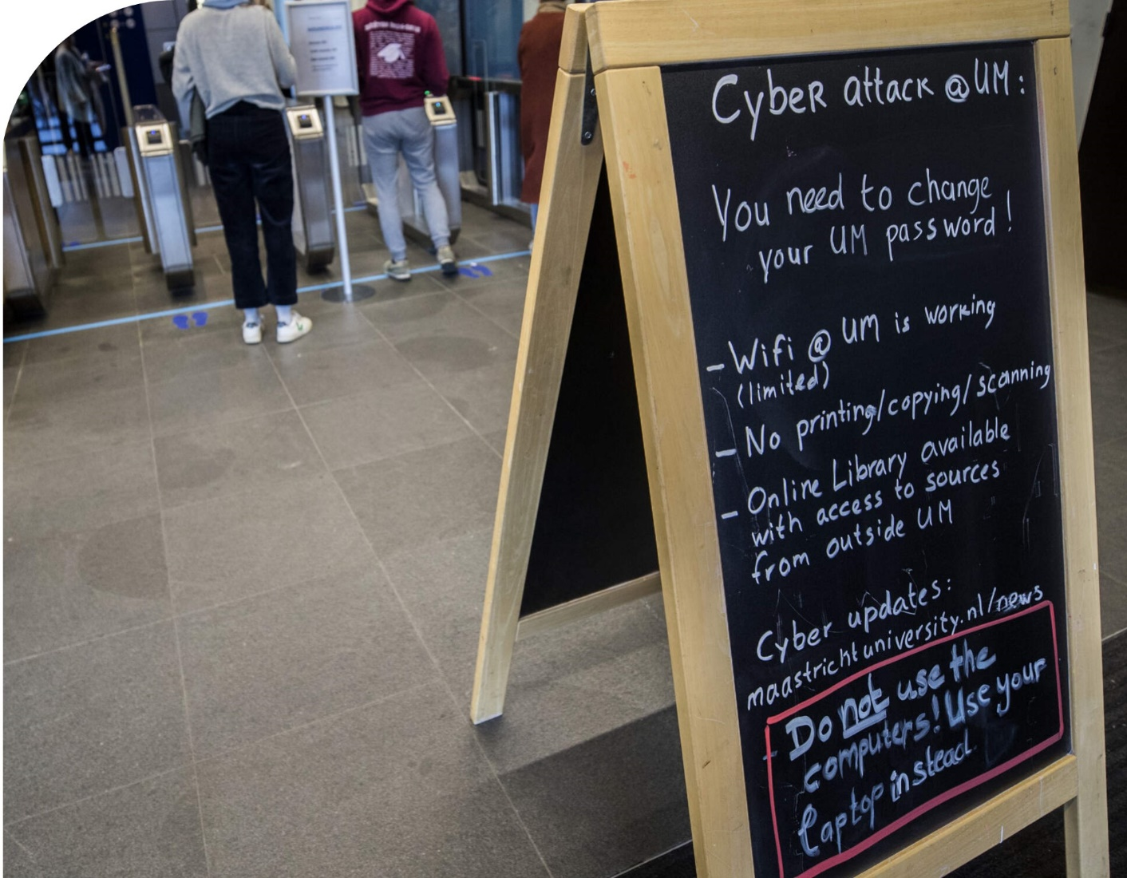
Cyber attacks: problematic!
Vulnerable privacy data on dark web
Disruption of educational continuity
Doubts about value of diplomas and degrees
Hackers paid with public money intended for education

Slide 6
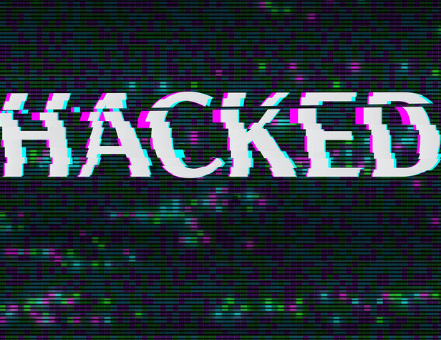
Insights from Dutch threat assessment
Schools are increasingly targeted by cyberattacks
Seen as ‘soft targets’ with valuable information
Main threats: ransomware, phishing, and attacks on IoT devices
AI being used to enhance these attacks
    Cybersecurity is no longer just an IT issue but a core responsibility for school leadership, requiring proactive risk management.

Slide 7

Digital resilience and safety
Digital resilience
    the extent to which schools and boards are able to protect the digital educational environment of their pupils, students, and staff, and to guarantee their digital safety.
Digital safety
    the actual protection of systems, data, and users against digital threats. Examples of threats are hacking attempts or data breaches.

Slide 8

European and national legislation
European Legislation
  Privacy (AVG)
  Knowledge safety in higher education (NIS2)
  AI Act
Dutch legislation in the making:
  Digital resilience and safety in primary, secondary and vocational education

Slide 9
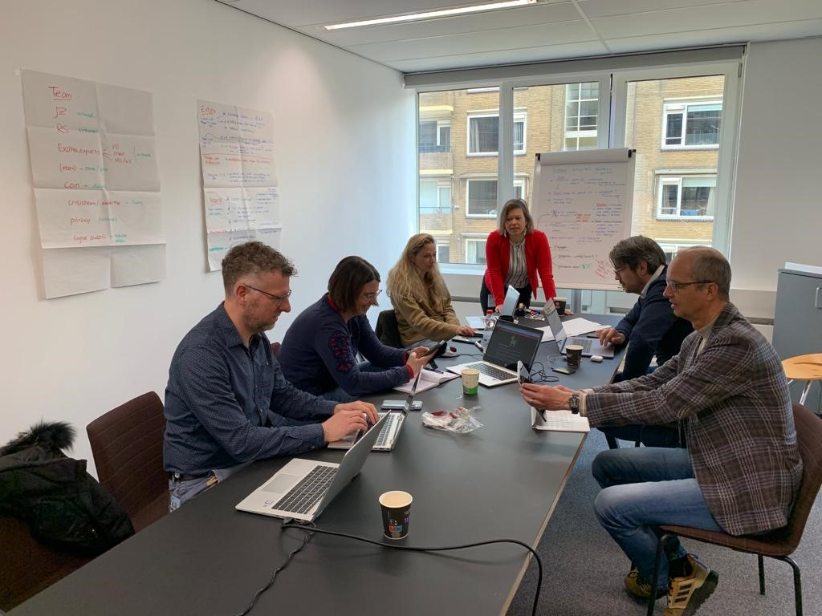
Developing the oversight on ‘everything digital’
Increasing awareness and urgency (2023-2028)
Preparing for legislation
  Higher education (2026): new department?
  Primary-vocational education (2027): in regular workload?
Plus…
  Deciding on framework for norms
  Deciding on oversight procedure & highest risks
  Training inspectors

Slide 10
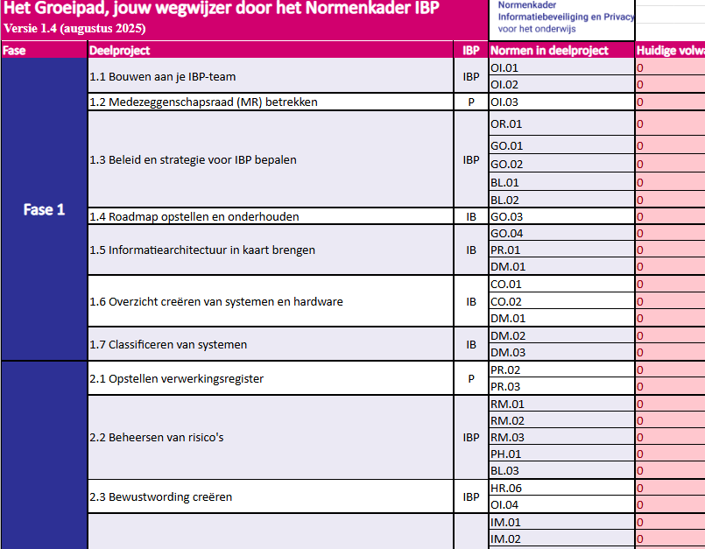
Example: Framework on digital standards
Developed by Kennisnet, the Dutch public organization for Education & ICT
  Examples of various documents, such as norms and growth path
Expectation:
  Guidance, providing information
  Check yearly report of school boards
  NOT check (technical) digital safety itself

Slide 11
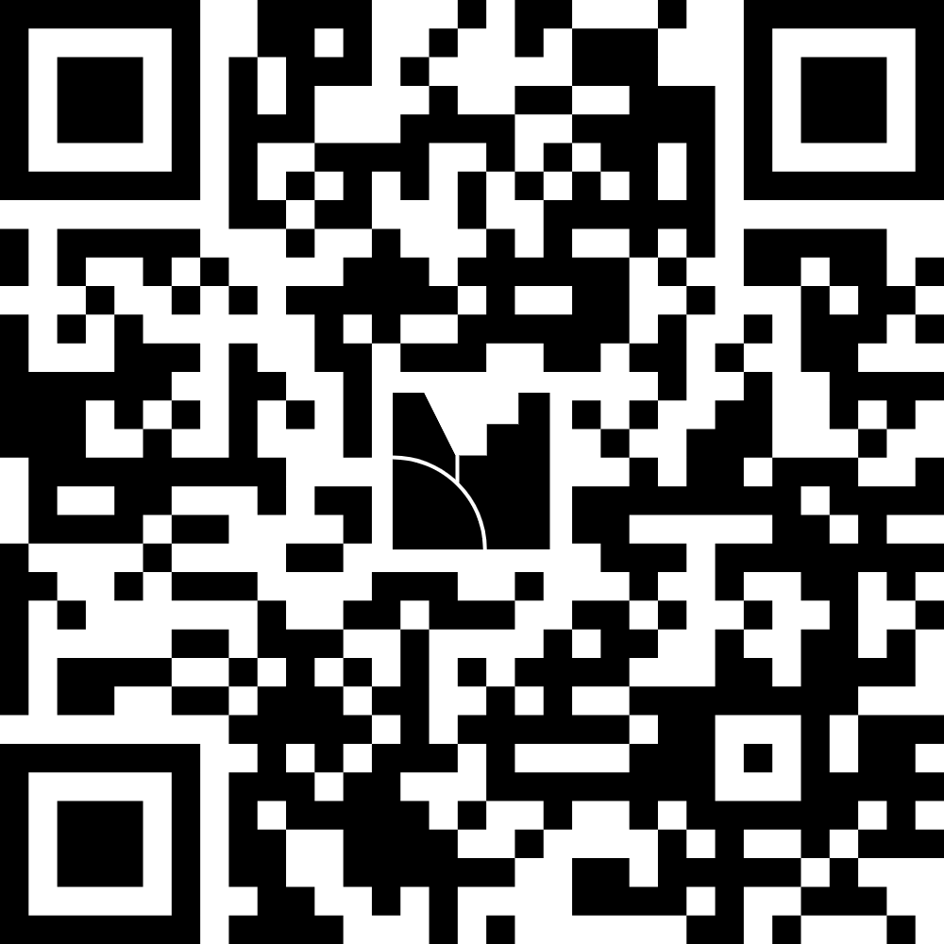
Food for Thought

Slide 12
Thank you for your attention!
Any questions?
Feel free to contact us at m.m.spanier@owinsp.nl

Slide 13
Questions for Broader Discussion
How is oversight on the European regulations on digital safety in schools organized in your country?
Do you have recommendations for other countries?

