Slide 1

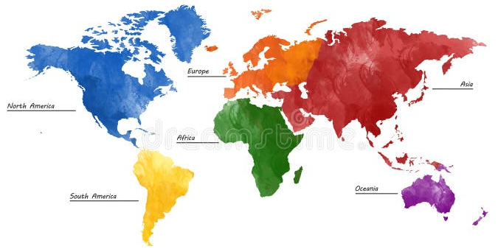
An Educational Inspection for five (or six) continents
https://es.dreamstime.com/
SICI WORKSHOP
Plovdiv, Bulgaria
11 June 2026
Camila Tudurí Vila, Deputy Director of the Central Inspectorate of Education in Spain
Martin Casado, Central Inspectorate of Education in Spain

Slide 2


SICI WORKSHOP
Plovdiv, Bulgaria
11 June 2026
AI created image
Notes:
Good morning, or almost good afternoon, really. We're the last ones before lunch, which means we must compete with hunger, so we'll try to make our presentation easier to digest than an inspection report or instructions for properly justifying an Erasmus+ project.
Our presentation is titled “A Central Inspection for Five (or Six) Continents.” The title illustrates an apparent contradiction, because the central inspection is actually the least central of all inspections. We will be talking about educational inspection, yes, but about an inspection that packs its bags, goes through airport security, and carries in its luggage, along with a computer and the LOE (Organic Law of Education), pajamas, a plug adapter, and, of course, a toothbrush. However, its “inspection DNA” remains absolutely intact.
The central inspection is probably the smallest inspection team in Spain, but it covers the largest territory, as it oversees Spain's Educational Action Abroad, from Europe to the Americas, from Africa to Asia and Oceania. Their work is governed by the same principles and regulatory frameworks as any other inspection, but it takes place in very different contexts, with Spanish-owned schools and others where the cultural, legal, or educational context adds a unique complexity—and richness.
And since this is all about travel, distance, and learning, today we're going to do it in a quiz format. Specifically, a "Who Wants to Be a Millionaire?" version. So get your competitive spirit ready, because we're going to need volunteers.
7 questions, 3 lifelines, and prizes…

Slide 3


Slide 4
1
ECUADOR
EL SALVADOR
EMIRATOS ÁRABES UNIDOS
ESLOVAQUIA
ESTADOS UNIDOS
FRANCIA
GUATEMALA
GUINEA ECUATORIAL
HUNGRÍA
IRLANDA
ITALIA
LUXEMBURGO
MARRUECOS
MÉXICO
ALEMANIA
ANDORRA
ARGENTINA
AUSTRALIA
AUSTRIA
BÉLGICA
BRASIL
BULGARIA
CANADÁ
CHILE
CHINA
COLOMBIA
COSTA RICA
NUEVA ZELANDA
PAÍSES BAJOS
POLONIA
PORTUGAL
REINO UNIDO
REPÚBLICA CHECA
REPÚBLICA DOMINICANA
RUMANÍA
RUSIA
SÁHARA
SUECIA
SUIZA
URUGUAY
Notes:
Heterogeneous presence, different types of centers and programs.
Significant examples: Morocco (11 CTEE), India and New Zealand (only AT).

Slide 5
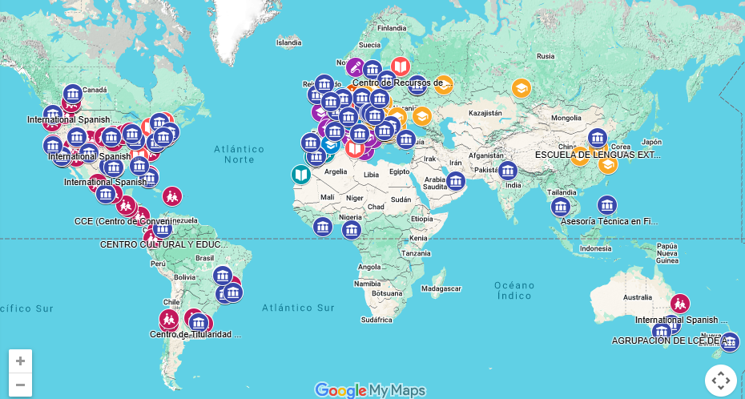
1
https://aee.educacionfpydeportes.gob.es

Slide 6
2
ECUADOR
EL SALVADOR
EMIRATOS ÁRABES UNIDOS
ESLOVAQUIA
ESTADOS UNIDOS
FRANCIA
GUATEMALA
GUINEA ECUATORIAL
HUNGRÍA
IRLANDA
ITALIA
LUXEMBURGO
MARRUECOS
MÉXICO
ALEMANIA
ANDORRA
ARGENTINA
AUSTRALIA
AUSTRIA
BÉLGICA
BRASIL
BULGARIA
CANADÁ
CHILE
CHINA
COLOMBIA
COSTA RICA
NUEVA ZELANDA
PAÍSES BAJOS
POLONIA
PORTUGAL
REINO UNIDO
REPÚBLICA CHECA
REPÚBLICA DOMINICANA
RUMANÍA
RUSIA
SÁHARA
SUECIA
SUIZA
URUGUAY

Slide 7
3
GENERAL ACTION PLAN
2025-2029
ANNUAL ACTION PLAN
2025-2026
GUIDELINES
OBJECTIVES
ACTIONS
REGULAR
PREFERENTS
INCIDENTALS
Notes:
The correct answer, considering how the question has been phrased, is 2. However, all the others could be true under certain circumstances.
A minimum frequency has been established, which is considered necessary for proper supervision; for example, CTEE once a year, CC once every two years, etc. Routine visits are carried out, but visits may also be necessary in extraordinary circumstances.
Finally, we must adapt our activities to the political (and even health) situation in the country.

Slide 8
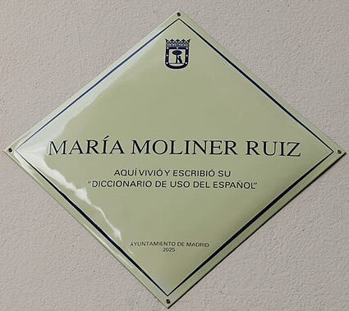
4
ANDORRA | Escaldes-Engordany | Colegio Español María Moliner
COLOMBIA | Santa Fe de Bogotá | Centro Cultural y Educativo Español Reyes Católicos
FRANCE | Neuilly-Sur-Seine | Liceo Español Luis Buñuel
 | Paris | Colegio Español Federico García Lorca
ITALY | Rome | Liceo Español Cervantes
MOROCCO | Alhucemas | Instituto Español Melchor de Jovellanos
 | Casablanca | Instituto Español Juan Ramón Jiménez
 | Larache | Colegio Español Luis Vives
 | Nador | Instituto Español Lope de Vega
 | Rabat | Colegio Español de Rabat
 | Tánger | Colegio Español Ramón y Cajal
 |  | Instituto Español Severo Ochoa
 | Tetuán | Colegio Español Jacinto Benavente
 |  | Instituto Español Juan de la Cierva
 |  | Instituto Español Nuestra Señora del Pilar
PORTUGAL | Lisbon | Instituto Español Giner de los Ríos
UNITED KINGDOM | London | Instituto Español Vicente Cañada Blanch
SÁHARA | El Aaiún | Colegio Español La Paz. Misión Cultural Española
Notes:
The CTEEs are undoubtedly a fundamental part of our work. There are 17, spread across 7 countries, plus 1 in Western Sahara.
Most are named after important figures in Spanish history, especially those linked to language, culture, and education.
Most are integrated centers, except in cities where there is more than one.

Slide 9
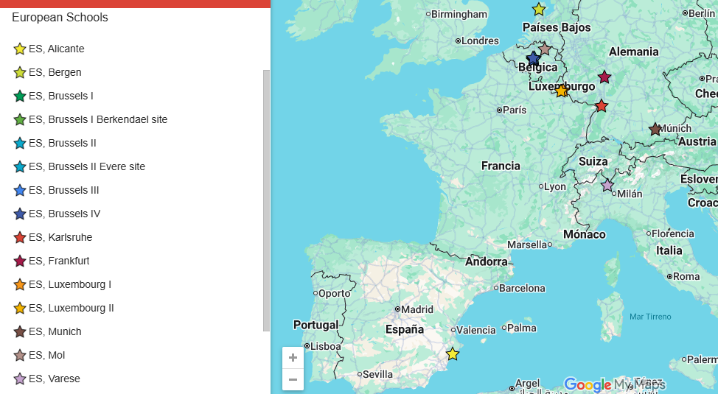
5
https://www.eursc.eu/en/European-Schools/locations/map
Notes:
Currently there are 13 European Schools in six countries (Belgium, Netherlands, Germany, Italy, Spain and Luxembourg), with a total of approximately 29,000 enrolled students.

Slide 10

6
https://www.brainyquote.com/
Notes:
Efficiency is obviously important. Before each visit, the inspector must prepare a report justifying the visit, which is then reviewed by the deputy director, who proposes any necessary adjustments to maximize efficiency.
Teamwork and contextualization are fundamental principles of any service.
Planning is what makes the difference, as these visits involve costly travel and cannot be repeated the following week if there are unresolved issues. Teams, telephone, and email are used extensively.

Slide 11
7
EVALUATION OF TEACHERS/ADVISORS
POSITIVE
WITHOUT RECOMMENDATIONS
WITH RECOMMENDATIONS
NEGATIVE
Notes:
The result can be favorable or favorable with recommendations, which implies a two-year extension, or unfavorable, which implies a return to Spain.

Slide 12


Slide 13
Thank you and, if you have any questions, we will be glad to answer them
https://es.dreamstime.com/
SICI WORKSHOP
Plovdiv, Bulgaria
11 June 2026
Camila Tudurí Vila, camila.tuduri@educacion.gob.es
Martin Casado, martin.casado@educacion.gob.es

