Slide 1

Avaluació integrada per a la millora (AVIM)
Comprehensive Evaluation for School Improvement
Catalonia Education Inspectorate
SICI Workshop in Plovdiv, Bulgaria
June 12, 2026

Slide 2
Summary
1
Why AVIM?
2
The role of the Education Inspectorate
3
Dimensions of the AVIM
4
AVIM Application
5
Final Report
6
AVIM Support Documentation
Comprehensive Evaluation for Improvement in Educational Centers in Catalonia

Slide 3
Why AVIM?
1
Comprehensive Evaluation for Improvement in Educational Centers in Catalonia

Slide 4

AVIM in the Regulatory Framework
Freepik
Catalan education law determines that there must be evaluation of educational centers (external evaluation) and self-evaluation of centers supported with public funds.
Comprehensive Evaluation for Improvement in Educational Centers in Catalonia

Slide 5
AVIM as an Evaluation Model
In the educational field, evaluation processes constitute a key element of professional reflection to consolidate good practices and specify proposals for development and continuous improvement.
The Catalan Administration has applied several models over time which combine internal evaluation with external evaluation, that is, integrated evaluation. The AVIM is the latest version.
The AVIM has been implemented for the first time during the 2025-2026 academic year in a sample of educational centers.
Comprehensive Evaluation for Improvement in Educational Centers in Catalonia

Slide 6

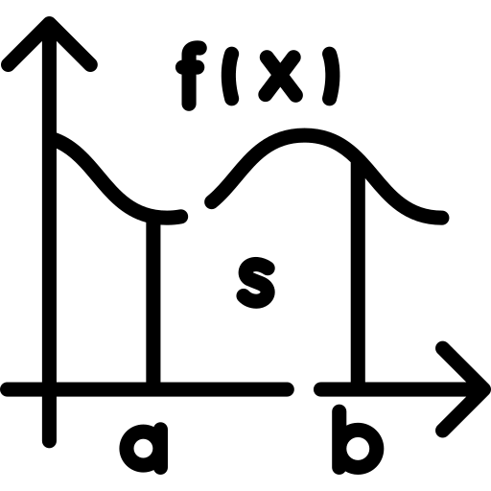
AVIM within Educational Policies
The government of the autonomous community of Catalonia has decided that actions aimed at improving the teaching and learning of language and mathematics should be prioritized.
Freepik
Freepik
Comprehensive Evaluation for Improvement in Educational Centers in Catalonia

Slide 7
Purposes of the AVIM
Promote reflection by schools on the quality of the implementation of their educational project.
Provide objective elements that help generate a shared vision of the strengths, satisfactory points, points that can be improved and critical points of the school in terms of organizational, pedagogical and results aspects.
Provide a diagnosis of the evaluated teaching-learning processes that help take measures aimed at improving educational results.
Specify the improvement proposals that need to be prioritized and ensure their application.
Provide relevant information on the state of the education system in the evaluated elements that may be useful to the inspection itself and to other units of the Department of Education and Vocational Training.
Comprehensive Evaluation for Improvement in Educational Centers in Catalonia

Slide 8
The Role of the Education Inspectorate
2
Comprehensive Evaluation for Improvement in Educational Centers in Catalonia

Slide 9

The Education Inspectorate Evaluates
kornkun
The Catalan education law lists the functions of the Education Inspectorate and establishes as its first function the supervision and evaluation of educational centers and services.
Comprehensive Evaluation for Improvement in Educational Centers in Catalonia

Slide 10
Two Inspectors for External Evaluation
Two inspectors are responsible for external evaluation. Neither of them is the inspector ordinarily assigned to the center. One of the evaluative inspectors focuses on the evaluation of language teaching and learning. The other evaluative inspector focuses on the evaluation of mathematics teaching and learning.
It is the responsibility of the evaluating inspectors to specify the evaluation process and calendar with the educational center, advise the center in the internal evaluation process and compare the results of the self-evaluation, carry out the focused evaluations (language and mathematics) and compare the results of these evaluations with the center inspector and the school evaluation committee and prepare the final evaluation report.
Comprehensive Evaluation for Improvement in Educational Centers in Catalonia

Slide 11
Dimensions of the AVIM
3
Comprehensive Evaluation for Improvement in Educational Centers in Catalonia

Slide 12
Three Dimensions and Seven Sub-dimensions
Dimensions | Sub-dimensions
I. ORGANIZATION | 1. Purpose, vision and strategy
 | 2. School culture, leadership and organization
II. TEACHING AND LEARNING | 3. Programming, methodology and evaluation | LANGUAGE MATHEMATICS
 | 4. Inclusion and equity
 | 5. Educational guidance and tutorial action
III. RESULTS | 6. Educational results
 | 7. Perception of the school community
Comprehensive Evaluation for Improvement in Educational Centers in Catalonia

Slide 13
AVIM Application
4
Comprehensive Evaluation for Improvement in Educational Centers in Catalonia

Slide 14

Time Frame
It is up to the evaluating inspectors to specify the evaluation calendar with the educational center, within a six-week framework, not including a preliminary preparation period that usually lasts one or two weeks.
DinosoftLabs
Comprehensive Evaluation for Improvement in Educational Centers in Catalonia

Slide 15
Preliminary Phase
ACTIONS | AGENTS INVOLVED
Preparation of the action Prior analysis of information | Evaluating inspectors School inspector
Initial information to the school management team | School inspector
Establishment of the evaluation committee. Presentation of the action to the management team and the evaluation committee. | Evaluating inspectors School management team Evaluation committee (Made up of a minimum of 4 teachers, one of whom is from the management team)
Information to the teaching staff about the center's participation in the AVIM and its characteristics | School management (with the support of the center inspector if necessary or requested)
Communication to the educational community about the center's participation in the AVIM | School management team
Comprehensive Evaluation for Improvement in Educational Centers in Catalonia

Slide 16
Self-assessment Procedure
ACTIONS | AGENTS INVOLVED
Internal reflection sessions (2 different reflection groups) | School management and coordination team Tutor team (and other teaching staff if applicable)
Questionnaires to the school community (teachers, non-teaching staff, students and families) | School management team
Information analysis | Evaluation committee
Contrast session 1 | Evaluation inspectors Evaluation committee School inspector (optional)
Comprehensive Evaluation for Improvement in Educational Centers in Catalonia

Slide 17

Focused Assessment Procedure in Language and Mathematics
ACTIONS | AGENTS INVOLVED
Classroom observations Interviews with teachers Interviews with students Analysis of student productions | Evaluation inspectors
Analysis of information | Evaluation inspectors
Contrast session 2 | Evaluation inspectors Evaluation committee School inspector (optional)
Freepik
Comprehensive Evaluation for Improvement in Educational Centers in Catalonia

Slide 18
Final Report
5
Comprehensive Evaluation for Improvement in Educational Centers in Catalonia

Slide 19
Final Report
Once the actions linked to both the self-evaluation and the focused evaluation have been completed, the information obtained in the contrast sessions with the evaluation committee has been analyzed and discussed, the evaluator inspectors prepare a provisional report, with the collaboration of the center's inspector, which will be contrasted with the management team before making it final and presenting it to the school community.
In relation to the three dimensions that make up the self-evaluation (organization, teaching-learning and results), the report records, in accordance with the information collected in the self-evaluation assessment summary table, the most relevant strong, satisfactory, areas for improvement and critical points of each dimension and specifies the improvement proposals referring to areas for improvement and critical points.
Comprehensive Evaluation for Improvement in Educational Centers in Catalonia

Slide 20

Final Report
Finally, the report reserves space to make global assessments, if applicable, and ends with a prioritization of improvement proposals resulting from the evaluation process (a maximum of 5 prioritized proposals is recommended).
Freepik
Comprehensive Evaluation for Improvement in Educational Centers in Catalonia

Slide 21

Presentation of Results
The team of evaluator inspectors will present the overall assessment of the evaluation process to the teaching staff and will present the final report with special attention to the prioritization of improvement proposals and the need for these to be integrated into the center's continuous improvement cycle and its strategic documentation.
geotatah
The school management team, optionally accompanied by the center's inspector, will report back to the center's school board the results of the evaluation process in accordance with the final report.
Comprehensive Evaluation for Improvement in Educational Centers in Catalonia

Slide 22

Meta-evaluation
Once the process is finished, the collaboration of the evaluation committee will be requested to complete the meta-evaluation questionnaire that will serve to improve future applications of the AVIM.
Likewise, at the end of each period, a meta-evaluation will be carried out by the Inspectorate itself in order to introduce, if necessary, improvements in the AVIM application process.
Freepik
Comprehensive Evaluation for Improvement in Educational Centers in Catalonia

Slide 23

Implementation of Improvement Proposals
The school inspector will monitor the implementation of the improvement proposals resulting from the application of the AVIM and the progression of the results within the framework of his systematic center supervision actions.
The implementation of the improvement proposals and the evolution of the results will be taken into account in the evaluation of the management function.
orvipixel
Comprehensive Evaluation for Improvement in Educational Centers in Catalonia

Slide 24
AVIM Support Documentation
6
Comprehensive Evaluation for Improvement in Educational Centers in Catalonia

Slide 25

AVIM Support Documentation
All actions in the different phases of the AVIM have the corresponding supporting documentation, available to the evaluator inspectors, the school inspector and the school evaluation committee.
This documentation has been prepared by a working team from the Education Inspectorate of Catalonia.
nangicon
Comprehensive Evaluation for Improvement in Educational Centers in Catalonia

Slide 26
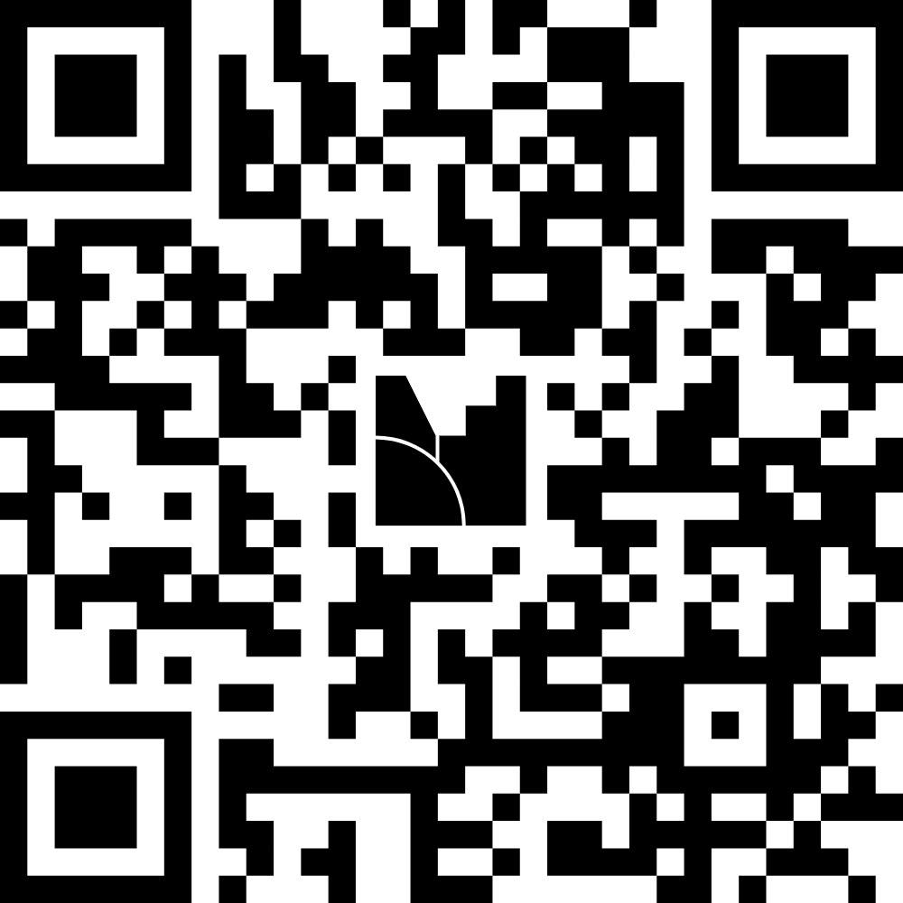
Food for Thought
Comprehensive Evaluation for Improvement in Educational Centers in Catalonia

Slide 27
Thank you for your attention
Comprehensive Evaluation for Improvement in Educational Centers in Catalonia

Slide 28
Departament d’Educació i Formació Professional
Inspecció d’Educació
https://educacio.gencat.cat

