Slide 1



VISION FOR THE FUTURE:
The Role of the National Inspectorate of Education for Positive Motivation and Improvement of Quality
SICI WORKSHOP : FUTURE-ORIENTED INSPECTION AS A DRIVER FOR EDUCATIONAL QUALITY
10 - 12 .06. 2026 , Plovdiv , Bulgaria

Slide 2

European trends in the implementation of education quality inspection/evaluation policy
Quality Expectations
Four directions
Results and effects
Promoting development
Quality development
Educational policies

Slide 3

General Principles and Attitudes towards Quality/Quality Assessment
Quality Framework; Quality Management Standard; Shared Vision for Quality in Education; Quality Assessment Policies
Integrated and coherent/connected teaching and learning
Accountability and transparency
Autonomy and flexibility
Reporting
Inclusion, support and resources
Effective communication, professional dialogue and reflection
Competence development

Slide 4
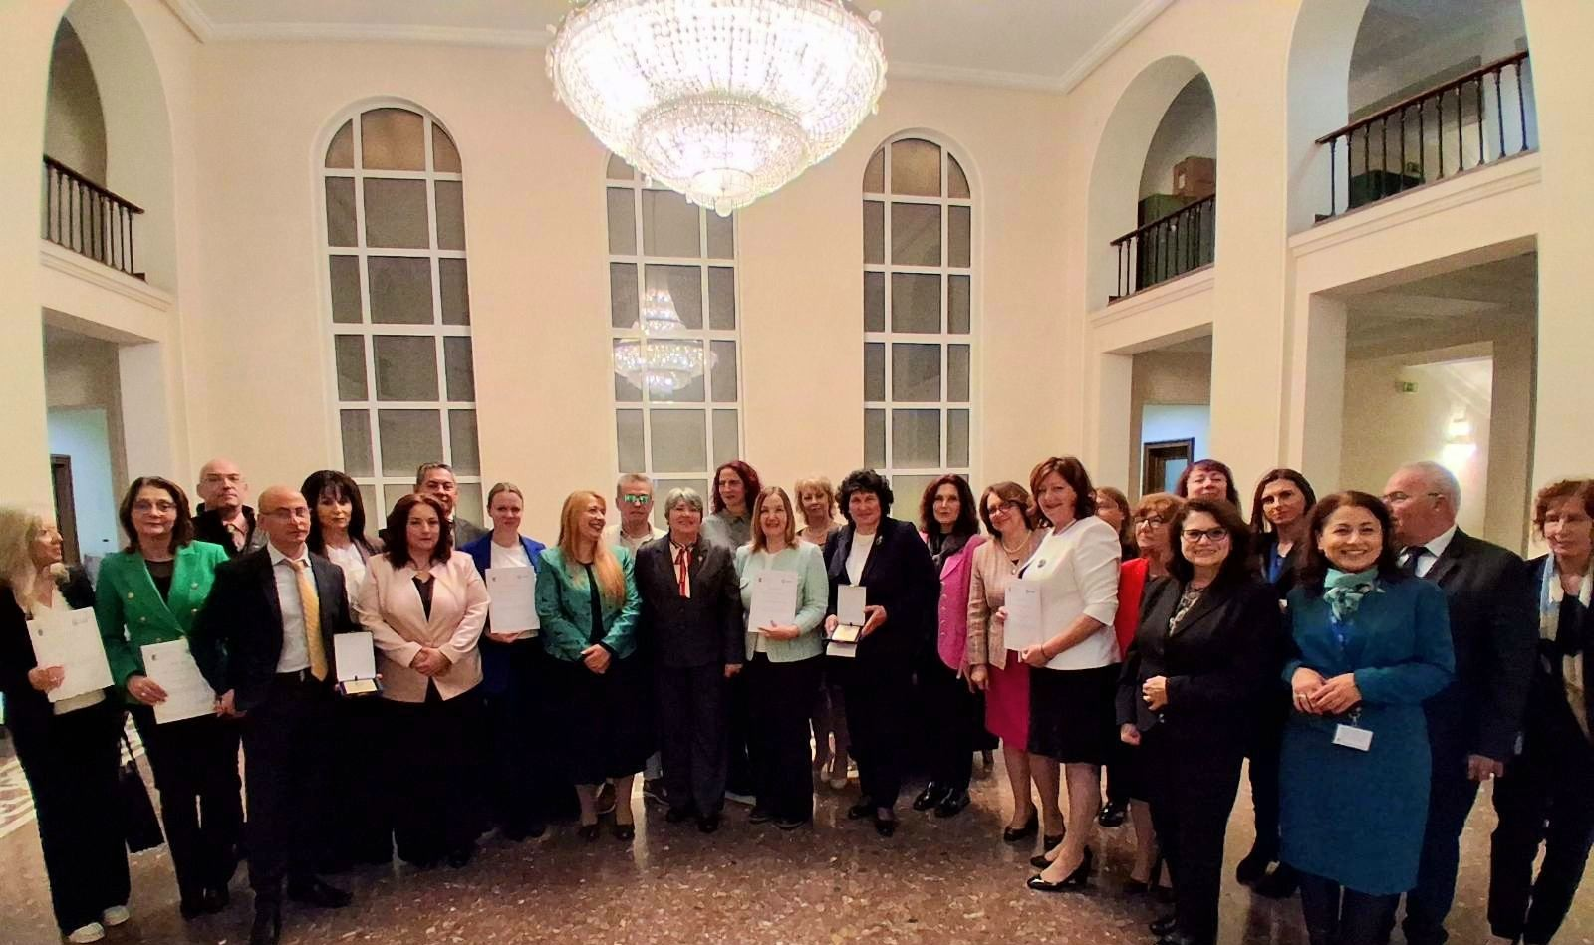

Strategy for the Development of the National Inspectorate of Education
VISION:
NIE is a leading, innovative, learning and responsible institution for the assurance of education quality through supportive external evaluation
MISSION:
To lead the improvement and transformation of schools and kindergartens through high-quality inspection

Slide 5

Global strategic goal of the NIЕ:
Transformational Leadership as a Driver of Sustainable Processes for Ensuring Educational Quality
Main priority areas
Quality education, focused on the future.
Innovation and digital transformation.
Community and connectivity.
Sustainable development, culture and social responsibility

Slide 6
Objective: Supporting institutions to provide added value to the quality of education
Ensure high-quality inspection processes;
Identify strengths and good practices through inspections;
Provide clear guidance and recommendations based on inspections results;
Assist schools and kindergartens in using their data for effective quality management;
Prepare annual reports analyzing the quality of education using a variety of indicator;
Improve educational quality through follow-up inspections to add further value;
Provide recommendations to support the implementation of national education policies.

Slide 7
Objective: Focus on competence-based education
Develop and update criteria, indicators and sub-indicators for evaluation of competence-oriented learning;
Conduct internal monitoring of inspection processes to ensure high-quality evaluations that support competence-based education;
Research and analyze competency-oriented learning in educational institutions following completed inspections;
Provide schools with targeted recommendations to help develop students’ competencies, life skills, and positive attitudes for success.

Slide 8
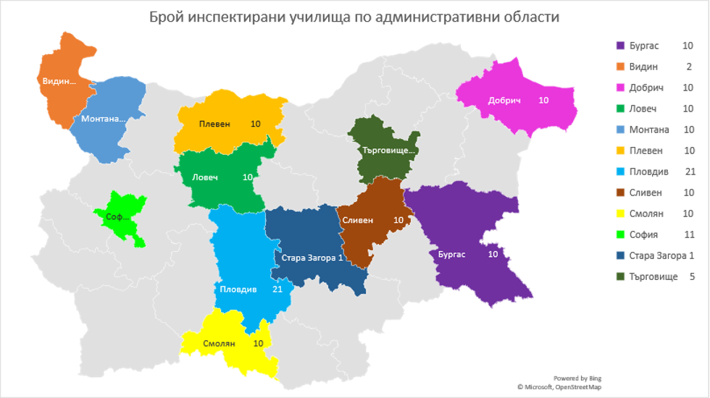
The 2025/2026 school year
  110 schools inspected
  from 12 administrative districts and 22 municipalities
  Participants
  110 inspection teams
  4 068 teachers
  19 007 students
  22 661 parents

Slide 9
25 vocational high schools
Types of Inspected Schools
33 gymnasiums
8 specialized high schools
35 secondary schools
117 initial inspections
3 follow-up inspections
By stage or level of education
32 primary schools
8 elementary schools
Based on funding method
95 municipal schools
15 public schools

Slide 10






Preparing Teachers for the Development of Artificial Intelligence in Education as an Innovative Asset
Erasmus+ Programme Grant Agreement № 101132955
Objectives
Training
Customized teacher training programs to master AI tools and techniques
Boosts Europe’s Innovation Capacity
Focusses on „Key Success Factors“ for Inclusive and High-Quality Digital Education and Training
Promoting the Use of the DigCompEdu Tool
Research
Pilot Deployment to evaluate and refine AI integration in real-world classrooms
Collaboration platform
European online forum for sharing best practices, case Studies and innovations in AI and education

Slide 11



Project "Improving the Quality of School Education through a New Model of Inspection"
UNICEF GA/BULA/2025/06 GA/BULA/2025/06
Research
Objectives
Review of existing quality evaluation models
Analysis of international best practices
Ensuring Long-term Sustainability of Quality Assurance in Education
Focus on Student Well-being
Concept
New model for evaluation the quality of school education
Mechanism
Mechanism of interaction: School – NIE – RDE, based on "self-assessment – external assessment – follow-up activities"

Slide 12
Innovation and Openness
Strategic Planning
Competence and Capacity
Openness and Transparency
The NIЕ strives to
Ethical Behavior and Responsiveness
Reporting
Effectiveness and Efficiency
Sound Financial Management

Slide 13
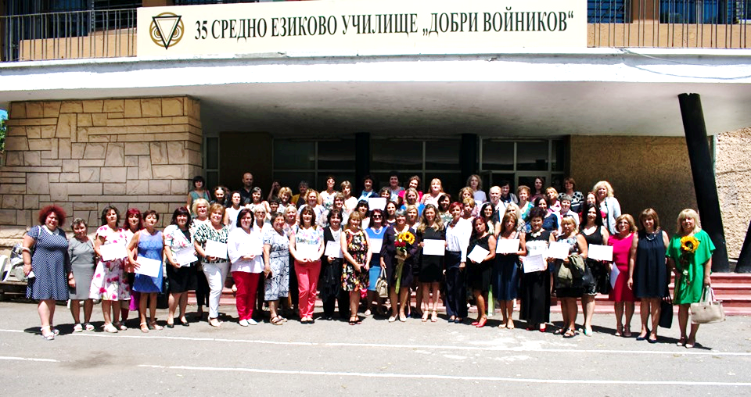
National Inspectorate of Education
+359 886725055
info@nio.government.bg
https://nio.government.bg/
София 1797, бул. Г. М. Димитров 52Б

