Slide 1

SICI National Coordinators meeting
General Assembly
Sliema, Malta
21.11.2024

Slide 2
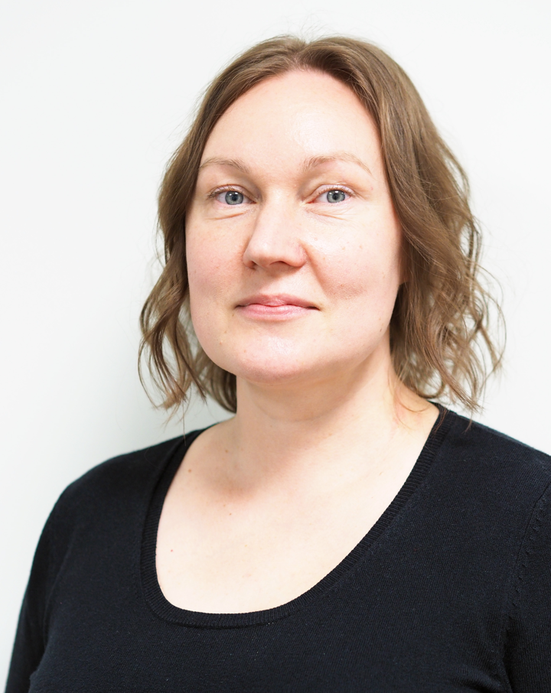
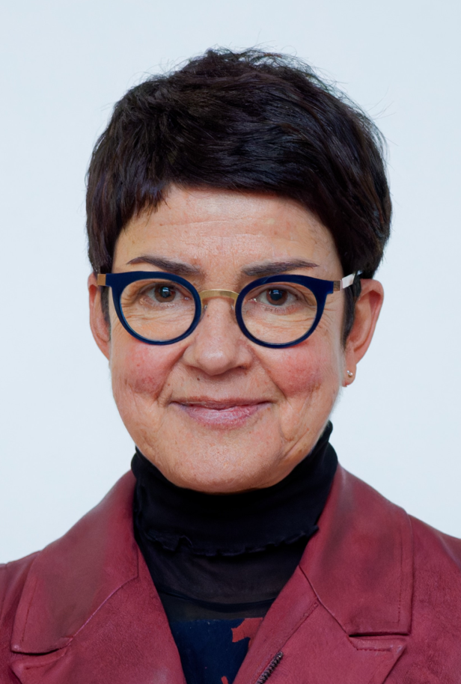
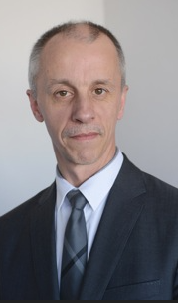
Introduction and welcome ‘new’ National Coordinators
Belgium - German speaking Community:
Angélique Emonts
Finland: Niina Rumpu
France:
Françoise Parillaud
Thierry Goater

Slide 3
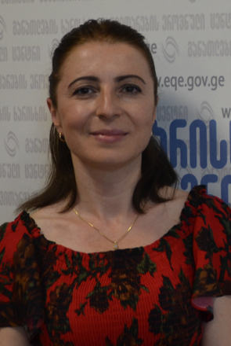
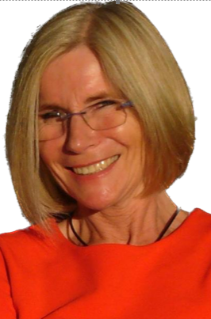
Introduction and welcome new National Coordinators
Georgia: Tamar Ratianidze
Germany – Hamburg: Andrea Albers
Germany – Hessen: Sabine Keitel

Slide 4
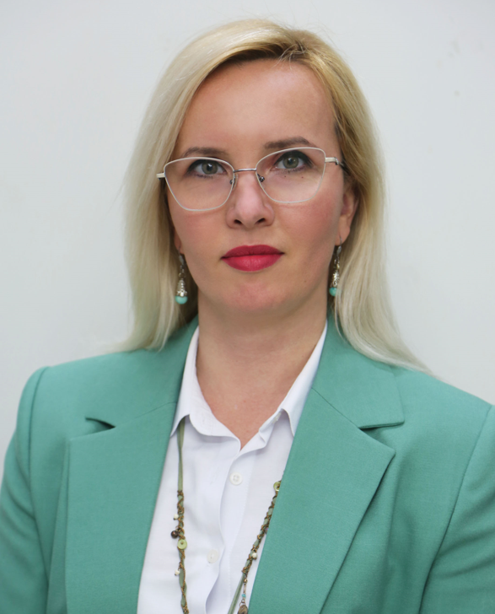
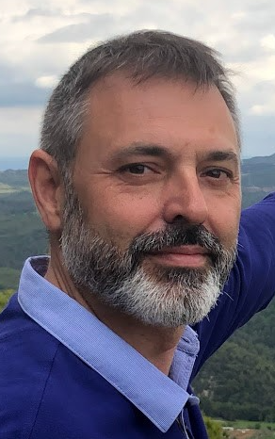
Introduction and welcome new National Coordinators
Kosovo*: Suzana Gjergji
Lithuania: Rytis Siautkulis
Spain – Catalonia: Jordi Gonzalez Ramirez

Slide 5
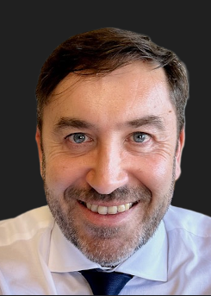
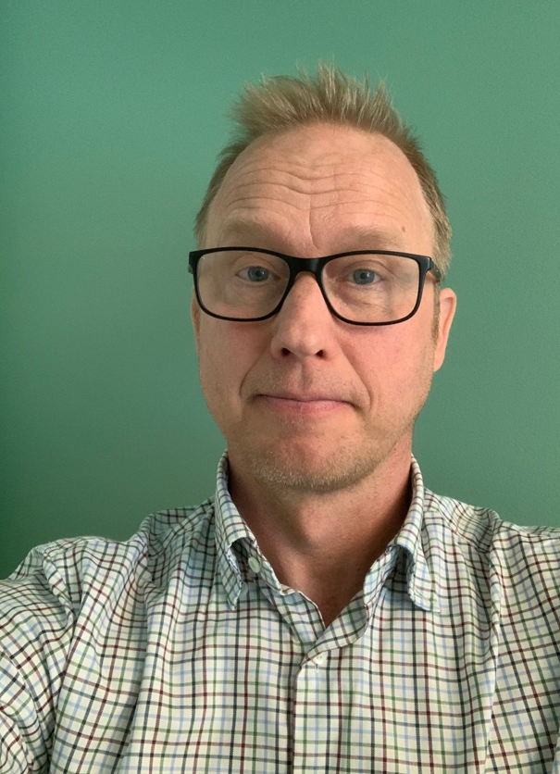
Introduction and welcome new National Coordinators
Spain – Valencia: Manuel Ortiz Lobato
Sweden: Jacob Johansson

Slide 6
The network of SICI members by the National Coordinators
Report of the NC meeting in Bilbao: remarks and follow-up
Possibilities for national coordinators (NCOF, MSTeams, country profiles…)

Slide 7


Slide 8


Slide 9


Slide 10
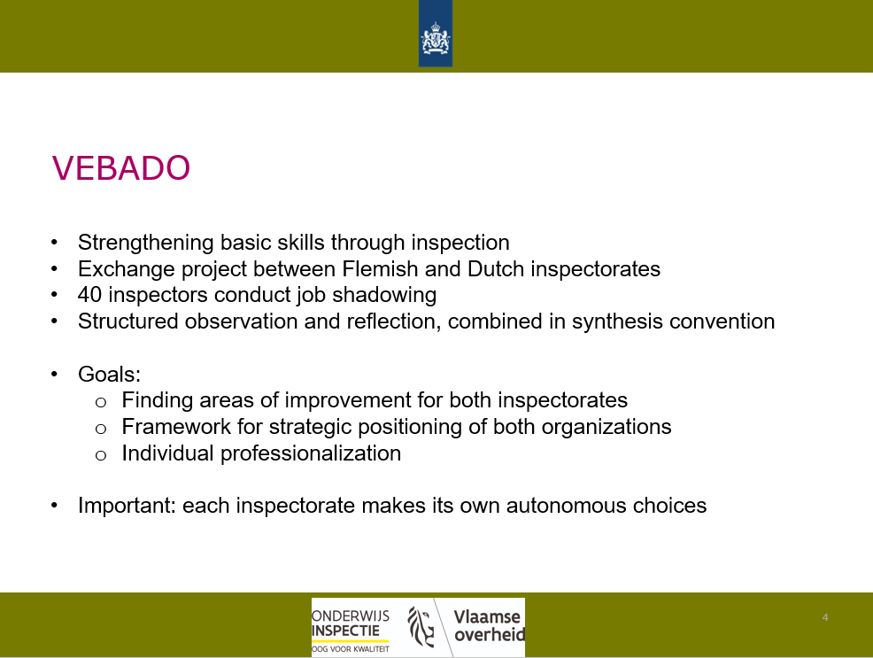

Slide 11
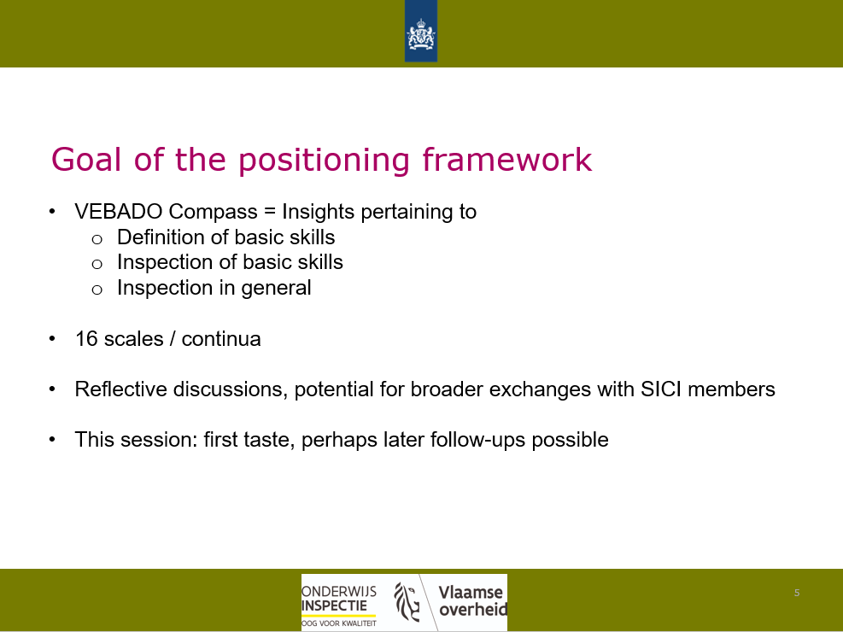

Slide 12


Slide 13
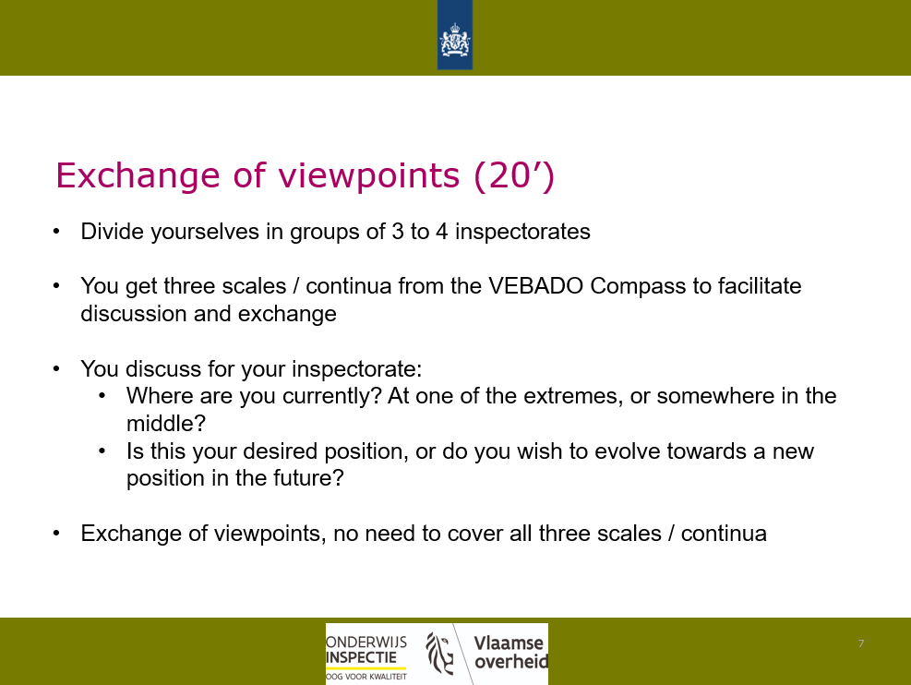

Slide 14
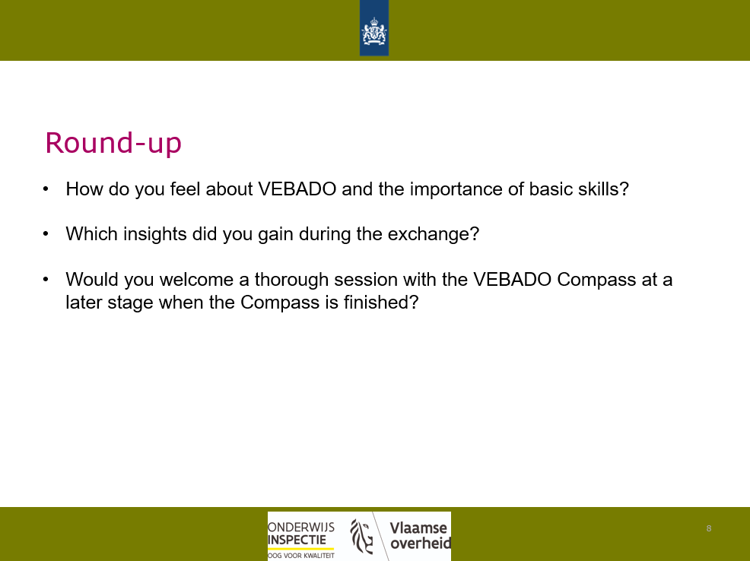

Slide 15


Slide 16
Poll data for National Coordinators Open For a (NCOF) in 2025
Poll: https://forms.office.com/e/JA22rEy0XD

Slide 17
AOB
Group photo

