Slide 1

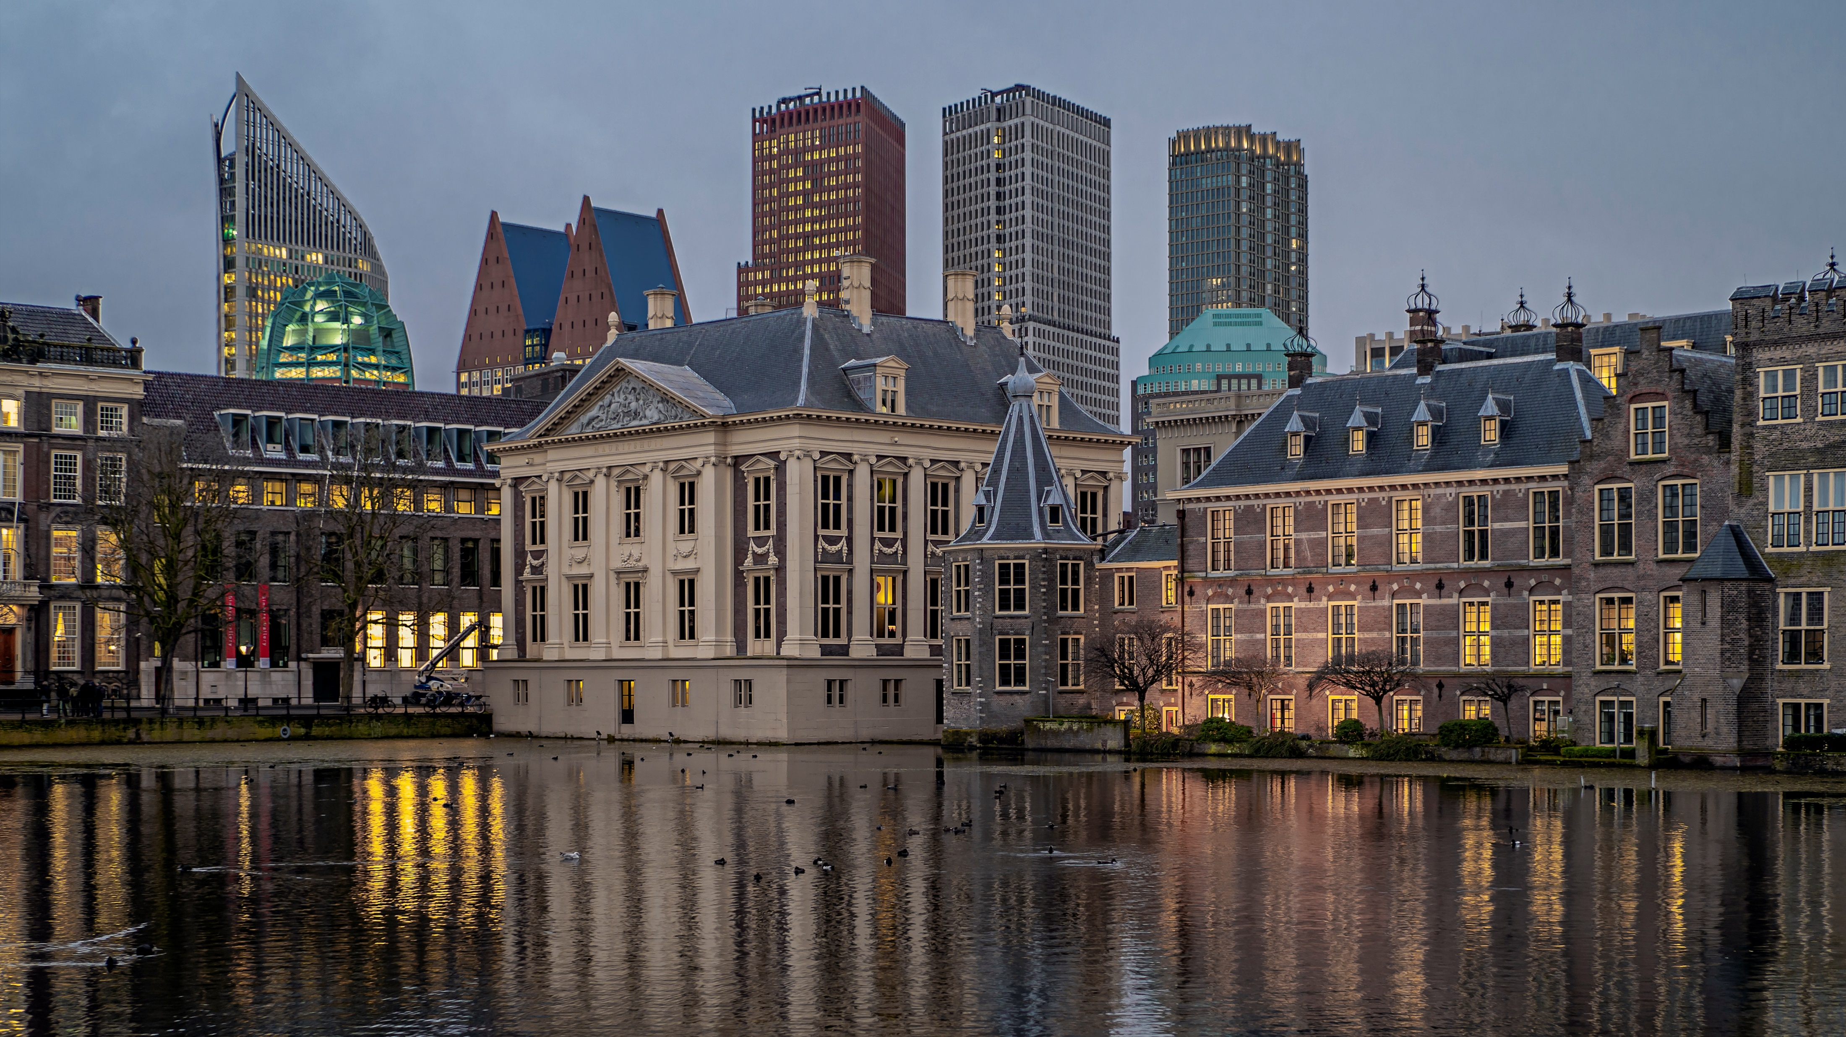

GENERAL ASSEMBLY DEN HAAG 2025
19, 20 AND 21 NOVEMBER 2025
CELEBRATING 30 YEARS SICI

Slide 2
HIGHLIGHTS
CELEBRATION OF 30 YEARS SICI
THEME DISCUSSIONS FOR CHIEF INSPECTORS
CULTURAL PROGRAMME: DUTCH POLITICS AND ART
INFORMAL DINNER ON WEDNESDAY
AND MORE…..

