Slide 1

Encourage schools to use our data
Three formats that we use

Slide 2
The individual phases of the inspection process
Pre-phase
Coordination Meeting
Main-phase
School Visit
Post-phase
School Inspection Report
Impulse Workshop
---------
Agreement on Objectives between the School and the Supervisory Authority
School and Teaching Development
Notes:
In a coordination meeting it will be decided which criteria the school-specific analysis table should contain

Slide 3
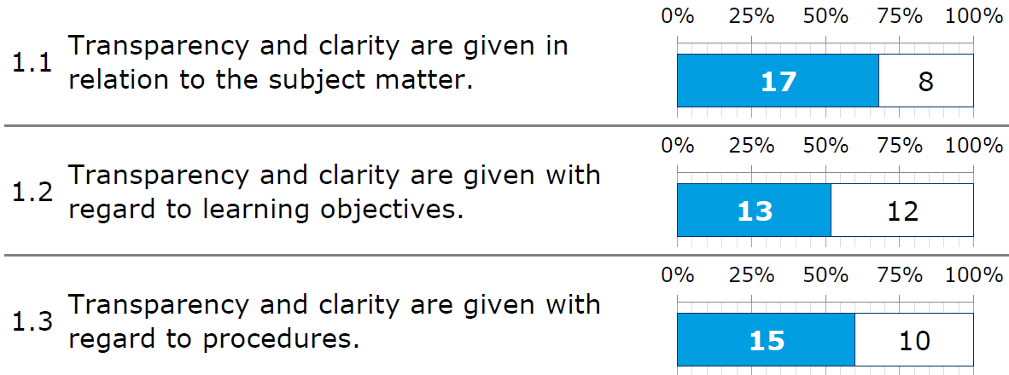
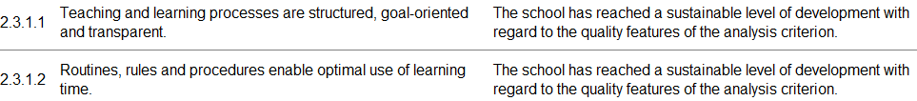
The data sets we leave to the schools
Strenghts and development potentials
Evaluation related to the criteria
Results from lesson observations
The Quality Report
Strenghts | Development Potential
Wide range of learning opportunities
Structured teamwork | Professional teamwork
Concept for self-regulated learning | Learning arrangements for effective learning

Slide 4

First Feedback at the End of the School Visit
Feedback to the head teacher or leadership team with the focus on leadership
Feedback to teachers with a focus on teaching – workshop format
What they use
What they do
Results from lesson observations
Results from lesson observations
Comments on the lesson observation sheet
Comments on the criteria of the inspection framework
Exchange on …
what results were expected
which results confirm their work
which results surprise
what first practical steps for further improvement could be

Slide 5
Workshop on the Lesson Observation Sheet
Become familiar with the Lesson Observation Sheet (LOS) as part of the overall process
Develop an understanding of the use of the LOS in school nspection
Develop ways to use the LOS within the school
Three steps
Exchange about …
Input (visible and deep structures of teaching)
Discussions in small groups
Simulation of how the data of a school are aggregated
what the comments say about the items
whether this corresponds to their idea of good teaching

Slide 6
Impulse Workshop
Answer key questions that have arisen in working with the inspection report
Support the interpretation of data and impulses from inspection report to prepare the following target setting process
Explore further training to support the development of the school and their teaching
Participants
Setting / Organisation
Representatives of the school
School supervision
Inspection team
School development advisor (possible)
Based on the concrete objectives of the school
Timeframe depends on the resources available and will be agreed with the people involved
School safeguards the results as a basis for their further development process

Slide 7

Vielen Dank!
Claudia Bensen
Ministerium für Schule und Bildung
des Landes Nordrhein-Westfalen
Telefon: +49 211 5867 3580
E-Mail: Claudia.Bensen@MSB.nrw.de
Bildmaterial: panthermedia.net – Dmitriy Shironosov, Jens Ickler, Sommai Larkiit, Razihusin sowie Land NRW

