Slide 1
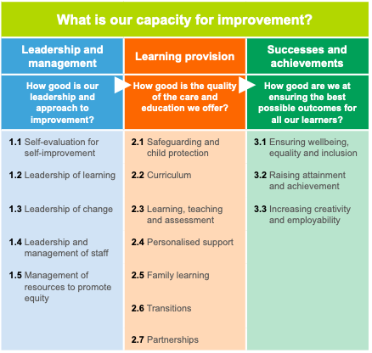
Self Evaluation Framework- How Good Is Our School 4
How good is our school? - HGIOS 4 |
Self-evaluation | National Improvement Hub (education.gov.scot)
Notes:
EMPHASISE the READ-ACROSS
Golden thread of equity

Slide 2

Quality Indicator
3.2: Raising attainment and achievement
Are effective systems in place to promote equity of success and achievement for all children and young people?
Can the school demonstrate learners’ success?
  Attainment across all areas of the curriculum
  Can the school show how they have raised attainment of the most disadvantaged?
Is continuous improvement/sustained high standards over time a key feature?
Notes:
QI 3.2: Raising attainment and achievement
Attainment in literacy and numeracy
Attainment over time
Overall quality of learners’ achievement
Equity for all learners
NB: Importance of wellbeing in supporting raising attainment and achievement.

Slide 3

Quality Indicator
1.3 Leadership of change
How effective is the tracking and monitoring of children’s
progress?
Do they measure the impact of interventions to raise attainment
of the most disadvantaged?
Are staff aware of the number of children in school living in poverty?
For Scotland's learners, with Scotland's educators

Slide 4
Overall scrutiny activities
Ensure we are looking for evidence that staff are closing the poverty gap
Look at how the Pupil Equity Fund is being spent. Is it making a difference?
What steps are being taken to ensure children with additional support needs are included and achieving?
For Scotland's learners, with Scotland's educators

Slide 5
Identifying excellence through Inspections
Six point scale from ‘weak to excellent’
Sketch note and blog to highlight features of excellence
Webinars to share good practice
Inspectors delivering professional learning sharing good practice
Published reports
For Scotland's learners, with Scotland's educators

Slide 6
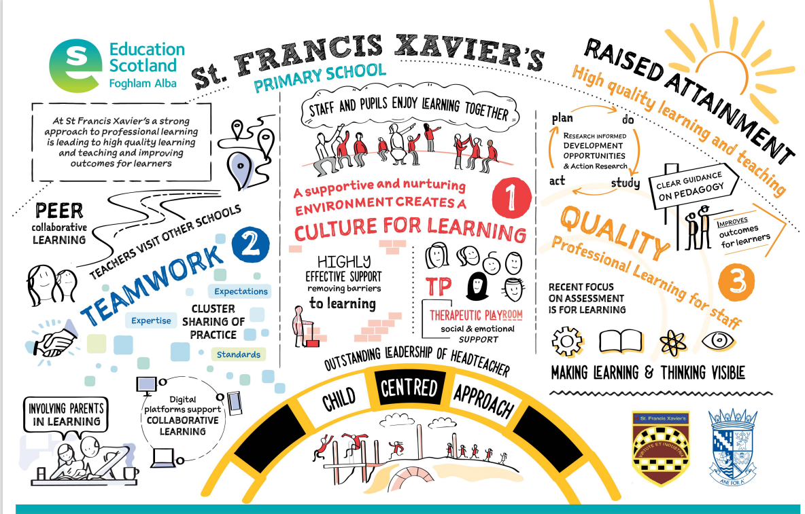

Slide 7
Identifying excellence through Inspections
Sketchnote – St Francis Xavier’s Primary School – Professional learning improving learning and teaching - May 2019 | Practice exemplars | National Improvement Hub (education.gov.scot)
StFrancisXaviersBlog.pdf (education.gov.scot)
For Scotland's learners, with Scotland's educators

Slide 8
Impact of inspections
Return to weak schools until satisfactory.
Uptake on voluntary support visits has been positive
Post inspection questionnaires
National survey on the effectiveness of schools in closing the gap positive.
Coronavirus (COVID-19): impact of school building closures - equity audit - gov.scot (www.gov.scot)
Closing the poverty-related attainment gap: progress
For Scotland's learners, with Scotland's educators

Slide 9

The impact of COVID – 19 on learning
Before
After
Notes:
The first section was an overview of the Attainment Scotland Fund and how this links to Scotland's vision of Excellence and Equity.
This next section moves on to describe the changes for some children as a result of COVID-19 and how that manifests itself in their learning. It highlights the importance of tracking and monitoring systems to ensure that no child is at risk of missing out as a result of COVID-19.

Slide 10
What is the ‘new normal’ for children and families?
Pre-COVID disadvantage
Children and young people whose disadvantage we know about and are addressing.
  Post-COVID disadvantage Children and young people not previously identified as disadvantaged learners who may now face poverty as a barrier to learning resulting from the COVID-19 pandemic.
Notes:
Being able to identify and understand children who are at risk is critical if we are to support their growth and development.
Prior to COVID tracking and monitoring systems typically identify and plan interventions for children and young people affected by poverty. Targeted interventions are evaluated and reviewed taking account of children's progress against national measures or local measures identified by the school.
Post COVID- targeted groups of children previously identified may have been affected negatively and some may be affected positively. ( A non- poverty related positive example.... in few residential special schools, some children appeared to benefit from a more blended, nurturing approach to learning during lockdown, resulting in higher levels of engagement and a reduction in incidents of distress and physical intervention. These children seemed to prefer having fewer transitions and a reduction in social contact. )
In addition, there will now be a group of children nationally who now face poverty as a barrier to their learning as result of the pandemic.
For consideration: what impact has COVID -19 had on the targeted group of children already known to the school?
For example:
As a result of a lack of contact with their support network
Due to exposure to domestic or other forms of abuse etc.
Some children may have been accessing HUBS or accessing support provided in different forms.
WHAT effect does this have on children's emotional wellbeing as well as their literacy and numeracy.
The next slide looks at the poverty triggers as a result of COVID-19 pandemic.

Slide 11
Potential impact on children and families
Consider the impact of:
Weakened economy – job insecurity
Widespread unemployment
Food insecurity
Housing instability
Increased substance misuse and addiction
Potential increase in child protection concerns
Notes:
Teachers need to be tuned in to the culture of poverty and be sensitive to the vast array of needs that children of poverty bring to the classroom. The national strategy to respond to the pandemic has the potential to have a negative impact on some children and families. Therefore, knowing your school's local context is extremely important.
Example: The Glasgow Centre for Population Health website generates insights and evidence and supports new approaches to improve health and tackle inequality. Schools can utilise the range of data this provides to inform their work on themes such as children and families, health behaviours, money and work and population health trends. (1 in 3 children in Glasgow were estimated to be living in poverty in 2017. 1 in 5 Scottish children are growing up in relative poverty.)
Example: job insecurity/unemployment (Scotland's unemployment rate is the highest in the UK.)
A school is located in an area where the economy is heavily reliant on the hospitality and tourist industry. The pandemic has had a significant impact on these businesses and job-insecurity/unemployment has become a reality for many families. Unemployment is a new experience for many of the families affected. This is causing parents a high degree of stress and anxiety.
Example: Parents feel able to approach the school to discuss their changing circumstances and the impact on their child as a result of the very positive relationships already established. The school's approach to effective communication between home and school is very good. PEF is used effectively to employ the services of a Family support worker to work directly with parents to ensure they know about/can access available financial help.
Example: Looking after family wellbeing
Some families faced isolation due to the withdrawal of services visiting homes and access to support group networks has become more challenging during the pandemic. In addition, measures to prevent the spread of COVID – 19, such as self-isolation, can be a particular risk for certain groups, such as those experiencing domestic abuse. Regular pastoral calls to families helps the school to gauge the extent of issues being experienced by families.
Example: Free school meals
There are reports of significant increases in the demand for food parcels as a result of the pandemic. How has this provision of free schools meals been continued during school closures/holidays? For example, the use of voucher systems has supported families to continue to access this support. How does the school inform parents about/signpost families to... foodbank provision? Do they actively promote this service/encourage people to donate food to it?

Slide 12
Taking a closer look at the impact of COVID -19 during future inspections
Which other Quality Indicators will support us to do this?
  QI 1.5 Management of resources to promote equity
  QI 2.4 Personalised support
  QI 3.2 Raising and attainment and achievement
Notes:
The impact of the pandemic is something that schools have never faced before. It is therefore important to establish a benchmark against which future progress can be measured.
What do these tell you about the impact of COVID-19 on children and their families? Do you have sufficient information or do you need to explore this further? For example, do you need to think further about the questions used in questionnaires? If you hold wellbeing conversations- are they helping to identify what is going well and where there may be pressure points?
For the purpose of the following workshop session we will be using QI's 1.5, 2.3 and 3.2 to explore the question 'what is the impact of COVID-19 on our school community?'
QI 1.5 - Is the Leadership and management impacting on closing the poverty related attainment gap – use of PEF
QI 2.4 - Is the learning provision ensuring that all children achieve success – the process
QI 3.2 - Are systems effective in promoting equity of success? Is the attainment of the most disadvantaged children increasing? - the outcome
NB: Although QI's 1.5, 2.4 and 3.2 have been selected for this activity, the selection of quality indicators can be dictated by the specific needs of a school.

Slide 13
QI 1.5: Management of resources to promote equity
Importance of sound risk assessment
Puts needs of learners at the centre of decisions
Should result in building a more sustainable and equitable future for all.
Promotion of equity is a
SHARED RESPONSIBILITY
Notes:
There a many scenarios for schools to consider at this time – all of which have to be considered in terms of equity:
For example:
the management of resources – including finances, the environment and digital technologies
Lack of teaching staff due to general absence/self-isolation / lockdown
Pupil attendance being affected by parents shielding/self-isolation
The potential requirement for blended learning / reduced class sizes
Equity of access to digital technology
Local lockdowns – class /whole school
Finance
There is a real risk of interpreting the current ‘flexibility in funding’ (such as PEF) that takes people away from the core business of SAC and Scotland and a danger that we will lose the good progress made to date. It is therefore vital to ensure that this flexibility remains consistent with the principle of equity in education.
Consider: how are you assessing risk to ensure the needs of children are at the centre of decision making? In what ways do you ensure that everyone is sharing the responsibility for promoting equity? Are your approaches sustainable?

Slide 14
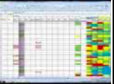
QI 2.4: Personalised support
The effective use of tracking and monitoring:
  to identify barriers to learning
  to identify children not previously identified
  to inform universal and targeted support
  to enable staff and partners to take positive and proactive steps to ensure barriers to learning are minimised/removed
Notes:
Being able to identify and understand the needs of children who are at risk is essential therefore effective monitoring and tracking is key.
QI 2.4 Personalised support
Universal support.
Targeted support.
Removal of barriers to learning
Focuses on provision of high-quality support that enables all children and young people to achieve success.
Highlights the importance of wellbeing and involving children and young people in decisions about how their needs should be met.
Strong partnerships with parents and partners who support children and young people are essential.
Monitoring the impact of interventions and making timely judgements to practice are key to providing highly-effective and targeted support.

Slide 15
Visits from August
Involving staff in school more in planning inspections
Working with local authority representative on the visit
No grades
Context - Listening to COVID-19 story and impact on community
For Scotland's learners, with Scotland's educators

Slide 16
Secondary Sector – age 12-18.
Educating Young People in Scotland
Ann Floyd HMI
For Scotland's learners, with Scotland's educators

Slide 17
Educating Scottish young people.
One third of Scottish young people live in poverty.
Poverty in families is multi factorial
Poverty impacts on self-confidence, feeling of control of lives, feeling valued, being listened to.
Young people are fiercely protective of their reputation – they would often rather fail at school than admit to being poor.
For Scotland's learners, with Scotland's educators

Slide 18

Focus area – supporting equity
How does inspection support improvements in these areas?
What does inspection tell us now that is successful and what does it tells us that shows we need to further improve.
For Scotland's learners, with Scotland's educators

Slide 19
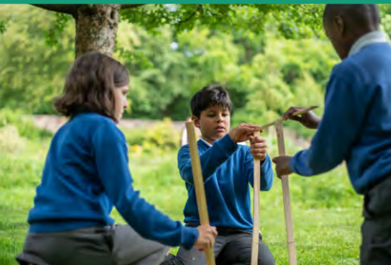
Three key areas of focus in Scottish schools
Teach explicit aspects of social justice and model equity in behaviours in classes. School values- tolerance/ respect/ kindness…
Support and encourage equal academic opportunities regardless of background. Support for parity of esteem across course choices.
Provide resources to support- food/ uniform/ trips etc. Many examples of opening access to all and providing structures to enable equity – supported study/ school trips/ after school clubs etc.
For Scotland's learners, with Scotland's educators

Slide 20

Role of HMI in each of these
HMI focus on school values- how they promote respect/ tolerance/equity?
HMI ask young people about feeling valued and included.
HMI talk to parents about how they are included and involved in the school.
Inspection reports try to reflect equity and parity of esteem in attainment
HMI record evidence about numbers being supported and achievement opportunities.
For Scotland's learners, with Scotland's educators

Slide 21
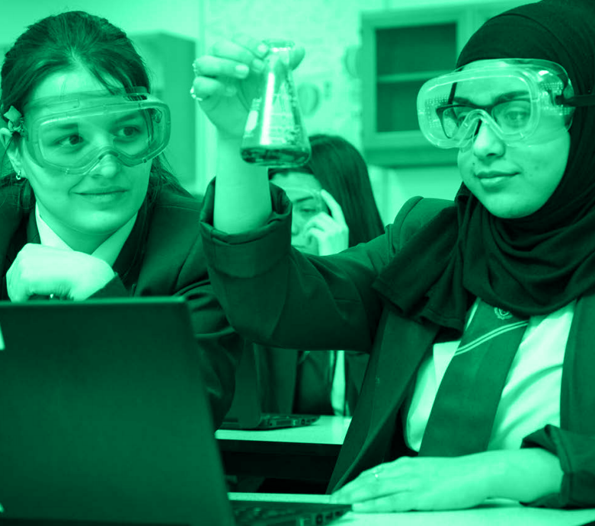
Closing the Poverty Gap – the challenge
HMI look closely at the poverty gap – and the opportunity gap.
We evaluate: access to curriculum / engagement and partnership with parents / attainment across the measures of deprivation / achievement opportunities offered and tracked / career planning and work experience/ leadership opportunities/ partnership approaches / progression and transition arrangements…
For Scotland's learners, with Scotland's educators

Slide 22
Scottish Index of Multiple Deprivation
Every school has information about the socio economic status of each young person. There are targeted approaches to support them in the curriculum and in broader school life.
HMI evaluate attainment and achievement data based on the SIMD levels.
For Scotland's learners, with Scotland's educators

Slide 23
HMI consider how the school meets needs
We look at the curriculum offer and how it meets the needs of all learners. Disadvantaged YP often disengage from school and curriculum. We look at approaches to teaching which enable better engagement. Post pandemic concerns about lack of engagement?
(All learning is free – no YP should now pay for Home Economics/ art materials etc.)
For Scotland's learners, with Scotland's educators

Slide 24
The challenge of disengagement
Early information points to an increased number of disengaged and absent young people. Many are from poorer households.
There is evidence that disadvantage leads to anxiety and a feeling of lack of control. This can lead to youth turning off school. They feel disempowered.
HMI now emphasise the importance of empowerment and real decision making for learners.
For Scotland's learners, with Scotland's educators

Slide 25
Many schools go the extra mile.
Almost all schools now provide practical support such as ; breakfast clubs/ school uniform banks/ free lunches/ free school trips/ free PE kit/ free stationery / free transport /prom dress donations/ many give laptops and internet access. Glasgow had a winter coat appeal.
HMI evaluate the impact of these initiatives. We look at destinations, attainment , achievement and attendance.
For Scotland's learners, with Scotland's educators

Slide 26
Current challenges facing schools
The impact of current economic context on child poverty. How do HMI continue to support equity?
How can schools continue to support the most vulnerable young people and also raise attainment, with potentially reduced staffing numbers? What is HMI view of the challenge here?
How can schools re engage the harder to reach families who have become detached from school over the last two years? Social challenges can be difficult for schools.
How do HMI support closing the opportunity gap when there are multiple and complex reasons behind disadvantage?
For Scotland's learners, with Scotland's educators

Slide 27
Excellence and equity in school – so where does it lead?
Prepared and supported for the next step?
John Laird HMI

Slide 28

The longer journey…. Key policies
There are policy initiatives aimed at leading young people to a positive outcome, one of the most notable is Developing the Young Workforce https://www.dyw.scot/
Another example is the Young Persons Guarantee Scheme which ….. aims to connect every 16 to 24 year old in Scotland to an opportunity. This could be a job, apprenticeship, further or higher education, training or volunteering. https://youngpersonsguarantee.scot/
Schools, colleges and other stakeholders aim to prepare young people well for the next stages of learning or work…growing focus on work

Slide 29
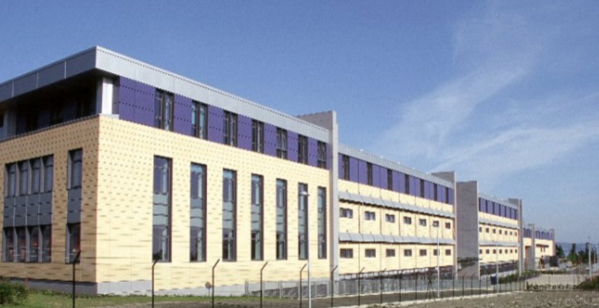
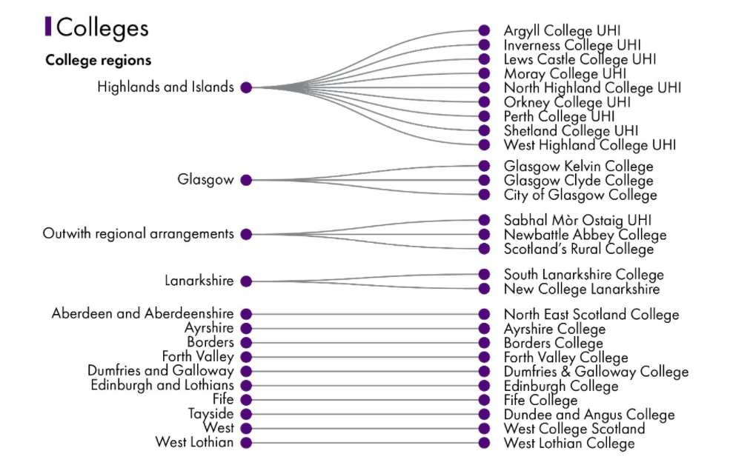
Scotland’s colleges

Slide 30
Who should help young people get a more successful outcome…and how well do they do it?
Schools – scrutiny in high schools include a Post 16 inspector in the team who will focus on the senior phase, career management skills, school/college linked opportunities etc.
Careers advisors – Scotland has a dedicated careers service led by Skills Development Scotland. https://www.skillsdevelopmentscotland.co.uk/
HMI have just completed a four year programme of inspecting all local authority careers provision.
Colleges – subject to scrutiny by HMI, who look at the quality of learning, of support for the learners and of outcomes for learners.
Employers – some of the provision supported by public funds is subject to review or scrutiny by HMI.

Slide 31
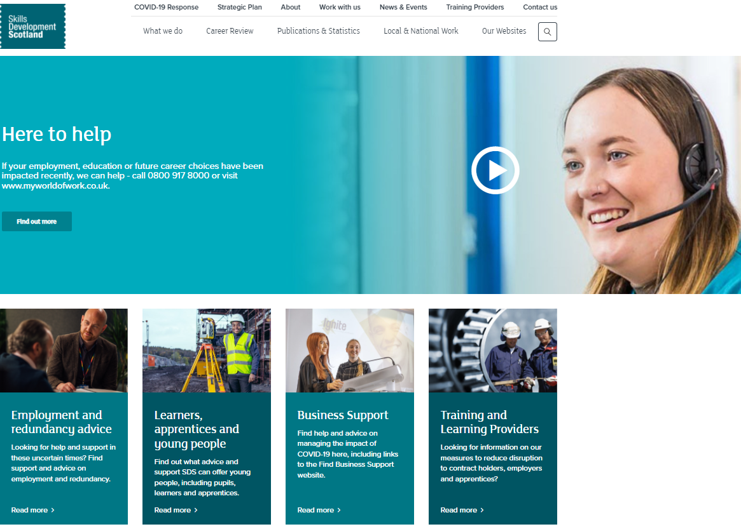

Where is the data about outcomes and what does it tell us?
School numbers vary a little by year and by area, but around 96% of young people are recorded as going into a positive destination. SDS hold detailed data working with schools and local authorities.
College numbers can be between 85% – 95%, but this is a measure relatively soon after leaving and doesn’t fully reflect the status longer term, perhaps one year after. It also raises the question of - what is positive?
Our more detailed college feedback raises a few interesting points. For example, how many young people do not find work in the subject they studied?

Slide 32
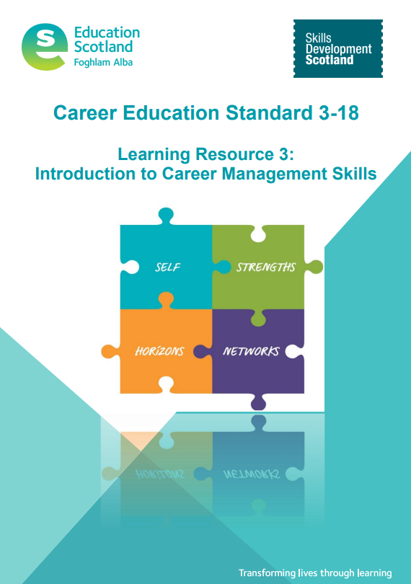
Understanding is part of making things better
Qualitative college feedback raises a few interesting points
In many disciplines, young people do not follow their qualification subject in the numbers you might expect.
When asked about their college experience in retrospect, young people often focus on wider social and employability skills.
Employers always focus on the need for core skills/essential skills/meta-skills.
Career management skills are a major essential.
A person now stays with one employer around ten years (source - statista) but this is reducing

Slide 33
Some long term considerations for effective scrutiny at the post school stage…?
Speculation, but worth some reflection….
A continued central role in establishment level work?
Strengthening the self-evaluation in the system, using supported peer review?
Examination of all work in a geographical area?
Perhaps validating self-evaluation processes?
Some focus on funding/qualifications/management bodies using public funds?
A greater focus on the longer term impact of policies?

Slide 34

URLs feature in this Workshop
References:
Building the Curriculum 3: A Framework for Learning and Teaching (education.gov.scot)
Education: improvement framework and plan - 2021 - gov.scot (www.gov.scot)
How good is our school? - HGIOS 4 | Self-evaluation | National Improvement Hub (education.gov.scot)
Scotland Learns | National Improvement Hub (education.gov.scot)
RICs: improving Scottish Education through collaboration? – SPICe Spotlight | Solas air SPICe (spice-spotlight.scot)
Supporting remote learning | National Improvement Hub (education.gov.scot)

Slide 35


URLs featured in this presentation
A Blueprint for 2020: The Expansion of Early Learning and Childcare in Scotland (www.gov.scot)
early-learning-childcare-statutory-guidance (7).pdf
Realising the Ambition | Learning resources | National Improvement Hub (education.gov.scot)
Successful Approaches to Learning Outdoors | National Thematic Inspections | HM Chief Inspector Report | Inspection and review | What we do | Education Scotland
Sketchnote - Riccarton Early Childhood Centre - Using data to ensure progress - April 2019 | Practice exemplars | National Improvement Hub (education.gov.scot)
How good is our early learning and childcare? | Self-evaluation | National Improvement Hub (education.gov.scot)
Sketchnote – St Francis Xavier’s Primary School – Professional learning improving learning and teaching - May 2019 | Practice exemplars | National Improvement Hub (education.gov.scot)
StFrancisXaviersBlog.pdf (education.gov.scot)
Notes:
Helpful Links

Slide 36
URLs featured in this presentation
https://education.gov.scot/improvement/learning-resources/compassionate-and-connected-classroom
PRAISE framework (education.gov.scot)
DYW - Scotland – Home
https://www.dyw.scot/
https://youngpersonsguarantee.scot/

Slide 37


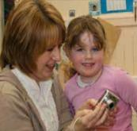
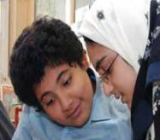
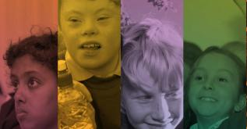

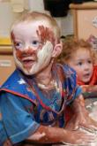
Closure of the conference
Janie McManus HMI
Strategic Director of Scrutiny

Slide 38
For further information or share ideas further please contact:
Janie.McManus@educationscotland.gov.scot
Education Scotland Strategic Director of Scrutiny and Executive member of SICI
Aileen.Monaghan@educationscotland.gov.scot
Alison.MacDonald@educationscotland.gov.scot
SICI National Coordinators

Slide 39
For further information or share ideas with today’s HMI presenters further please contact:
Sandra.Kehoe@educationscotland.gov.scot
Patricia.Madden@educationscotland.gov.scot
Sadie.Cushley@educationscotland.gov.scot
Ann.Floyd@educationscotand.gov.scot
John.Laird@educationscotland.gov.scot

