Slide 1
Quality Management
Systems in the Inspectorate
in times of pandemic
6 May 2021
Basque Country

Slide 2
WHO WE ARE
WHAT WE WANT TO ACHIEVE AND WHY
WEBINAR
HOW WE ORGANISE OUR WORK
FINAL CONSIDERATIONS

Slide 3
WHO WE ARE
Our education system
Two education networks: a public and a private one, with favourable indicators related to inclusion, low rates of school early leavers, high rates of attainment at tertiary level, and challenges such as improving excellence.
More than 1100 schools
Around 400.000 students
Ten years of compulsory schooling, from the ages of 6 to 16, high rates of early childhood education (95% of children under the compulsory age attend school for at least 2 years) and a growing Vocational Training Education.
Public schools (55%) and
private schools (45%)
Complexity of linguistic models with two official languages

Slide 4
WHO WE ARE
Sustainable Development
Goals 2030
Commitments of the education system
Agenda Euskadi
Basque Country 2030
Agenda Euskadi Basque Country 2030
Goal 4: Ensure inclusive and quality education for all and promote lifelong learning

Slide 5
WHO WE ARE
The Inspectorate
Functions of the Education Inspectorate
Central Inspectorate
Regional inspection units
Inspection zones
under the Vice Ministry of Education
Contribute to improve the quality of the education system, ensure compliance with the law to guarantee the rights of all stakeholders as well as evaluate, give advice and supervise the development of educational processes.
(Decree 98/2016)
Central:1+3
3 regional
81 insp.

Slide 6
WHO WE ARE
The Inspectorate's Quality Management System
To ensure its objectives, the efficiency of its processes and continuous improvement, a quality management system has been established with a process management approach.
Since 2008
Renewal every 3 years
ISO 9001:2015

Slide 7
WHAT WE WANT TO ACHIEVE AND WHY
Guarantee the effective and efficient achievement of the organization's objectives and ensure that the established requirements are met. All this in a sustained, sustainable way, and moving forward to continuous improvement.
Make compatible the satisfaction of all stakeholders and the improvement of the results of the organization.
Ensure the planning, management and evaluation of activities
PLANNING: Correct decision making based on evidence and elimination of risks
Three-year and annual plans
MANAGEMENT: Analyse the processes to define new strategies and lead changes in the human, technological and organizational dimensions
Macroprocesses, processes and subprocesses
EVALUATION: Analyse the results to review the planning
Indicators of achievement and annual reports
Establishment of standarised processes and suppy of documentary evidence of activities
Computer application (V92)
Avoid errors

Slide 8
WHAT WE WANT TO ACHIEVE AND WHY
Create an organizational and operational structure
Autonomous and coordinated work teams
Orientation to results and not just to tasks
Avoid bad practices
Aumentar el sentimiento de pertenencia, la motivación, y la competencia profesional
Align with the organization's goals
Improve professional and personal satisfaction through participation
Detect training needs
Clear and defined roles: inspector role
Commitment versus compliance
Improve the "know-how" of the organization
Improve internal communication
Provide work techniques and tools
Standardized procedures
Report models
IT tools and applications
Promote a culture of continuous improvement
Efficacy - efficiency
Time management
Elimination of products and services without added value

Slide 9
WHAT WE WANT TO ACHIEVE AND WHY
Improve the satisfaction of stakeholders and their relationship with the organization
Align with the interests and demands of stakeholders
Improve the value perceived by stakeholders
Measure the degree of satisfaction through surveys (quarterly, annually)
Improve external communication
Be a role model for schools
Certify: audits
Internal and external vision of the level of compliance of the management system
Proposals for improvements and innovation for an organization that learns
Facilitate the resilience and stability of the organization in times of crisis
Easy and agile process control and change Framework to manage risks
Framework for managing risks
Achieve goals in an uncertain environment
Identify opportunities and threats

Slide 10
IT’S NOT EASY...
Difficulties
Substantial initial effort: time…
Training need
Specific additional resources
Visualize the qualitative and quantitative benefit of the effort you've made
Partial improvements versus the desired comprehensive improvement
Need for structural and cultural changes that take time
Overcome resistance to change
Inadequate understanding of the quality system
Effort Training Routine Change Time

Slide 11
HOW WE ORGANISE OUR WORK
Make decisions to support schools during the pandemic
MP01 Strategy, planning and organisation
MP02 Identification and provision of services
MP03 Human resources management
MP04 Documentation management
MP05 Material resources management
MP06 Mesurement, analysis and improvement
Road sheet for the pandemic
Mission-Vision-Values
Process map:
Macroprocesses
Processes
Subprocesses

Slide 12
HOW WE ORGANISE OUR WORK
How to decide what is key at all times
(COVID 19)
Impact or social demand
Data
Decisions
Actions
Contribution to the achievement of the triennial / annual objectives
Biggest impact or need
Inequality vs
inclusion
Needs
management
Context situation
NOT OVERLOOKING OUR OBJECTIVES
con
LOCKDOWN

Slide 13
HOW WE ORGANISE OUR WORK
School supervision in the COVID situation
Changes in key services during the pandemic
2020-21
COVID19
Contribution to the educational improvement of schools.
COVID supervision
Regulatory control: guarantee of rights and duties.
Management of absenteeism. Control of school attendance and confined students.
Conflict resolution: living together
Program monitoring: purpose of the system
Collaboration activities
Student absenteeism
Collaboration activities

Slide 14
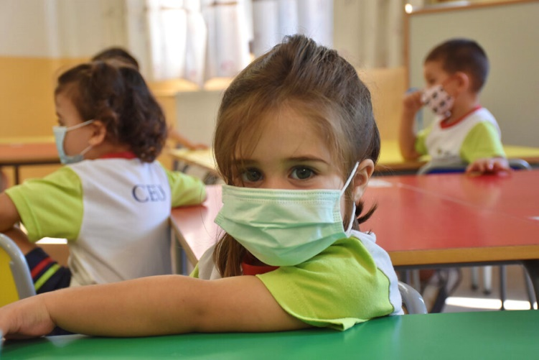
COVID 19
Every day
I
N
F
O
R
M
A
T
I
O
N
Data on the incidence of COVID
DEPARTMENT OF EDUCATION
DECISIONS ADAPTED TO THE NEEDS OF THE CONTEXT
AGILE DECISIONS
School
Inspectorate
PUBLIC ORGANIZATIONS
Data treatment
SOCIEDAD
SCHOOLS ARE OPEN, FROM PRE-PRIMARY TO SECONDARY EDUCATION

Slide 15
KEY SUBPROCESSES IN TIMES OF PANDEMIC
COVID SUPERVISION:
School’s strategic documents: Annual plan and report
Contingency plans
Review and adjustment of syllabus design
Students’ assessment
STUDENT ABSENTEEISM:
Guarantee the right to education in the different scenarios
Tools for monitoring students in non-face-to-face teaching
From 8 to 2

Slide 16
Ensuring continuous improvement: advanced management (assessment)
AND LOOKING AHEAD ... WITH OR WITHOUT A PANDEMIC
PROCESS MANAGEMENT TO:
Visibility!
MEASURE THE TRUE IMPACT
OF THE
INSPECTION
From what to what for
Self-assessment and strategic and shared reflection
CURRENT CHALLENGES
RETHINK THE 20th AND 21st CENTURY INSPECTION
Adaptability

Slide 17
AND LOOKING AHEAD ... WITH OR WITHOUT A PANDEMIC
In search of excellence…
with permission from viruses
Mila esker
Gracias
Thank you

