Slide 1
Czech School Inspectorate and research Small beginnings matter
SICI GA Ireland 2022
Dana Pražáková | National Coordinator | Czech Republic

Slide 2
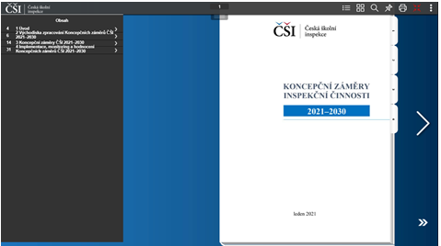
We use different approaches to cooperation

Slide 3
Virtual observation and inspector training
The need for consistency of inspectors‘ understanding and implementation of evaluation criteria
Simulation approach based on video-recorded lessons
Joint observation of lessons/blocks; completion of forms. University collaborators comment in terms of findings from both basic and applied research – they provide the theoretical basis.

Slide 4
Creating examples of inspiring practice
Identifying schools that can be regarded as a good practice in specific evaluation criteria – source of inspiration (e.g., for other schools)
Case study (school) approach based on a collaboration between a practitioner from the school and a researcher or inspector
Supervision and counselling of each case study provided by two university experts – link to the state-of-the art of research in education
Online result dissemination – the CSI methodological portal

Slide 5
Capacity building within the organisation through collaboration with universities
The Czech School Inspectorate (CSI) is a guarantor of international surveys (PISA, PIRLS, TIMSS …) for the Czech Republic
Sample educational surveys (need for sample design) – more formative type of assessment
Interconnection between national (surveys and inspections) and international data
Gradual shift from descriptive to more advanced statistical methods → quantitative approaches as the basis for data-based arguments and recommendations (evidence based approach)

Slide 6
Processing of results – from basic statistical methods
Proportion of pupils in environmental education test result categories
Pupil characteristics | Attitudes to climate change | Actual and potential pupil behaviour | Relationship of pupil to place of residence
Gender of pupil | Higher consent rate of girls | Higher consent rate of girls | Higher consent rate of boys
Pupil’s field of study | Higher consent rate of secondary general school pupils | No differences | Higher consent rate of secondary general school pupils
Pupil’s participation in interest group or club | No differences | Higher consent rate of pupil from group/club | No differences

Slide 7
to more advanced forms

Slide 8
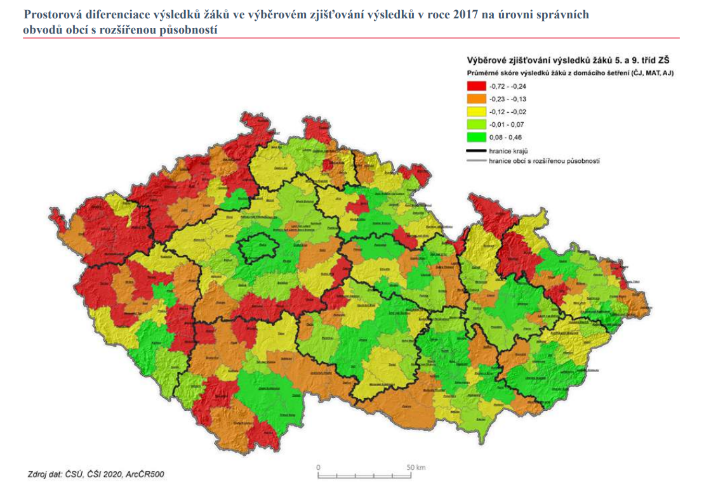
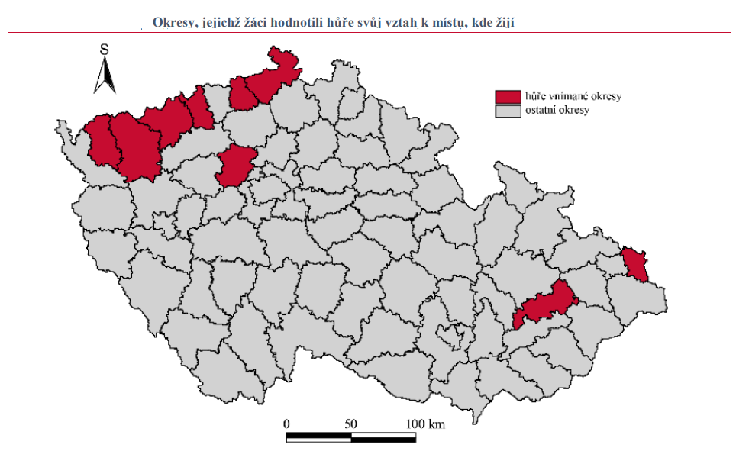
Processing of results – cartographic visualisation

Slide 9
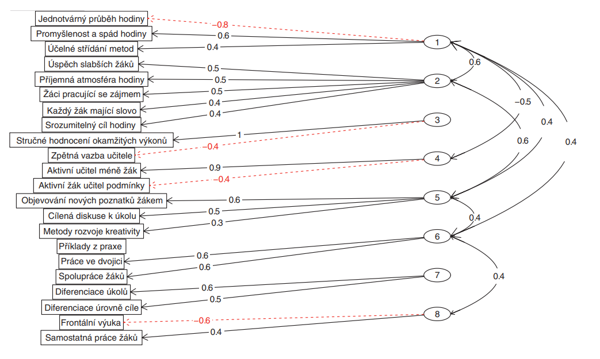
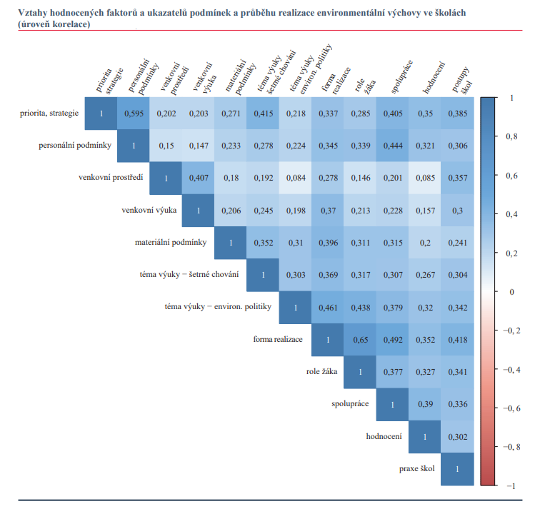
Processing of results – factor analysis
Teaching factors based on information from observation records

Slide 10
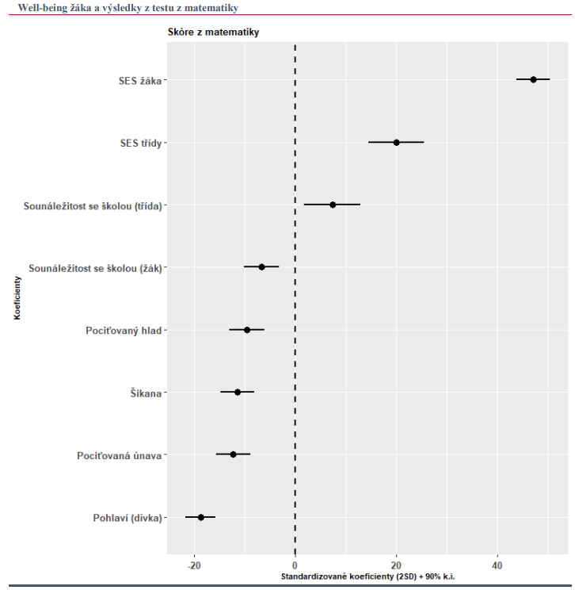
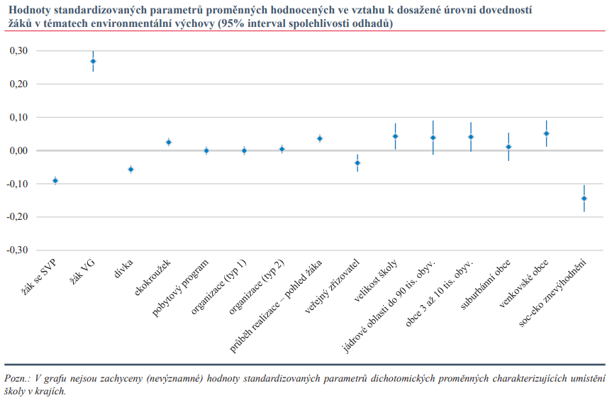
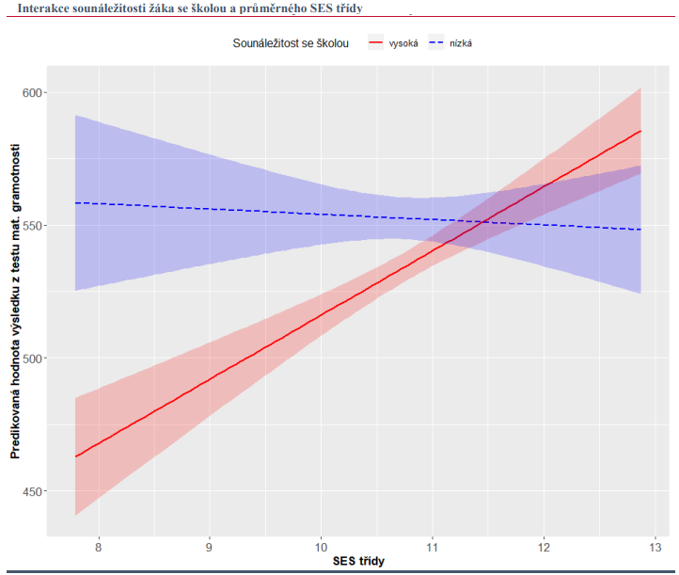
Processing of results – regression models
Relationships between factors and pupil results

Slide 11
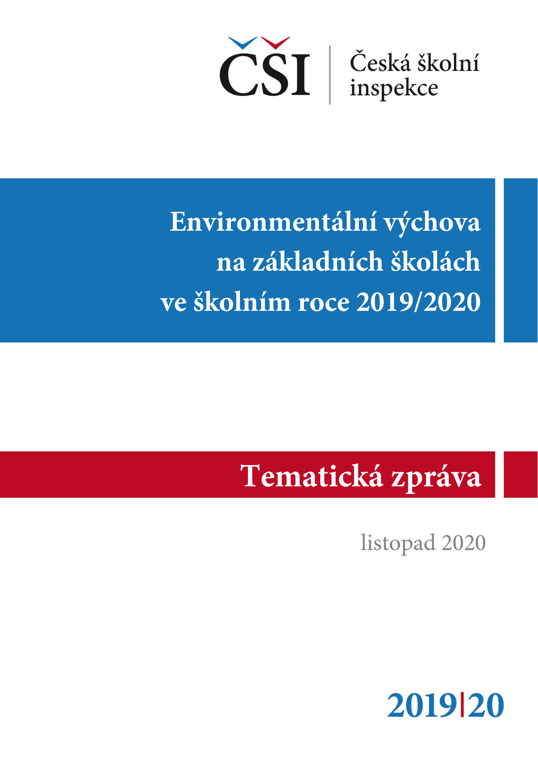
Outputs – thematic reports with recommendations to the level of ministry, statutory authority (mainly municipality) and schools

Slide 12
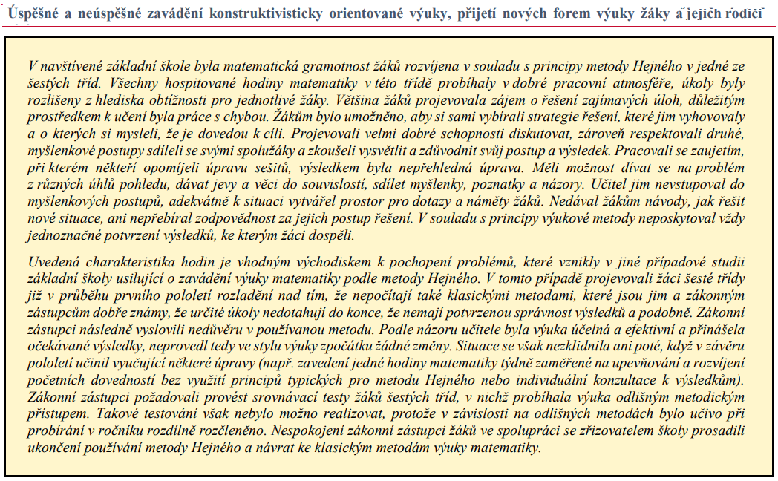
Processing of results – qualitative approaches two-year tasks

Slide 13
Opportunity for improvement

Slide 14
Negotiating a method of cooperation
Project financing requires a very precise contract set up several years in advance.
Who should guarantee the activity – an internal employee of the CSI or an employee of the university implementing the project?
Do we have the capacity within the organisation to define the contract well?

Slide 15
Team characteristics
It should be ensured that the external research team consists of true experts on initial education, not “only” analysts:
Knowledge of the legislative environment
Practical knowledge of the school environment (making actionable recommendations and formulating findings in a way that is not too harsh on schools or indicative of a lack of knowledge of school reality)
When academics and inspectors work together, it should be ensured that both roles are equal.
Who has the “final say” if there are different views?

Slide 16
We are still in progress To be continued …

