Slide 1
Developing a sustainable and adaptive framework for a rapidly changing environment
Tessie Kuiper-Coordinator International Affairs
SICI-Cyprus 12-4-2024

Slide 2
Content
The design phase
The development phase
The formal alignment phase

Slide 3
Phases in framework development
January 2023 – January 2024 In the design phase we arrive at a vision and the principles for the new inspection framework. In this phase, the vision and principles are elaborated and we consult important internal and external sources.
February 2024 – June 2026
In the development phase we elaborate the new research framework based on the principles. We do this through consultations and discussions with key actors, including the professional field, science, policy and other internal and external sources.
July 2026 – June 2027
In the formal alignment and determination phase, we present the framework and gain support. The process starts with consultations and ends with the implementation and communication.

Slide 4
The design phase

Slide 5
Why a new inspection framework ?
Adaption
Adapting to a changing environment (educational field, politics, society)
Improvement
Improving the current framework based on internal and external evaluations
Public interest
Serving public interests in line with Sparrow’s notions

Slide 6
Our current frameworks
Are multifold, complex and contain attachments for sector-specific needs
Need to be revised annualy
Bureaucratic time-consuming procedure
Cannot easily adapt to sudden change or shifting public demands
Focus on governing boards

Slide 7
Design phase method
Consultations:
discussion
Working sessions:
creation
Product discussion:
decisions

Slide 8
First building stone: New Vision
Our approach will be integral, interest driven and adaptive.
We look at the educational system, governing boards and schools/settings (preschool settings, schools, VET- education courses and universities) in coherence.
We act in line with urgent public interests or social demands that we see in the education system.
We are able to adjust and be adaptive to these needs or demands.
In this way, we aim to be as effective as possible
Notes:
Speech text:
In order to be stable in our role, we need to hold on to our vision. Here you can see it in words and images.
Fitting with mission: 'effective supervision for better education'.
Effectiveness is therefore at the core.
In addition, 3 important elements that are also interrelated: integral-task-oriented-adaptive.
What does this mean? Explanation:
We first look at task-oriented (bottom left). Social developments require our attention, e.g. citizenship, equality of opportunity, newcomers, basic skills. We focus our energy where there is the greatest need. This is OBJECTIVE. Consider our focus on language and mathematics in continuation of the downward trend in education that I already mentioned.
The choices in the way we supervise: which intervention is appropriate? What is needed now? That's ADAPTIVE (the triangle at the bottom right).
-> Adaptive and task-oriented influence each other: it is not our framework or our instrument that is leading, but what you want to achieve in the outside world . You adapt to what is needed outside, and only rest when that has been achieved.
The icing on this triangular cake is integrated supervision. This means: supervision of all dimensions of national, administrative and institution/school. The point now is that the interaction between the 3 levels of supervision, i.e. system-administration-school or institution, provides added value.

Slide 9
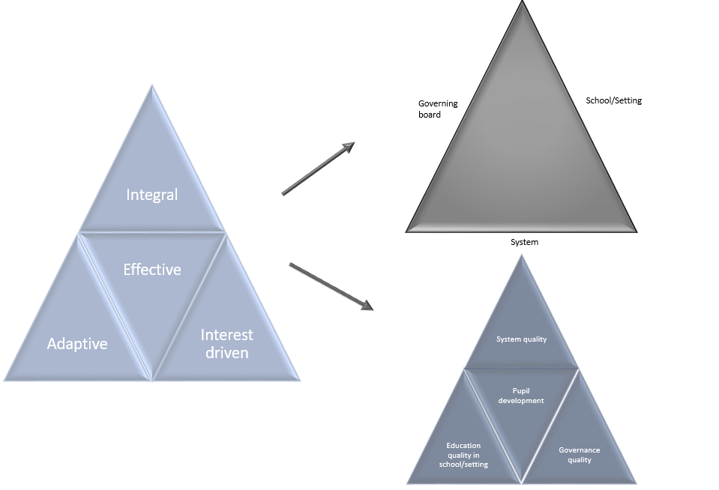
Integral
Notes:
DO: design: blue triangle, must be school/institution (also in VT sheet 14)
Speech text:
Zoomed in for a moment: the triangle on the right is an elaboration of the upper triangle 'Integral'.
Example for illustration: Basic skills.
- Task-oriented. Because we raised this topic ourselves based on social developments in combination with the gap between our institutional supervision and our observations at system level.
- Adaptive. Because we have figured out how we want to approach this ourselves
- Integral. Because we incorporate the outcome of thematic research into management supervision .
[Bruggetje]: Given the current context, we see this vision as a guideline for the development of our supervision... Then we're already there, right?
But that is not true, because our organization still has a number of challenges. I'll show you which ones they are.

Slide 10
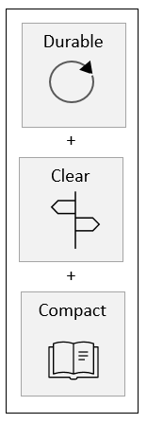
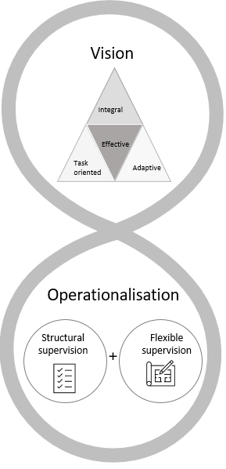
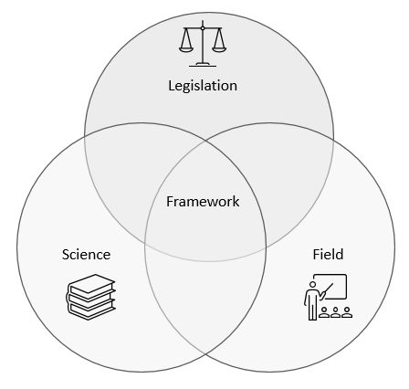
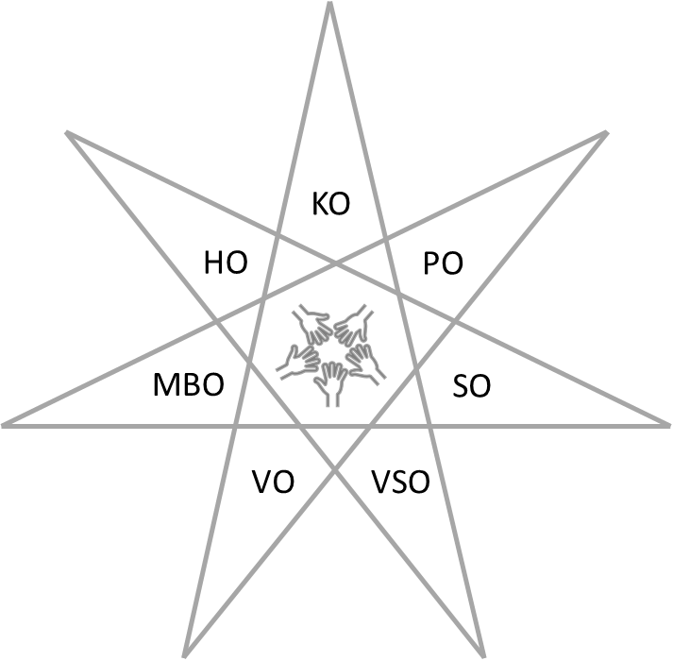
Second building stone: Principles new framework
The framework is durable, clear and compact
A distinction is made between structural and flexible supervision
The framework is substantiated by legislation, science and the professional field
A common framework is created for all forms of education: from childcare to Higher education

Slide 11
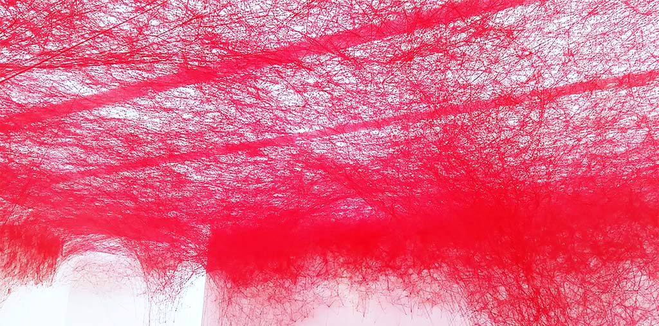
On course: towards strategic lines
Common threads
Context
Broad approach, based on public interest
Structural and flexible supervision
Level of supervision: what and where
Common framework
Principle
Design
Substantive issues

Slide 12
Design projects new inspection framework
Context
Context analysis
Principle
Continuous learning paths
Common framework
Design
Design structural and flexible supervision
Normative effect of the framework
Legal basis for the framework
Substantive issues
Governing board supervision: content and method
Risk orientation and proportionality in board supervision
Interaction between schools/settings, boards and system
The use of (overall) judgements
The interpretation of the stimulating task
Relevant developments

Slide 13
The development phase

Slide 14
Components of the development phase
Phase | Initial phase | Middle phase | Final phase
Product | Overarching framework | Sectoral frameworks | Substantiation
To develop
Try
Dialogue
Dialogue
Try
To develop
Try
To develop
Dialogue

Slide 15
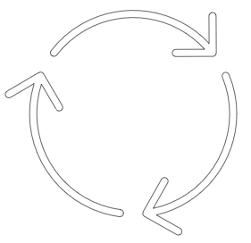
Development, testing and dialogue
To develop
We develop components of the research framework (overarching framework, sectoral frameworks, substantiation).
Try
We pilot or test small parts of ideas in the new regulatory practice to gain knowledge and practice implementation.
Dialogue
We discuss our ideas with internal and external stakeholders, while collecting good practices in the field.
Cyclic process
Evaluation results

Slide 16
Theory of Change of educational supervision*
* The theory of change presents the assumptions on which our supervision is based. It presents the intended effects and the way in which these are expected to arise.
1st ^{half} 2023 Document analysis and expert session
Late 2023, early 2024 Input from design themes
2024-2027 Input from Development phase and Administrative process
Theory of Change Research Framework 2021
Advanced Theory of Change Research Framework 2027
2 ^{nd} half 2023 Literature study scientific substantiation
2024-2026 Evaluation of governing board supervision

Slide 17
Development phase timeline
2024
2025
2026
Determintation phase
Initial phase
Middle phase
Final phase
O
b
D
Product 1: Overarching framework
Product 2: Sectoral frameworks
Product 3: Substantiation

Slide 18
Strategy: pilots and trials
Learn and improve by piloting and trying suggested practices of the new supervision; Examples: Regional pilots and Systemized board discussions
Including inspectors and other colleagues in the development process

Slide 19
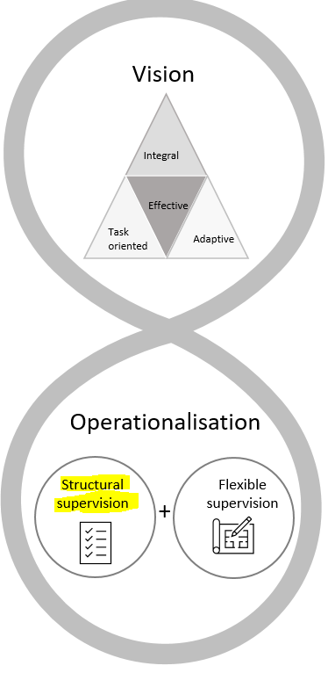
Further operationalisation of structural supervision

Slide 20
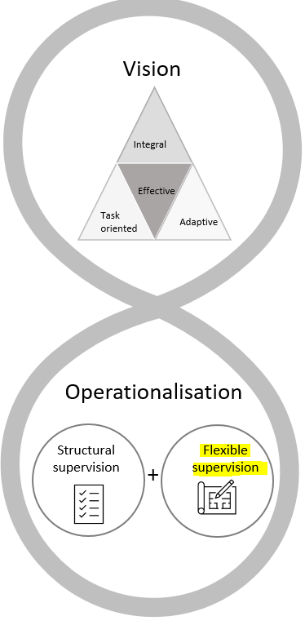
Further operationalisation of flexible supervision

Slide 21
Information from your inspectorates fuel our developments
Supervision scans-finished
Inspection frameworks
Stimulating supervision and (overall) judgements
Governing board supervision
Unannounced inspection activities
Curriculum supervision
System level interventions
Supervision scans in progress
Quality of education
Digitalisation, AI and digital safety
Inclusive education
….

Slide 22
Formal alignment and determination phase

Slide 23
Formal alignment and determination phase (2026-2027)
Determation by Chief inspector
Accordance by Department for education
Accordance of our so called ‘Rings’
Accordance second chamber?
Determination ministers of education
Publication in State Newspaper
In the meanwhile implementation and finetuning

Slide 24
Thank you for you attention!
Questions?

