Slide 1
Impact of inspection on education policy Policies on the North-South divide November 2017 Amy Finch amy.finch@ofsted.gov.uk

Slide 2
Ofsted’s role and relationships
Head of state
Parliament
(Education Select Committee)
Holds to account
Government
(Department for Education)
Appoints HMCI
Sets legislative framework in which Ofsted operates
Reports
Advises
Ofsted and HMCI
HMCI is accounting officer
HMCI advises SoS
Ofsted sets its framework and inspection policy
HMCI appointment, legislative framework

Slide 3
Assessing policy impact
Under our new strategy, Ofsted is positioned as
“A force for improvement through intelligent, responsible and focused inspection and regulation”
Old strategy
New strategy
Measure citations in govt and parliamentary documents;
Work under ‘focused’ requires policy influence:
Inspecting multi-academy trusts
Inspecting more ‘outstanding’ schools

Slide 4
North-South divide: the problem
Ofsted inspection outcomes, 2016
10 best local authorities (% schools ‘good’ or better) all in London or South East
10 lowest performing all in North or Midlands
Pupil attainment gap, 2016 GCSEs
LA range of between 38% and 58% achieving ‘Attainment 8’ at GCSE
6 of lowest 10 LAs are in North West
8 of highest 10 LAs are in London
Potential influences
Academisation around cities
Cities attracting high-quality teachers
Economic growth and opportunities across regions

Slide 5
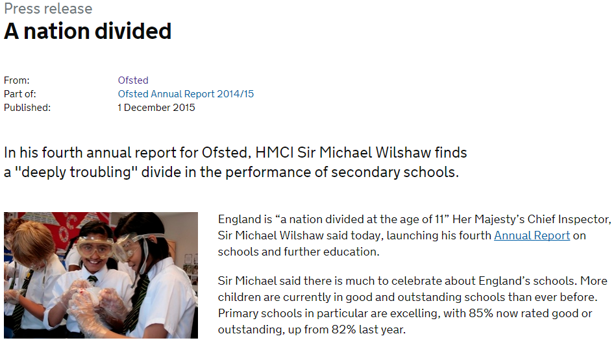
Ofsted action
HMCI Annual Report, 2015 and 2016
HMCI commentaries
News coverage

Slide 6
Policy impact
Northern Powerhouse Schools Strategy, 2016
DfE commissioned Sir Nick Weller to review northern education;
Recommendations such as ‘Teach North’ and MAT growth funds.
Opportunity areas
This year DfE launched £72m to boost leadership capacity in 16 poorest performing areas.
MAT growth funds
DfE established funds to support MAT to grow in disadvantaged areas.
Focus on teacher workload
DfE launched teacher workload survey.

Slide 7
Conclusions
What gave us impact?
Power of bird’s eye view of whole system
Systems to track trends in education quality
Having a national stage for our findings
Tapped into public interest on ‘a nation divided’
Impact of govt policies on North-South divide not yet assessed.

