Slide 1
SICI Bilbao 2023 Basque Country
General Assembly
Inspection & Research
November 15th-17th, 2023

Slide 2
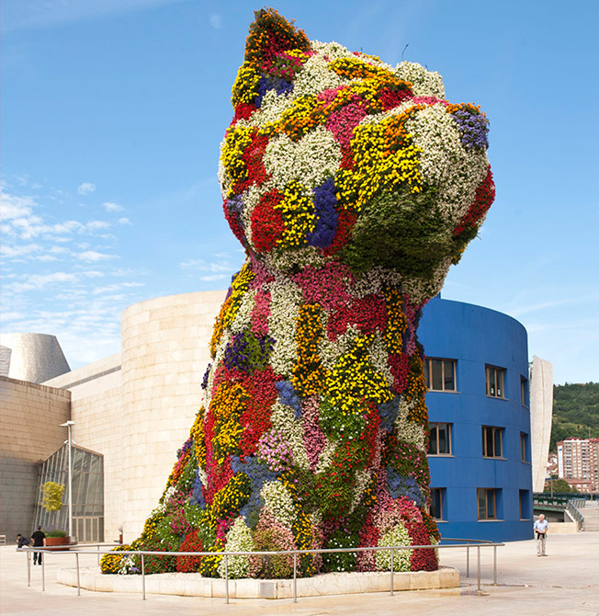
WELCOME TO BILBAO Ongi etorri

Slide 3
General Assembly Programme November 15th, Wednesday
13:30-16:30 | Executive Committee meeting Members of the Committee
14:45-16:00 | Presentation "Basque vocational training system“. Jose Ramón Gómez
17:00-19:00 | Cultural visit Guggenheim Museum

Slide 4
General Assembly Programme November 16th, Thursday
09:00-09:15 | Registration and refreshments
09:15-09:45 | Official Opening SICI President Basque Vice Minister of Education Bilbao City Education Councellor Basque Chief Inspector.
09:45-11:00 | 1st Keynote address "The role of inspection: Improving the Educational System by research" by Nekane Zabaleta and Martin Casado (Basque Inspectorate)
11:00-11:30 | Coffee break
11:30-12:30 | 2nd Keynote address"A research-informed approach to inspecting the quality of education in schools in England" by Richard Kueh (OFSTED)
12:30-14:00 | Lunch
14:00-14:15 | Summary report and analysis Previous workshops organizers: Madeira, London, Luxemburg (5 minutes each)
14:15-15:00 | Discussion and feedback Small groups
15:00-15:15 | Coffee break
15:15-15:30 | Conclusions of the small group's discussion
15:30-16:30 | National Coordinators’ meeting
16:30-17:30 | Business Meeting (annual general)
19:30 | Gala dinner: Euskalduna Jauregia

Slide 5
General Assembly Programme November 17th, Friday
09:00-09.30 | 2024 SICI Theme introdution "Inspecting in a rapidly changing educational environment"
09:30-10:30 | 3rd Keynote address
10:30-11:00 | Coffee break and Group photo
11:00-12:00 | Roundtable discussion: Cyprus, Estonia, Romania. "Inspecting in a rapidly changing educational environment"
12:00-12:30 | 2024 Malta General Assembly Presentation 2023 General Assembly Evaluation Closure
12:30-14:00 | Lunch

Slide 6
General Assembly OBJECTIVES
1 | Achieve common bases of work as inspectors by sharing good practices about the relationship between research and inspectorate.
2 | Identify criteria that can be applied to improve the connection between research and inspection.
3 | Make proposals that improve the work of the inspection to enhance the Quality and Equity of Education promoting the inclusion of all the students.
4 | Promote mutual knowledge between different inspectorates in such a way that subsequent bilateral exchanges can be fostered.

