Slide 1
Remote education and learning loss in England, February 2021
Dr Donna Neill
Head of Research

Slide 2
The current context in England
Schools have been open for only vulnerable children/children of key workers since Christmas
By the end of this week, the 8.5 million children in school in England will have lost 5% of their overall face-to-face time in school with a teacher
There are concerns about:
Learning loss
Children’s mental and physical health
Safeguarding
Future lost earnings

Slide 3
What we’ll whizz through today…
What remote learning looks like in England
What matters most in remote learning
Whether children progress when learning remotely
Some benefits of remote learning

Slide 4
What is remote learning?

Slide 5
What is remote learning?
Remote learning is a broad term encompassing any learning that happens outside of the classroom/school, with the teacher not present in the same location as the pupils
Digital remote learning, often known as online learning, is remote learning delivered through digital technologies
Blended learning is mixing face-to-face and remote methods. An example would be flipped learning, where main input happens remotely (e.g. through video), while practice and tutoring happen in class

Slide 6
What schools are doing to teach remotely
Notes:
Data from YouGov survey of 1003 teachers conducted for Ofsted between 24th November - 11th December 2020.

Slide 7
Senior leaders are most likely to choose something that’s easiest to implement
How they are making choices about methods?
Top factors for the choice of remote learning approach (senior leaders)
Teachers
Q3. Which, if any, of the following most influenced the choice of your remote learning approach? (Please select all that apply) Base: All Senior Leaders whose school offers remote learning (n=190)
Notes:
Data from YouGov survey of 1003 teachers conducted for Ofsted between 24th November - 11th December 2020. The fact that ease of implementation is the key consideration needs to be scrutinised and balanced with user needs, but the need for systems to be user-friendly for teachers is something SLT should be taking into account.

Slide 8
What matters most in remote learning?

Slide 9
Curriculum alignment
Remote education as a medium does not change how pupils learn
The same understanding of cognition and curriculum scaffolding still applies
School leaders generally agreed this was important however…
Our survey of 2,000 teachers found only 15% of teachers said they had been able to align their curriculum remotely so far – it is recognised that this is a journey on which schools are at differing stages and it may also differ by subject

Slide 10
The majority said they ‘don’t know’ how easy it is to align their curriculum…
Notes:
Secondary teachers are more likely than primary teachers to state it has been easy (54% compared with 41%). Independent schools are much more likely to have found it easy (64%) compared with only 43% in maintained schools. Half of teachers feel it is possible to align remote learning completely with the curriculum, but a similar figure do not. This divide in agreement is particularly apparent between primary and secondary teachers (59% of secondary agree compared with 41% of primary). Schools with an ‘Outstanding’ Ofsted rating are more likely to agree than those with a ‘Good’ rating (57% compared with 46%).
Though they have found it hard, 80% of teachers feel the curriculum is at least somewhat aligned (65% think it is completely aligned). Data from YouGov survey of 1003 teachers conducted for Ofsted between 24th November - 11th December 2020.

Slide 11
Pedagogy – keeping it simple
Around a third of teachers said they lacked confidence teaching remotely
Adaptions teachers had made to make remote teaching easier/more effective included:
a closer focus on verbal explanations and exposition, and presenting concepts in ‘bitesize’ segment
shortening the length of lessons
using a variety of different ways of presenting information, although still making sure they are an appropriate fit to the task
ensuring time for pupils to practise what they have learned, for example through independent work or pupil discussion
avoiding open-ended tasks that can potentially overwhelm pupils

Slide 12
Engaging pupils
One in 10 parents told us accessing a device or the internet was difficult for their children – feedback from parents is key
40% said their main challenge was getting their children to focus on studying
Schools find it difficult to assess the ‘true’ engagement of pupils but were developing ways to do this:
Increasing teacher-pupil interactions
Increasing pupil-to-pupil interactions

Slide 13
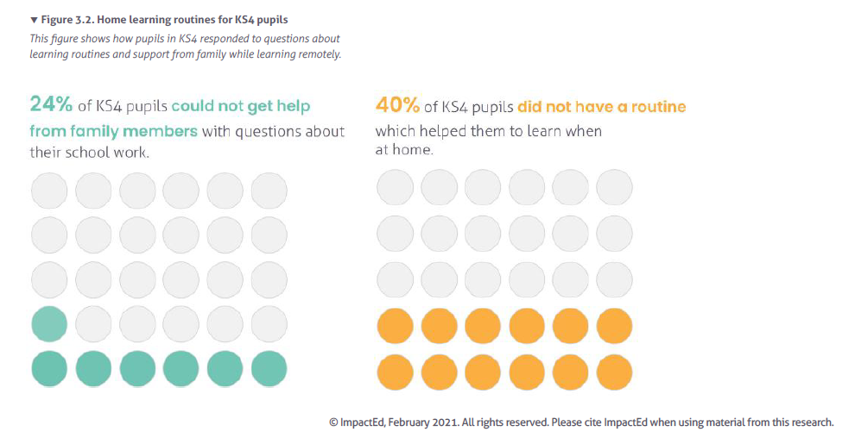
Pupils sometimes find it hard to get what they need…

Slide 14
Current levels of participation
Based on a small sample of 50 inspections, of inadequate and RI schools, some early findings suggest:
Most schools told us that at least 80% of children did some learning last week, but there were a minority of schools where only around half of children did any learning
Nearly half of schools are struggling to engage children from disadvantaged backgrounds
Engaging children with SEND and EAL also appears challenging
Biggest barriers to remote education are:
Parents not being able/willing to support children with their remote learning
Followed by schools feeling that they are unable to assess whether children have learned the material

Slide 15
Feedback and assessment
Quality feedback should allow pupils to know:
where they currently are in terms of the topic, task or knowledge they are working on
where they need to get to
how they can close any gap between the two
Assessment was one of the main areas that schools told us they needed to think more about
Some leaders were very clear that assessment was about understanding what parts of the curriculum children were learning, using it to plan subsequent remote lessons and making sure children weren’t rushed through the curriculum

Slide 16
Evaluating remote solutions
Current remote education solutions have been established through a process of continuous development, adjustment and refinement – again, we’re all on a journey
Our report outlines several ways in which schools have begun to evaluate and refine their remote learning solutions
The Department for Education in England have developed a remote education self-assessment framework here.

Slide 17
Overcoming common challenges
Early years and KS1
Remote education for children with SEND
Safeguarding
Teacher well-being
Training

Slide 18
Are children progressing with remote learning?

Slide 19
Established evidence of learning loss in primary
The Netherlands assessed primary pupils pre and post an 8 week school closure.
Likely to be a ‘best case’ scenario with a short lockdown and world-leading broadband.
The average pupil made little or no progress when learning at home.
Pupils from less educated homes lost 55% more learning [Engzel et al 2020]
This study is supported by more recent research from NFER/EEF (Jan 21) in England which found substantial learning loss at KS2 in reading and maths, and a seven-month disadvantage gap
The EEF calculated that the gap will widen between advantaged and disadvantaged pupils by a median of 36% (range between 11%-75%).

Slide 20
Less established in secondary
‘No More Marking’ found in the autumn that Year 7’s writing skills had significantly declined on previous years.
More generally though, learning loss research in secondary tends to either assume learning loss and so focuses on remote learning solution designs, or uses statistical modelling to assess the potential impact of learning loss, for example on future earnings.
There is some subject specific research starting to emerge, e.g. looking at starting points for undergraduates in chemistry [Turner et al 2020] but again these are based on assumptions about learning loss, rather than assessments of the exact extent.
We don’t have a lot of reliable evidence of the extent of learning loss for children in secondary, particularly those in the exam years.

Slide 21
Parents say they are struggling to support their primary aged children more…
Data from ParentPing suggests parents are struggling more with supporting primary remote learning, than secondary.
The charts below show parent feelings on a scale of 1 to 10 where 1 is “I can’t do it at all” and 10 is “certain I can do it”.

Slide 22
We need to be careful about the research that exists…
Disadvantaged children’s learning loss is easier to measure, but not the only fault line
Parents’ education level or profession may be having a big effect
Children in early years and their readiness for school is a concern
School/classroom level assessment of children’s knowledge by their teacher is most important

Slide 23
It’s not all doom and gloom…!

Slide 24
Benefits of remote education
Having spent time and resource over the last 10 months developing new systems, they were able to identify some positive benefits that may aid pupils learning in the future. These included:
Video lessons from subject experts to:
Where there subject specific teacher recruitment and retention issues
To provide cover for lessons in teacher absence
Available for pupils where they miss lessons due to illness
Supporting anxious or excluded students off site or in other on-site learning areas
Improvements to homework delivery
Developing older pupils’ independent learning
Increased flexibility to support children with special educational needs

Slide 25
Questions?

Slide 26
Ofsted on the web and on social media
www.gov.uk/ofsted
https://reports.ofsted.gov.uk
www.linkedin.com/company/ofsted
www.youtube.com/ofstednews
www.slideshare.net/ofstednews
www.twitter.com/ofstednews

