Slide 1
Education Scotland
National overview of remote learning
24th March 2021
For Scotland's learners, with Scotland's educators

Slide 2
Aims of this session
Supporting the quality and effectiveness of the delivery of remote learning.
This session aims to:
Provide an overview of the Education Scotland National overview of remote learning
Provide a short summary of work undertaken to date
Share high level key findings

Slide 3
Delivery of education in Scotland from March 2020
Mar 20
June 20
Aug 20
Jan 21
Feb 21
Mar 21
Closure of school buildings for most learners
Local authorities plan blended learning approach from Aug 20
Reopening of all schools.
Second closure of all school buildings
School buildings open for ELC + P1-3 learners
22 Feb 21
School buildings open for all primary aged learners
15 Mar 21
HMI supporting schools across Scotland during recovery year
Hub provision for vulnerable learners and key worker children
Provision for vulnerable learner and key worker children
HMI review of local authority blended learning plans
Blended learning for secondary aged learners
15 Mar 21
Temporary suspension of school inspection programme
Publication of remote learning guidance 8 Jan 21
National overview of practice begins 18 Jan 21

Slide 4
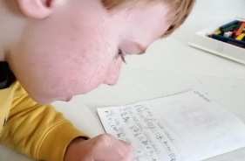
Remote learning guidance and entitlements – 8 Jan 21
“Remote learning is learning that is directed by practitioners and undertaken by children and young people who are not physically with the practitioner while instruction is taking place.”
“Remote learning can be delivered in a variety of ways. It may include reading, doing, creating and inventing, playing, problem solving, observing and investigating with some of the best learning examples not requiring technology at all, although in the current context, digital and online approaches will be commonly used.”
COVID-19 Education Recovery Group (CERG)

Slide 5
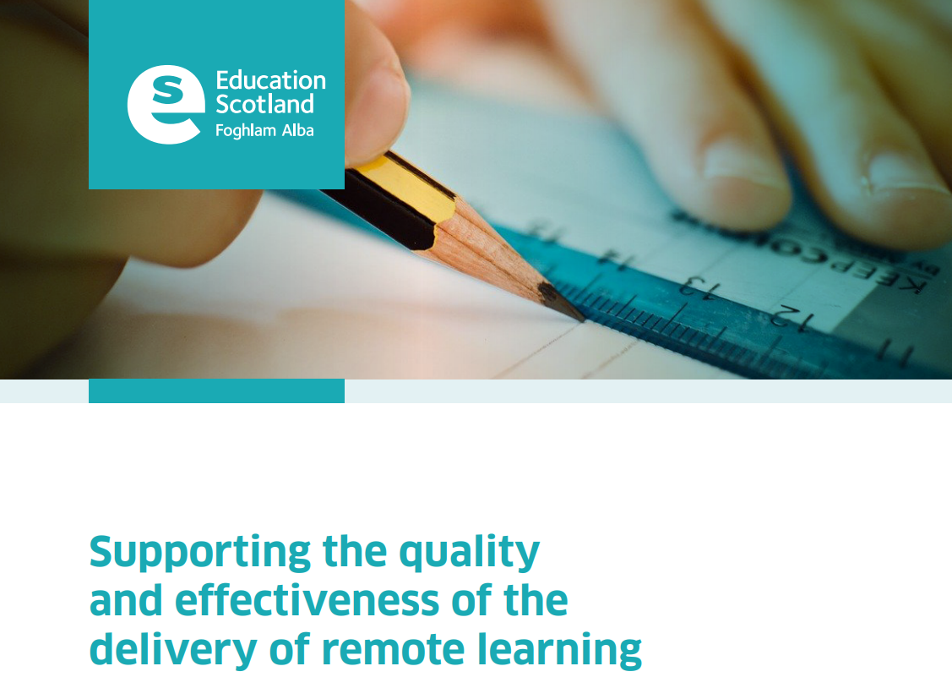
January 2021: Scotland’s Deputy First Minister requested that HM Inspectors carry out a national overview of practice on the delivery of remote learning.
The purpose of the Education Scotland National overview of practice is to:
Learn what is working well and share this widely to celebrate success and support consistency in the quality and effectiveness of delivery of remote learning.
Surface the challenges and/or issues so that these can be addressed, either locally or nationally, as appropriate.
Identify what further assistance is required to continue to improve the delivery of remote learning so that relevant support can be provided at local and/or national level.
Supporting remote learning | Supporting remote learning | National Improvement Hub (education.gov.scot)

Slide 6
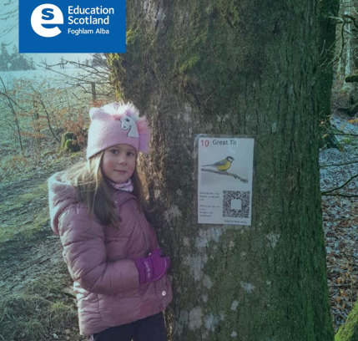
Phase 1 and 2 methodology
Engagement with local authorities, schools, parents and learners
Engagement with local authorities:
focused on local authority planning and guidance for the delivery of remote learning to:
Draw out common themes;
Exemplify approaches being used to address local need including local authority support; and
Identify any further support and any areas for improvement required.
Engaged with all local authorities in Scotland
National overview report to share findings and recommendations
Notes:
Parent and learner national surveys ran between 20 and 25 January 2021.

Slide 7
Phase 1 and 2 methodology
Engagement with schools:
5% sample of school in all local authorities across primary, secondary and special schools
Sample agreed in advance with local authorities
Professional dialogue and reflection with school leaders and, where possible, practitioners through a brief online/telephone discussion focused on:
Talking about what is working in their own context;
Listening to concerns and any challenges; and
Learning what further support is needed.
No direct observation of learning episodes or lesson delivery
Series of national overview reports to share findings and recommendations
Notes:
Parent and learner national surveys ran between 20 and 25 January 2021.

Slide 8
Phase 1 and 2 methodology
Engagement with parents and carers:
Three focus groups to hear views of parents in partnership with the National Parent Forum of Scotland and Connect Scotland
Three focus groups to hear views of learners in partnership with Children in Scotland and Young Scot
22 focus groups with children and young people across a selection of local authorities
Two national surveys, one for parents and one for learners which focused on:
Communication and wellbeing
Resources and equipment; and
Learning and teaching.
Survey resulted in 12,105 responses from parents and 2,667 responses from children and young people.
National overview report to share findings and recommendations
Notes:
Parent and learner national surveys ran between 20 and 25 January 2021.

Slide 9
Phase 3 methodology
This phase focuses on taking a closer look at particular themes emerging from the evidence of Phases 1 and 2. These reports focus on identifying what is working well for schools and local authorities which can be shared to support improvement.
Engagement with local authorities and schools
Themes agreed with the Association of Directors of Education in Scotland (ADES)
All 32 local authorities involved – self nominated for a theme
Local authorities nominated schools which were exemplifying strong practice in the theme
Professional dialogue and reflection with school leaders and, where possible, practitioners through a brief online/telephone discussion
Series of six national overview reports to share findings, emerging strengths and areas for continued improvement.
Notes:
Parent and learner national surveys ran between 20 and 25 January 2021.

Slide 10
National overview of remote learning
Supporting remote learning | Supporting remote learning | National Improvement Hub (education.gov.scot)

Slide 11
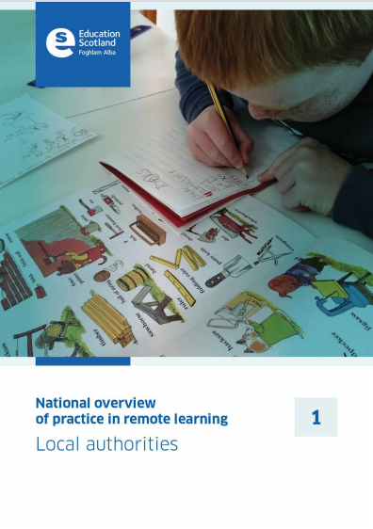
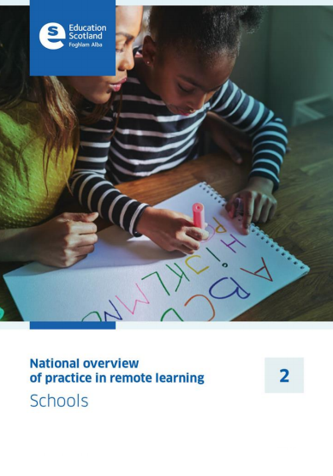
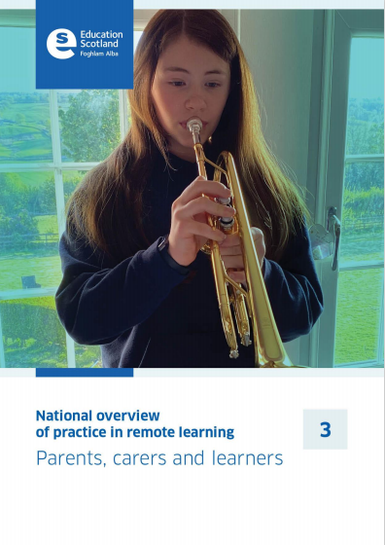
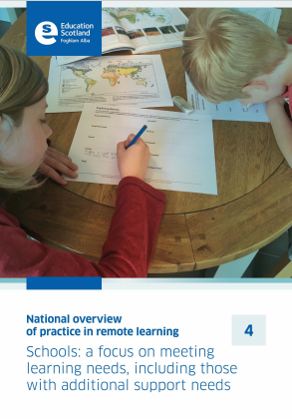
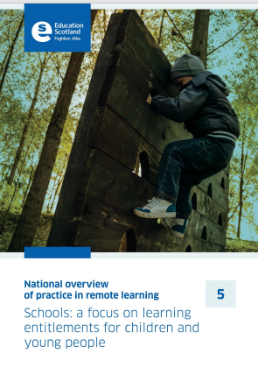
National overview of remote learning reports
National overview of practice: reports | National overviews | Supporting remote learning | National Improvement Hub (education.gov.scot)

Slide 12
Key points arising from Phase 1 and 2
Overall, there is a strong commitment to continually evolve and improve the quality of remote delivery.
Staff have increased confidence in remote delivery and in the use of digital platforms.
Local authorities and schools feel better prepared and more equipped to deliver remote learning.
There is improved engagement with parents and carers and this helps parents to understand better the delivery of remote learning.
Approaches developed by schools to the delivery of remote learning increasingly take account of remote learning entitlements and expectations.
Approaches to supporting the health and wellbeing of children and their families continue, with schools understanding the wellbeing needs of their learners well.
Schools recognise the need for, and are taking steps to provide, a balance between online, digital learning and non-digital activities.
balance varies within and across schools
fewer than half of parents believe that their child has a good balance of live learning and independent activity

Slide 13
Key points arising from Phase 1 and 2
While progress has been made in providing children and young people with a broad range of learning, the breadth and depth of the curriculum remains variable.
challenges in delivering practical subjects remotely
challenges in providing learning that is appropriate for those children and young people with complex additional support needs
Schools are using a variety of approaches to give learners feedback on their learning.
staff find providing appropriate, meaningful and timely feedback remotely to children and young people challenging
quality and quantity of feedback on children’s and young people’s work and progress is variable
There are challenges in relation to the sufficiency and supply of information and computing technology resources, including devices and Wi-Fi access for all learners and staff.
Overall, there are concerns about the demands and impact on staff, learners and parents of remote learning.

Slide 14
Overall key messages
Overall, this series of reports which have been published weekly since 22 January 2021 show that:
Local authorities, schools and parents across Scotland have responded quickly to ensure children and young people continue learning during the period of lockdown.
Local authorities, schools and parents are to be commended for the commitment and effort to deliver learning and teaching remotely in the most challenging of circumstances.
It is clear that local authorities and schools have built on what they have learned from the first lockdown, and have used the experience to consider, develop and implement new ways of working.
Local authorities and practitioners have learned much along the way, proactively finding solutions to ever changing situations and challenges.
Schools are improving the balance and range of activities, including live, independent and pre-recorded lessons.
As to be expected, the delivery of high quality remote learning across schools varies.

Slide 15
Education Scotland
Denholm House
Almondvale Business Park
Almondvale Way
Livingston EH54 6GA
T +44 (0)131 244 5000
E enquiries@educationscotland.gsi.gov.uk
Education Scotland
National overview of remote learning
24th March 2021
For Scotland's learners, with Scotland's educators

