Slide 1

the effect of the pandemic on inspectorates
The Portuguese case
SICI webinar 25th March 2021
Isabel Barata and Rosa Micaelo

Slide 2




Timeline
March / April
2020
May / June
2020
October / December
2020
January
2021

Slide 3

March & April 2020
First cases of COVID-19 disease confirmed in Portugal
Strict lockdown and unprecedented announcement of school closures
Main issues of remote teaching and learning: equity and inclusion
Social and political concerns

Slide 4
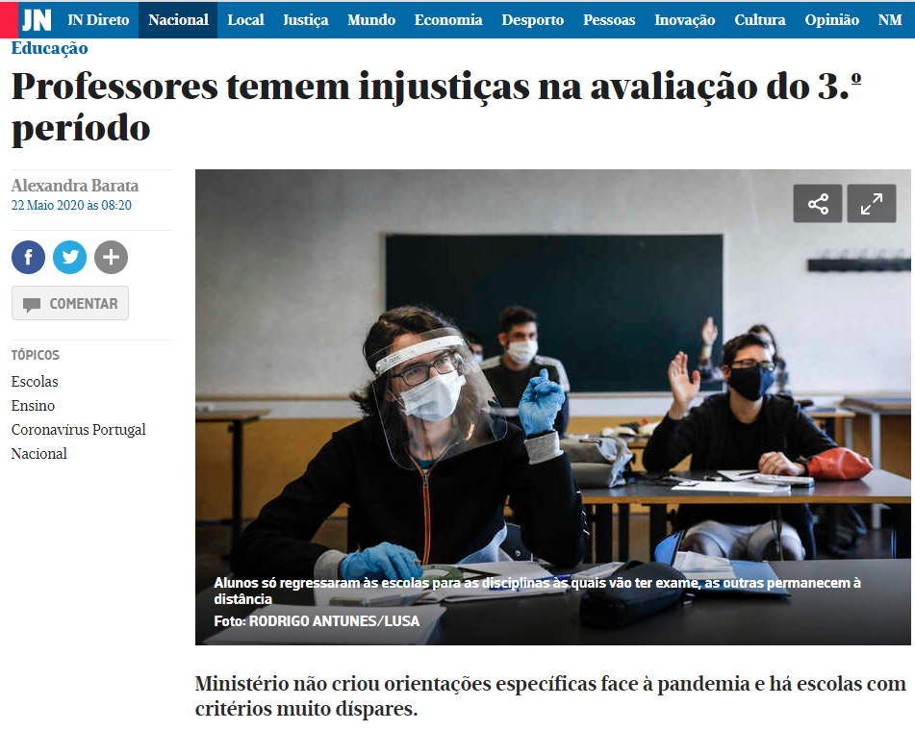
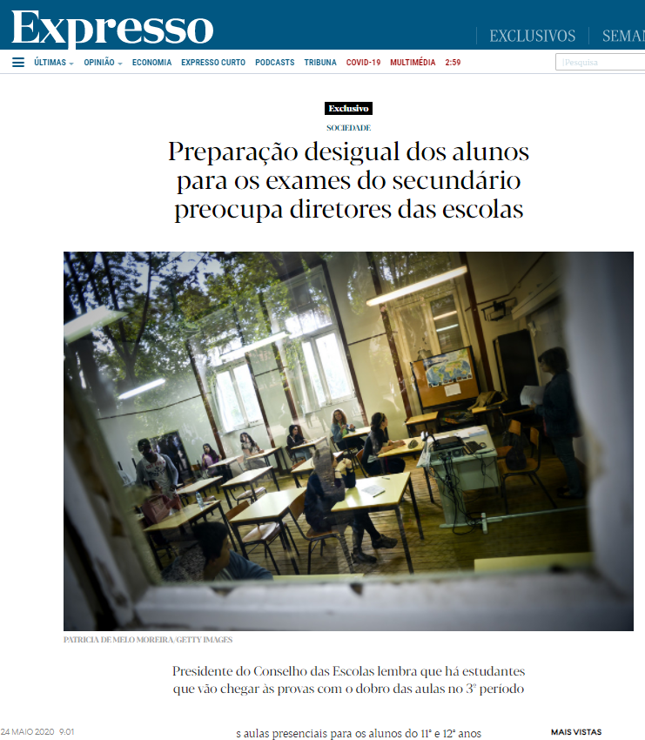
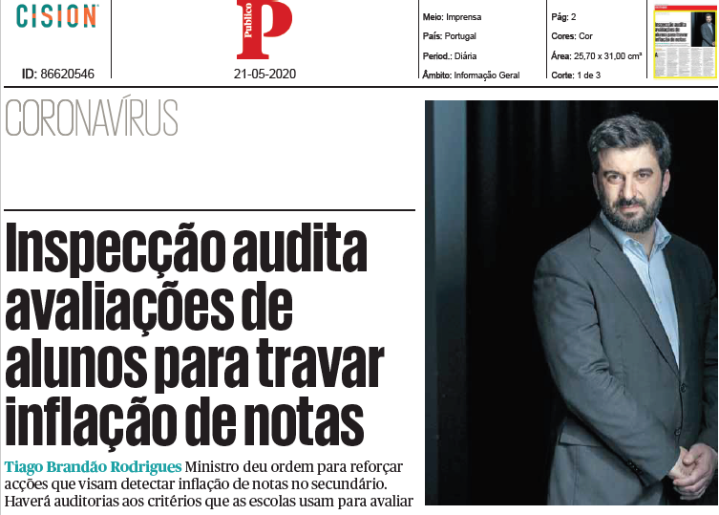
Media news
Notes:
Público - inspection audits student assessments to curb grade inflation
JN – Teachers fear injustice in the assessment of students in the 3rd trimester
Expresso - Unequal preparation of students for secondary school exams worries school principals

Slide 5


May & june 2020
Minister of Education demanded the intervention of the inspectorate
Pedagogic Assessment in the Secondary School – Monitoring Schools Performance (APES)
  21st May – first meeting of the coordination team
  27th May – pilot (4 schools)
  1st June – inspectors online training
  5th June until 23rd June – complete cycle of school APES inspections (total of 100 schools)

Slide 6







Methodological & procedural adaptations
One inspector at school & distance support team
Online questionnaires to students from the 11th and 12th grades
Flexible time management & adjusted schedule
Individual interviews with teachers & principals
School documents in digital support
Aim: to reduce exposure to risks associated with the pandemic
Aim: to triangulate information from different sources

Slide 7

some highlights
The need to supervise the development of pedagogical evaluation in secondary schools (during remote and blended learning) was motivated by the influence of grading on the access to higher education in the Portuguese system.
It aimed to contribute to the assessment of learning in secondary education as a participative, rigorous, and reflexive process for all students.
Inspectors carried out a process of triangulation of information in 100 schools, coming from a range of sources: school documentation, interviews (100 principals and 300 teachers) as well as online questionnaires (5300 students).

Slide 8

some highlights
Positive aspects are related to organizational procedures and/or the establishment of conditions for the development of distance learning.
Aspects to be improved are associated to substantial issues that result from difficulties in integrating pedagogical assessment in the development of the curriculum.

Slide 13

October & December 2020
Reporting & deepening the approach of Pedagogic Assessment in the Secondary School – Monitoring Schools Performance (APES)
  Focused on specific cases of inflation of school grades previously identified
New training sessions for inspectors (via Microsoft Teams: group works, followed by presentation and discussion)
Similar methodological and procedural adaptations used in other inspections

Slide 14

January 2021
Inspectorate Annual Activity Planning for 2021 provides continuity to APES
Improvement of the working instruments used in 2020
  exploratory interviews with parents, students and teachers to confirm and raise new critical questions (via Google Meet)
  reformulation of some items of the questionnaire to be applied to students and testing procedures in a secondary school
  updating the form used to collect and triangulate the information

Slide 15

Thank you
Any questions?

