Slide 1
Teacher evaluation and accompaniment: changes in the French Inspectorate's practices

Slide 2
1. History of Inspectorate practices 2. Changes in the French Inspectorate’s practices – PPCR 3. Assessing the change
Outline

Slide 3
1. History of Inspectorate practices
Inspection today
History of inspection practices in France
Inspections and a teacher’s career

Slide 4
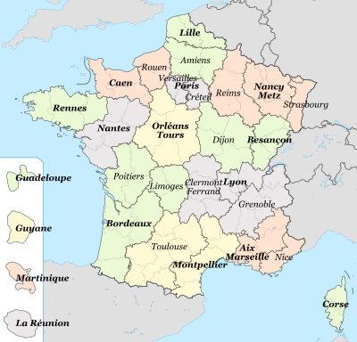
Inspection today : a functional administration
National territory
Regional educational authorities (rector)
Departments (Academic Inspectors)
Notes:
The French territory is divided into 30 reagional educational authorities, including 4 overseas ones. In each one, there are several departments (goverment administrative units). In each regional educational authority, a rector is in charge. He, and increasingly she, colaborates with Academic Inspectors, who have the responsability for Education in one department. Each Academic Inspector works with regional inspectors and National Education Inspectors.

Slide 5
Inspection today
The General Inspection
Oversees the inspectors’ acitivities
Participates in the assesment of the educational system
Territorial Inspectors
IA-IPR : academic inspectors, regional pedagogical inspectors middle school and high schools
National Education Inspectors:
primary schools
National Education Inspectors :
vocational high schools
Notes:
First of all, let’s see how Inspection works today : in France, we have 3 inspection units. Their main responsability is to ensure the quality of education.
The G. I.
Territorial inspectors : The regional pedagogical inspectors are in charge of the secondary schools, in their own subjects.
Some inspectors are in charge of the vocational schools and some others of pupil orientation. They inspect in a whole area of the regional educational authority.
Another unit of inspectors oversees primary schools. They are in charge of a part of a department, which usually represents around 300 teachers and more than 5000 pupils.
All of them ensure the implementation of education policy.
Now, let’s see how this system was built through History.

Slide 6
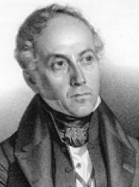
History of inspectorate’s practices
Impose the authority of the State over the country/education
1802 : Napoleon created High schools and General Inspectors
Purpose : control high schools
François GUIZOT
19th century :
One primary school in each village
Primary school inspectors in 1835
1881-1882 : free and compulsory school : Jules Ferry
Notes:
During the late eighteenth and early nineteenth centuries, the Republican State has the desire to install its presence throughout the entire national territory, to develop unity by means of a shared national language, to oppose the influence of the Catholic Church and different corporatisms in education and training.
The republican school responds to this principle by developing a republican state culture.
After the French Revolution, at the beginning of his Empire, Napoleon Bonaparte created the General Inspection, in order to control the quality of education, in high schools.
Throughout the 19th century, the school system grew rapidly : Primary inspection was born in 1835. François Guizot, the Minister of Public Instruction, wrote the law for the creation of a primary school in each village of more than 300 inhabitants (at that time, it was only for boys. School became obligatory for girls in 1850).
The Jules Ferry Laws of 1881 and 1882 established a public system of free and compulsory education.
Throughout the 19th century, Inspection became a strong institution. The state and the school institution became a hierarchical organisation, in a pyramidal vision with policy decided at the top. Public instruction became the way to guarantee the principle of democracy : school was an institution in the Republic, for the Republic.
At that time, the inspectors’ mission was essentially a mission of control.

Slide 7
Changes in the 20th century
1964 : creation of the IA-IPR unit
1968 : State authority and institutions into question
1983 :
=> Teachers were given 2 weeks prior notice
=> Teachers obtained a right to reply.
1990 :
=> New definition of Inspectors’ action
From control to evaluation
Notes:
In the sixties, with the rise of mass education, a new unit of territorial inspectors was created, because the general inspectors couldn’t inspect all the teachers.
Teachers used to fear the visit of the Inspector and did not look kindly on the inspectorate and its practises.
With 1968 social events, Inspection was violently contested. Some teachers refused to be inspected.
In the 1980s, the procedures of inspection were deeply modified :
The inspection was announced generally 2 weeks ahead, the context was taken into account and several visits could be programed before the inspection. The teacher had the right to answer and contest the report, especially if their mark was decreased. He/she could ask for another inspection.
In 1990, a new decree defined the new duties of the inspectors, establishing the two levels where educational choices were made : the State for defining curricula and national goals, and the school which was recognized as having autonomy for the realization of projects. It was appropriate for the body of inspectors to now go beyond the notion of control compliance with official curricula and to evolve towards the evaluation of educational action in the broad sense.

Slide 8
Inspection practices until 2017
In secondary school :
Inspection, and evaluation by the school principal
2 marks :
pedagogical ( / 60)
administrative ( / 40)
In primary school :
1 inspector
1 mark ( /20)
One report, every 3 or 4 years…
Notes:
Until 2017, in secondary school : In their specific discipline, regional inspectors would visit the teachers during the class. They would evaluate them by observing classroom practises. Teachers would be given two marks : a pedagogical mark (by the inspector) following each inspection and an administrative one (by the school head) on a yearly basis.
The Inspector would write a report for the teacher and his administration.
In primary school, the inspector would spend usually around 2 hours in the classroom. Then, the teacher and the inspector would exchange views about what had been observed. The inspector would write a report and give the teacher a mark.
A copy of these reports were filed in the teacher‘s administrative dossier.

Slide 9
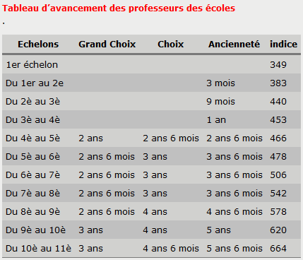
Inspections and teachers’ careers
Notes:
Until 2017, this mark had a real impact, regarding the speed at which teachers could move up the pay scale.
For example, in primary school, here is the picture of the progress of teachers :
According to the mark, a teacher can progress more quickly and get to the next step in 3 years instead of 5 years. Through time, it can make a big difference on the salary.

Slide 10
1. History of Inspectorate practices
CONCLUSION
A means for managing human ressources
A tool of control
A support process
Called into question
PPCR in 2017
Notes:
The inspection system was : a means for managing human ressources, a tool of control, a support process for teachers.
However, in 2013, the General Inspection wrote a report about the teachers evaluation. They questionned the efficency of this system, pointing to big disparities between practicies. The rythms of inspection were very different from one regional educational authority to another, from one subject to another. The system was considered as inequitable.
The marking system was also called into question for its lack of transparency and liability. Finally, it was judged to be an unfair system.
That led to the new system, which started in 2017 : the PPCR : parcours professionnels carrières et rémunérations.

Slide 11
2. New practices P.P.C.R.
What does PPCR stand for?
The reasons behind the change
Identified and known evaluation criteria based on professional skills
How a career rendez-vous works?
How these new practices are innovative?

Slide 12
PPCR ?
What does PPCR stand for ?
The reasons behind the change
Identified and known evaluation criteria based on professional skills

Slide 13
How ?
How a career rendez-vous works
In what way these new practices are innovative
From evaluation to co-evaluation

Slide 14
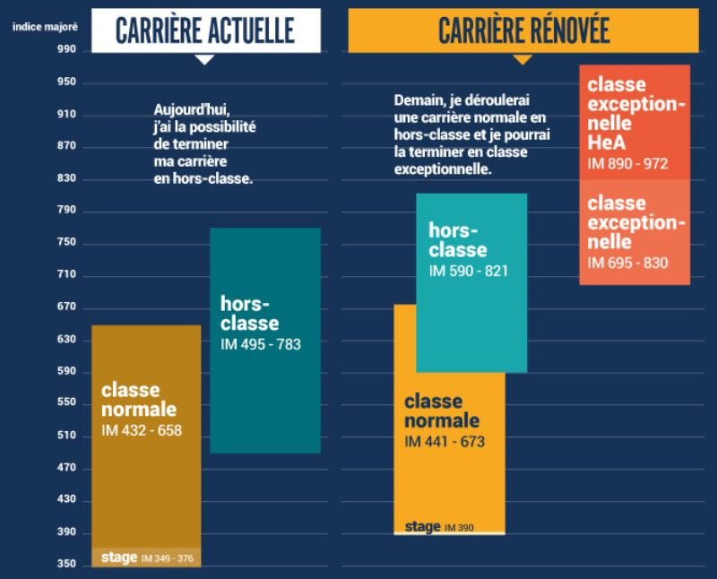
3. Assessing the change
Drawbacks of the new system
Less flexibilty compared to the previous system
Disparities in inspectorate workloads according to the age pyramid of teachers in a given subject
Often less time spent by the inspectorate in any given school
Time constraints can make it difficult for the inspectorate to offer teaching teams a true accompaniment
Fewer teachers benefit from a quicker advance up through the pay scale, but…
(Future) impact on teacher motivation?
Notes:
The new system was introduced at the beginniing of the 2017-2018 school year.
Regarding drawbacks to this new sytem, it would be interesting to look at them from two angles; that of the inspectorate, but also from a teacher’s perspective
One of the criticisms, or maybe frustrations, levelled at the PPCR was the prior notice of 30 days minimum which had to be given to teachers before an inspector’s visit. This could be amended, but only under certain conditions and introduced severe constraints to how inspectors could manage their agenda and deal with other priorites.
It has been observed, at secondary school level, that some inspectors have a heavier workload depending on the age pyramid of teachers. This gives them less time for other dossiers and projects.
Before, inspectors would set their own inspection plan and would often see several teachers in a school (maybe over a two-day period) before meeting with the team in a face-to-face exchange. With the new system, at best, three teachers might be eligible within a school but quite often only one teacher is. This means that inspectors, in order to fulfil all their PPCR obligations, visit up to three schools in a single day, thus making it more complicated to have a real feel for teachers’ needs. It is also more tiring for inspectors who find themselves on the road much longer.
When coupled with other missions and the need to accompany disfunctional teachers, inspectors have little time to organize meetings with teaching teams at the end of a school day. However, should accompaniment be just limited to meeting teaching teams?
We have pointed out how the previous system worked with some teachers being fast-tracked in order to move up the pay scale more quickly than their peers. Following dialogue with teachers’ unions, the PPCR system was introduced and seriously reduces this possibilty. This is countered by the fact that all teachers will have access to the highest pay grades, which was not necessarily the case before.
However, it goes without saying that this can have a serious impact on teacher motivation. Why would a teacher heavily invest time and effort if the financial rewards were minimal? This is a question raised by teachers and school principals alike. If tis question has been raised by some teachers already, it will probaly come to the fore in the years ahead.

Slide 15
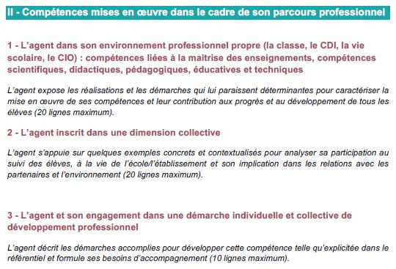
3. Assessing the change
Benefits of the new practices
Career rendez-vous take place at clearly-identified moments during a teacher’s career
A degree of self-assessment
Changes in the feedback process
Global appreciation of teachers’ implication in schools and their professional skills
Richer, more constructive professional dialogue between inspectors and teachers
Richer professional dialogue between inspectors and school management
Notes:
Under the previous system, there were disparities in the length between visits by an inspector. Some teachers benefitted from visits in relatively quick succession, others received fewer visits. There was a perception that teachers in schools far from the centre of the regional authority were passed by. By instauring visits at clearly-identified moments in a teacher’s career, the system is much more equitable.
Under the previous system, a lot of time was given over during the interview to assessing teaching choices during the class which had been observed. Teachers were asked to explain their choices and this constituted professional dialogue. With PPCR, when teachers receive notifcation of the visit-to-come, they are invited – it is not an obligation – to answer a short series of questions on their work practices, which is not just limited to their time in front of pupils. If, during the first year, a significant percentage of teachers did not take the time to assess their own work, this practise has become much more commonplace, allowing teachers to develop a critical analysis of their own practices which can serve as the basis for the dialogue which follows the classroom observation.
Teachers are evaluated according to 11 clearly-defined criteria which are communicated to them and form part of the professional skills which they are expected to master. Whereas before, the emphasis was on what had been observed in the classroom, the professional dialogue between teacher and inspector is more balanced. Teachers, in their self-assessment, are invited to talk about their participation in, and/or organisation of projects within the school as well as how they would like to see their career evolve. This is quite constructive as it allows the inspectorate to have a more rounded opinion of the teacher’s implication in the everyday activites of the school. It also allows teachers to place emphasis on certain points to which they would like to draw the inspectorate’s attention. This can allow the inspectorate to provide advice when it comes to career management and, thanks to a more open and less fraught discussion, can lead to some very pleasant surprises regarding teaching practises.
PPCR has also led to a richer professional dialogue between inspectors and school management. There is no empirical data to support this statement However, informal exchanges with school principals on this subject invariably come to this conclusion. PPCR has been embraced by school principals as a tool for managing human ressources. Furthermore, the dialogue between inspectors and school principals is more developed than previously. Before, the marks given to teachers respectively by the two parties were done so without concertation. PPCR has introduced concertation, thus allowing both parties to have a global appreciation of a teacher’s skills.

Slide 16
Conclusion
Innovation in French inspectorate practices
New system is now in its 3rd year
Some shortcomings of the new system have been addressed
Evolving teacher viewpoint of inspectors’ role, but also how inspectors see their role
Evaluation, valorization and accompaniment
Embedding innovative Inspection practice?
Notes:
This new system is now in its third year, and there is little or no appetite for a return to the previous inspection methods.
Some shortcomings, which had been observed, have been addressed. The notice period has been reduced to fifteen days, which will no doubt introduce a degree of flexibility which had been missing. Furthermore, following feedback from inspectors and school principals, the Ministry made it possible for reports to be longer than the ten lignes which had been intially planned.
Whereas teachers who, during the first year of PPCR, had not received a visit whether it be due to the fact that they were on prolonged sick leave or maternity leave, could benefit from an exchange with an inspector over the phone, it is now possible to visit them in the first month of the following school year.
PPCR is having an influence on how techers view the inspectorate. Where once their visit might be a source of great stress for teachers – and it remains the case for a sizable percentage of teachers, it is increasingly viewed as an opportunity for an open discussion of their practices, projects for the school, for their pupils, and for their own professional development.
These new inspection practices have also had an effect on how inspectors view this specific mission. Having to evaluate teacher performance across a wide spectrum of criteria has encouraged inspectors to take into consideration a global view of a teacher’s practices, instead of being highly focused on classroom practices as in the past. Indeed, contrary to previous inspection reports, we are not allowed to specifically refer to what was observed in class.
So, can we speak of innovative inspection practices being embedded in normal practices in France? It could be argued that there is still room for improvement.
Thanks to the input and agreement of all stakeholders upstream from its introduction, these new practices have been accepted and have already become embedded into the French education system.

Slide 17
Thank you for listening
Any questions?

