Slide 1



Better Inspection for Better Social Inclusion
Strategic Partnership for school education
December 16th 2021
Poitiers
Notes:
<numéro>

Slide 2




Erasmus+ / KA2
Key Action 2: Cooperation for Innovation and the Exchange of Good Practices is all about enabling organisations to work together in order to improve provision for learners and share innovative practices within and beyond the participating organisations.
Under Key Action 2, organisations can apply for funding to work in partnership with organisations from other participating countries.
The projects funded under this Key Action 2 will focus on sharing, developing and transferring innovative practices in education, training and youth provision between participating countries.
Key Action 2 aims to increase the positive impact of European activities at all levels to ensure benefits for the individuals, organisations and countries involved in projects.
Notes:
<numéro>

Slide 3








Partners

Slide 4
Why this project ? ‘BIBESOIN’
‘BIBESOIN’ focuses on the European priority of ‘Social inclusion’.
Priority is given to actions that help address diversity and promote and stimulate social inclusion in mainstream schools, through transnational project meetings and training activities for school inspectors, external school evaluators, directors and teacher and inspector educators.
Strengthening the profile(s) of the teaching profession

Slide 5
Why this project ? ‘BIBESOIN’
The objectives are in line with the priority themes of SICI:
1. Strengthen 'the impact of inspection’ (2018) on social inclusion (How can inspections and external evaluation help to promote social inclusion in mainstream schools?)
2. ‘Innovate practices of inspections’ (2019) about social inclusion (Which are the different methods used?)
3. Optimise the ‘Internal quality assurance of inspectorates’ (2020) concerning social inclusion. (How can we create together a strong European model for promoting and stimulating ‘social inclusion’ in mainstream schools?)

Slide 6
Why this project ? ‘BIBESOIN’
The three strategic objectives of SICI are closely aligned with the priorities chosen for this project:
1. Support improvement of inspectorates and the professional competences of inspectors
2. Promote and support partnership and cooperation between inspectorates and other organizations
3. Actively participate in the international debate about evaluation and quality improvement in education.

Slide 7
Why this project ? ‘BIBESOIN’
The 'training events' and the 'meetings' focused on the 3 sub-objectives of our chosen priority of social inclusion:
Foster the development of social and civic and intercultural competences
Enhance the access, participation and learning performance of disadvantaged learners
Support and assess new approaches to reducing disparities in access to and engagement with digital technologies

Slide 8
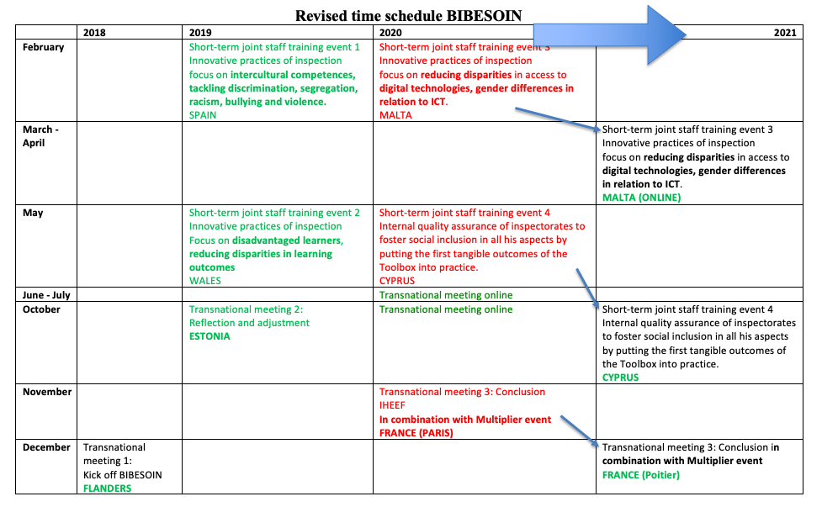

Slide 9
Structure of short-term joint staff training eventS
Each training consisted of 3 days effective working days.
Content:
  National inspection system of the host as ‘friendly consultants’
  Focus on a specific topic (nnovative practices of inspection, internal quality assurance of inspectorates)
  Different sub objectives of 'social inclusion' in regular education

Slide 10
Intellectual Output: TESSIE
The tangible output: the provision of (online) resources for the professional development of inspectors, evaluators, directors as well as for inspector and teacher educators to evaluate and stimulate social inclusion. All information is integrated in the 'Toolbox for Evaluating and Stimulating Social Inclusion in Education' (TESSIE).

Slide 11

TESSIE Toolkit
An overview of the key developments
Notes:
Hello everyone in France ,
Greetings from Wales. I’m sorry I could not be with you in France. But I hope you can hear me loud and clear.
My name is Mamta Arnott, I am appointed as Her majesty’s Inspector for Estyn in Wales.
My role today is to share with you a little bit about the development of The TESSIE toolkit and to provide you with some brief insights into the framework –
as a taster for the multiplier event that my colleague Dominique will tell you about.
<numéro>

Slide 12
Background and influences
National and regional frameworks and tools of project partners
Research and other literature
Training events Spain, Wales and Malta
COVID-19 pandemic
Testing in Cyprus
Feedback from partners and external organisation
Project partners – Estonia, Flanders, France, Cyprus, Spain, Wales and SICI (30+ members)
Notes:
NEXT SLIDE PLEASE
SICI sent out an expression of interest to be involved in a project to look at equity and inclusion in mainstream education.
One of the reasons we decided to be involved in the project as we saw this as an opportunity to share experiences and approaches around addressing disparities in outcomes of vulnerable learners on a multinational level
Erik has already told you about the partners,
What we have developed is a framework that
has been influenced by the national and regional inspection and evaluation approaches of the project partners and the professional experience of these organisations
A wide range of research and literature into equity and inclusion
Sharing of practice through 3 training events held in Spain, Wales and Malta and it was tested in Cyprus in pre school, primary, special and secondary education
We saw that the COVID 19 pandemic had a disproportionately negative impact on the education and wellbeing of disadvantaged learners – so we adapted the framework in the light of schools experiences during the pandemic and research carried out during this time
And we have received feedback from partners, such as schools, SAVE the children and University Researchers ,
We are committed to developing TESSIE
<numéro>

Slide 13
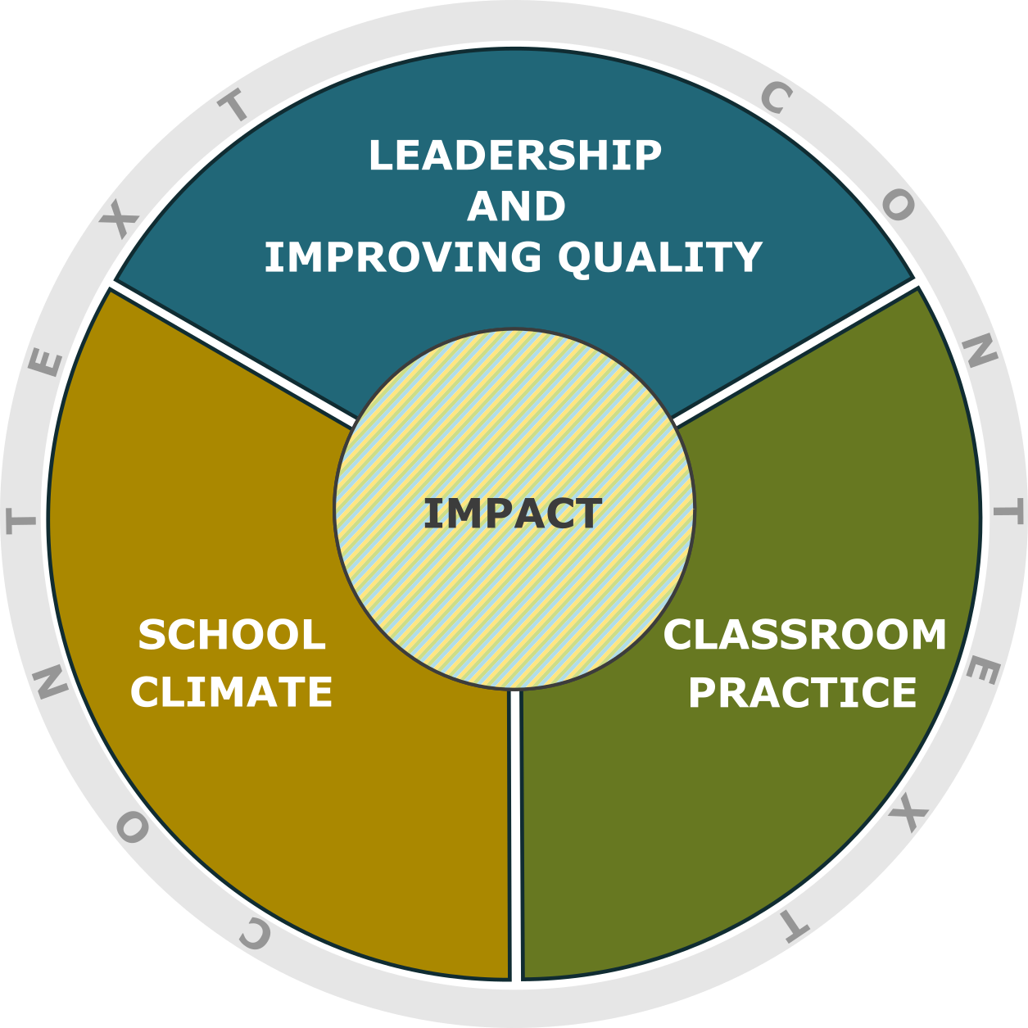
Adapt to context
For example:
Socio economics
Resources
National policy framework
Profile of learners
Parents and home environment
Experiences and skills of staff, leaders and governance
Notes:
NEXT SLIDE PLEASE
So now let me give you a small snapshot of the framework …
One of our most important findings when we tested the framework in Cyprus is that it is important to know the context of the school when using it
… it’s important that inspectors and evaluators understand how context can determine the decisions that leaders and school staff make on a day to day basis
This does not represent a lowering of the bar, but understanding what needs schools have to meet, what autonomy they have and what systems are in place to support them
By context we mean….
Context –
socio-economic and other characteristics of the local area
available resources
policy and legal background
It can also refer to
Profile of
learners (gender, identity, language competence, special educational needs)
parents, home environment (such as socio economic background, access to facilities such as pens, writing materials, technology)
staff (such as pedagogical skills and expectations of learners),
the capacity of leadership and governance – experience and composition
You will see that the framework primarily covers four areas of a school’s work….
The framework includes evaluation criteria for Leadership, school climate classroom practice… and also impact
<numéro>

Slide 14
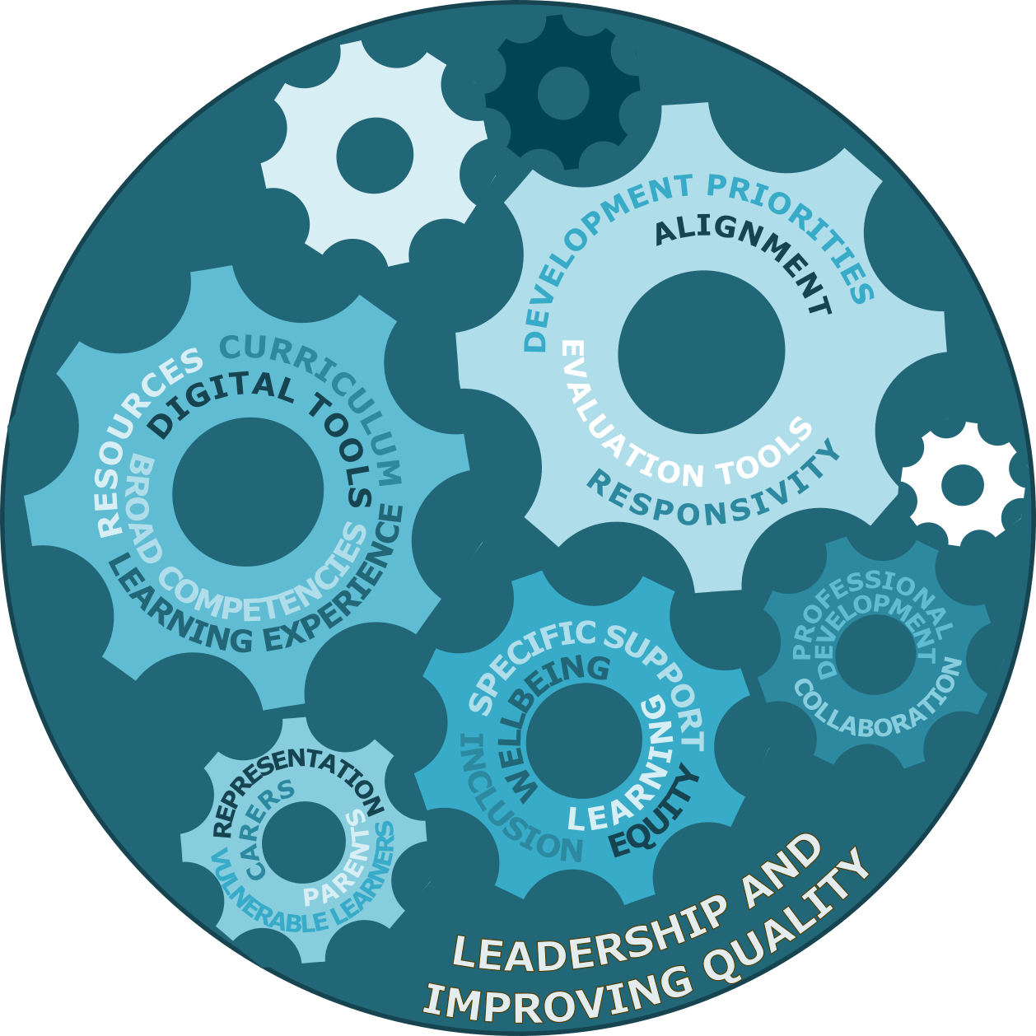
Leadership
Examples:
Vision
Track record of improvement
Use of resources
Curriculum meeting learners’ needs and prioritising competencies, e.g. skills
Professional learning for staff
Agility of leadership to meet learners’ needs in times of crisis (e.g. pandemic)
Notes:
NEXT SLIDE PLEASE
Under leadership we ask a wide range of questions….
Do leaders have a clear vision for inclusion and equity? How well is this communicated and shared with other stakeholders?
How effectively do leaders evaluate the school’s inclusive practices?
To what extent does the school demonstrate a good track record of improvement in inclusion and equity?
How effectively do leaders plan for and use available resources (for example physical, financial and human resources) to address the school’s priorities related to inclusion and equity?
This could include any special grants that they receive because of the Socio economic deprivation or special educational needs of their pupils
How well do leaders ensure the school develops progressively learners’ broad competencies, e.g: numeracy, literacy, digital literacy, lifelong and collaborative learning skills?
How well do they involve community parterns, parents and how well do they seek the views of all stakeholders
As a result of covid, the framework also asks questions around the agility of leadership to ensure that learners do not fall behind in unexpected circumstances, for example long term illness or unexpected school closures
<numéro>

Slide 15

Climate
For example, how well does the school…
embrace equity and diversity as a positive feature?
support learners to develop socially and emotionally?
remove barriers to secure high levels of behaviour, attendance and participation in learning and school life
work with external partnerships, to reduce barriers, to enrich and stimulate an inclusive environment?
adapt its inclusive practices in unexpected and challenging situations?
Notes:
NEXT SLIDE PLEASE
In school climate, we have criteria that prompt us to ask
How well does the school embrace diversity as a positive feature?
3. How well do staff support learners to develop socially and emotionally, and to develop healthy and inclusive relationships with their peers and their teachers?
4. How successful is the school in removing barriers for vulnerable learners.. For example to secure strong school attendance,
5. work with external partnerships and the local community, to reduce barriers?
6. adapt its inclusive practices in unexpected and challenging situations, for example to secure continuity in wellbeing and participation in learning
<numéro>

Slide 16
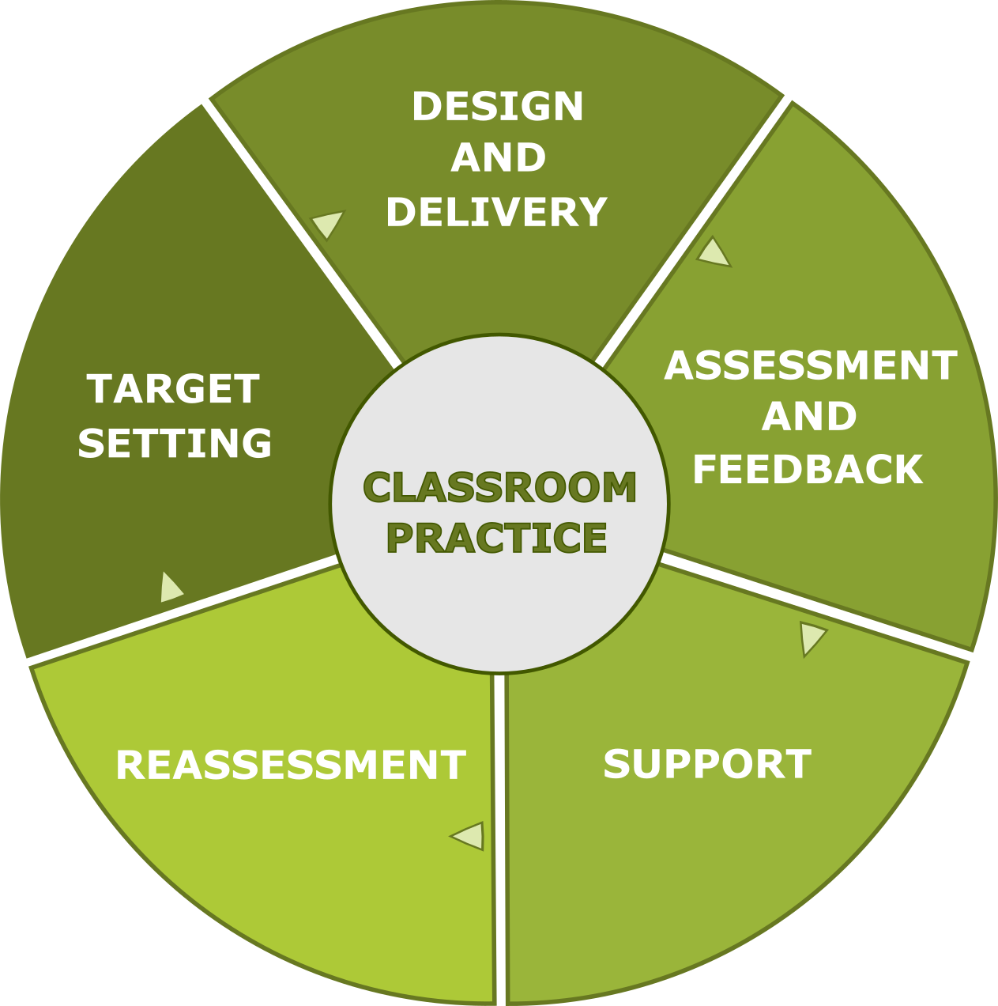
Classroom practice – for example, how well do teachers….
know their learners…and their needs?
use starting points to set appropriate goals?
create an inclusive and safe environment?
employ a range of appropriate teaching, learning and assessment approaches?
develop learners’ language and digital literacy skills?
how effectively is digital technology used?
Notes:
NEXT SLIDE PLEASE
How well do teachers and other educational staff
know their learners, and in particular their specific educational, social and emotional learning needs?
use learners’ starting points to set achievable and challenging goals?
create an inclusive and safe environment, in which all learners feel confident to take risks?
employ a range of appropriate teaching, learning and assessment approaches to meet the needs of all learners
develop learners’ language and digital literacy skills necessary to access learning, and express their ideas, thinking, and emotions
Is digital technology used to reduce barriers, engage learners, ensure strong progress in learning
<numéro>

Slide 17
Impact on learners and staff
E.g. to what extent do learners…
feel safe, for example from harm or bullying?
make good progress from their starting points?
feel accepted, respected and that they belong to the school community?
progress successfully on to appropriate education, training or employment?
E.g. to what extent do staff have a secure understanding of…
child development and psychology?
the learning process of learners with special educational needs?
a wide range of appropriate pedagogical approaches to meet the needs of all learners?
Notes:
NEXT SLIDE PLEASE
And as I mentioned at the beginning,
It is important to consider what difference is the school’s work making? What impact does it have on learners engagement and progress?
E.g. to what extent do different groups of learners…
feel safe, for example from harm or bullying?
make good progress from their starting points?
feel accepted, respected and that they belong to the school community?
progress successfully on to appropriate education, training or employment?
And what impact does it have on the professional practice of its staff.
On their understanding of
child development and psychology?
the learning process of learners with special educational needs?
a wide range of appropriate pedagogical approaches to meet the needs of all learners
Thank you very much for listening to this whistlestop tour of the framework… there is so much more to share with you about the framework and I hope that this has provided you with a taster of more to come in Potiers in December when we will share the framework in its entirety with you. .
<numéro>

Slide 18
Possible evaluation methods
Notes:
(When evaluating a school’s provision, adapt your evaluation methods to the time available to you and your lines of enquiry.
You can use the questions to develop your own tools…)
<numéro>

Slide 19
Interviews and discussions
Finances
School’s self evaluation and improvement planning
Questionnaires
Teaching, learning, environment
Learners’ work
Key documents and data
Professional learning
Notes:
Interviews and discussions with pupils, staff, parents/carers, teachers, governors, leaders (… for example, you could use the questions to develop interviews and discussions, for example with pupils, parents or leaders
Questionnaires (or to carry out questionnaires with parents, pupils and staff)
Observe teaching and learning, the school environment
(The reflective questions may help you design a tool for observing teaching and learning in the classroom, or to record observations of the school environment)
Review learners’ work (You may want to review learners work or other key documents in the school, such as school policies or performance information, tracking data. The criteria in the questions can help you focus your inquiry
)
Key documents, including curriculum plans and school policies
Data, including tracking data
The school’s own self evaluation and improvement planning processes (A review of the schools own self-evaluation and improvement planning processes might help inspectors understand how well the school evaluates its provision for vulnerable learners and plans for further improvement)
Finances and grants (You could include a review of the school’s finances to see how well it uses its finances and any grants to support disadvantaged learners)
Professional learning offer (inspectors may also want to review a school’s professional learning offer for teachers to see how well it plans to improve the inclusive practices of teachers and staff)
These are just some examples of methods of evaluation that you may want to you. You should always only use the most appropriate methods for your investigation.
This text covers 3 symbols
Please use the symbol already provided, or something similar
<numéro>

Slide 20
Reflections of a partner
- Flanders/Belgium –
Notes:
<numéro>

Slide 21
Pratical use of the tessie toolbox
Use of the toolbox to be integrated into our inspection instruments for the external evaluation of schools.
It provides added value to reinforce the evaluation of the following aspects:
  INCLUSION
  EQUITY
  PUPILS’ GUIDANCE (support provided to pupils)
These aspects are essential and compulsary within every evaluation (new legislation).
<numéro>

Slide 22





Adaptation within our framework
Improving quality
and leadership
Guidance principals
Classroom practice
Evaluating inclusion and equity
<numéro>
Notes:
Het blauwe tandwiel
de kwaliteit van de onderwijsleerpraktijk (O-schalen/OV4-schalen/H-schalen)
situeert zich op substantief niveau
deze schalen kunnen gedeeltelijk of volledig of niet meegenomen worden in een DL (indien de schalen niet meegenomen worden, wordt er toch steeds een substantief onderzoek gevoerd, met andere substantieve schalen)
Het groene tandwiel
omvat de kwaliteitsontwikkeling
situeert zich op systeemniveau
kwaliteitsontwikkeling is steeds onderdeel van de DL (dit kan met alle of slechts enkele K-schalen zijn)
Begeleidingsprincipes: waarom?
Vanuit HGW (wetenschappelijke onderbouwing); niet expliciet opgenomen in de regelgeving maar wel in opbouw kaders
De begeleidingsprincipes kunnen gedeeltelijk of volledig of niet of breed/smal meegenomen worden in een DL (flexibiliteit in functie van het gedifferentieerd doorlichten)
De beoordeling van de begeleidingsprincipes kan gevoed worden vanuit verschillende bronnen. Dit kan de onderwijsleerpraktijk zijn voor één/meerdere vakken/leergebieden, dit kan ook een thema zijn (vb vrijheidsbeperkende maatregelen, IAC, POAH/TOAH,…) of vanuit specifieke onderzoeksdaden (gesprekken, documenten, observaties) naar het begeleidingsprincipe.
<numéro>

Slide 23
REFLEctIONS FROM THE SPANISH PARTNER
IES MONASTIL is the only school in the project.
We are the critical friend.
Our role has been to provide:
Documents from our inspection system.
Information and data about our Education Department
A field for testing the tool and proposals for its improvement.
A critical outlook.

Slide 24
REFLEctIONS FROM THE SPANISH PARTNER
CONCLUSIONS:
-Our inspection has to respect a stringent framework. From our perspective as school leaders, we feel our inspection could provide more feedback. However, from our participation in this programme we now know the complexities of the inspecting mechanism.
-We feel we should have specific training about how to cope with the real issues to be able to solve the situations we face every day at school.
-We believe inclusion should have a wide approach to embrace all aspects and members of the educational community: gifted students, gender equality and identity, minorities, family issues and legal matters… a proposal for a follow up project???

Slide 25


Reflections of a Partner
- Estonia -
Estonia hosted a transnational meeting in October 2019
reflection and adjustment

Slide 26
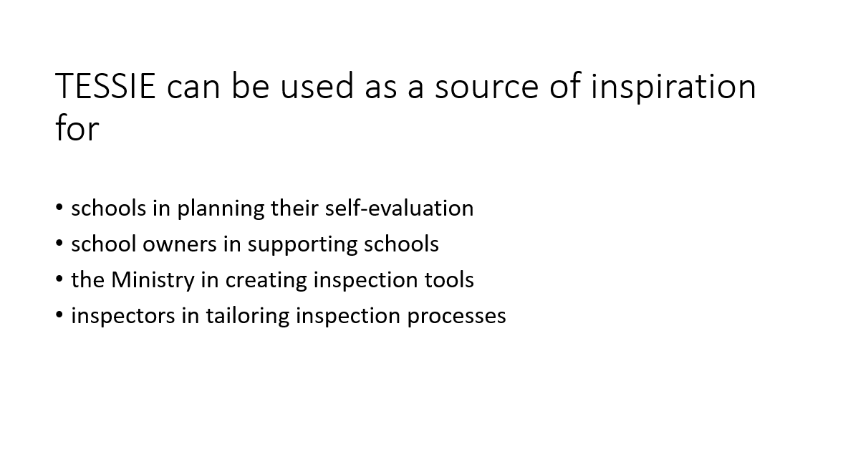

Slide 27
DIRECTORATE For quality and standards in education malta
Current national standards similar to the main key areas of the TESSIE tool kit
The TESSIE tool kit will be used by the QAD to revisit national standards to better evaluate and support inclusive practices in schools.
The tool kit can be the basis of a wider framework for a thematic review on inclusive education.
The tool kit can be disseminated with school leaders to be used as a reflective tool when carrying out their self evaluation.
The tool kit will be shared with other departments including the National School support services.
Notes:
<numéro>

Slide 28
DIRECTORATE For quality and standards in education malta
The tool kit will provide inspectors opportunity to take more into account the context the school is operating in.
The tool will also allow officers the possibility to reflect more on the impact of inclusive practices on learners and staff.
The tool kit can also help to modify the external review tools used by inspectors such as lesson observation sheets, questionnaires and interview questions.
Notes:
<numéro>

Slide 29

Reflections from
Cyprus

Slide 30
During the training event in Cyprus, in October 2021, we had the opportunity to examine and test the TESSIE Toolbox:
With Cypriot headteachers
With Pre-Primary and Primary Education Inspectors
With people from the Ministry of Education and Local Education Authorities

Slide 31
The future… (1)
School systems can adapt the statements according to their own content.
Each country can translate the TESSIE Toolbox into its own language.
Inspectors and schools may use a part or the whole questionnaire.
Inspectors may use it during their visits to schools and encourage teachers to:
- Study more on students and family profile
- Implement personal goals for each student
- Use different approach in classroom, in order to
meet the different profile of each student (differentiation).

Slide 32
The future…(2)
Schools can use the Tool at the beginning of the school year as a roadmap for the creation of the school action plan.
Then, it will be used for school self evaluation.
School Inspectors will use the tool to assess and evaluate the school policy on Inclusion.
Policy makers can use schools and inspectors' experiences in order to implement national guidelines regarding inclusion in all levels.

Slide 33
Thank you
Panayiotis Kyrou
Inspector of Primary Education
Cyprus
pkyrou@cytanet.com.cy

Slide 34


Slide 35


Slide 36
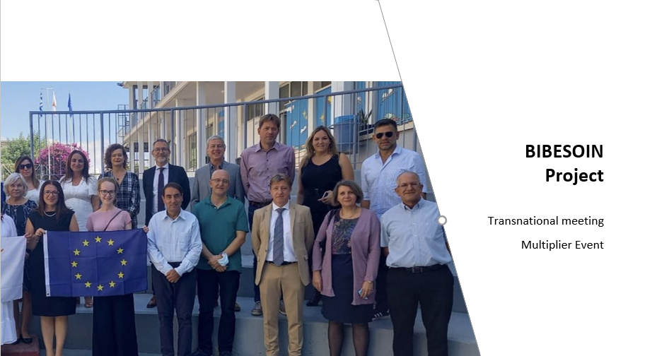

Slide 37


Dissemination
TIME for questions….???

Slide 38
Dissemination
And our website:
https://www.sici-inspectorates.eu/Activities/Projects/TESSIE

