Slide 1
Launching SICI’s Year on Impact of Inspection
Chantal Manes-Bonnisseau
Gordana Capric
SICI executive committee
Malta, general assembly, 2017

Slide 2
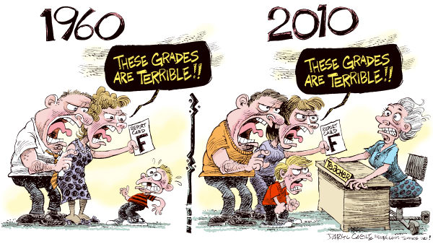
Then and Now

Slide 3
Then and Now

Slide 4
Launching SICI’s Year on Impact of Inspection
Changes in the context we work in, which we cannot ignore :
International environment
Governance through outputs
Governance through results
Greater responsibility of educators
School has a duty to make all students succeed.

Slide 5
Launching SICI’s Year on Impact of Inspection
Responsibility has led to the development of evaluation processes, tools and agents.
Multiplication of new players, both on national and international levels in charge of evaluation and quality assurance in the field of education.
What role can we/ do we/ inspectors want to play in this new environment?
If you want to have a say, we need to speak.

Slide 6
Launching SICI’s Year on Impact of Inspection
Focusing on a priority theme every year
Building knowledge,
Sharing this knowledge
Within the SICI community,
Outside the SICI community,
In order to contribute to informed decisions and policies.
And to the success and well-being of students.

Slide 7
Launching SICI’s Year on Impact of Inspection
Impact of Inspection
At the centre of our professional identity
Not a new theme for SICI
some research exists....

Slide 8
Launching SICI’s Year on Impact of Inspection
Articles – Impact of school inspection
Education & Educational Research – 235 Journals
Publishers
Sage Journals – 95
Springer-Link – 32
Emerald Insight – 20
Science Direct – 15
Wiley – 14
Search Engines
EBSCO – 66
JSTOR – 16
Google Schoolar – 73
Other resources
ERIC – 165
TALIS - The OECD Teaching and Learning International Survey
OECD - Synergies for Better Learning: An International Perspective on Evaluation and Assessment
176
Notes:
Publishers publish several listed educational journals with high factor impact.
Searching machines usually list popular but less important resources from researcher prospective.
ERIC - Education Resources Information Center
Examples of the journals
Impact Factor (from 6.257 till 0.118)
Educational Psychologist, IF 6.257
Review of Educational Research, IF 5.263
Educational Research Review, IF 3.839,
Educational Researcher, 3.827
American Educational Research Journal, IF 2.931
Educational Evaluation and Policy Analysis, IF 2.254,
Review of Research in Education, IF 1.727
School Effectiveness and School Improvement, IF 1.491
Educational Review, IF 1.464
Journal of research on educational effectiveness, IF 1.310
Educational Measurement: Issues and Practice, IF 1.419
Journal of Educational Research, IF 1.197
British Journal of Educational Studies, IF 1.133
......
Journal of Psychologists and Counsellors in Schools, IF 0.118

Slide 9
Launching SICI’s Year on Impact of Inspection
Articles - Impact of Inspection
School improvement
Student achievement results
Side effects
intended strategic behaviour
unintended strategic behaviour
emotional impact on school staff members
OECD research: perception of Evaluation by teachers.

Slide 10
Launching SICI’s Year on Impact of Inspection
Lessons learned
There are limited number of studies of impact of school inspection.
Many of them published in English describe systems in several countries (e.g. GB, NL, FI, BE, a very few such as DE, FI, NO, CZ).
Most of them describe negative effect or has no impact of school inspection at all.
Most of the researches are methodologically based on surveys or qualitative research conducted on small samples (not representative). Although researchers are aware of methodological limitation and emphasize it. In spite of that the conclusions are the most cited parts of researches.
Research results became foundation for decision making, thus it is important to collect as many relevant evidence as possible in order to explore the impact in debt.

Slide 11
Launching SICI’s Year on Impact of Inspection
Conclusion – Why the theme of Impact of Inspection?
It is at the centre of our professional identity
We need to build on what we already know
We need to confront what we think to what evidence says
We need to develop a clear message
We need to speak for ourselves, to communicate this message.

Slide 12
Launching SICI’s Year on Impact of Inspection
Main Goal
Publication of a report at the end of 2018
Summary of research and exchanges within SICI
Good practices in different countries
Identification of possible levers of improvement

Slide 13
Launching SICI’s Year on Impact of Inspection
Organisation of the year
Workshops will focus on this theme and address one specific aspect.
November 13-14, 2017: Paris
March 26-30, 2018 :Luxemburg
September 17-19, 2018: Scotland
November 1-2, 2018: Belgrade: Wrap up conference
Team of writers: three inspectors, part of their training
Role of national coordinators

Slide 14
Looking forward – GA in Serbia

Slide 15
Launching SICI’s Year on Impact of Inspection
Thank you for your attention.

