Slide 1
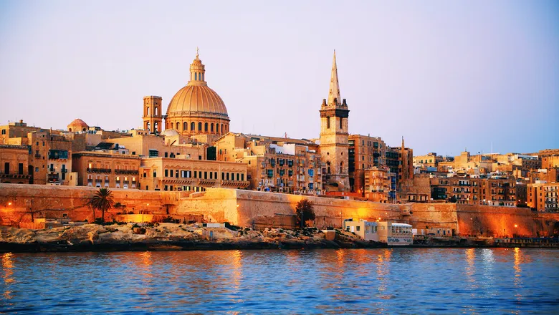
General Assemby 2024 – Malta

Slide 2
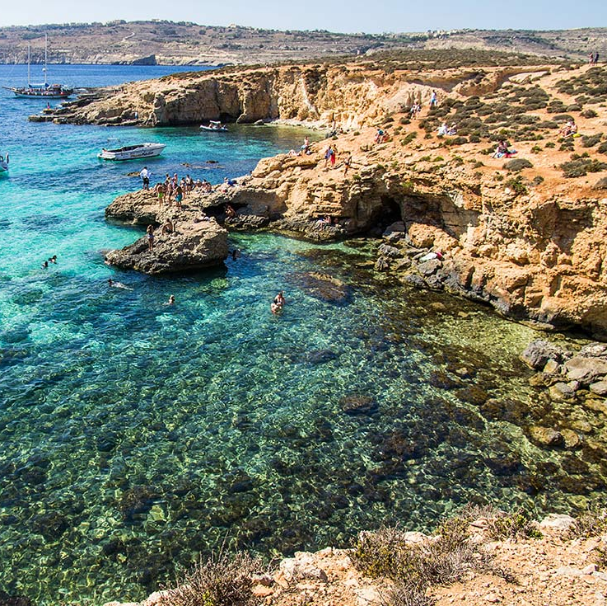
The Maltese Islands
Archipelago composed of 3 islands – Malta, Gozo, Comino
Area: 316 km²
Capital City : Valletta
Population 2023 – 535,000
Official languages : Maltese and English
Roman Catholic – 365 churches in Malta and Gozo
Rich culture influenced by its varied and interesting history

Slide 3
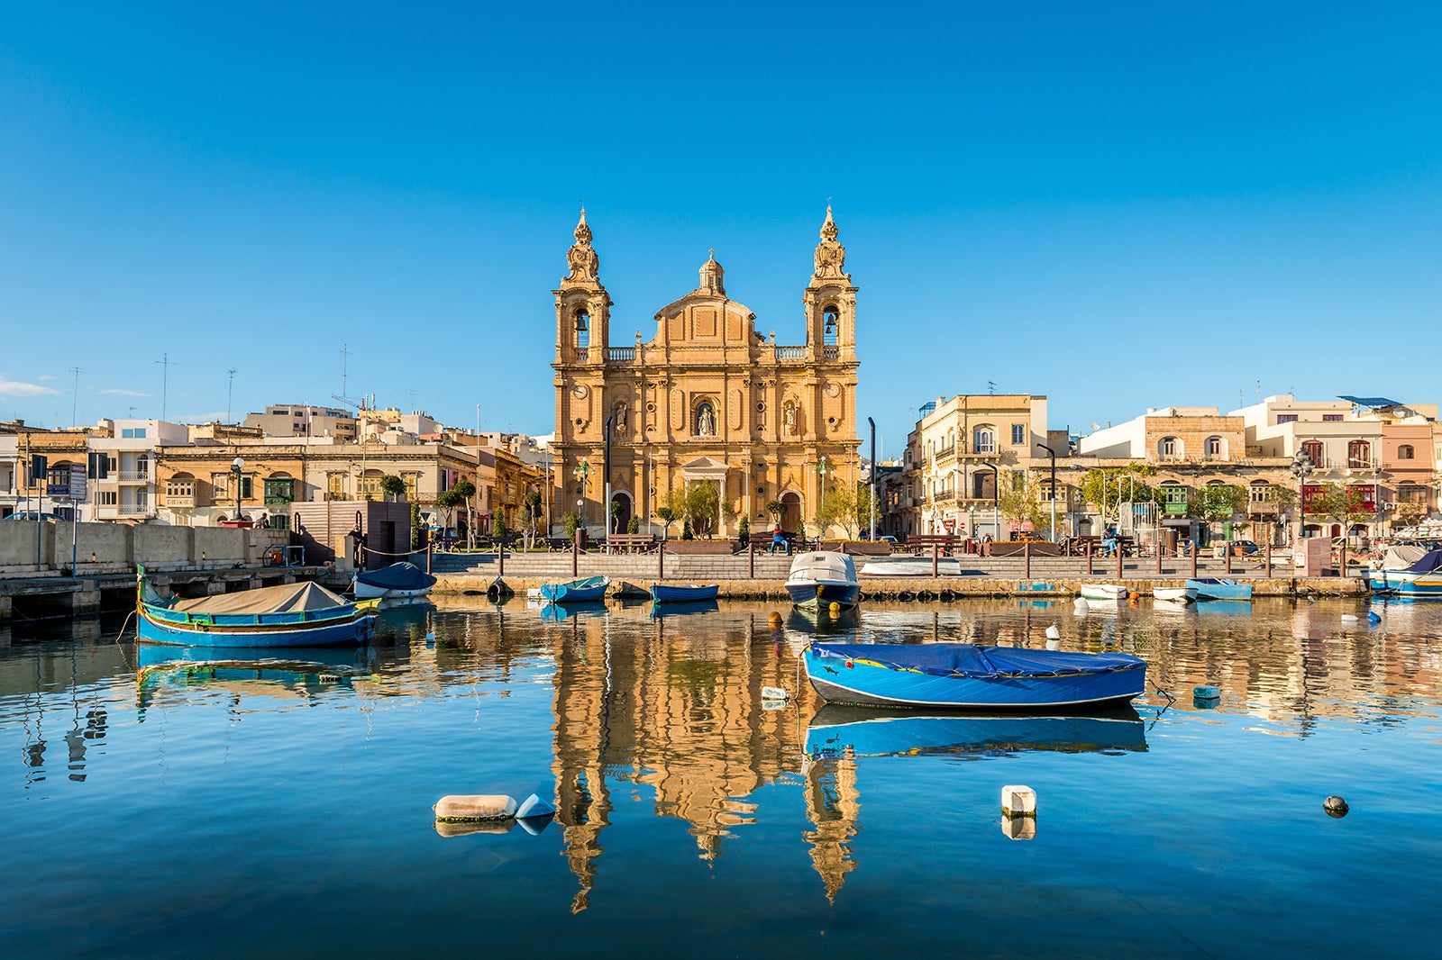
The Maltese Education System
194 Childcare Centres (0-3)
101 State Schools (34,762 learners)​
52 Church Schools (16,885 learners)​
38 Independent Schools (8,448 learners)​

Slide 4
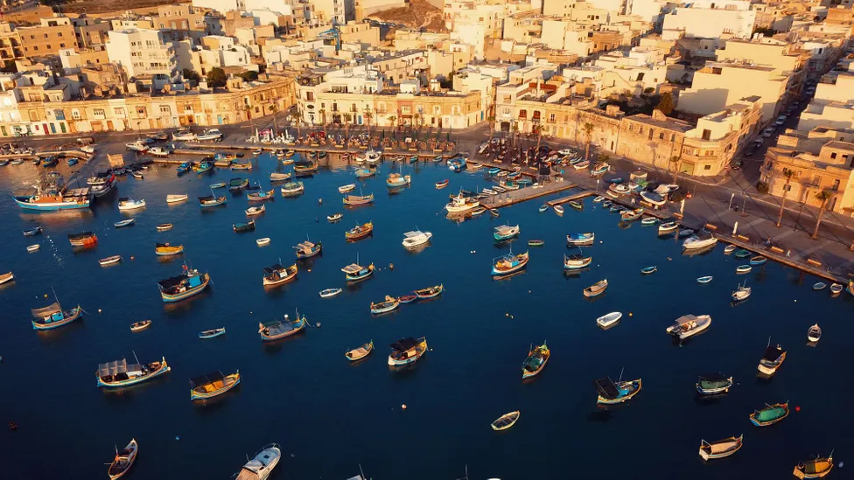
The Directorate for Quality and Standards in Education (DQSE)
National Regulator for pre-compulsory and compulsory education (0-16)
Responsible for monitoring and evaluation of educational provision but also issuing of school licenses.
National Framework for QA and National Standards launched in July 2023
Currently participating in the STESSIE project – Workshop held in Malta in October 2023.

Slide 5
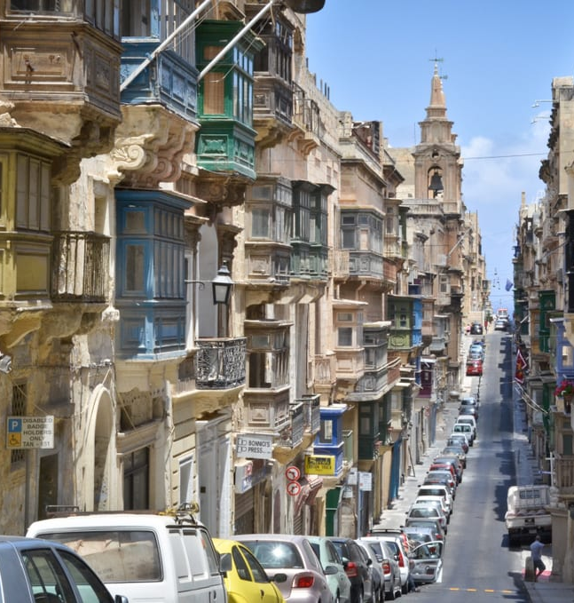
Malta’s changing educational environment
Multiculturalism in schools; understanding and embracing the change.
Digital literacy and AI in schools; increasing accessibility for all
Inclusion and equity for all; process of reculturing and redefining understanding.

