Slide 1
Does school data pass the test? An Ofsted perspective of data and inspections
Mike Howe, Head of Data Analysis for Schools, Ofsted
SICI Workshop
21st September 2023

Slide 2
To answer this we will look at….
How is school data used in inspection?
How does a schools performance data relate to school inspection judgements?
How can school data lead to unintended consequences?

Slide 3
How data and inspection work in Ofsted

Slide 4
School inspection in England
There are 22,000 state-funded schools
Regulated by the Department for Education
Inspected by Ofsted every 4 years
Inspection is underpinned by the Education Inspection Framework (EIF)
Inspectors will look at evidence gathered on inspection
Inspection grades can have far reaching consequences

Slide 5
The Education Inspection Framework (EIF)
Overall effectiveness
Quality of education
Intent
Ambition
Behaviour and attitudes
Attitudes to learning
Behaviour
Personal Development
Spiritual, moral, social and cultural development
Leadership and management
Exclusions
Attendance
Bullying
Citizenship and modern British values
Careers guidance
Curriculum design, coverage and planning
Implementation
Curriculum delivery
Teaching
Assessment
Attainment and progress
Destinations
Impact
Vision and ethos
Staff workload & well-being
Off-rolling
Governance / oversight
Safeguarding

Slide 6
Graded judgements
We use a four-point grading scale in all inspections to make the principal judgements.
Inadequate
Requires Improvement
Good
Outstanding

Slide 7
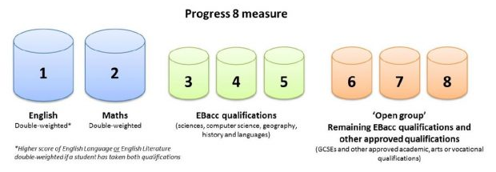
Performance data in England
Primary school exams (around age 11):
Focusing on achievement on Reading, Writing and Maths.
Reports on percentage of pupils who achieve expected or higher standard.
Reports on both attainment & progress based on teacher assessed grades at around age 7.
Secondary school exams (around age 16):
Focus on achievements in range of GCSE subjects
Pupils receive scores 1-9 grades.
English & Maths, 3 science/humanities/languages subjects as well as 3 other subjects make up Progress 8.
Pupils and schools receive a “Progress 8 score” which
demonstrates how well they have performed based
on their prior attainment from age 11.

Slide 8
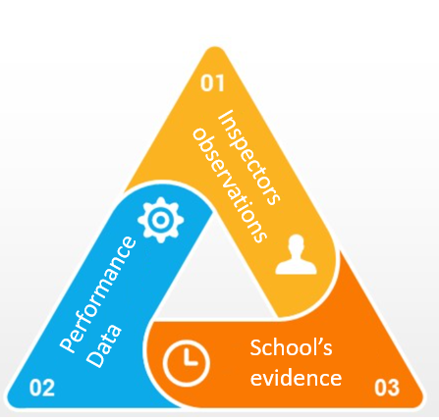
Performance data is used for triangulation

Slide 9
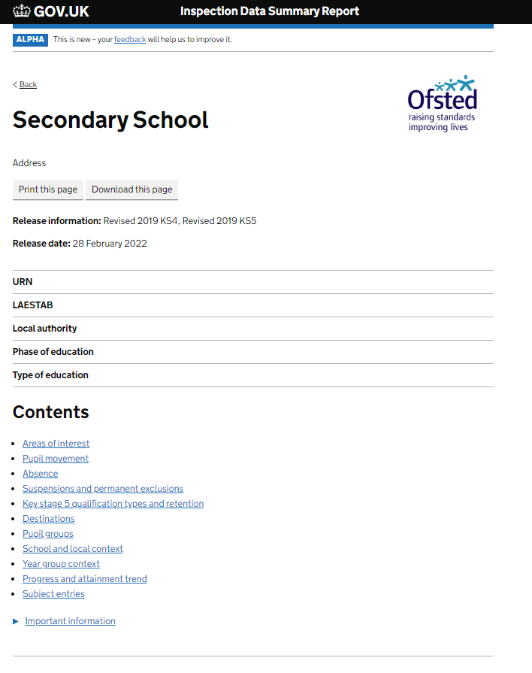
School Pre-Inspection Analysis
Schools ‘Inspection Data Summary Report’ (IDSR)
Data driven insight for inspectors, summarising what is important.
Reduces inspector time analysing data and improve consistency.
Data is starting point for an inspection, the IDSR helps provide the context but is not the only evidence inspectors will look at.
Contains contextual information as well as performance data:
Pupil Characteristic data
School workforce data
Absence & exclusion data
Financial data
Built in an automated HTML report – 22,000 schools, 4,500 inspections per year
Shared to inspectors and schools.
School inspection data summary report (IDSR) guide - GOV.UK (www.gov.uk)
The main product for school Inspection, used since 2017/18

Slide 10
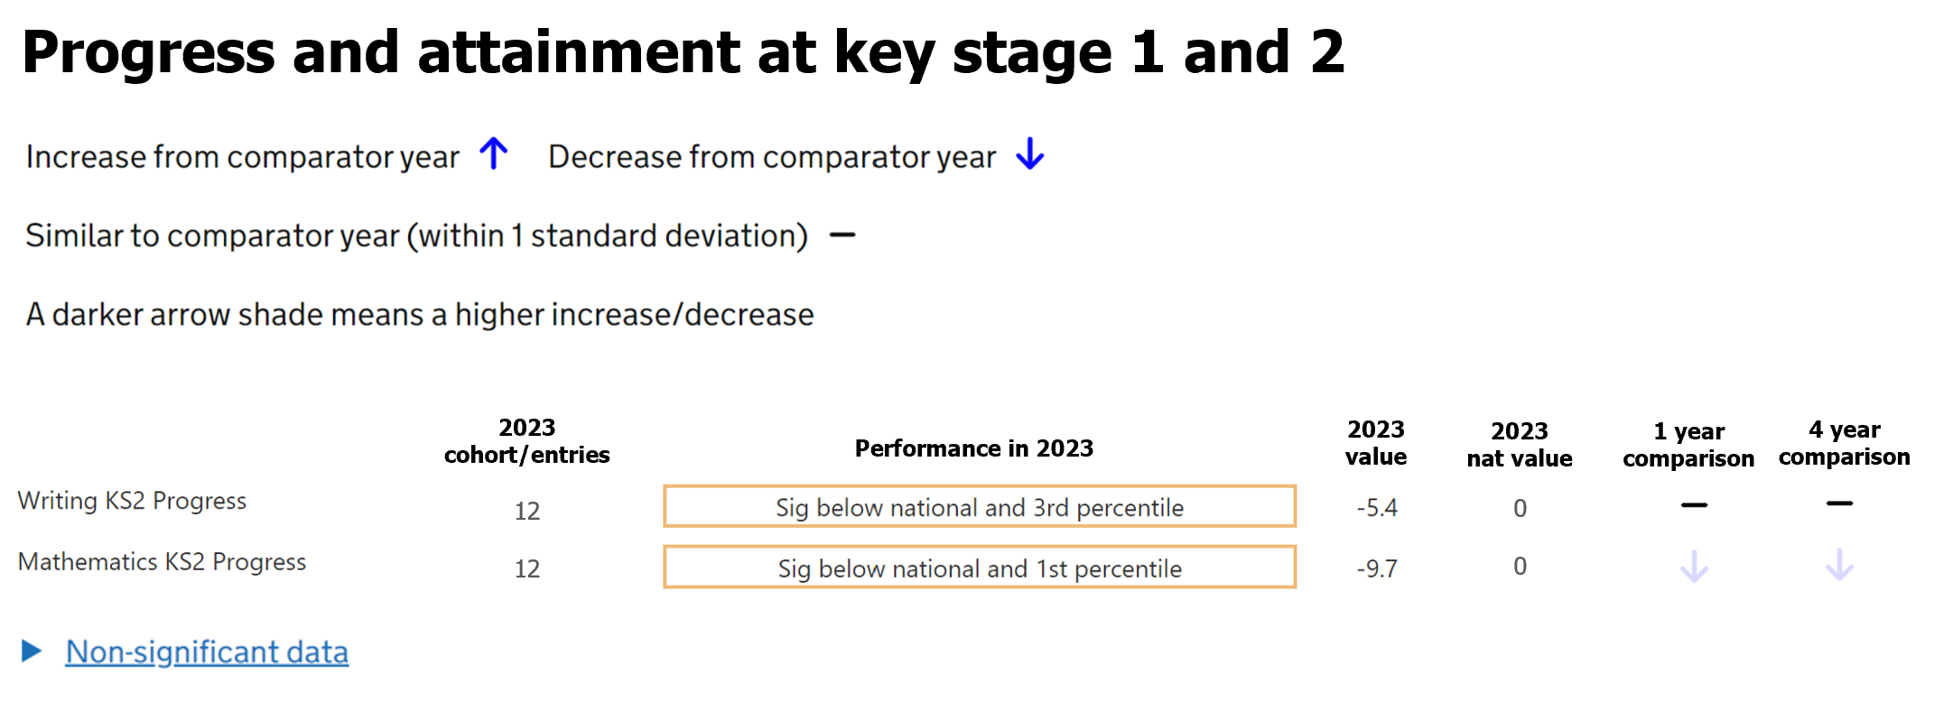
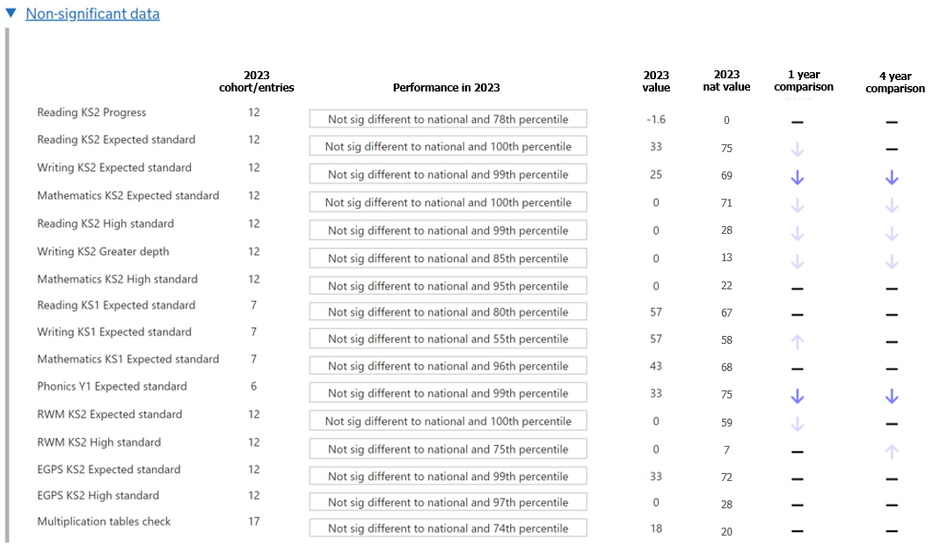
The arrows are based on standard deviations (i.e. standardised data)

Slide 11
How is the IDSR used?
Pre - inspection
Inspectors use the IDSR prior to inspection to understand the impact the current curriculum is having
Contextual information also helps them to prepare, for example identifying where SEND pupils reside
The inspector can also use the IDSR to facilitate initial conversations with senior leadership
They may also refer to it during the inspection to balance with observations
During inspection

Slide 12
Questions?

Slide 13
Thank You!
Contact me: Michael.Howe@ofsted.gov.uk

