Slide 1
‘The data guide’ (De datawijzer) The Flemish education inspectorate's tool for data-based monitoring AND for encouraging schools to implement data-wise policies
Wendy.Luyckx@onderwijsinspectie.be
Wim.Verreycken@onderwijsinspectie.be

Slide 3
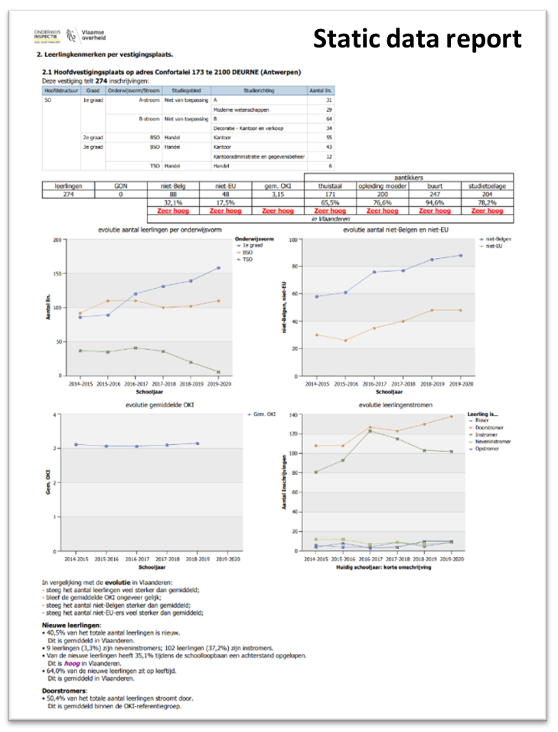

Slide 4
enable
encourage
present data
Consulting data
EFFICIENT - EFFECTIVE
Implementing
DATA-wise policies
Quality
improvement
INSIGHTS

Slide 5
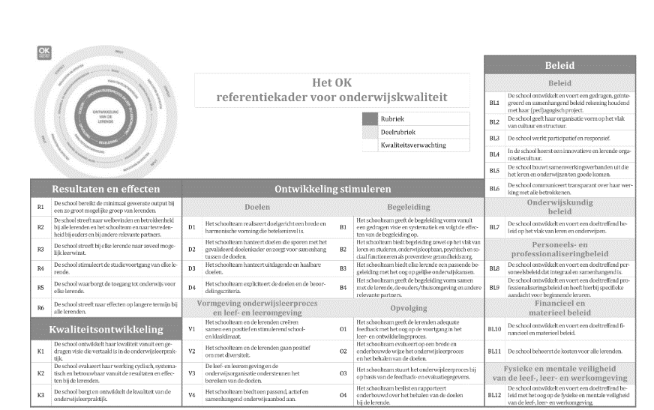
Offered to ALL schools
Made by inspectors
Linked to the flemish reference
Framework for education
Acces own data
& benchmark
INSIGHTS & research questions
NO PREJUDGEMENT
for the audit

Slide 6
https://datawijzer.onderwijsinspectie.be/dataguide

