Slide 2
  Equité et excellence dans le système scolaire : quelles actions des inspections pour concilier ces deux objectifs ?
  Equity and Excellence: how can inspectorates work towards meeting these two targets?

Slide 3
Word of Welcome by Caroline PASCAL, head of IGÉSR
Notes:
Dear SICI partners,
Thank you for being here today for the last workshop before the General Assembly.
I am happy to welcome you to this online seminar. I would prefer to welcome you on site here in Paris and I hope we can meet in Dublin.

Slide 4
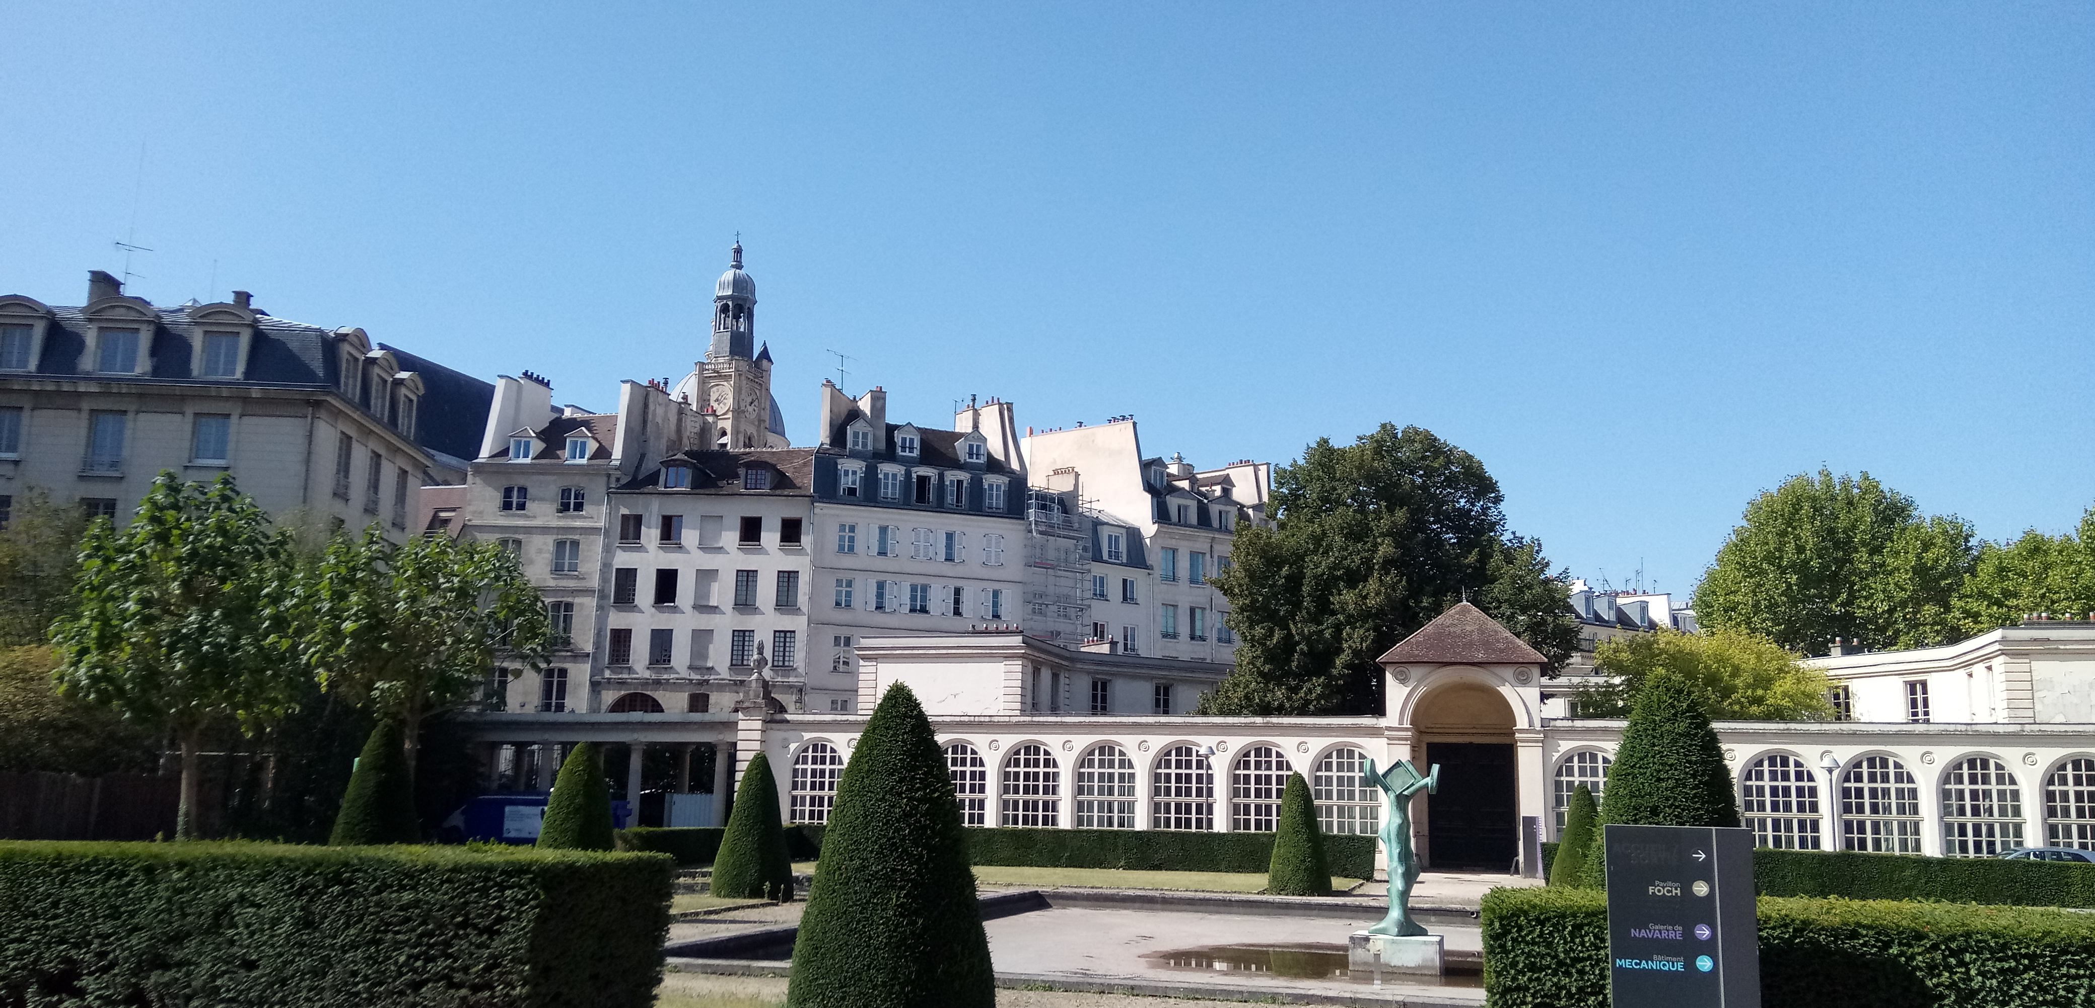
1. IGÉSR and its missions
    I Inspectorate
    G General for
    É Education
    S Sport (and)
    R Research
Notes:
First, I would like to remind you of our missions: some of you heard me present our new inspectorate in 2020. I will just sum up the more important aspects today.
Our inspectorate covers all the aspects of a young person’s life, from early years to higher education, all the way up to employment.
We operate at national level and our aim is to support and review all the policies concerning young people in the fields of school, higher education, research, associations, public libraries and sport - sport which will be the centre of attention after the lunch break.
The specificity of our inspectorate is to provide advice and support in the elaboration and implementation of educational policies and also to assess their impact. I know, of course, that some of your organisations work in a different way. In France, school inspection began in 2020, in spite of Covid. The evaluation of school units is the responsibility of the Council for School Evaluation, which will take part in the Round Table in a few minutes.
At regional level, inspectors attached to local education authorities inspect schools and teachers; they also support and implement policies at regional level. Some of them are with us today and they will present aspects of their work in relation to equity and excellence.

Slide 5
Equity and excellence – recent policies to reduce inequalities in education
Notes:
Now for our subject:
In his declaration of intention for the new school year, our new Education minister, Pap Ndiaye, gave the pursuit of equity and excellence as a priority, like his predecessor, Jean-Michel Blanquer. So, the priorities for this school-year meet exactly the subject of the SICI workshops and general assembly for 2022.

Slide 6
1.1. Equity and excellence: a few figures about the French school system
    12 118 300 pupils/students (ages 3 to 18)
    59 260 schools (primary and secondary education)
    859 000 primary and secondary education teachers
Notes:
Here you can see the number of students, schools and teachers in our system. It’s a lot of schools and people ! And a big challenge for us to promote excellence for all!

Slide 7
1.2. Equity and excellence: the French paradox?
    recognised expertise in many domains
    a diversity of shools leading pupils and students on the path to success
    but weak results on equity in international surveys.
Notes:
French schools nurture students in all sorts of domains (science, the arts, sports) and take them to a high level of achievement. Some of them go on to become experts in their domains, recognised internationally.
For example, 11 mathematicians whose work was done in France have been awarded a Fields Medal since the award was created (in 1936). There have also been several French Nobel prizes in recent years, in economics, physics or chemistry.
Yet, global surveys underline the weakness of the French school system: its limited ability to compensate for social inequalities. School achievement still depends too much on the type of school a child goes to, the region or area they live in, their backgrounds.

Slide 8
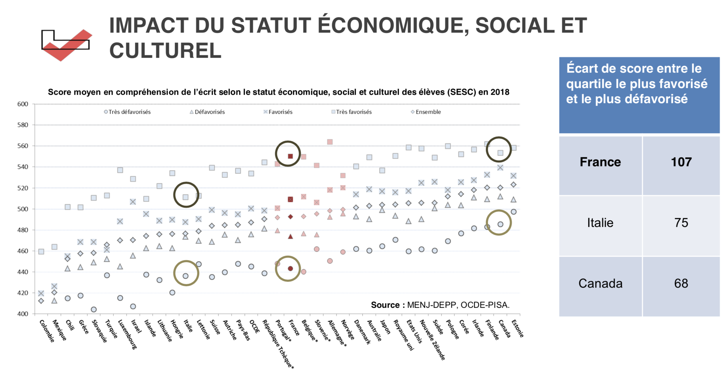
PISA results 2018 based on socio-economic factors
Notes:
Diapo 8 - This diagram shows indeed the gap between the 25 % of French students reaching high scores and the 25 % with the lowest scores. Compared to other countries such as Italy or Canada, the gap is considerable and underlines the challenges to be met in terms of equity.

Slide 9
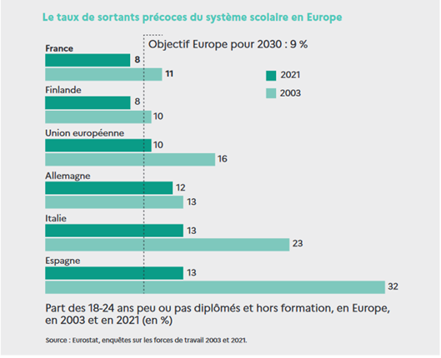
Some progress...
Notes:
Diapo 9 - Still, things are changing and we are looking forward to the results of the new PISA survey, in December 2023, which will evaluate the first generation of pupils who benefited from the recent policies.
Today a sample evaluation of primary school achievements show that results are stable in spite of Covid, which is good news; and the best students are doing better, but the gap is widening with the lowest achievers.
Also, regarding early school leaving, a target set at European level, there has been a marked evolution in France.

Slide 10
1.3. Policies to improve equity and excellence (since 2017)
Compulsory education from the age of 3
A reduced number of pupils in primary schools (in disadvantaged areas) – 12 pupils per group (375 000 pupils benefit from this measure)
A new strategy in favour of the basics of education (French and Mathematics)
Notes:
Diapo 10
Targeting pupils in primary education, a number of policies have been implemented over the past five years to improve performance in disadvantaged areas:
Education is now compulsory from the age of 3.
In disadvantaged areas, the number of pupils per class has been limited to 12 (twelve)
– 375 000 (three hundred and seventy-five thousand) pupils have benefited from this measure so far.
Besides, priority has been given to the fundamentals of education, the teaching and learning of French and mathematics. To achieve better literacy and numeracy, a renewed pedagogical approach has been devised, involving the intensive training of teachers and the production of new teaching resources.

Slide 11
2. Inspection work to support equity and excellence
Notes:
Diapo 11 - These educational policies are supported by specific teams of general inspectors within our inspectorate and implemented by regional inspectors within local education authorities.

Slide 12
2.1. The general inspectorates’ contribution to the deployment of education policies
Supervision of national evaluations of pupils’ attainment
Elaboration of training schemes and national resources
Inquiry into the pedagogical impact of national evaluations
Notes:
Diapo 12 –
Regular evaluations of pupils’ achievements in French and mathematics, at ages 6, 7, 11 and 15 (since 2018 - twenty-eighteen) are central to the improvement of performance for all pupils.
Evaluations allow local education authorities and school leaders to monitor progress over the years and to communicate directly with families about their children’s results. The children who need educational support are identified and measures are taken in schools to provide individualised support.
Every step of those evaluation campaigns is either supervised or assessed by inspectors:
general inspectors work with the service dedicated to performance and statistics (DEPP) to devise the tests for national evaluations,
general inspectors also provide advice to the heads of local authorities on the exploitation of the test results;
groups of experts led by inspectors have also produced guides to teach French and Mathematics following new pedagogical approaches.
Finally, a team of inspectors has recently been tasked with evaluating the pedagogical impact of those evaluations. The report is expected at the end of the school-year.

Slide 13
2.2. The regional inspectorate’s contribution to the implementation of education policies
Evaluation of schools in primary and secondary education, following a framework and methodology conceived by the Council for School Evaluation (since 2020).
Implementation of policies regarding teacher information and training, creation of teaching resources.
Notes:
Diapo 13
The inspectors working within local education authorities take part in the external evaluation of schools (alongside school-heads). More will be said about school evaluation in the round table this morning.
They also supervise the implementation of the educational policies and the related teacher training schemes and they contribute to the production of national and local resources.

Slide 14
Merci de votre attention

