Slide 1
A Portuguese Inspectorate of Education and Science’s Monitoring Activity :
Managing the Curriculum: Teaching English from grades 3 to 6 – identifying good practices
Funchal, Madeira
30th of May 2019
Ana Márcia Pires

Slide 2
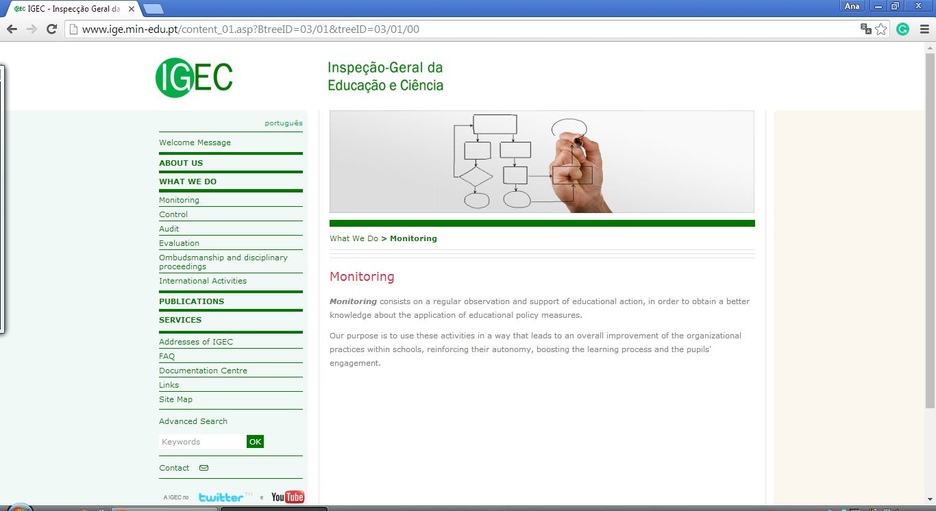

Slide 3
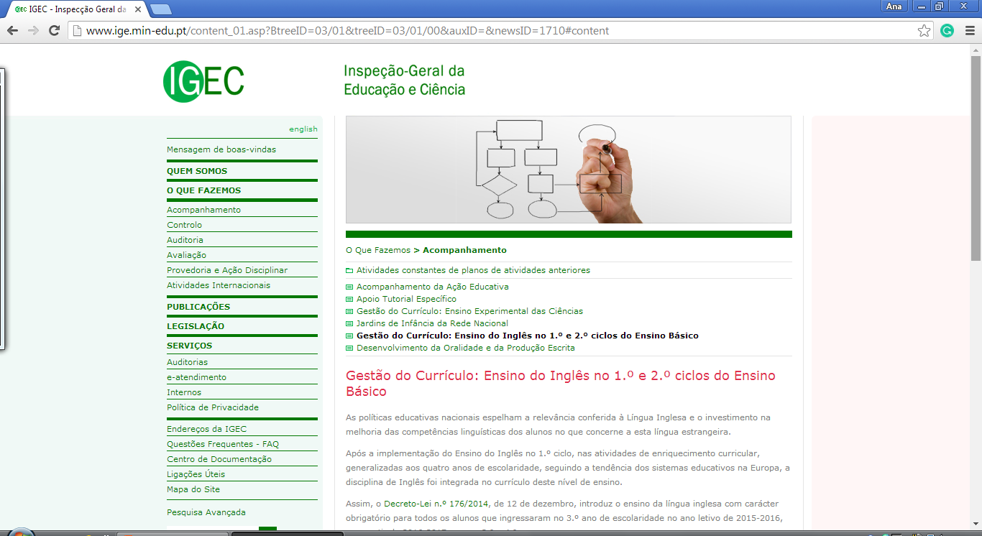

Slide 4
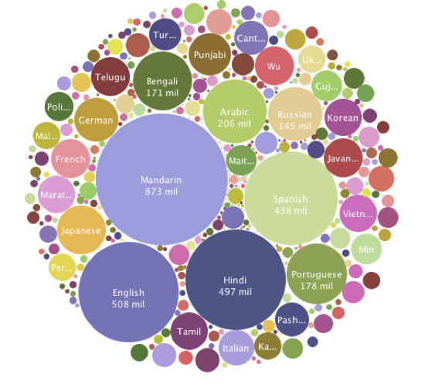
Notes:
English is the third most spoken language in the world, more than 350 million native speakers and many more speak it as a second language.

Slide 5
Educational policies:
English as a Curriculum Enrichment Activity, since 2006.
English as part of the curriculum of grades 3 and 4 (Decree-Law no. 176/2014, of the 12th of December).
Recruitment group 120, (specifically created for teachers to work with students from grades 3 and 4).
Metas Curriculares (national curriculum framework) for the English subject, 2015.
Aprendizagens Essenciais (Essential Learnings) for the English subject, 2018
I. Introduction

Slide 6
May 2017, report concerning the school year 2014-2015 stated that English is the second subject with the lowest scores in grades 5 and 6.
IGEC believes it to be vitally important to get to know how the English curriculum is being managed by schools and teachers, and induce effective pedagogical practices in the English classroom that would have impact on the students’ learning.
I. Introduction

Slide 7
Objectives:
to promote a school that mobilizes and organizes to provide an inclusive education, for each and every one, having as reference of its educational action the Profile of the Students when finishing the Compulsory Schooling.
to get to know the planning, development and evaluation of the educational action from grades 3 to 6.
to encourage critical thinking concerning issues related to the teaching , collaborative work, pedagogic supervision, self-evaluation of the practices, correlation and sequence within and along grades 3 to 6, diversification of methodologies and to improve the students’ learning experiences.
to contribute to an efficient management of the curriculum in order to guarantee a positive impact on the students’ outcomes and to identify good practices.
II. Objectives and Methodology
Each intervention lasts 5 days, including the conclusion of the report to be shared in a final meeting.

Slide 8
Document analysis
Interviews
Classroom activities observation
II. Methodology: triangulation of information

Slide 9
Director, other school board members and a member of the inclusive education team
English teachers from grades 3 to 6; heads of the Language Department; Head of the 1st Cycle Department, and representatives of the English group, if any.
Students’ representatives from grades 3 to 6
Parents and/or representatives of the classes (grades 3 to 6)
II. Methodology: interviews

Slide 10
Roteiro (framework)
Classroom Activity Observation Form
Activity Guide
Intervention Report
Global Report
II. Methodology: documents

Slide 11
Definition
- a good or wise thing to do
Merriam-Webster Dictionary
Being a good experience;
Having the qualities that are desirable;
Serving the desired purpose or end;
Being superior to the average.
III. Good practice

Slide 12
IV. Good practice:
Planning

Slide 13
The clear definition of objectives, goals and strategies for the development of the teaching and learning process of the English language in the school’s planning documents.
IV. Good practice: Planning
The elaboration of the short and long term planning, its analysis and reformulation in order to focus on the learning process and sequenced development of all the seven referential domains in the Metas Curriculares (national framework for English), and simultaneously the elaboration of the assessment criteria which in turn should include all the referential domains as well as an instrument to apply them, for instance, guidelines.

Slide 14
An effective collaborative planned work for and among teachers from grades 3 to 6, which leads to the knowledge of how English is being taught in the different years so as to create resources together such as correction criteria for tests and worksheets.
IV. Good practice: Planning
The supervision of the teaching practices allowing the solving of common or different issues to improve the teaching practice.

Slide 15
The identification of success and/or failure factors which necessarily lead to a set of actions/activities and strategies thus promoting the continuity and/or improvement of the students’ outcomes throughout the school year and the following.
IV. Good practice: Planning
The attention toward the planning of specific training courses in didactics for young learners or teaching young learners, so as to foster adequate methodologies for students in the that age range.

Slide 16
IV. Good practice: Development

Slide 17
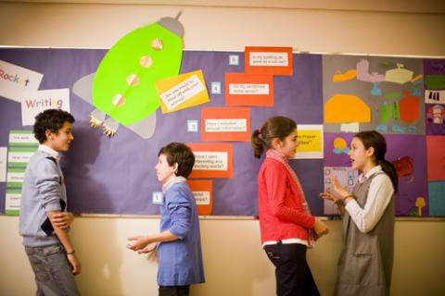
The use of English as the main communicational language and the native language strictly when necessary.
The attention to the use of English in oral interaction situations among students, namely through pair and group work/activities as well as projects and activities developed collaboratively by different grades.
IV. Good practice: Development
The development of differentiated practices and the use of a variety of activities adapted to the students’ different learning needs and pace.

Slide 18
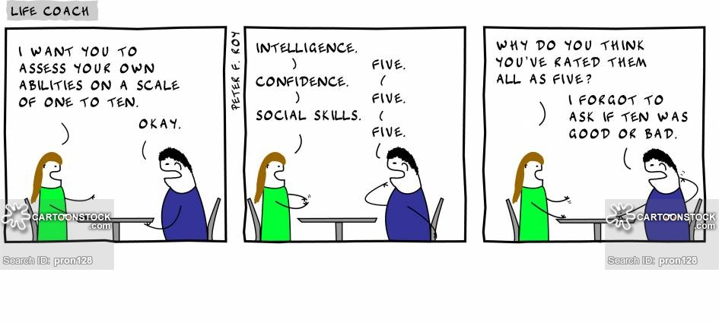
The effective collaborative work among teachers from grades 3 to 6 in order to aim at a sequenced learning and educational experience.
The development of students’ self-assessment and reflection on the lessons’ activities, their personal performance and the subject itself.
IV. Good practice: Development

Slide 19
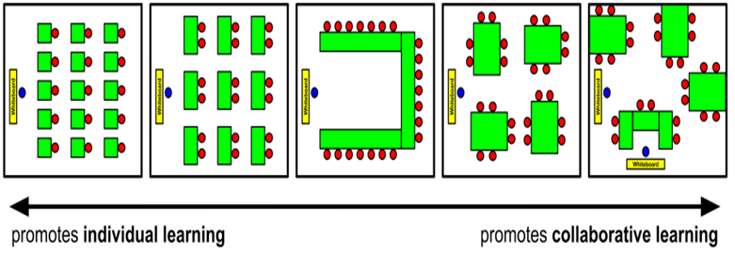
IV. Good practice: Development
The classroom management, i.e., adapting the layout of the furniture to the class size number, valuing and using the natural light, the use of technological and other resources, displaying students’ projects as a strategy of motivation.

Slide 20
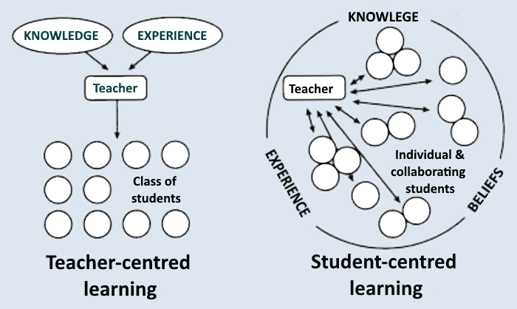
The intentional selection of resources to use in a classroom so as to bring a change from teacher-centred to student-centred teaching and learning.
IV. Good practice: Development
The development of intercultural aspects, whenever possible, and not just in festive seasons or in the celebration of national holidays.

Slide 21
The debate and reflection on the usefulness of giving students extra work to do at home and necessarily explaining its aims.
The effective use of the lesson time, ending it with a summary or assessment of the contents/practices within its time limit.
IV. Good practice: Development
The incorporation of fun activities, i.e., songs, music and games which help children to relax and enjoy the learning process as well as the retention of the language skills.

Slide 22
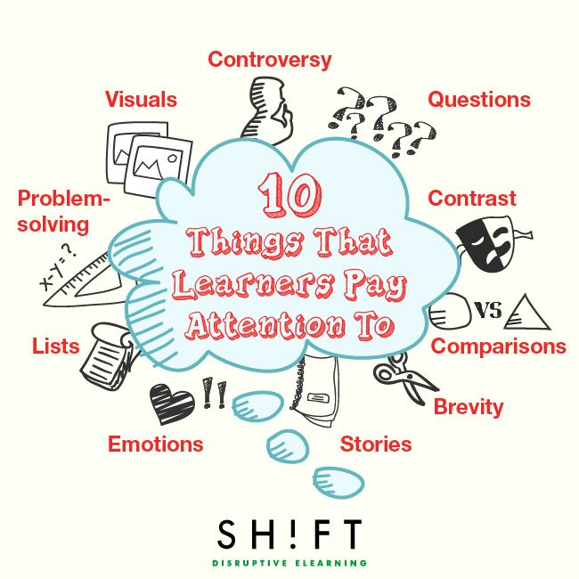
Young learners have very short attention spans, so the more diverse the activities the more motivated, attentive, participative and engaged the students will be.
IV. Good practice: Development

Slide 23
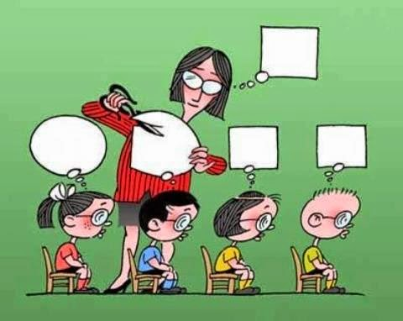
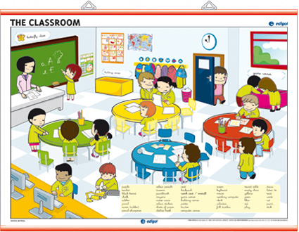
The focus on the Metas Curriculares using different materials, allowing creativity to be at the core of the activities so as to get students to feel involved and taking active part in their learning process.
IV. Good practice: Development
The classroom environment, special attention must be given to the classroom layout, look, and ambience and at the same time, because we are working with children, it is also important to promote a disciplined learning style.

Slide 24
The use of simple and clear English language in order to reinforce the students’ need to use language skills, vital for their education.
IV. Good practice: Development
Students should be able to track their progress.
They also need positive reinforcement to help them to grow and validate their hard work in order to stay motivated which also contributes to a shared and productive environment.

Slide 25
IV. Good practice: Evaluation

Slide 26
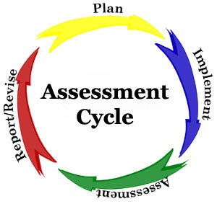
The involvement of the students in their assessment, evaluation and educational process through the use of register instruments which allow them to monitor their linguistic acquisition and learning progress as well as to assess the subject itself and the practices.
IV. Good practice: Evaluation
The reflection on the information derived from students’ evaluation data for critical decision making on classroom practices and the differentiation of strategies.

Slide 27
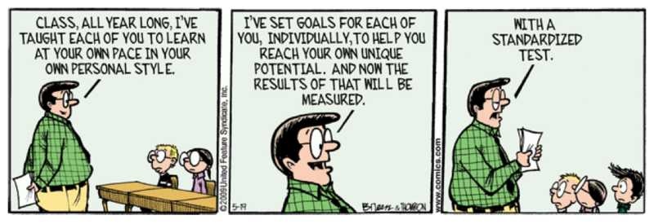
IV. Good practice: Evaluation
The establishment of assessment routines by the teachers concerning their practices and the training courses so as to redefine the methodologies in the teaching and learning process.

Slide 28
The sharing with the students of the instruments with the necessary information on their assessment in compliance with the referential domains of the Metas Curriculares.
IV. Good practice: Evaluation

Slide 29
IV. Good practice: Evaluation

Slide 30
A method, a technique or methodology that has been proven as the best in comparison to other alternatives, because it produces greater results or because it has become a pattern, i.e., techniques identified as being the best to accomplish a certain task or that have produced the most efficient outcomes.
V. Best practices
- Surpassing all others in excellence, achievement, or quality; - Most satisfactory, suitable, or useful; most desirable: the best solution; - Most highly skilled

Slide 31
Characteristics of best practice at schools:
Efficient planning, development and assessment
Planning: objetives, targets, partnerships, how to monitor
Development/implementation: what is working, what needs to be changed, identification of vulnerabilities
Assessment: is it successful, innovative?; impact; challenges
Sustainability: continuous improvement
Replicability
V. Best practice

Slide 32
Bretschneider, S., Marc-Aurele, F.J., Jr., and Wu, J. (2005). "Best Practices" Research: A methodological guide for the perplexed, Journal of Public Administration Research and Theory (15)2:307-323.
IGEC (2018). Atividade I.5 Gestão do Currículo: Ensino do Inglês no 1.º e 2.º Ciclos do Ensino Básico. Relatório Intermédio.
IGEC (2019). Atividade I.5 Gestão do Currículo: Ensino do Inglês no 1.º e 2.º Ciclos do Ensino Básico. Roteiro 2019
IGEC (2019). Atividade I.5 Gestão do Currículo: Ensino do Inglês no 1.º e 2.º Ciclos do Ensino Básico. Guião da Atividade.
IGEC (2019). Atividade I.5 Gestão do Currículo: Ensino do Inglês no 1.º e 2.º Ciclos do Ensino Básico. Ficha de observação da prática letiva.
IGEC (2019). Atividade I.5 Gestão do Currículo: Ensino do Inglês no 1.º e 2.º Ciclos do Ensino Básico. Relatório da Atividade.

Slide 33
Ana Pires
ana.pires@igec.mec.pt

