Slide 1
COVID-19 and challenges for educational quality: repairing learning loss and teacher agency
Prof dr. Melanie Ehren (m.c.m.ehren@vu.nl)
Professor in Educational Governance
Director research institute LEARN!

Slide 2
Agenda
Learning loss
Teacher agency and moving forward: catch-up programmes
Q&A at the end of each theme and reflection on implications for inspection.
Add your question/comment in the chat!

Slide 3
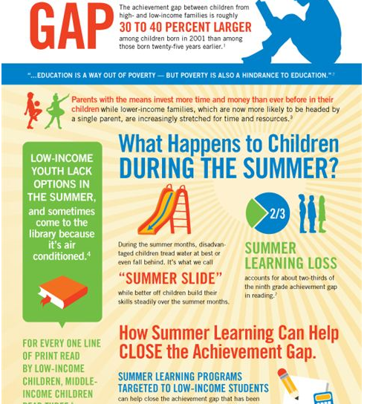
Learning loss
What is learning loss?
Political sensitivity of the term…
Who has ‘lost’ learning?
How do we know?
Do Inspectorates of Education have a role in providing evidence of learning loss? What evidence? And in which areas?

Slide 4
What is Learning loss?
Comparison of learning and development in the period of lock down, compared to previous ‘normal’ years.
Are students learning less during lockdown than in a typical year?

Slide 5
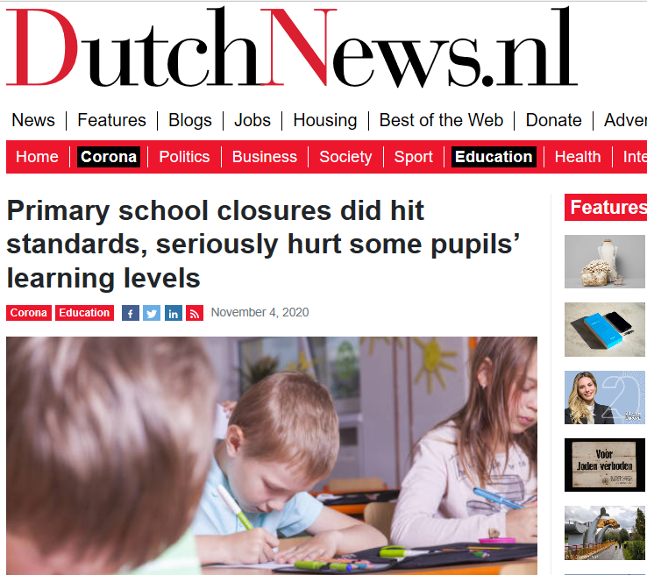
How do we know? How to measure?
Netherlands:
Poll of school heads in primary education: only 11% of school heads had concerns over learning loss in May
Engzell et al (October 2020): comparing assessment outcomes before and after lock down
Notes:
three main subjects: Maths & Arithmetics, Spelling, and Reading Comprehension
The researchers compared the result of school tests before and after lockdown in spring 2020 and in the previous three years, and found that there had been what they called a ‘learning loss’.They found that this loss was up to 55% larger among pupils who came from homes where parents were less educated. The average learning loss was equivalent to a fifth of a school year, nearly the same period that schools remained closed. ‘These results imply that pupils made little or no progress while learning from home, and suggest much larger losses in countries less prepared for remote learning,’ the report said.
We use the fact that national exams took place before and after
lockdown, and compare progress during this period to the same period in the
three previous years using a dierence-in-dierences design. Our results reveal
a learning loss of about 3 percentile points or 0.08 standard deviations. These
results remain robust when balancing on the estimated propensity of treatment
and using maximum entropy weights, or with xed-eects specications that
compare students within the same school and family. Losses are up to 55%
larger among students from less-educated homes. Investigating mechanisms,
we nd that most of the eect reects the cumulative impact of knowledge
learned rather than transitory inuences on the day of testing. The average
learning loss is equivalent to a fth of a school year, nearly exactly the same
period that schools remained closed. These results imply that students made
little or no progress whilst learning from home.
Those in the two lowest categories of
parental education|together accounting for 8% of the population (Appendix Fig-
ure A2)|suered losses 40% larger than the average student ( ^ by high/low/lowest
parental education: 3.04, 4.30, 4.24). In contrast, we nd little evidence that the ef-
fect diers by sex, school grade, subject, or prior performance.
study on learning loss in Grade 6 in Flanders: https://feb.kuleuven.be/research/economics/ces/documents/DPS/2020/dps2017.pdf
We ﬁnd that students of the 2020 cohort experienced signiﬁcant learning losses in all tested subjects, with a decrease in school averages of mathematics scores of 0.19 standard deviations and Dutch scores of 0.29 standard deviations as compared to the previous cohort. This ﬁnding holds when accounting for school characteristics, standardised tests in grade 4, and school ﬁxed effects. Moreover, we observe that inequality within schools rises by 17% for math and 20% for Dutch. Inequality between schools rises by 7% for math and 18% for Dutch. The learning losses are correlated with observed school characteristics as schools with a more disadvantaged student population experience larger learning losses.

Slide 6
Dutch study
Students lost two thirds of expected progress whilst learning from home.
These losses are evident in all grades 4 through 7 and across three subject areas: Maths, Spelling, and Reading.
Students from parents with low educational background are disproportionately affected.
In the most low-resourced households, the size of the learning slide is up to 55% larger than in the general population.

Slide 7
How do we know?
Difficulty in measuring learning loss and attributing it to school closure (teaching was disrupted longer than closure).
World bank scenario’s:
Percentage of efficiency in learning (e.g. optimistic scenario: schools closed for 3 months and remote learning operating at 60% efficiency)
Proportion of gains made in a normal year (e.g. optimistic scenario is 0.3 years of quality-adjusted schooling lost).
Emphasis on test scores and academic subjects

Slide 8
Whose learning loss?
Students from parents with low/high educational backgrounds
Students from low-resourced homes (lack of IT and internet access)
Students from parents who both work
Younger versus older students
Students with special educational needs
Students from schools with varying teaching philosophies (e.g. executive skills, self-regulation)
Boys versus girls
Relevant to understand ways forward, teacher agency and school quality
Concerns over rising inequality

Slide 9
Q&A and discussion
Do Inspectorates of Education have a role in providing evidence of learning loss?
What evidence?
And in which areas?
And learning loss of whom?
Academic subjects (reading, writing, math), social competences, student well-being, other…?
Boys versus girls, according to parental educational background, according to school type, according to parental income level?

Slide 10
Teacher agency
Have teachers been able to change their practice to ensure (the continuation of) learning and students’ well-being during the pandemic?
Which conditions have facilitated and/or impeded this?
Agency: teachers who, alone or in groups, in a given situation, make decisions, take initiatives, act proactively rather than reactively, and deliberately strive and function to reach a certain end (Imants and Van der Wal, 2020; Bandura; social cognitive theory) .

Slide 11
Teacher agency
Individual capacities (skills, knowledge, beliefs)
Perceived self-efficacy
Collective agency
Enabling environment: physical and relational constraints

Slide 12
Teacher agency
Three phases
Initial closure and sense of crisis: develop new skills, copy and paste of in-school models, individual responses and high workload and mental stress.
Part opening: developing blended modes
Full opening but with physical distancing
Notes:
Spill-over: more holistic understanding of students, better family relationships versus only seeing the trade-off for pupil participation and pointing to the lack of evidence or good practice framework for online/remote teaching.

Slide 13
Teacher agency
Responses vary for/by:
Teachers: consideration of long-term benefits (spill-over learning for ‘regular’ teaching, or valuing online/remote teaching in its own right)
Teachers’ home environment (e.g. having to teach their own children)

Slide 14
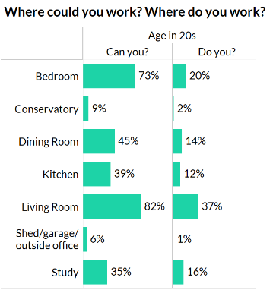
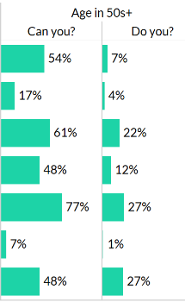
Teachertapp UK
Notes:
A simple reason for the difference is that teachers in their 20s are more likely to be in a house share or living with parents, whereas those in their 50s are most likely to have older children and so can requisition a former bedroom as an office!
But what about all those empty study areas? Why isn’t everyone who has one, working in it? Several tappers pointed out that their partners, who had endless phone calls in their non-teaching jobs, had taken the room. In other cases, it was kept as a booth for whoever needed to make a call – with one teacher sharing a picture of their kitchen table with themselves, their partner, and their two adult children all working at the main desk: “It’s like a call centre in here!”

Slide 15
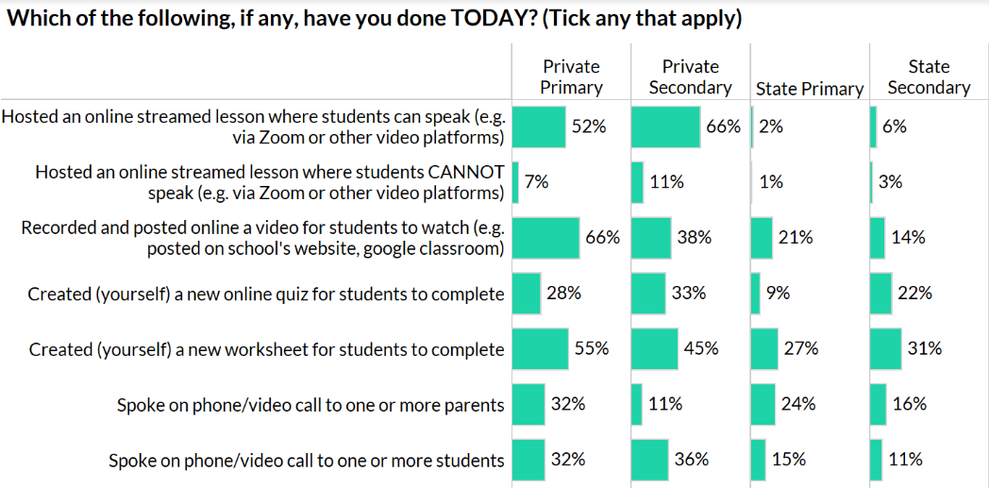
Teachertapp UK
Notes:
In part, these differences in work tasks are due to the different resources that teachers are using. Primary schools often have online app subscriptions for maths, literacy and other curriculum products as part of their homework offer and are recommending children continue with these. In secondary schools, the large range of online maths products also means that maths teachers are recommending these to their pupils and are spending much less time creating resources.
Humanities, English and Arts teachers, meanwhile, are much less well served by online products and so are relying on resources they have created.

Slide 16
Teacher agency
Responses vary for/by:
Environment
School: coordination and planning (e.g. rota and coordination of platform and communication to families)
Students’ home environment and IT/internet access and support
Educational partnerships
System-level coordination

Slide 17
Q&A and discussion
Do we need to change regular inspection frameworks; e.g. to include
The quality of home-school partnerships
Teacher/school’s approaches to repairing learning loss

Slide 18
Final reflections
Why we need to ‘repair’ learning loss…
Concerns over increasing inequality
Dynamic models demonstrate how small initial losses can accumulate into large disadvantages with time.
Test scores do not consider children's psycho-social development, neither societal costs due to productivity decline or heightened pressure among parents).
the importance of social investment strategies to build back better" and enhance resilience and equity.
Future pandemics? Weather-related closures?
(Engzell et al. October 2020; UNESCO, 2020)
Notes:
The relevance for Inspectorates of Education: these targeted approaches to enhance learning of specific student groups, in addition to other/wider indicators of educational quality become increasingly important.

