Slide 1
Innovation in the Irish education system
Pádraig Mac Fhlannchadha
23 September 2019

Slide 2
Innovations
Support schools and students to break the cycle of disadvantage
Encourage and recognise excellence and innovation in schools
Build the capacity of school leaders
Reform the curriculum to ensure better learning experiences for young people
Support schools and teachers to promote and nurture students’ wellbeing
Improve STEM education
Give parents and learners a greater voice in the education system

Slide 4
Supporting schools and students to break the cycle of disadvantage

Slide 5
STEM
Creative
Digital
Encouraging and recognising excellence and innovation in schools
DEIS
Step up
(New Junior Cycle)
Gaeltacht

Slide 6
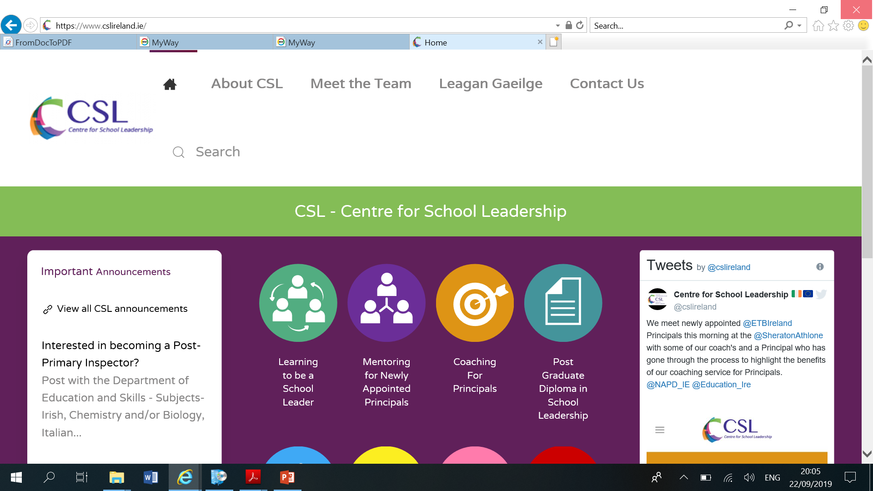
Building the capacity of school leaders

Slide 7
Reforming the curriculum to ensure better learning experiences

Slide 8
Improving STEM education

Slide 9
Giving students and parents a greater voice

Slide 10
https://www.education.gov.ie

