Slide 1



SUMMARY
SICI workshop
‘Internal Quality Assurance on Judgements’
Utrecht, 5-6 March 2020

Slide 2
Five levels
Quality culture
Continual professionalization
Framework, tools and instructions
Quality activities during/after each inspection
Periodical centrral research

Slide 3
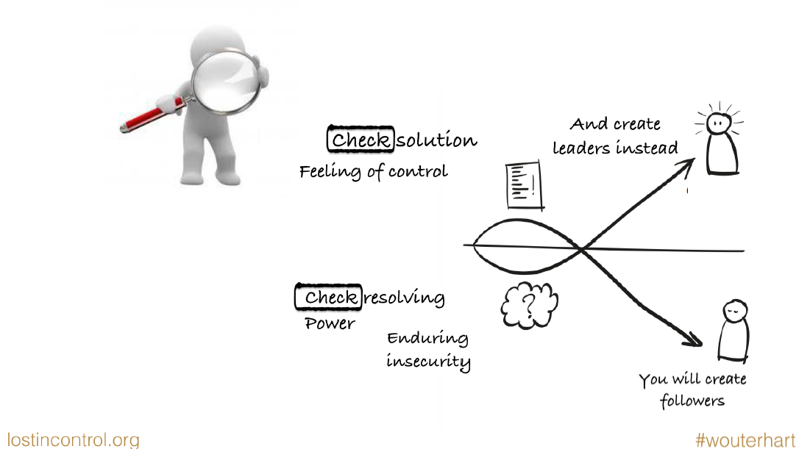
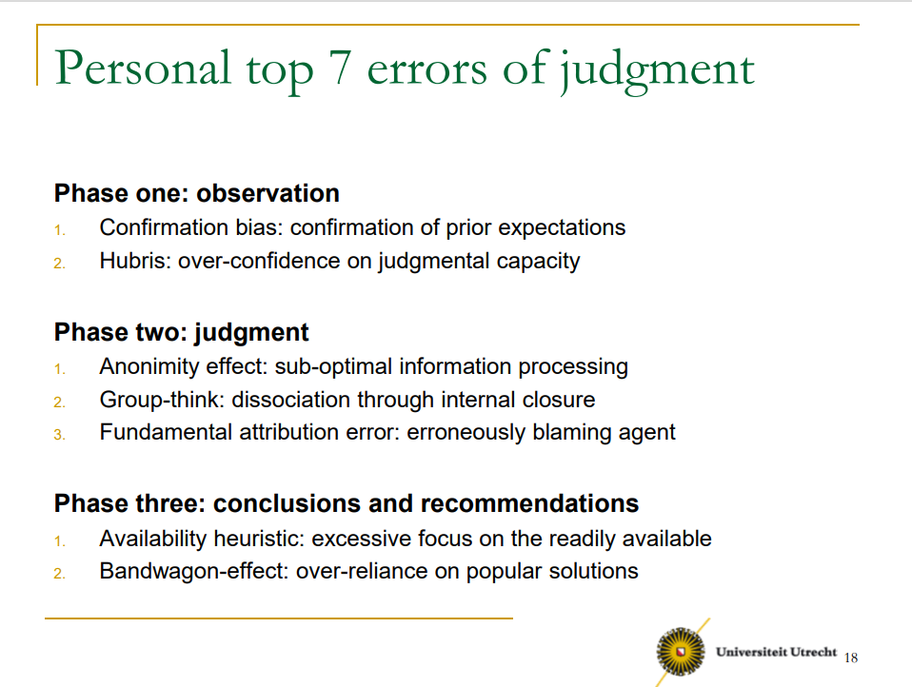
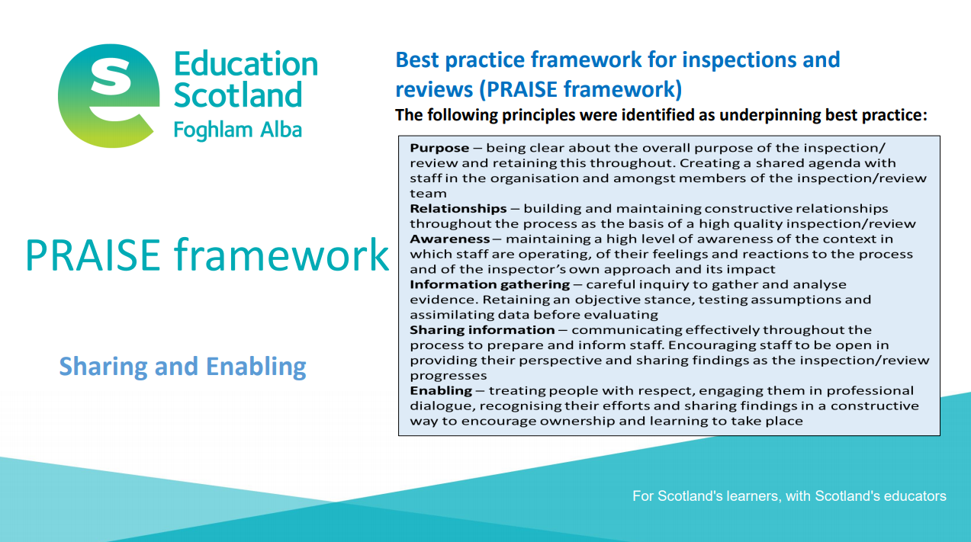
1. QUALITY CULTURE
Self reflection and feedback

Slide 4
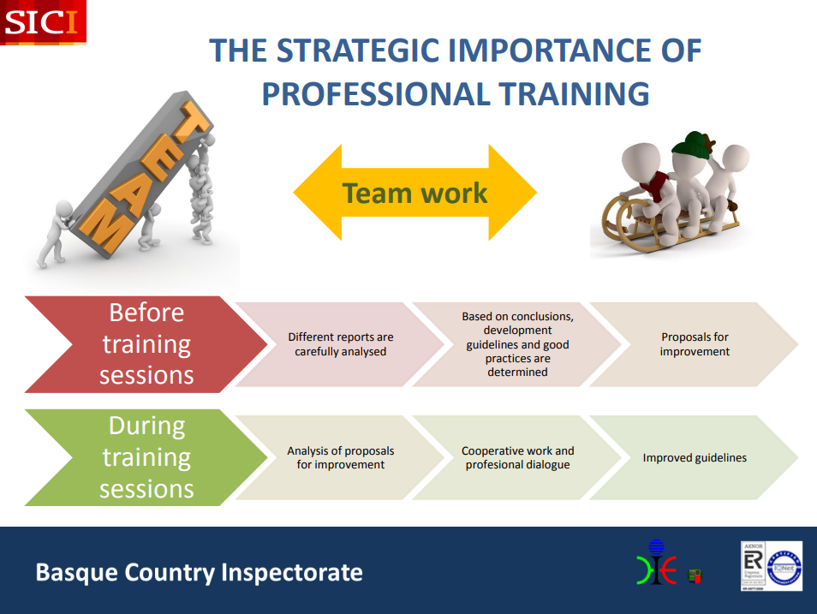
2. CONTINUAL PROFESSIONALIZATION
Training programme new colleagues
Regular training of all colleagues
Collegial consultations
Case studies
Sharing knowlegde

Slide 5
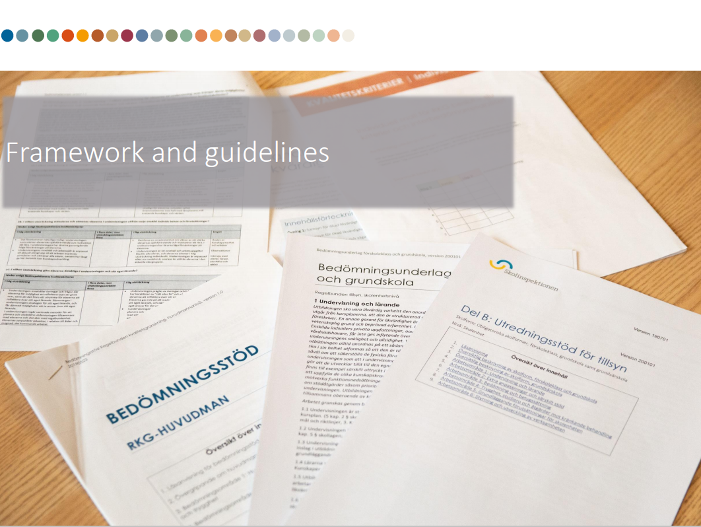
3. FRAMEWORKS, TOOLS AND INSTRUCTIONS
Frameworks and underlying guidelines
Process descriptions and key performance indicators
Evicence gathering forms
and guidelines
Tools and instruction
for writing reports
Other tools and guidelines
Sharing of best practices

Slide 6
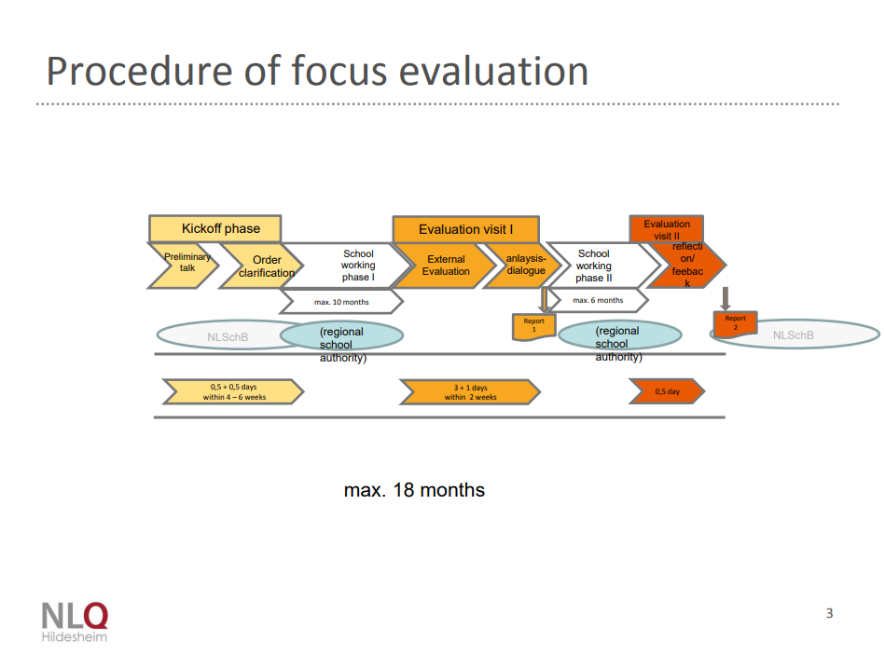
4. QUALITY ACTIVITIES DURING/AFTER EACH INSPECTION
Triangulation and evicence gathering
Moments of reflection
Consensus meeting
Referencing and approval
of reports
Pre-publication meeting
Evaluation meeting
Satisfaction survey

Slide 7
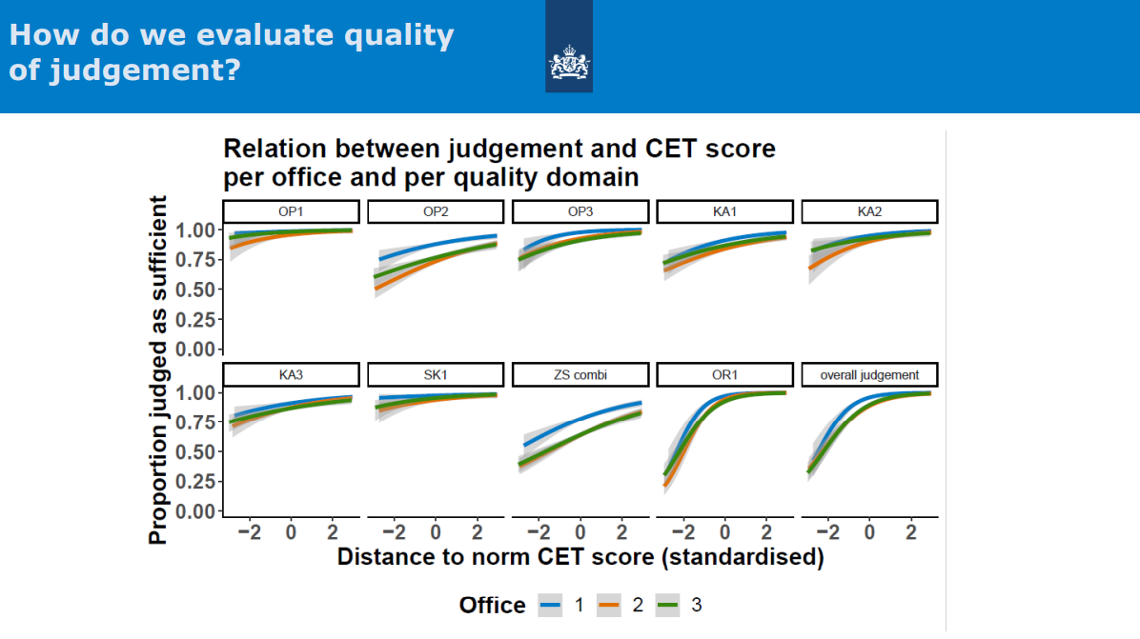
5. PERIODICAL CENTRAL RESEARCH
Analysing satisfaction surveys
Analysing judgements and reports
‘Labatory experiments’
Peer reviews
Panels
Research by external
organisations

Slide 8

QUALITY ASSURANCE ON JUDGEMENTS
Finding the right balance between trusting and supporting our experts

