Slide 1
The Flemish Inspectorate’s Data Management in Perspective
Model, Collection, Analysis and Synthesis
Prague 21-22 November 2013 Gerd Van Den Eede, Jaak Stappers

Slide 2
Concept of external evaluation in Flanders
Cycle (3rd) of 9 years
Every school/institution is evaluated once per cycle.
Fundamental idea: differentiated approach based on strong and weak aspects of the institution.
Aspects to be considered found in CIPO, a framework of indicators, variables and building blocks.
4 main phases:
Planning
Preliminary inquiry
External evaluation on site
Reporting

Slide 3
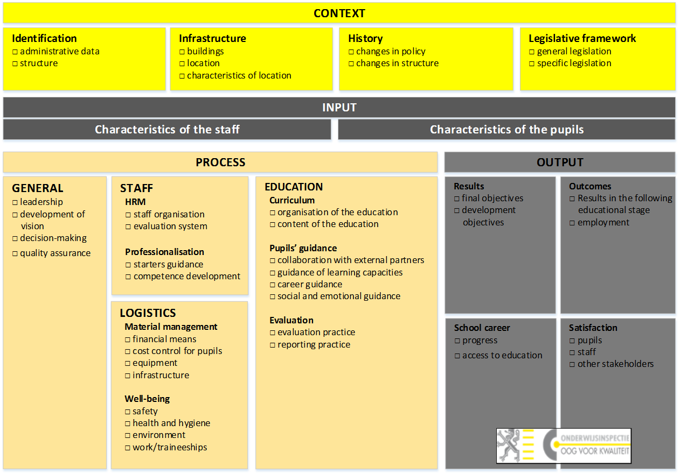
CIPO framework

Slide 4
Planning

Slide 5
Planning
Collection | Analysis | Synthesis
Structured data on schools: administrative data, fields of study, amount of subscriptions pupil characteristics Staff characteristics Information file | Structured and unstructured data, used to determine: list of schools to be evaluated focus period of the external evaluation. | List of schools to be evaluated
Unstructured data: reports of the previous external evaluation cycles (1 and 2) |  | Scheme with the external evaluations, arranged by education level, period and school
 |  | Team of inspectors for each school

Slide 6
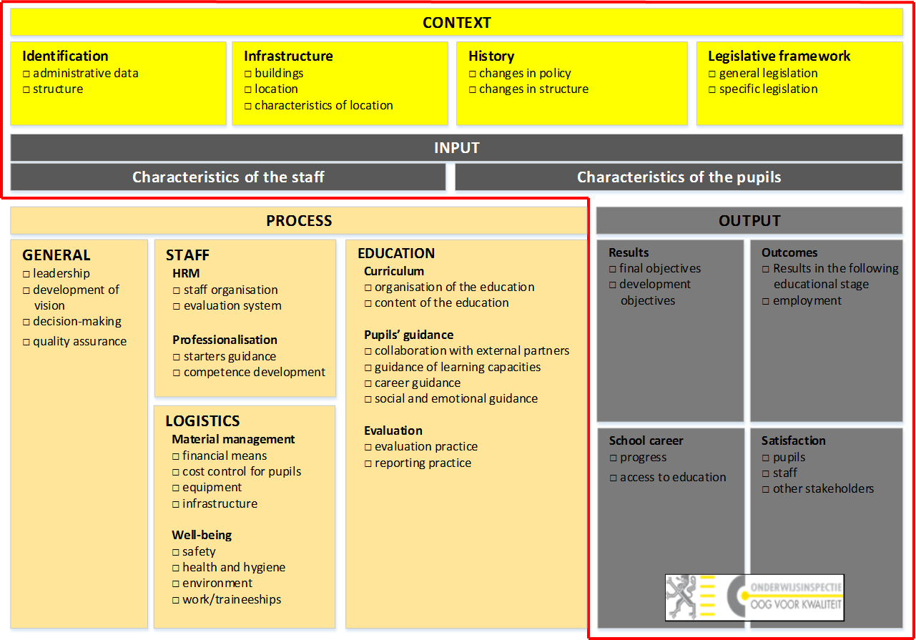
Preliminary inquiry on site

Slide 7
Preliminary inquiry on site
Collection | Analysis | Synthesis
Interview | Structured and unstructured data used to determine information gaps | Missing information is integrated
Structured & unstructured data

Slide 8
The external evaluation on site

Slide 9
The external evaluation on site
Collection | Analysis | Synthesis
Structured data: output outcomes retentiveness survey on pupils’ well-being | Structured and unstructured data used to draw conclusions on the focus. Strong and weak aspects? Evolution? Other aspects that have to be taken into account? Management of processes? | Every inspector, responsible for the screening of some fields of study, processes and other aspects writes down his findings in an intermediate report or registers them directly into the web application.
Unstructured data: documents interviews
Observations class room other processes

Slide 10
Reporting

Slide 11
Reporting
Collection | Analysis | Synthesis
Structured data: identification data fields of study focus | Structured, unstructured data and conclusions of observations | Writing of the final report, using the web application based on the data registered in the solution and during the external evaluation process assessment (Favorable – Unfavorable – Favorable , but with time restriction).
Unstructured data: descriptions of the findings divided into the basic and specific aspects of the fields of study screened
Web application, used by every inspector

Slide 12
Overall Reporting
“Onderwijsspiegel” [Education Mirror)
Annual report from the Flemish Inspectorate for the Flemish parliament
External evaluations
Specific inquiries
Other assignments

