Slide 1

Notes:
This is a front cover page and can only be used at the beginning of a PowerPoint presentation once. Do not add anything else to this screen if it is being used.

Slide 2


Scottish Attainment Challenge
Evaluating progress in improving learning, raising attainment and closing the poverty-related attainment gap
For Scotland's learners, with Scotland's educators

Slide 3
Context
A wicked problem
Government Commitment
System-wide buy-in and a common moral purpose
Excellence and Equity
For Scotland's learners, with Scotland's educators
Notes:
.

Slide 4
The Scottish Attainment Challenge
Launched by First Minister 2015
Underpinned by NIF, CfE and GIRFEC
Improvement in literacy, numeracy, HWB
About Scotland’s Children reaching their potential
£750 million 2015/16-2020/21
9 Challenge Authorities -SIMD data
For Scotland's learners, with Scotland's educators
Notes:
SIMD Scottish Index of Multiple Deprivation
GIRFEC Getting It right for every child
CfE Curriculum for Excellence
NIF National Improvement Framework

Slide 5
Evaluating progress
Key principles
Adding value to the evaluation strategy already in place
In keeping with Education Scotland’s Corporate values -creativity
Model collaboration (with, not to) Involve partners, including those being evaluated
Start with self-evaluation
Build capacity in the system –disseminate good practice
EFQM
Educational Psychology Service included
Role of Elected Members and governance
For Scotland's learners, with Scotland's educators

Slide 6
Co-production and working with others
Association of Directors of Education in Scotland
Professional Associates
Audit Scotland
For Scotland's learners, with Scotland's educators

Slide 7
Inspection Framework-
Gathering evidence to answer two big questions
How effective in the education service’s use of data to target, select and evaluate the impact of initiatives?
How effective is the education service’s leadership, governance and management of resources to improve learning, raise attainment and narrow the poverty-related attainment gap?
Nine reports now published -case studies
For Scotland's learners, with Scotland's educators
Notes:
.

Slide 8
Inspection activities
Professional Associates full team members
Met with focus groups; headteachers, staff, learners, parents, partners
Observed practice
Reviewed data
Reviewed documents
Managing relationships- meet with Director daily-attend inspection team meetings
Dynamic process
Bespoke within framework
For Scotland's learners, with Scotland's educators

Slide 9
The inspection week
Working together to :
plan meetings
build the evidence
manage relationships and expectations
allow the programme to evolve
enable the MI to manage the team and set the direction each day
For Scotland's learners, with Scotland's educators

Slide 10
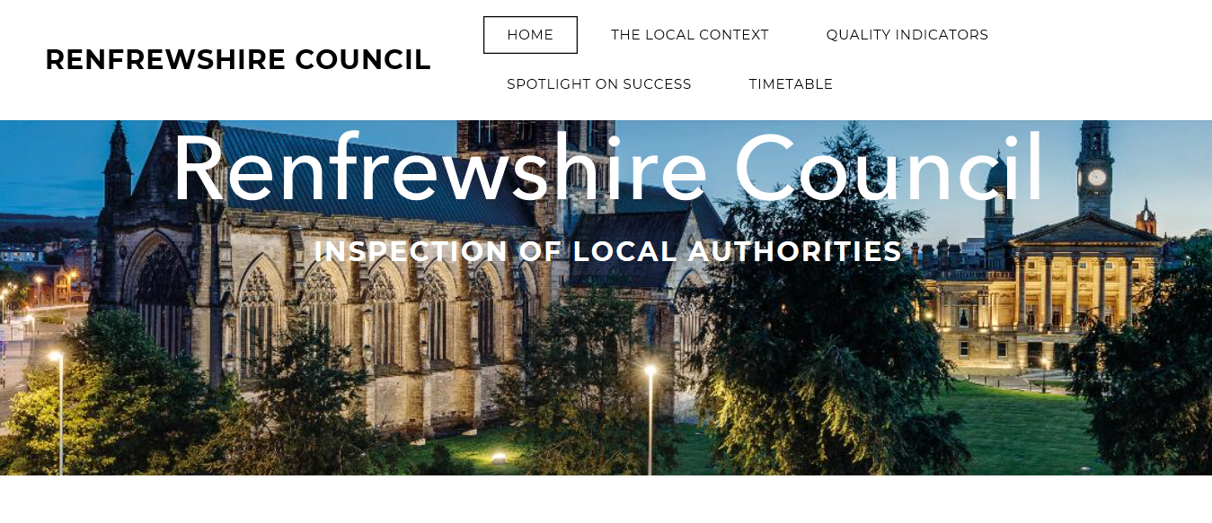
Creative presentation of evidence for the inspection team
For Scotland's learners, with Scotland's educators

Slide 11
Sample timetable for the morning of day two.
Day: |  | Tuesday
Time |  | Activity | Venue | Meeting participants
Start | Finish |  |  | Local authority | Education Scotland
09:00 | 10:00 | Sampling Evidence | Meeting Room HQ | - | MI ALO HMI TMs HMI EPS PA TMs
10:00 | 11:00 | 1:1 with Procurement | Meeting Room HQ | Staff | AS TM
10:00 | 11:00 | Leadership Focus Group | Meeting Room HQ | Staff and focus group | 2 HMI
10:00 | 11:00 | Numeracy Focus Group | Council Chambers HQ | Staff and focus group | HMI and PA
10:00 | 11:00 | HWB: Health Promotion | Board Room | Psychologist and focus group | 2 HMI
11:00 | 12:00 | Parental Involvement Focus Group | Council Chambers HQ | Leadership staff and focus group | HMI and PA
11:00 | 12:00 | Literacy Focus Group | Meeting Room HQ | Staff and focus group | HMI and PA
For Scotland's learners, with Scotland's educators

Slide 12
Team meeting and sharing of findings
The inspection team meets toward the end of the inspection week to discuss their findings and agree an evaluation.
Education Scotland website - What feedback will I get?
The discussion of findings at the end of the inspection week will provide feedback on the strengths and aspects for development identified by the inspection team. These will be based on the performance criteria set out in the inspection framework. HM Inspectors will also indicate the overall evaluation of the progress made by the local authority and the next steps in relation to the inspection. These messages will be further articulated in a report published on our website. Senior managers in the education service should share the inspection findings with the Chief Executive and other stakeholders, including with children, young people and families, as soon as possible after the inspection to support ongoing improvement.
For Scotland's learners, with Scotland's educators

Slide 13
Reporting
Excellent progress
Glasgow City Council
Renfrewshire Council
Very good progress
Inverclyde Council
North Ayrshire Council
West Dunbartonshire Council
Good
Dundee City Council
North Lanarkshire Council
Satisfactory
Clackmannanshire Council
East Ayrshire Council
Unsatisfactory
None
For Scotland's learners, with Scotland's educators

Slide 14
Published reports
What did we say?
There is now a clearly articulated vision and well-defined set of priorities for raising attainment and closing the poverty-related attainment gap within the council. It is closely aligned with the values and priorities of the current council’s corporate plan, the Children’s Services Plan and in line with the National Improvement Framework (NIF) priorities. This is providing a strong shared vision for improvement amongst elected members, centrally deployed staff and heads of establishment. However, the vision, has not yet reached all staff, particularly at classroom and playroom levels. As a result, it has not yet had sufficient impact on classroom and playroom pedagogy and practice.
For Scotland's learners, with Scotland's educators

Slide 15
Published reports
What did we say?
Education Services’ clear focus and drive has mitigated the impact of poverty on the performance of primary-aged children in SIMD deciles 1 and 2 at almost all stages. This has brought their performance in line with, or in the case of numeracy, above national averages.
Glasgow City Council is mitigating the impact of poverty successfully for its young people at the senior phase across a number of measures
For Scotland's learners, with Scotland's educators

Slide 16
Published reports
What did we say?
Renfrewshire Council has developed an outstanding approach to the use of data to inform improvement in all aspects of its work related to the Scottish Attainment Challenge. The central team of authority officers is strongly focused on improvement and rigorously discusses data regularly with schools, including a focus on the local evidence for impact of Scottish Attainment Challenge and Pupil Equity Funding. The data analysis team supports this work by providing highly effective professional learning for individual staff, groups, schools and officers.
For Scotland's learners, with Scotland's educators

Slide 17
Sketchnotes
For Scotland's learners, with Scotland's educators

Slide 18
Sketchnotes
For Scotland's learners, with Scotland's educators

Slide 19
Conclusions
What did we find out?
All nine challenge authorities received an evaluation of satisfactory or better.
Where there are clear links between the strategic vision and the day-to-day
actions of staff, this is supporting a coherent approach and effective collaboration
across the authority.
• High-quality professional learning has been the most significant influence in
bringing about improvement across the system. Professional inquiry, research and
research methodology have supported staff in working collaboratively to select,
implement and review interventions within their schools. Partnership working with
academia has enhanced pedagogical learning and leadership for learning.
For Scotland's learners, with Scotland's educators

Slide 20
Conclusions
What did we find out?
All challenge authorities analyse and interpret data and benefit from specialist
support to do this well.
Leadership at all levels, including that of principal educational psychologists is an
improving feature across the challenge authorities. This is having a positive
impact on the quality of service delivered to children, young people and families.
Family learning is evident in all nine challenge authorities. The strongest practice
offers clear strategies to improve learning, for and with families. Universal and
targeted approaches are supporting the most vulnerable learners.
For Scotland's learners, with Scotland's educators

Slide 21
Thank you.
For Scotland's learners, with Scotland's educators

Slide 22
Education Scotland
Denholm House
Almondvale Business Park
Almondvale Way
Livingston EH54 6GA
T +44 (0)131 244 5000
E enquiries@educationscotland.gsi.gov.uk
For Scotland's learners, with Scotland's educators

