Slide 1
Challenges and Opportunities
in being
Small
Þóra Björk Jónsdóttir

Slide 2
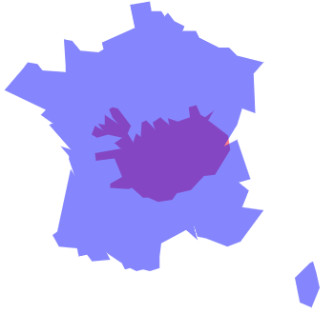

Small?
Country | Area km² | Population
Iceland | 103.000 | 360.000
Wales | 20.761 | 3.078.000
Ireland | 70.273 | 4.857.000
Sweden | 450.295 | 10.223.500
France | 643.801 | 66.998.000

Slide 3
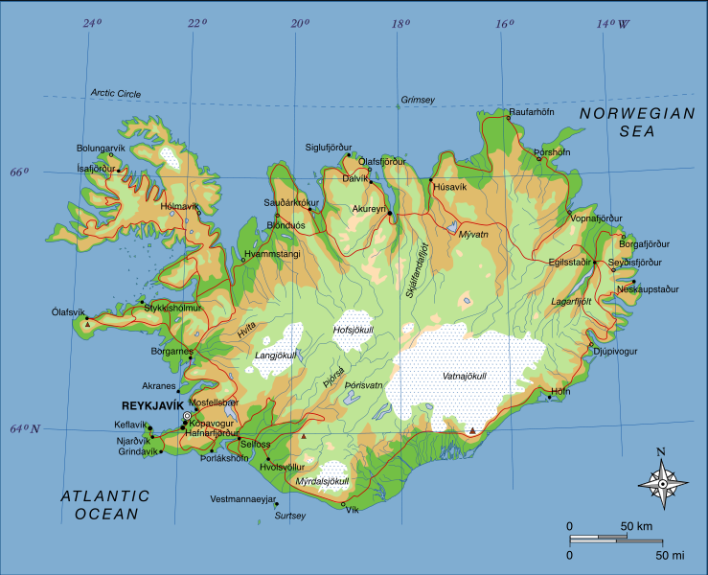

Slide 4
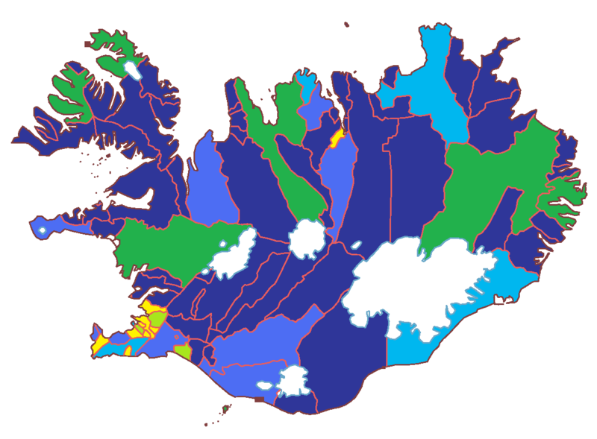
Municipalities by population
Yellow: 10,000+
Light green: 6,000-10,000
Green: 3,000-6,000
Light blue: 2,000-3,000
Blue: 1,000-2,000
Dark blue: 43-1,000

Slide 5
Governance
The State is responsible for the upper secondary level and higher education
Local municipalities are responsible for the pre-primary schools and compulsory school (primary and lower secondary schools)
  administration and financing
  general teaching and substitute teaching
  specialist services
  special education
General policy for pre- primary school and compulsory school operations in the municipality.
Pre-primary school/compulsory school committee, elected by the local authorities, shall be in charge of school affairs on behalf of the local authorities.

Slide 6
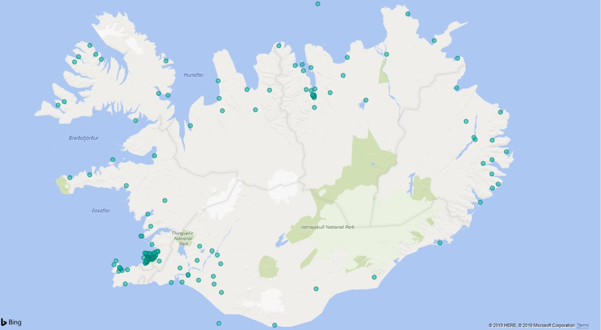
Schools in Iceland

Slide 7
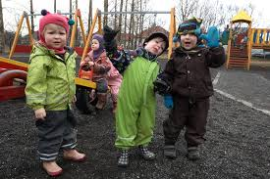
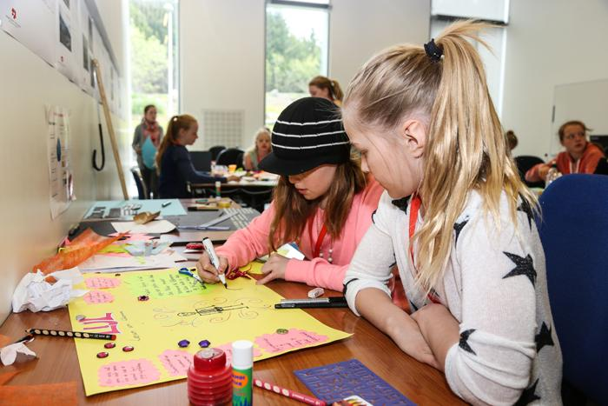
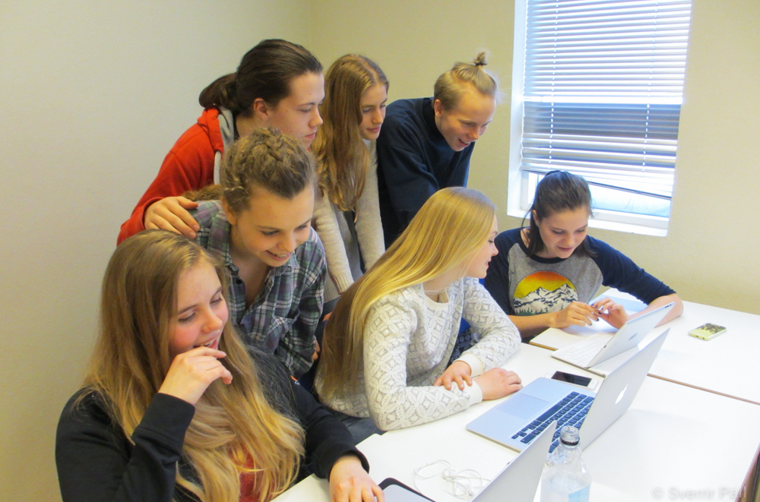
250 Pre-schools. Six evalued a year
170 Compulsory schools 27 evalued a year
41
6
5
31 Upper secondary schools 6-7 evalued a year

Slide 8
Challenge in being small
Few inspectors work at the Inspectorate
Lack of educated inspectors – and CPD for inspectors
All know each other
  Disqualification of evaluators
  Relationship and relatives
  Prejudice!
The cost of evaluation is high for small municipalities
Most municipalities are very small and have uneven ability to ensure that the evaluation leads to improvements
Notes:
development

Slide 9
Challenge in being big
Schools are scattered and travelling takes a long time for inspectors
Planning for visits
  Transports
  Seasons – no access to some schools
Inspectors have to stay for days away from home and the office
It is costly to train inspectors around the country

Slide 10
Opportunities
Cooperation in evaluation
Inspectors must have a broad experience of schools and communities
Inspectors know each others well
Lines of communications are short
Flexibilities, not a heavy system
People in small communities are close and keen to help their school and participate in evaluation

Slide 11
Our „product“
On school level –
Teachers feedback after classroom visits
Full report and a summary of good practice and what can/must be done better in the school
Data on teaching and learning
School profile
On policy level –
Short introduction of each school
Data of teaching practises and students learning behaviour
Student teacher ratio
Holistic picture in details of trends
… and evaluation of evaluators!

Slide 12
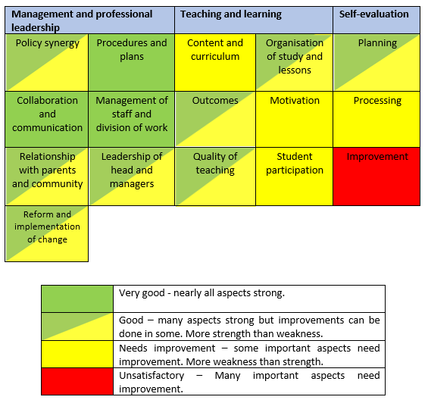

School profile

Slide 13
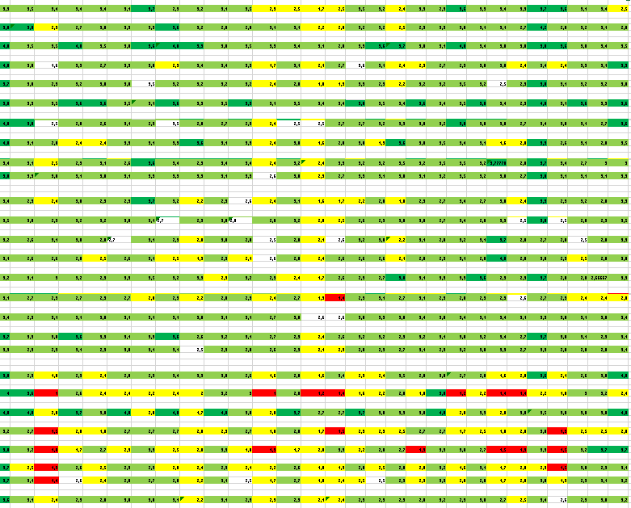
Profiles for policymaking

Slide 14
Classroom observations

Slide 15
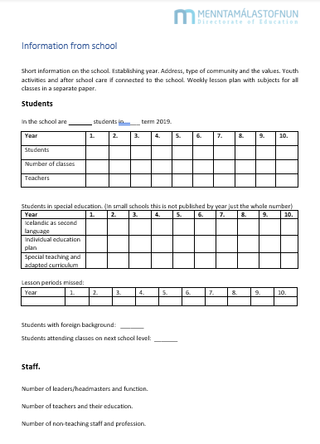
Information from schools on
students, special needs student, student with foreign background
lesson periods missed,
Teachers and other working in the school.

Slide 16
Challenges for all not just the small
Students participation – students voice
Parents participation
Honest answers
Municipalities/schoolboards ownership of the evaluation and commitment to improvement
How to ensure further improvements in school operations in the wake of external evaluation

Slide 17
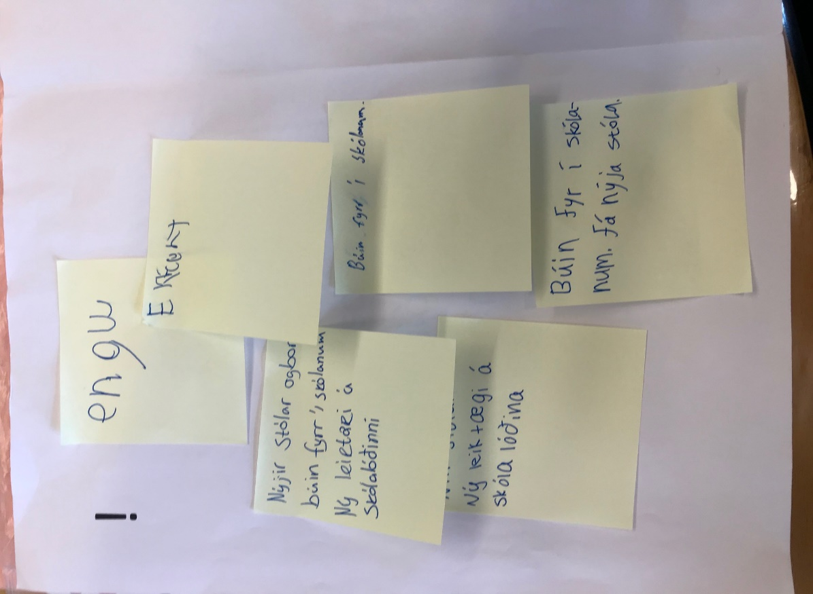
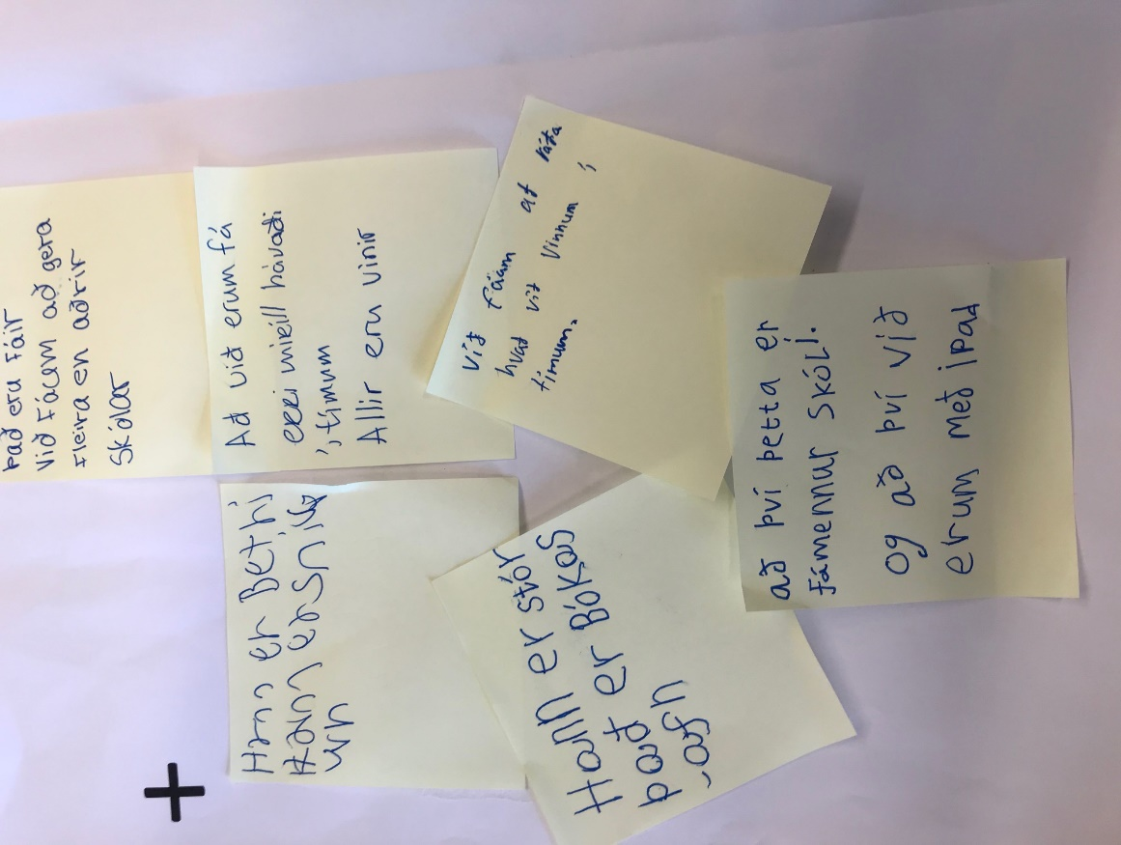

Slide 18

Thank you
?
Þóra Björk Jónsdóttir
Menntamálastofnun
thora.bjork.jonsdottir@mms.is

Slide 19
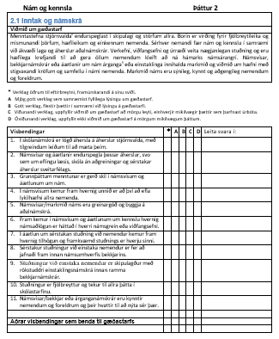
Matsþáttur
Nám og kennsla
Viðmið
Kaflar
Inntak og námskrá
Árangur náms
Gæði kennslu
Skipulag náms
Námsvitund
Ábyrgð og þátttaka
Vísbendingar

Slide 20
Gátlistar
Stefnumótun | Já - nei
Skólanámskrá, þ.m.t. námsvísar/bekkjar-/árganganámskrár, er birt á heimasíðu skólans.
Starfsáætlun er birt á heimasíðu skólans og/eða á annan aðgengilegan hátt.
Áætlanir um nám og kennslu sem ná til skólaárs eða annar eru skráðar og birtast í skólanámskrá.
Stefna skólans er skýrt fram sett og birtist á heimasíðu skólans.
Skólinn hefur mótað einkunnarorð/gildi skólastarfsins.
Í stefnu skólans kemur skýrt fram að lýðræðisleg vinnubrögð séu viðhöfð í öllum þáttum skólastarfs.
Í skólanámskrá kemur fram hvað felst í jákvæðum skólabrag.
Í skólanámskrá er sett fram stefna skólans og markmið með kennsluháttum.
Skólanámskrá er skýrt fram sett, birt opinberlega og aðgengileg.
Starfsáætlun er uppfærð árlega.

Slide 21
Viðmiðin og kynning á matinu
Leikskólaviðmið (SFS) https://reykjavik.is/sites/default/files/ymis_skjol/skjol_utgefid_efni/1_vidmid_og_visbendingar_2_prentun.pdf
Nýju viðmið grunnskóla eru á heimsíðu MMS https://www.mms.is/sites/mms.is/files/gaedastarf_4.9.2018.pdf
Kynning á ytra mati grunnskóla https://mms.is/kynning-a-framkvaemd
Matsviðmið framhaldsskóla https://mms.is/sites/mms.is/files/matsvidmid_framhaldsskola.pdf

