Slide 1

Inspecting (for) Equity and Excellence. Making Inspection Feedback Work.
SICI meeting
November 19th 2021
Stockholm
Jan Vanhoof – Antwerp University

Slide 2
This lecture
About Equity and Excellence (and why it should be on your agenda)
(1 slide on) What it takes from schools
Four pathways for effective inspectorates (Equity and Excellence)

Slide 3

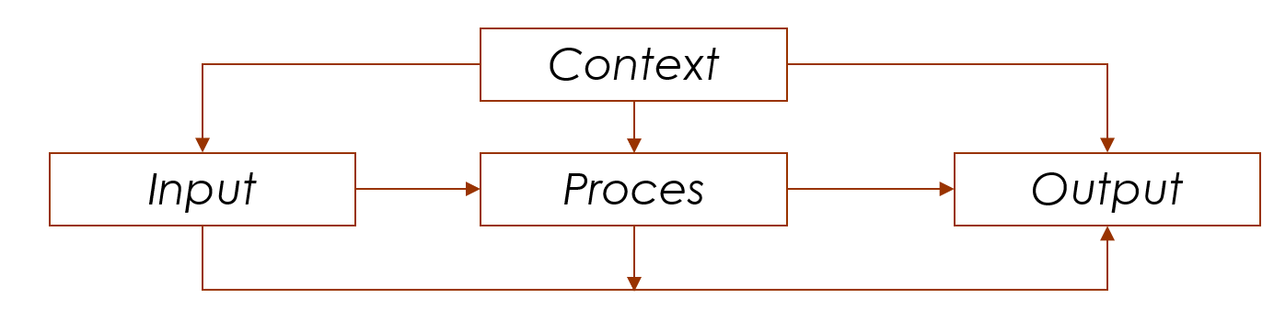
Educational quality: a unifying concept?

Slide 4
Educational quality:
a tricky concept
Subjective
Evolutionary
Context-sensitive
Manipulative

Slide 5
Equity and excellence: conceptual
Equality: equal distribution of IPO among students
Equity: fair distribution of IPO among students. Everyone gets what it takes to be successful.
Excellence: productivity view, attainment of aspired output.

Slide 6
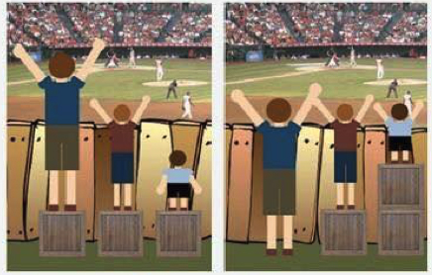
Equity and excellence:
Avoid thinking in a dichotomy
Ethical-ideological issues
How many differences do we accept in the use of resources across students?
  “pull yourself up by your own bootstraps”
How many differences do we accept in final performances across students?
  “look for the largest collective gross learning effects”
Notes:
Collectieve leerwinst: minima voor iedereen, sterke leerlingen kunnen excelleren

Slide 7
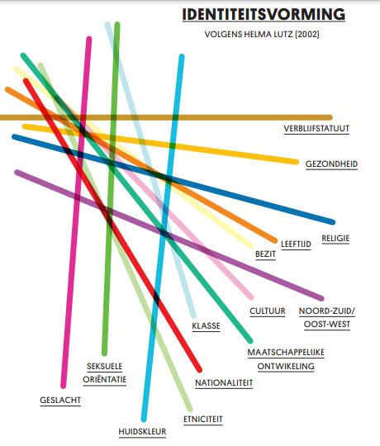
Equity means being fair over…?
Intersectional thinking

Slide 8
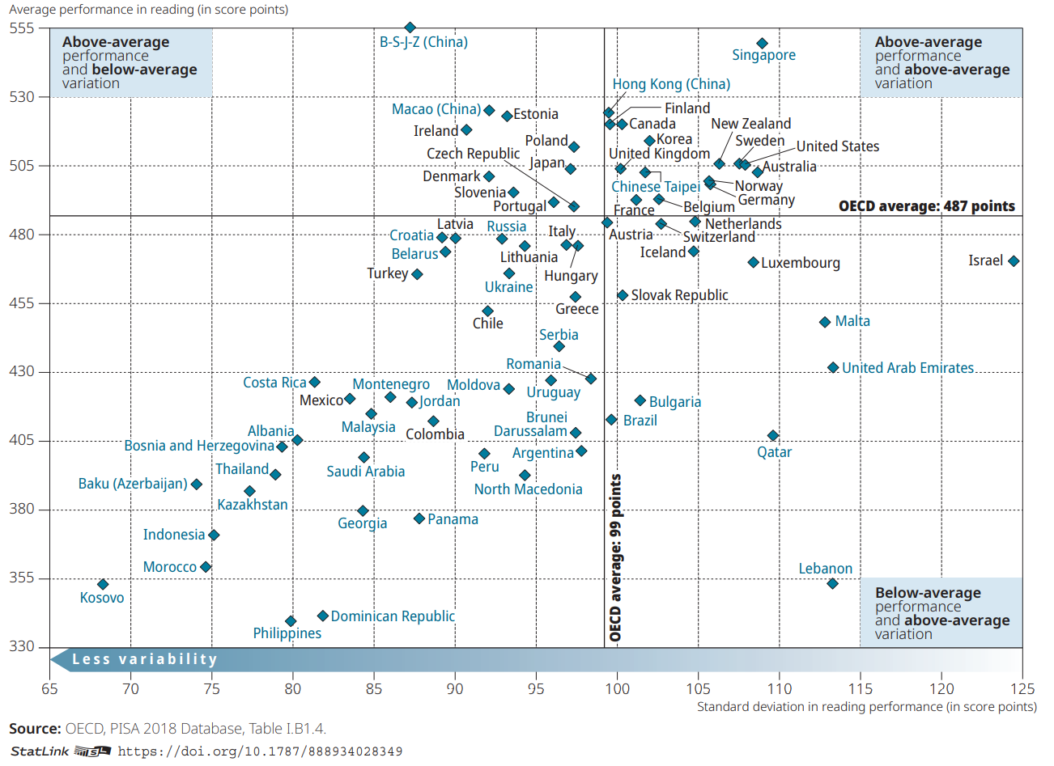
Equity and excellence: empirical (Pisa 2019, reading)

Slide 9
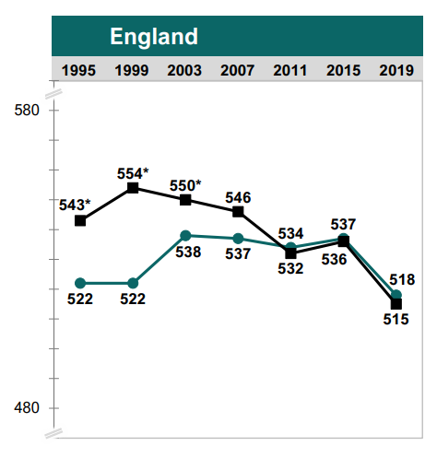
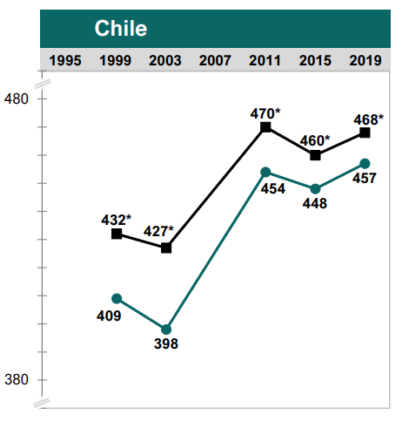
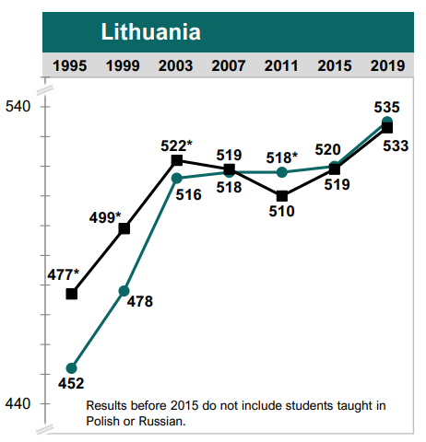
Equity and excellence: not only about gap reduction
TIMSS 2019: Trend Plots of Average Science Achievement Across Assessment Years by Gender

Slide 10

Equity and excellence: not only about gap reduction
Do you know what the pattern looks like for your context?
For gender, for economic status, for migration background or not?

Slide 11
Combining equity and excellence pays off…
Social cohesion and social mobility
Higher welfare - Capacity of economies to grow/innovate
Individual student emancipation (health, job satisfaction)

Slide 12
Implications for inspection
Inspection systems vary
Goals (accountability, improvement, capacity building)
Standards and targets (process, output)
Measurement methods (tests, desk research, school inspections, results of internal evaluations)
Stakes ((public) sanctions or rewards, interventions)
Reporting (public reports of schools, annual reports)

Slide 13
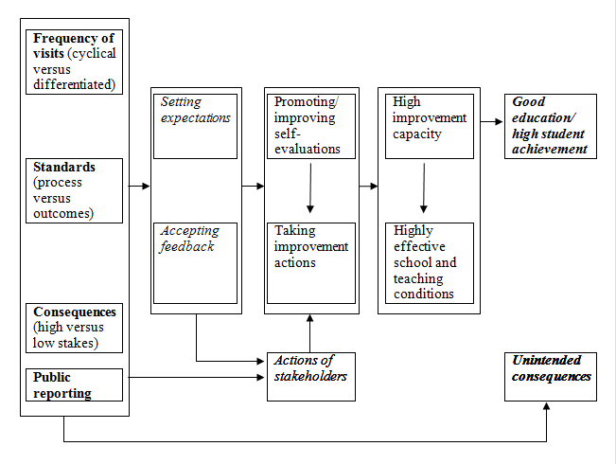
Conceptal mapping on inspection impact
M.C.M. Ehren, J.E. Gustafsson, H. Altrichter, G. Skedsmo, D. Kemethofer & S.G. Huber (2015) Comparing effects and side effects of different school inspection systems across Europe, Comparative Education, 51:3, 375-400,
Notes:
Setting expectations
Indicatoren die inspectie voorop stelt, beïnvloeden het beeld dat scholen hebben van kwaliteitsvol onderwijs op vlak van organisatie, sse, onderwijsleerpraktijken → implementeren in schoolwerking
Leraren en directies ‘passen’ zich aan om tegemoet te komen aan de verwachtingen van inspectie
Acceptatie van inspectiefeedback
Tijdens schoolinspectie geven inspecteurs feedback ( = informatie over sterktes en zwaktes van de school, rekening houdend met de beoordelingscriteria en standaarden)
Soms ook suggesties/aanbevelingen om onderwijskwaliteit te verbeteren
Inspecteurs verwachten dat scholen reflecteren over deze feedback en acties ondernemen om tekorten weg te werken en goede zaken te borgen (focus op ontwikkeling onderwijskwaliteit)
Stakeholders involvement (‘third’ party)
Door externe partners (ouders, pedagogische begeleidingsdiensten, …) te betrekken bij het evaluatieproces of in te lichten over de resultaten, wil inspectie schoolontwikkeling stimuleren
Voice
Choice
Exit
Improvement actions & capacity building
School moet voldoende verbetercapaciteit hebben om met feedback aan de slag te kunnen gaan
Schoolinspectie kan verbetercapaciteit ook stimuleren:
SSE: interne kwaliteitszorg (soms wettelijk bepaald; controle door inspectie)
Professionele ontwikkeling van schoolteam (voor, tijdens, na schoolinspectie)
Scholen in special measures: meer ondersteuning en middelen
Reorganisatie in scholen na schoolinspectie (nieuwe directie)

Slide 14
4 Key pathways (for Equity and Excellence)
Set high standards (for schools and society)
Provide targeted monitoring (to inform inspection judgement)
Provide feedback on top of judgement
Accountability pressure matters (to a centain extent)

Slide 15
Set standards (for schools and for society)
Explicitly communicate that both equity and excellence are expected
    ‘We do not accept individual students or groups being left behind.’
    ‘Learning is not a walk in the park. Our expectations are high.’
Focus framework attention on those things that matter/work
Co-create and be ‘manipulative’
Gentle but firm and demanding

Slide 16
(If you ask me) Topics to include as inspection criteria
Expect demanding curricula (rich in knowledge content)
Expect rigorous assessments
Expect support (policies)for all students, without lowering standards
Expect quality instruction
Expect school cultures that show academic optimism
Expect sufficient comprehensiveness (as far as practically feasible)
Start expecting at kindergarten inspection

Slide 17
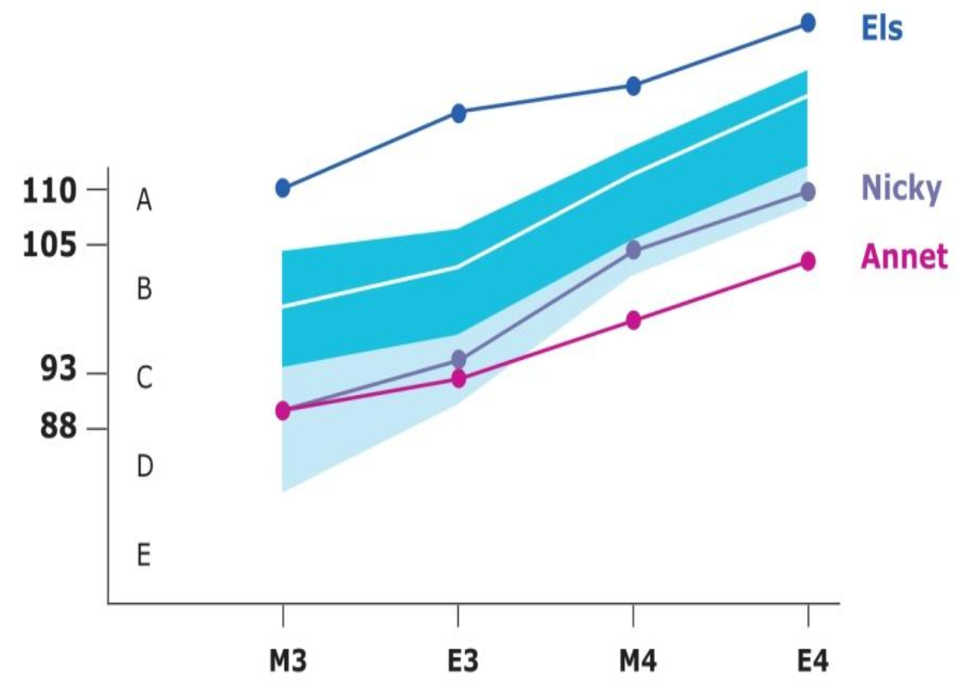
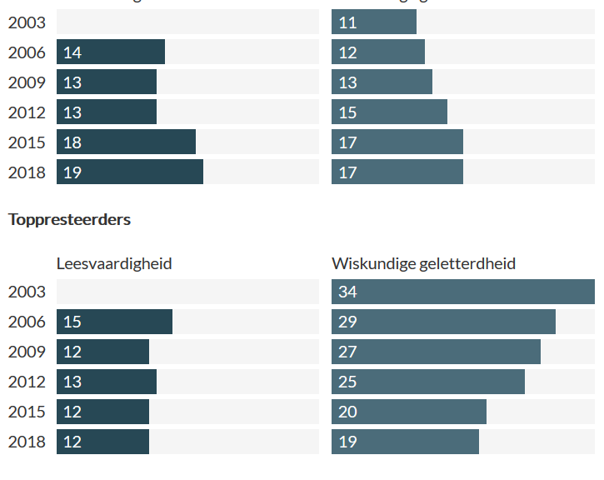
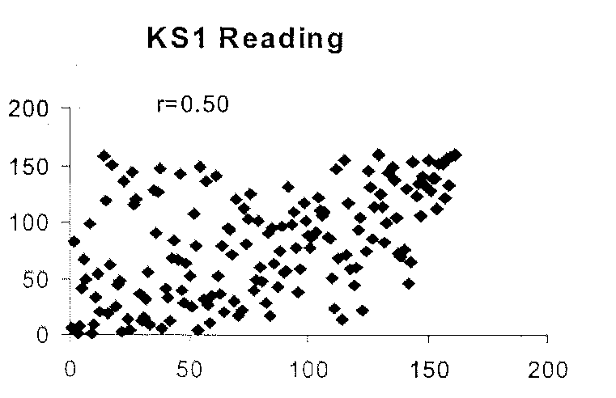
Targeted monitoring (QUAL and QUAN, processes and output)
Embed learning (gain) data (for different student groups)
Use a complete set of perspectives in doing so: standard, norm & self
% Low achievers
Reading Math
% high achievers
Reading Math

Slide 18

Inspection criteria and monitoring
Are we using the right indicators?
Are we monitoring them with sufficient regularity?

Slide 19
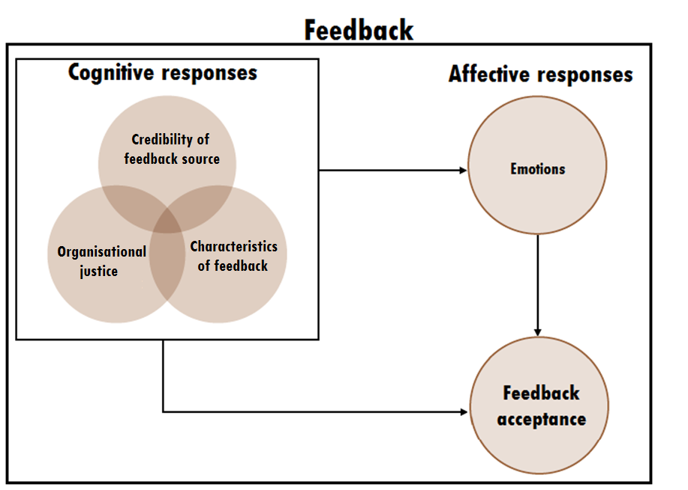
Provide feedback on top of judgement
Notes:
Mere negative judgement can harm emotional and motivational wellbeing of school staff
Teachers’ cognitive responses to feedback are crucial in the feedback acceptance process. More than emotions
Characteristics
Sign, constructiveness, clarity, relevance, specificity
Positive feedback is always better accepted (Kluger & DeNisi, 1996)
Teachers prefer constructive feedback that includes improvement suggestions (Ehren & Visscher, 2008).
Teachers accept feedback more easily, when the content is relevant to them, and consistent with their goals and expectations (Dobbelaer et al. 2017; Ehren and Visscher 2008).
Appraisal theorie: Is this feedback relevant for me (doelen/welbevinden)? Yes, affectives responses. If not, no responses,

Slide 20
Emotions during inspection (Flemish case)

Slide 21
We asked Flemish elementary school teachers...
(1=low ... 7=high)
Inspector credibility | Mean | SD
Expertise
Intelligent | 6.27 | 0.83
Well trained | 6.38 | 0.77
Expert | 6.22 | 0.90
Competent | 6.38 | 0.89
Trustworthiness
Trustworthy | 6.15 | 1.08
Caring | 5.38 | 1.23
Respectful | 5.99 | 1.49
Polite | 6.37 | 1.15
Honest | 6.15 | 1.06

Slide 22
How to improve feedback acceptance?
- Credibility: Expertise & trustworthiness
Inspectors’ abilities to identify areas for improvement
Inspectors’ negative attitude triggers resistance and rejection
Inspector training on communication skills enhances teachers’ acceptance of unfavourable inspection results
Positive relationship between school inspectors and teachers results in more acceptance of the feedback
Notes:
School inspectors have a crucial task in creating trust among school staff to foster an open evaluation culture.

Slide 23
How to improve feedback acceptance?
- Organizational justice
Distributive justice: The fairness of outcomes (or consequences of the decisions)
Procedural justice: The fairness of the inspection process
  - Transparent and bias-free
  - Clear expectations regarding frameworks used
Notes:
Distributive justice: The fairness of outcomes (or consequences of the decisions)
- Feedback users are more readily to accept negative feedback when they perceive the feedback to be correct
Procedural justice: The fairness of the inspection process
- When individuals perceive these procedures as transparent and bias-free, feedback will be more likely accepted
- Clear expectations regarding expectation frameworks lead to a higher level of feedback acceptance

Slide 24
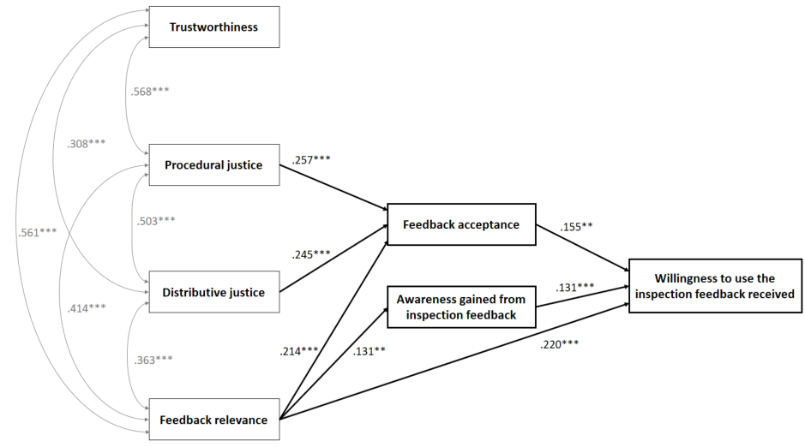

Slide 25
Accountability pressure matters (to a certain extent)
Existence of (some) accountability pressure contributes to beneficial inspection effects (Hofer, et al, 2020)
Employ a general inspection time cycle that keeps schools on track
Create tangible follow-up, grab hold on (poor performing) schools
Be transparent, but avoid public ‘quality simplisms’ that can harm schools
Notes:
school shut down, loss of status, or financial sanctions

Slide 26

Accountability pressure matters (to a certain extent)
Being held accountable is not the same as feeling accountable
Maximize schools’ identification with the accountability system
Exploit the stockholm syndrome (wisely)
Notes:
school shut down, loss of status, or financial sanctions

Slide 27
In essence (according to me)
Yes, ‘Equity and Excellence’ should be on your agenda.
We know quite a bit about what it takes from schools.
We know quite a bit about what it takes from inspectorates.

Slide 28

In essence (according to you)
What are you taking with you?
What would you like to
to take a closer look at?
What would you like to discuss (with whom)?

Slide 29
Inspecting (for) Equity and Excellence. Making Inspection Feedback Work.
SICI meeting november 19th 2021
Stockholm
Jan.Vanhoof@uantwerpen.be
Twitter: Vanhf_j

