Slide 1
Framework development in changing times
Cath Evans
Liz Miles
Assistant Directors
Cath.evans@estyn.gov.wales
Liz.miles@estyn.gov.wales

Slide 2
What is Estyn?
Estyn is the office of His Majesty’s Chief Inspector of Education and Training in Wales.
It is independent of, but funded by, the Senedd under Section 104 of the Government of Wales Act 1998.
Estyn is a word in Welsh that means to stretch or reach out.
All our work is carried out in English and Welsh.
Our aim is to achieve excellence for all in education and training in Wales.

Slide 3
Our national context
1, 470 maintained schools in Wales & 22 pupil referral units
1, 225
182
23
40
22
primary schools
secondary schools
pupil referral units
maintained all-age schools
maintained special schools

Slide 4
Providers we inspect
The sectors Estyn inspects include:
nursery schools and non-maintained settings
further education
primary, secondary and all-age schools
work-based learning
special schools and pupil referral units
adult community-based learning
independent schools and colleges
local government education services
initial teacher education
regional school improvement services

Slide 5
Organisational structure
His Majesty’s Chief Inspector
Non-Executive Directors
Strategic Directors x 2
Assistant Directors x 7
Strategic Programmes Director
His Majesty’s Inspectors (HMI)
Central Services staff
Lead inspector and lead officer roles

Slide 6
Strategic objectives
Providing public accountability: inspection
Building capacity: professional learning and best practice
Informing policy: advice and guidance

Slide 7
Estyn and the law
Inspectors must report on:
the educational standards achieved
the quality of education provided
how far education meets the needs of the range of pupils
the quality of leadership and management, including whether the financial resources are managed efficiently
the spiritual, moral, social and cultural development of pupils
whether the provision promotes healthy eating and drinking
the contribution of the provision to the well-being of pupils.
What are our legal powers and responsibilities?

Slide 8
How we inspect
What we inspect

Slide 9
Planning inspections
The inspection cycle
The notice period of inspection
Models of inspection
Quality assurance

Slide 10
Inspector roles
Lay inspector
Team inspector
Peer Inspector
Lead Inspector
Nominee

Slide 11
The Learning Inspectorate
6 Years Since Publication (2018)
Significant Reform of Inspection in Wales to align better with other reforms
‘Estyn’s contribution to supporting improvement and building capacity should be enhanced’

Slide 12
Key Aspects (out of 34 recommendations)
High stakes an issue but must maintain rigour
Given other changes afoot, phased approach
Evaluative Findings in body of dialogue not as headlines
Improve consistency
Greater use and development of Peer Inspectors

Slide 13
Our response to COVID-19
Timeline of key events
(March 2020 – June 2021 )
Thematic reports & guidance, ‘Models of blended learning’
Publication
of report on regional support for schools
Suspension of all of Estyn’s inspections
Engagement calls to providers began
April
2020
Dec
2020
June
2021
August
2020
March
2020
July
2020
Sept
2020
Jan
2021
Advice for leaders, ‘Developing approaches to support distance learning’
Report: approaches to tackling common challenges across sectors
Publication
of initial findings from engagement calls
Published
new approach to inspection

Slide 14
Inspection 2022 to 2024
Main changes (phase 1)
Removal of summative grades
More flexibility with reporting to align better with national reforms and priorities
Notice period reduced
Increased emphasis on the mindset of inspectors
Strengthening of the overview
Greter emphasis on inspecting the culture of safeguarding.

Slide 15
The shadow of the pandemic
The education reform agenda in Wales is wide ranging and prioritises the right areas, but to make it more manageable and support post-pandemic recovery, our main focus as a country is on:
Curriculum and teaching
ALN
Self-Evaluation and securing improvement
Numeracy and Literacy
Attendance and the impact of poverty on learning.

Slide 16
What have we found?
Teaching and curriculum – a mixed picture
Many schools have developed well, balancing curriculum design with teaching/learning and progression/assessment
Others struggling, particularly focusing on curriculum at expense of teaching and learning and assessment/progression
Support for Specialist subjects poor
Numeracy and Welsh as second language, in particular, a concern

Slide 17
What have we found?
Societal changes (some caused by or accelerated by pandemic)
Absenteeism and behaviour reflects wider issues
Funding pressures and decline in supporting services

Slide 18
Next Steps – Inspecting for the Future

Slide 19
Inspection 2024
Evolve current arrangements
Continue without summative gradings
Increase focus on professional dialogue – including our established nominee model
Explore ways of ensuring our inspection work complements self-evaluation and improvement in the system
Consider how we engage more frequently with schools and PRUs

Slide 20
Principles
Learners are at the heart of our inspection process
Always focus strongly on the quality and effectiveness of teaching and learning
Consider everything in the ‘what’ and ‘how’ we inspect documents, but only report on the key strengths and weaknesses - although the reports may appear slightly shorter, there will be more opportunities for professional dialogue
focus each inspection on the specific provider and adapt our approaches accordingly

Slide 21
Involve
Listen
Trial & Review
Our approach

Slide 22
2024 Arrangements
Continue to report and feedback without summative gradings
Increased focus on professional dialogue
Strengthen nominee role
Notice period remains at 10 days
Shorter questionnaires
Statutory follow up remains

Slide 23
2024 arrangements
Engage more regularly with providers
Core and ‘Interim Visit’
Core inspections will be leaner based on 3 Inspection Areas

Slide 24
Inspection Areas
Current
Learning
Well-being and attitudes to learning
Teaching and learning experiences
Care, support and guidance
Leadership and management
2024
Teaching and learning
Well-being, care, support and guidance
Leading and improving

Slide 25
Feedback to date
Reducing 5 to 3 IAs is helpful & guidance for the IAs is clear
Joint observations were well received by HMIs carrying out the try outs as well as the school’s senior leaders
Professional dialogue incredibly valuable to the process
Input from HT prior to inspection was valuable
Concise feedback via bullet points proved useful and provided clarity

Slide 26
Interim Visit
A short visit – a day or 2 by a small team (1 to 4 inspectors)
Focus on the most important recommendations from the previous inspection report or current development plan
IV conclude with feedback to the headteacher and a brief report published on our website

Slide 27
Internal challenges
Managing HMI expectation
Reaching consensus
Balancing resources

Slide 29
Our message to providers is: Don’t overprepare for inspection – just teach as you usually would.
Through our new campaign we’re debunking myths about what a provider should do before and during inspection
Our campaign features school leaders and teachers from across Wales who have recent experience of the latest inspection framework and who provide honest feedback
We want to let providers know that you’re Ready Already!

Slide 31
Barod yn Barod | Ready Already
Ysgol Gynradd Alexandra, Wrecsam
Alexandra Primary School Wrexham

Slide 32
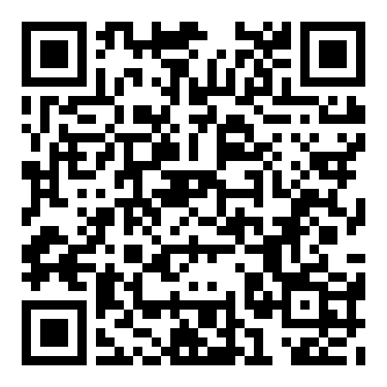
Discover more
Watch all the films, and download the toolkit

Slide 33
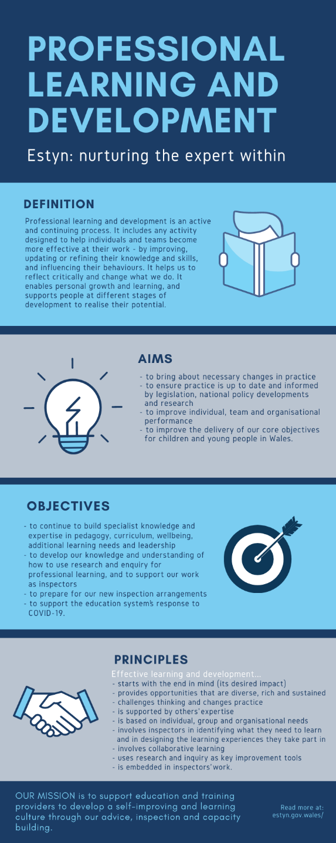
Lifelong learning
Professional learning and development weeks
Personal enquiries
Reading and reflection time
Collaborative research projects
Learning with and from schools and experts
Distance learning modules
Sector inspector networks
Continuous performance review
Conferences and courses
External inspector development programmes

Slide 34
‘In working together in our various ways, we all recognise that effective joined up thinking and working is the best way forward for learners in Wales.’

