Slide 1


How inspections in Scotland support innovation and change
Sally Stewart, HM Inspector
Louise Phillips, HM Inspector
For Scotland's learners, with Scotland's educators

Slide 2



Purpose of inspection
provide assurance for stakeholders
promote improvement
provide evidence-based advice to inform policy-making
https://education.gov.scot/improvement/documents/frameworks_selfevaluation/frwk2_nihedithgios/frwk2_hgios4.pdf
https://education.gov.scot/improvement/documents/frameworks_selfevaluation/frwk1_niheditself-evaluationhgielc/hgioelc020316revised.pdf
https://education.gov.scot/improvement/Documents/HGIOURS-Part1.pdf
https://education.gov.scot/improvement/Documents/HGIOURS-Part2.pdf
For Scotland's learners, with Scotland's educators

Slide 3
Inspection: not just schools!
As set out in the annual programme of inspection activity
SECTOR
early learning and childcare settings
primary schools
secondary and all-through schools
special schools
community learning and development services
independent schools
public and private colleges
English language schools
local authorities
prison education settings
modern apprentice training
career information, advice and guidance services
voluntary organisations
children’s services
https://education.gov.scot/who-we-are/management/Annual%20Programme%20of%20Inspection%20Activity

Slide 4
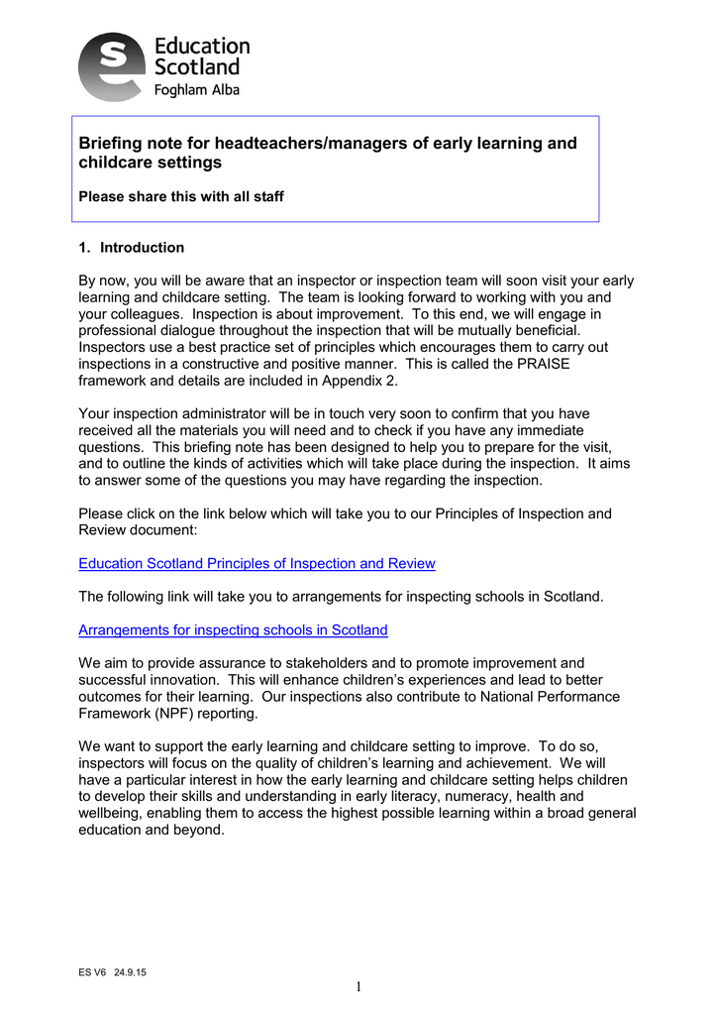
Education Scotland - committed to openness and transparency
Guidance and support
‘Through inspection, Education Scotland aims to promote improvement and successful innovation to enhance learners’ experiences and achievements’
HT Briefing 2016-17
https://education.gov.scot/Documents/PrimaryHeadteacherBriefingNote170816.pdf
For Scotland's learners, with Scotland's educators

Slide 5

Inspection: a three-way partnership
schools/settings evaluate the quality of their own provision
supported and challenged by the local education authority
backed up by rigorous external evaluation by HM Inspectors
-------------------------------------------------
Evaluations of set quality indicators and one additional quality indicator, which is the school’s own choice
For Scotland's learners, with Scotland's educators

Slide 6
Associate Assessors and Professional Associates
Associate Assessors were asked about the impact of being an Associate Assessor (AA) on
their own career-long professional learning.
skills, experience and knowledge they had developed to assist with the internal self-evaluation and quality improvement processes; to inform improvement planning; to evaluate learning and teaching; and to contribute to professional learning for colleagues
used their experience, training and their exposure to highly effective practice to lead developments in their own establishment or authority .
A key element for me in being an AA is gaining an insight into developing practice across the sector and geographically across the country. I consider my deployment as an AA as the best professional learning I can hope to get. The learning I have brought back has always been shared with other AAs in the authority in the first instance and where appropriate elements of that learning have influenced practice in my teams.
For Scotland's learners, with Scotland's educators

Slide 7
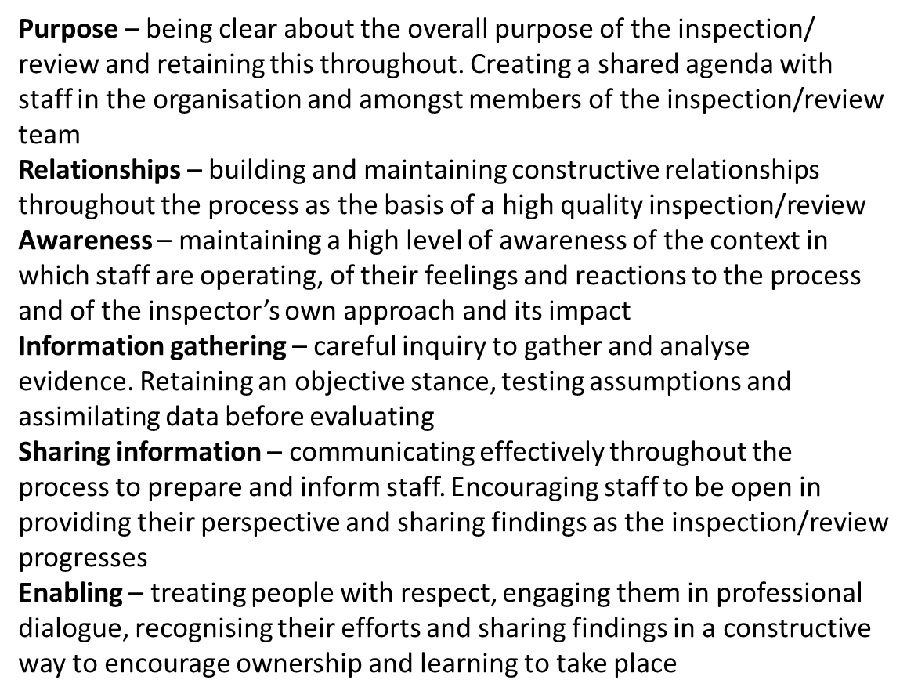
Best practice framework for inspections and
reviews (PRAISE framework)
The following principles were identified as underpinning best practice:
PRAISE framework
https://education.gov.scot/Documents/praise-framework.pdf
For Scotland's learners, with Scotland's educators

Slide 8

Inspection of local authorities
Nine Inspections of local authorities:
Clackmannanshire Council
Dundee City Council
East Ayrshire Council
Glasgow City Council
Inverclyde Council
North Ayrshire Council
North Lanarkshire Council
Renfrewshire Council
West Dunbartonshire Council
Inspection of local authorities
How well is Glasgow City Council improving learning, raising attainment and closing the poverty-related attainment gap?
March 2019
https://education.gov.scot/assets/contactorganisationinspectionreports/glasgowlains110319.pdf
For Scotland's learners, with Scotland's educators

Slide 9

National thematic inspections
Readiness for empowerment
Curriculum leadership
Parent and pupil participation
Numeracy and mathematics
https://education.gov.scot/what-we-do/inspection-and-review/thematic-reports/National%20thematic%20inspection:%20readiness%20for%20empowerment
https://education.gov.scot/what-we-do/inspection-and-review/thematic-reports/national-thematic-inspection-numeracy-and-mathematics
https://www.gov.scot/binaries/content/documents/govscot/publications/publication/2018/06/education-bill-policy-ambition-joint-agreement/documents/00537386-pdf/00537386-pdf/govscot%3Adocument
For Scotland's learners, with Scotland's educators

Slide 10
Sharing highly effective practice more widely
Inspectors signpost effective practice from which others can learn and offer advice and guidance about improved ways of working.
Sketchnotes provide a visual description of the practice and approaches HM Inspectors have observed during scrutiny activities.
Supports innovation and change.
https://education.gov.scot/improvement/self-evaluation/sharing-highly-effective-practice
For Scotland's learners, with Scotland's educators

Slide 11

Sharing highly effective practice identified through inspection
For Scotland's learners, with Scotland's educators

Slide 12
Education Governance: Next Steps (SG, 2017)
Priorities
“Working in partnership with local authorities and partners to develop the shape and composition of the regional improvement collaboratives. We will ensure that the experience of current and emerging partnership working informs the establishment of regional improvement collaboratives.”
https://www.gov.scot/publications/education-governance-next-steps-empowering-teachers-parents-communities-deliver-excellence/
For Scotland's learners, with Scotland's educators

Slide 13
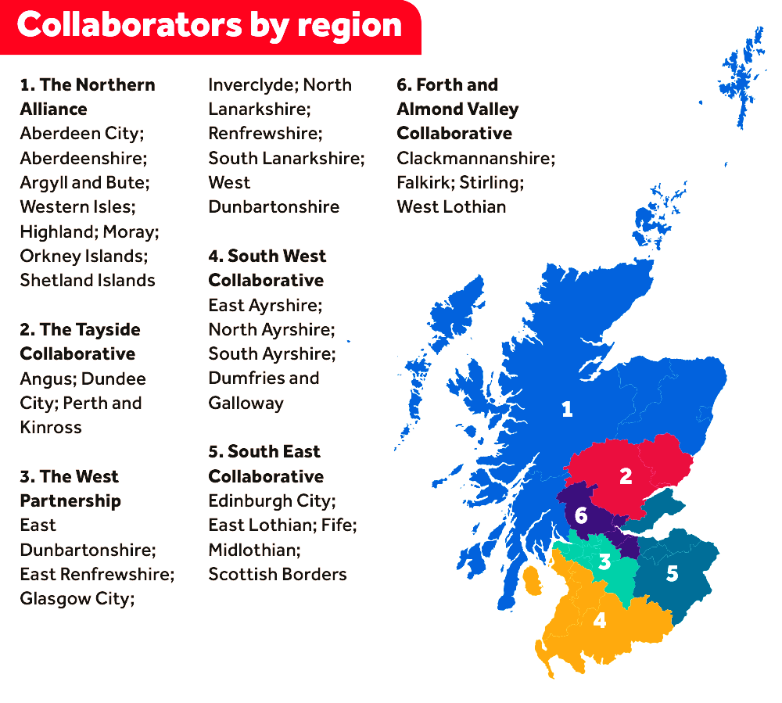
The Northern
Alliance
Forth Valley
& West Lothian Collaborative
The Tayside Collaborative
The West
Partnership
South East
Collaborative
South West
Collaborative

Slide 14
Reflections and questions…
For Scotland's learners, with Scotland's educators

Slide 15
Our contact details:
sally.stewart@educationscotland.gov.scot
louise.phillips@educationscotland.gov.scot
For Scotland's learners, with Scotland's educators

