Slide 1
Presentation to SICI in Tirana
Patrice BLEMONT
IGAENR/IGEN France

Slide 2
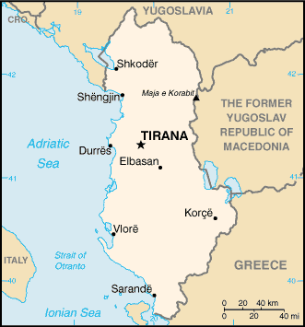
Inspectorates, leaders of change
Mirëmëngjes, me falni, unë nuk flas shqip …
Excusez moi, je ne parle pas l’Albanais
Excuse me, I do not speak albanese

Slide 3
Inspectorates leaders of change
Quick presentation about our procedures and our goals
focus on what could change for the times to come
how the inspectorates try to act to boost the changes we wish in the global system.

Slide 4
Inspectorates, leaders of change
there are two general inspectorates in my country.
History explains this.

Slide 5
Inspectorates, leaders of change
Purposes and procedures of the inspectorates
Relations with regional inspectorates

Slide 6
Inspectorates, leaders of change
Quick focus on regional organisation
Quick focus on the regional inspectorates, may be the bedrock of the system ...

Slide 7
Inspectorates, leaders of change
2 examples of change in the times being:
1. Priority education
2. General reform of the « collèges)

Slide 8
Inspectorates, leaders of change.
A focus on the time coming in education in France
Dealing with changes: some examples

Slide 9
See you later …
Mirupafshim, faleminderit!
Thanks a lot and see you soon.
Merci beaucoup et à bientôt.

