Slide 1

SICI Workshop
13 – 14 November 2017
In Scotland, how does inspection impact on education policies?
Notes:
This is a front cover page and can only be used once. Use the corresponding blue internal and back pages if you are using this page. You may add a title and a subtitle if needed only. Do not add anything else or move elements around.

Slide 2
The role of Education Scotland
Education Scotland is the national improvement agency for the education sector.
As an Executive Agency, it operates impartially and independently of the Scottish Government, while remaining accountable to Scottish Ministers for its work.
Current Mission:
‘to provide the best blend of national support and challenge to inspire and secure continuous improvement in experiences and opportunities for all learners in Scotland.’
  Two key roles include:
    Direct support for practitioners
    Support and challenge through inspection
Notes:
This is an internal page in blue and can be duplicated to create additional pages. Always keep the heading and footer as shown. Use the corresponding blue internal and back pages if you are using this page.

Slide 3
Further role
Influencing national policy through evidence-based advice
Role of Education Scotland professional staff (including inspectors) includes:
  Providing information to Scottish Ministers
  Liaising regularly and constructively with Scottish Government policy colleagues
  Generating extensive, detailed evidence from a wide range of activities
  Adhering to the principles of the Virtuous Cycle of Improvement’
Notes:
This is an internal page in green and can be duplicated to create additional pages. Always keep the heading and footer as shown. Use the corresponding green front and back pages if you are using this page.

Slide 4
Creating a virtuous cycle of improvement
Nationally shared aims and goals
applied and
developed
flexibly in
local contexts
Core principles, experiences and expected outcomes
BETTER LEARNING
knowledge
spread
effectively to
practitioners
impact
evaluated
at multiple
levels
knowledge drawn
out about
‘what works’
external research and intelligence
Notes:
Pulling all the strands of policy and strategy together can be summarised as one in which we are seeking to build and support a learning system.
A learning system is one in which the strong collective engagement of a highly professional workforce creates a virtuous cycle of evidence-based improvements in practice. This virtuous cycle can drive improvement in any or all sectors of education.
Our learning system has learners at the centre and relies on a high-quality professional workforce to make it work. To function at its best it:
Ensures practitioners have broad, enabling national guidance with clear expected outcomes
Encourages local interpretation and application in practice, with incentives for well-managed innovation
Ensures evaluation takes place at appropriate levels, ranging from internal to external and local to national
Brings in external evidence from high-quality research
Is vigorous in identifying and sharing evidence about what works in ways which are wel suited to informing decision-making by practitioenrs at the front line

Slide 5
Inspection evidence
Why is it valued so highly by policymakers?
  Independent and objective
  Provides insight into what is really happening on the education frontline
  Focuses on specific topics in national reports, which have recommendations, e.g:
    Tackling bureaucracy
    Technical education
  At local authority level, Area Lead Officers use inspection evidence to inform and support policy change
Notes:
This is an internal page in blue and can be duplicated to create additional pages. Always keep the heading and footer as shown. Use the corresponding blue internal and back pages if you are using this page.

Slide 6

Changes within Scottish Education
Development of the National Improvement Framework and Improvement Plan (NIF)
      Integrated, streamlined priorities and drivers for improvement
      Central, widely-agreed plan of action for everyone involved in education
      Importance of data to evaluate progress with NIF
      Education Scotland joint programme with Scottish Government Learning Directorate policy colleagues to develop NIF
Notes:
This is an internal page in green and can be duplicated to create additional pages. Always keep the heading and footer as shown. Use the corresponding green front and back pages if you are using this page.

Slide 7
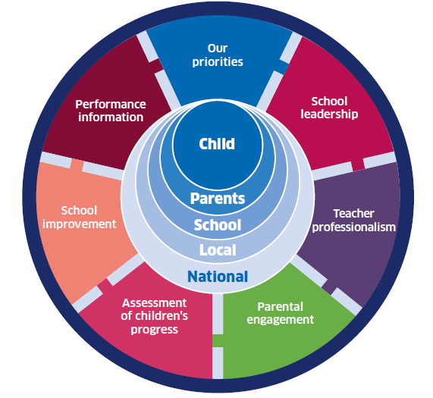
Alignment of inspection with NIF
        Alignment of new quality indicators (HGIOS 4) with NIF
        Design and launch of new, tailored inspection process 2016
        Now direct link between inspection evidence and NIF reporting on key improvement drivers
Notes:
This is an internal page in blue and can be duplicated to create additional pages. Always keep the heading and footer as shown. Use the corresponding blue internal and back pages if you are using this page.

Slide 8
Impact of Inspection on NIF
Involvement of Education Scotland staff in using inspection evidence to shape policy
  Workstreams for each NIF driver
  Discussions about potential amendments to NIF
Notes:
This is an internal page in green and can be duplicated to create additional pages. Always keep the heading and footer as shown. Use the corresponding green front and back pages if you are using this page.

Slide 9

Conclusion
  In Scotland at present, there has been a strong drive to position inspection, and the evidence it gathers, so that it impacts positively on Government policy development.
  This seems like good way forward.
Notes:
This is an internal page in blue and can be duplicated to create additional pages. Always keep the heading and footer as shown. Use the corresponding blue internal and back pages if you are using this page.

Slide 10
Graeme Logan, Interim Chief Inspector of Education and Chief Advisor on Education
Notes:
This is a back cover page in green. You may edit the address if needed only. It can only be once and at the end of the PowerPoint presentation. Use the corresponding green front and internal pages if you are using this page.

