Slide 1

SICI Questionnaire
Results
General Assembly
Stockholm, Sweden
18.11.2021
Gordana Capric
Erik de Bou
Herman Franssen

Slide 2
Content
1. Purpose and method
  The purpose of the questionnaire
  Method
2. Results
  Completed questionnaires
  Most chosen items ‘Need for knowledge/experience`
  Most chosen items ‘Sharing practice/experience’
  Matching:
    Which countries indicate a score of 4 or 5 when there is a need of knowledge? And which countries indicate a score of 4 or 5 in sharing practices?
  Job shadowing
3. Next steps
Content
Purpose
Results
Next steps

Slide 3

1. Purpose and method

Slide 4
Purpose
Content
Purpose and method
Results
Next steps
  Goals in strategic plan
  1. Support improvement of inspectorates and the professional competence of inspectors
  - Provide advice, support and evidence based on the experience of members to enhance the professional learning or inspectors.
  - Promote joint learning events like peer reviews and job shadowing.
  2. Promote and support partnership and cooperation between inspectorates.
  - Promote projects by taking stock of members' needs and actively use calls for proposals.

Slide 5
Purpose
Content
Purpose and method
Results
Next steps
  We present an overview based on the questionnaires.
  Subsequently, the members themselves can discuss whether they can come to a form of cooperation.
  This could include various forms of collaboration:
  ∙ Exchange of knowledge and materials
  ∙ Joint meeting to share experiences and knowledge
  ∙ Organizing mutual job shadowing/study visits
  ∙ Organizing peer review
  ∙ Setting up a joint project

Slide 6
Method
Content
Purpose and method
Results
Next steps
  The topics of the questionnaire were about:
  Inspection models/Roles and tasks of inspectorates
  Development of inspection/evaluation framework
  Inspection processes
  The impact of inspection work
  Professionalization of inspectors/evaluators/staff
  Internal quality assurance of inspectorate
  Cooperation with stakeholders
  Other themes and topics

Slide 7
Method
Content
Purpose and method
Results
Next steps

Slide 8
2. Results

Slide 9
Overview of the completed questionnaires
 | Inspectorate/Agency | Country/Region/Territory
1 | BMBWF | Austria
2 | Inspectorate | Basque Country
3 | Autonome Hochschule Ostbelgien | Belgian German Speaking area
4 | Service général de l'Inspection | Belgium - Fédération Wallonie-Bruxelles
5 | Flemish Inspectorate | Belgium/Flanders
6 | National Inspectorate for Education | Bulgaria
7 | Cyprus Inspectorates | Cyprus
8 | Czech School Inspectorate | Czech Republic
9 | Estonian MInistry of Education and Research | Estonia
10 | Finnish Education Evaluation Centre | Finland
11 | Inspection générale de l'éducation, du sport et de la recherche (IGÉSR) | France
12 | College of Directors of Basic Education | G-D Luxembourg
13 | Department for Evaluation Hesse, Germany | Germany, Hessen
14 | Lower Saxon institute of school qualitiy development (NLQ) | Germany, Lower Saxony
15 | Quality Analysis North Rhine-Westphalia | Germany, North Rhine-Westphalia
16 | Qualitätsagentur am Landesamt für Schule | Germany/Bayern
17 | Inspectorate, Department of Education | Ireland
18 | Quality Assurance Department, Directorate for Quality and Standards in Education | Malta
19 | Bureau for educational services of Montenegro | Montenegro
20 | Norwegian Directorate for Education and Training | Norway
21 | Inspectorate of Education and Science | Portugal
22 | Regional inspectorate of Madeira | Portugal - Região Autónoma da Madeira
23 | National Agency for Quality Assurance in Education and Research | Republic of Moldova
24 | Institute for Education Quality and Evaluation | Serbia
25 | State School Inspectorate | Slovakia
26 | Inšpektorat RS za šolstvo in šport | Slovenia
27 | Swedish Schools Inspectorate | Sweden
28 | Dutch Inspectorate of Education | The Netherlands
29 | State Service of Education Quality of Ukraine | Ukraine
30 | Independent Schools Inspectorate | United Kingdom, England
31 | Ofsted | United Kingdom, England
32 | Education Scotland | United Kingdom, Scotland
33 | Estyn | United Kingdom, Wales
Content
Purpose and method
Results
Next steps
Notes:
A total of 33 members participated in the research.
In total 28 out of 33 questionnaires was filled by the national coordinator. Rest of 5 was filled by: Director or Deputy Director, Chief inspector or participants in the focus group.

Slide 10
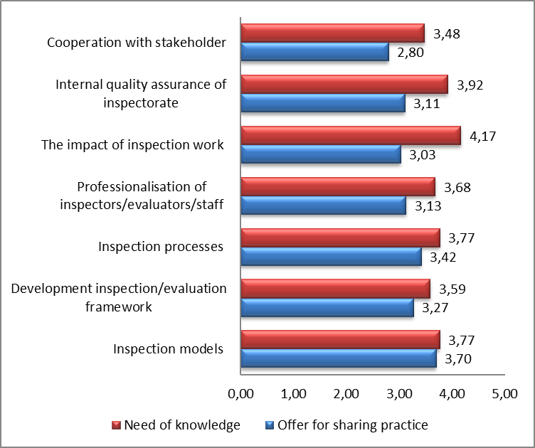
Results per domain
Mean scores
Content
Purpose and method
Results
Next steps

Slide 11
Needs for knowledge/experience
10 most chosen items
Need for knowledge/experience | Score 4 | Score 5 | No. of members
The impact of inspection work [Evaluation of the impact on overall quality of education] | 10 | 19 | 29
The impact of inspection work [Evaluation of the impact of inspection/external evaluation work on schools and providers of education] | 9 | 19 | 28
Inspection processes [Use of data] | 9 | 14 | 23
Inspection models [Flexibility: Adopting inspection model(s) to changing situation(s)] | 12 | 11 | 23
Cooperation with stakeholder [Collaboration with research-organizations] | 13 | 9 | 22
Internal quality assurance of inspectorate [Aspects of quality assurance of inspectorates] | 8 | 14 | 22
The impact of inspection work [Impact on policy makers] | 8 | 13 | 21
Internal quality assurance of inspectorate [Reliability of judgments] | 8 | 13 | 21
Inspection processes [Communication: strategies, reports...] | 9 | 12 | 21
Inspection processes [Triangulation/collecting evidence during inspection] | 7 | 12 | 19
Content
Purpose and method
Results
Next steps

Slide 12
Needs for knowledge/experience –
The overview which countries indicate a score of 4 or 5
Content
Purpose and method
Results
Next steps
Notes:
Needs for knowledge/experience – The overview which countries indicate a score of 4 or 5

Slide 13
Offers for sharing practice
10 most chosen items
Content
Purpose and method
Results
Next steps
Offer for sharing practice | Score 4 | Score 5 | No. of members
Inspection models [Roles and tasks of inspectorates] | 11 | 9 | 20
Development inspection/evaluation framework [How to develop framework and inspection and/or evaluation tools] | 10 | 10 | 20
Inspection processes [Collection of data] | 11 | 5 | 16
Inspection processes [Use of data] | 11 | 5 | 16
Inspection models [Flexibility: Adopting inspection model(s) to changing situation(s)] | 8 | 8 | 16
Professionalization of inspectors/evaluators/staff [General training programmes for new inspectors/evaluators and/or staff] | 6 | 10 | 16
Internal quality assurance of inspectorate [Aspects of quality assurance of inspectorates] | 10 | 5 | 15
Inspection processes [Triangulation/collecting evidence during inspection] | 7 | 8 | 15
Cooperation with stakeholder [Cooperation/relation with government] | 8 | 5 | 13
The impact of inspection work [Evaluation of the impact of inspection/external evaluation work on schools and providers of education] | 7 | 6 | 13
Notes:
10 most chosen items with a score of 4 and 5

Slide 14
Offers for sharing practice –
The overview which countries indicate a score of 4 or 5
Content
Purpose and method
Results
Next steps
Notes:
Offers for sharing practice – The overview which countries indicate a score of 4 or 5
Per item

Slide 15
Matching
Example: Use of data
Content
Purpose and method
Results
Nest steps
Need for knowledge/experience |  | Sharing practice
Inspectorate/Agency
Bulgaria | 5 | Czech Republic | 5
Luxembourg | 5 | Estonia | 5
Germany, Lower Saxony | 5 | France | 5
Republic of Moldova | 5 | Germany, Lower Saxony | 5
Portugal | 5 | Belgian German Speaking | 5
Estonia | 5 | Malta | 4
United Kingdom, England / ISI | 5 | Basque Country | 4
France | 5 | Ireland | 4
Malta | 5 | Portugal - Madeira | 4
Austria | 5 | Ukraine | 4
Czech Republic | 5 | Serbia | 4
Belgian German Speaking | 5 | Montenegro | 4
Sweden | 5 | The Netherlands | 4
Belgium/Flanders | 5 | Cyprus | 4
Germany, Hessen | 4 | Sweden | 4
Ireland | 4 | Austria | 4
Portugal - Madeira | 4
Slovenia | 4
Ukraine | 4
Serbia | 4
United Kingdom, England / Ofsted, | 4
Slovakia | 4
Basque Country | 4
Notes:
Which countries indicate a score of 4 or 5 when there is a need of knowledge? And which countries indicate a score of 4 or 5 in sharing practices?

Slide 16
Jobshadowing
Content
Purpose and metyhod
Results
Next steps

Slide 17
3. Next steps

Slide 18
Next steps
Final report will be available
Discuss the results in NC meeting and at open forums
Investigate possibilities for cooporation
Application for financial contribution to projects that countries want to carry out jointly
Agenda
Purpose and method
Results
Next steps
Notes:
The project is designed as a multilateral project of minimum 3 members.
1. All participating members co-finance and invest human resources into the project.
2. The project aims at developing or at further exploring an aspect of the SICI strategic plan. The aims are part of a short project description.
3. There is a project budget.
4. A plan for evaluating the project is presented with the application.
5. The dissemination into SICI is planned (Minimum: report in a workshop or GA)
A member of the EC will be appointed as a contact person for the project.

Slide 19
Thank your for your attention

