Slide 1
Inspection and Innovation
SICI Workshop Bratislava 2013
Professor Graham Donaldson CB

Slide 2
Shapers of educational policy
Societies
Work
Families
Connectivity
Globalisation
‘Trends Shaping Education 2013’ (OECD)

Slide 3
Globalisation
Interdependence and competition
BRICS but also Turkey, Phillippines, Nigeria, Thailand
Migration leading to greater ethnic and cultural diversity
Environmental issues like global warming
National identity and trans-national communities

Slide 4
Societies
Transformed
Urbanisation – by 2050 around 85% of world’s population in cities
Demographic shift to ageing population – loss of tax revenues and increased costs
Civic participation – democratic deficit

Slide 5
Skills and Work
Family/work balance
Gender issues – wages and top jobs
Skills are global currency of twenty-first century
Human capital – know-how, creativity and innovation
Research and patents

Slide 6
Family
Disadvantage and life chances
Working parents
Boys’ attainment
Technological Development
Connectedness
Hand-held communities
Social networking

Slide 7
“..many of today’s schools have not caught up as they continue to operate as they did in the earlier decades of the 20th Century.
“How can learning within and outside schools be reconfigured in environments that foster the deeper knowledge and skills so crucial in our new century?”
“To succeed in this is not only important for a successful economy, but also for effective cultural and social participation and for citizens to live fulfilling lives.”
OECD 2008

Slide 8
International Trends in Educational Policy (1)
Education increasingly central to broader government policy, leading to
increased expectations/equity as a driver
policy churn
Managerialism leading to emphasis on
effectiveness
planning
self evaluation
value for money (vfm)
standards, measurement, audit and control
‘New Public Sector Management’, leading to
move from focus on inputs and process to outcomes
greater diversity of schools
subsidiarity; devolution of decision making
emphasis on accountability to stakeholders

Slide 9
International Trends in Educational Policy (2)
Competition leading to
Marketisation
Demand-led responsiveness
Strengthened ‘customer voice’
Existential threat
Comparative international performance (e.g. PISA, PIRLS, TIMMS)
Challenging complacency
Benchmarking
Policy insight
Policy borrowing
Pervasive tension between immediate impact and long-term growth

Slide 10
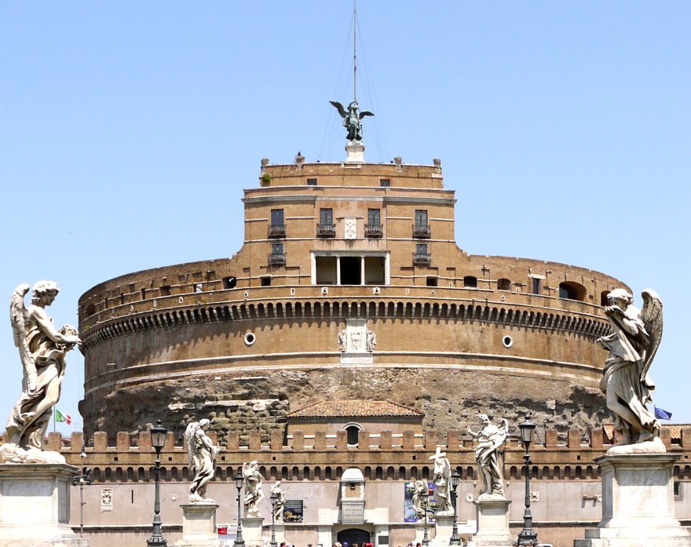
Policy Trends 3: Storming the classroom citadel
Package and push?
Manage and measure?
Carrots and sticks?
Hearts and minds?

Slide 11
States and individuals need high levels of education for future economic, social and personal wellbeing
Innovation is integral to educational quality - create the future not recreate the past
Models of governance and change need to be dynamic and promote alignment
↓
RE-EXAMINE APPROACH TO AND RELATIONSHIP BETWEEN
TEACHING / LEADERSHIP / CURRICULUM/EVALUATION

Slide 12
Key factors in success?
Clarity of purpose – values and curriculum
High expectations of achievement
Enabling all young people to achieve their potential
Emphasis on early learning
High quality teachers
Culture of effective professional learning
High quality leadership at all levels
Flexible and outward looking – open to but not beguiled by innovation
Intelligent evaluation
Reflective and self-evaluative

Slide 13
Evaluation/Inspection Traditions
Governance
Government agency
Degrees of distance
Broad purpose
Accountability/Control/Compliance
System monitoring
Informing ‘consumers’
Agent of improvement through expectations
Agent of improvement through capacity-building
Focus
Teachers
School

Slide 14
Influences on inspection
Culture/tradition – political/social/educational
Political environment – national / local / professional
Resource
Policy trends
Quality of education

Slide 15
Trends in Inspection
Increasing importance/prevalence
Eclectic use of an increasing range of approaches, reflecting underlying assumptions about schools and teachers
Development and use of standards
Growth of data - standardised testing
Search for improved traction/impact
Use in accountability
International lessons and comparisons
ICT allowing increased scale and responsiveness

Slide 16
Plasticity of Inspection
Enforcer
Assurer
‘Best buy’ guide
Mitigator of risk
Catalyst/driver of change
Capacity builder
Agenda setter
Preserver/creator of space for innovation

Slide 17
Preserver/creator of space for innovation
One of the main inhibitors of innovation can be the concerns which parents or education managers might have about ‘experimentation’ with young people. Inspection can help to create the space for a school to innovate by building confidence that the approach is well managed and potentially beneficial.

Slide 18
Deep and sustained educational change
If…
“the quality of education cannot exceed the quality of its teachers” (McKinsey 2007)
Then…
deep and sustained educational change will to a significant extent depend on the extent to which teachers are engaged in the change process and have the necessary capacity to make it happen.

Slide 19
The Policy Dilemma
‘Trust teachers’ risks
absolving system of responsibility
accepting inequities
‘High stakes’ external pressure risks
gaming
tokenism/playing safe
loss of control
loss of momentum
narrowing
passivity/compliance

Slide 20
Teachers and change
Cuban and Tyack in Hattie ‘Visible Learning ’ 2009

Slide 21
Learning Organisation
This ideal includes notions of organisational adaptability, flexibility, avoidance of stability traps, propensity to experiment, readiness to rethink means and ends, inquiry orientation, realisation of human potential for learning in the service of organisational purposes, and creation of organisational settings as contexts for human development.
Argyris, C. (1999), On Organizational Learning

Slide 22
How far are inspectorates learning organisations?

Slide 23
Inspection and Innovation -Themes
Importance of external/internal evaluation relationship
Focus on learning
Context matters
Risk and proportionality
Flexibility and adaptability
Transparency
Perceptions and media
Teachers matter
Data matter
Stakeholders and partnerships
Leadership

Slide 24
Questions
How far do you accept the analysis? Amendments or additions?
Implications of trends affecting education?
How far should/can inspection contribute to innovation?
Examples of inspection promoting innovation.
SICI Memorandum?

Slide 25
Thank You
Graham.Donaldson@glasgow.ac.uk

