Slide 1
Quality Assurance Department
Sustaining school improvement
through External Reviews
Ministry for Education and Employment
Dr. Jacqueline Vanhear
Malta, October 2017 -

Slide 2
Sustaining foundations, creating alternatives,
increasing employability

Slide 3
The External Review
Foci of external review (first cycle):
Educational Leadership
Learning and Teaching
School Ethos
Main external review tool:
Standards for Schools with indicative success criteria
Sources of evidence:
School Development Plan
Pre-Review School Self-Evaluation
Other school documents
Observations
Interviews
Questionnaires

Slide 4
A 3 year plan launched in October 2015

Slide 5
External Reviews
Jan - Jun
(30 follow-ups during Jan – Jun 2017)

Slide 6
External Reviews

Slide 7
External Review Reports
length
focused areas
focused recommendations
more evaluative
highlighting areas of strenghts
addressing the unsustainable cycle

Slide 8
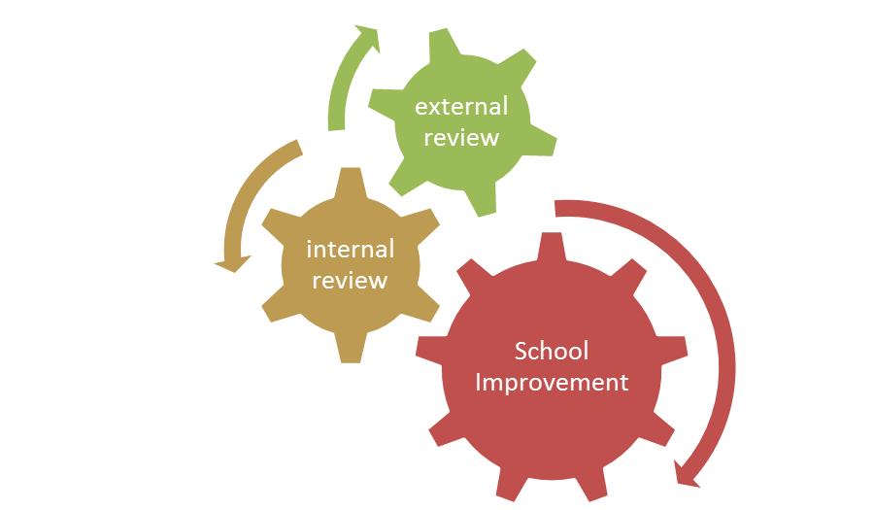
Aligned Internal & External Review Processes
ESTABLISHED STANDARDS
SELF-EVALUATE AGAINST ESTABLISHED STANDARDS THROUGH A STRUCTURED PROCEDURE
THROUGH A BALANCED SYSTEM

Slide 9
THE INTERNAL REVIEW PROCESS
EVALUATE:
Collect feedback/data
Analyse feedback/data
S.W.O.T. analysis of main
outcomes from feedback/
data.
REVIEW:
All teaching staff members agree upon whole school priority development targets
to devise procedures for
School Improvement
EVALUATE
REVIEW
Text Here
SCHOOL’S VISION & MISSION
IMPLEMENT
Text Here
PLANNING
Text Here
PLANNING:
Collaborative writing of Action Plan/s that respond/s to the identified developmental targets.
IMPLEMENT:
Teachers reflect the action plan/s in their classrooms.
SCHOOL DEVELOPMENT PLANNING

Slide 10
Internal Review Training (2016)

Slide 11
Compliance Checks
Jan - Jun

