Slide 1

Innovation and inspection:
Irish experiences
SICI SEMINAR DUBLIN
23 SEPTEMBER 2019
HAROLD HISLOP, CHIEF INSPECTOR

Slide 2
Overview
Innovation and inspection in Ireland
Innovation, schooling and inspection
What does an innovative learning environment in school look like?
Inspection in Ireland
  Co-creating an inspection model in Ireland
  Listening to children’s voices
  Inspection supporting innovation in schools
Inspection and creativity: what are we doing?
A future challenge that’s already here?

Slide 3
Innovation, schooling and inspection
Challenge: the success of mass schooling in the 19th and 20th centuries
  education as a public good and a human right
  common curricula, common assessments and qualifications
  education as a contributor to economic growth, social and cultural well-being
  common teaching approaches; the dangers of replication; relative lack of change
  commitment to address individual learning needs but difficult to realise
  inspection that encouraged compliance
  the increasing cost of education

Slide 4
If that was sustainable in 19th & 20th centuries, it’s not any longer….
Learning as knowledge, skills, attitudes and values
Learners are co-creators of “content of education”
Dynamics of learning organisations
Where does learning happen?

Slide 5
So what would innovative learning environments look like?

Slide 6
Innovative learning environments
Schools and education systems will be most powerful and effective when they:
Make learning central, encourage engagement and be where learners come to understand themselves as learners
Ensure that learning is social and often collaborative
Are highly attuned to learners’ motivations and the importance of emotions
Are acutely sensitive to individual differences, including prior knowledge
Are demanding of each learners but do not overload students with work
Use assessments consistent with their aims, emphasising formative feedback
Promote horizontal connectedness across activities and subjects, in and outside of school
Andreas Schleicher, Schools for 21st Century Learners (OECD, 2015)
David Instance, Innovative Learning Environments (OECD, 2013)___

Slide 7
Teaching and learning in an innovative and improving school system
Really effective learning is a social activity
We are often isolated in our practice of teaching
Challenging professional conversations are a really effective form of continuing professional development
Collaborative professional practice is at the heart of effective schools and improvements in learning
  Hattie (2008) Visible Learning ; (2011) Visible Learning for Teachers
  Hargreaves & Fullan (2015) Professional Capital
  Hargreaves & O’Connor (2018) Leading Collaborative Professionalism

Slide 8
Can inspection help to foster the sort of innovative environments we would like to see?

Slide 9
Can external inspection support innovation in schools?
There are dilemmas and challenges….
Challenge of regulation versus creativity
Prompting fear of failure versus willingness to take risks
Need for consistency and fairness versus flexibility and responsiveness to school and setting context
Risk of focus on work of individual rather than on collective/collaboration
Accountability versus improvement

Slide 10
Can external inspection support collaborative cultures in schools?
In Ireland, we have sought to develop inspection in ways that support collaborative professional practice…
Valuing professional collaboration in our inspection frameworks
Encouraging leadership that supports collaborative cultures
Building our working methods through collaboration
Focusing on observation of practice rather than over-relying on data; making the most of the value that inspection can add

Slide 11

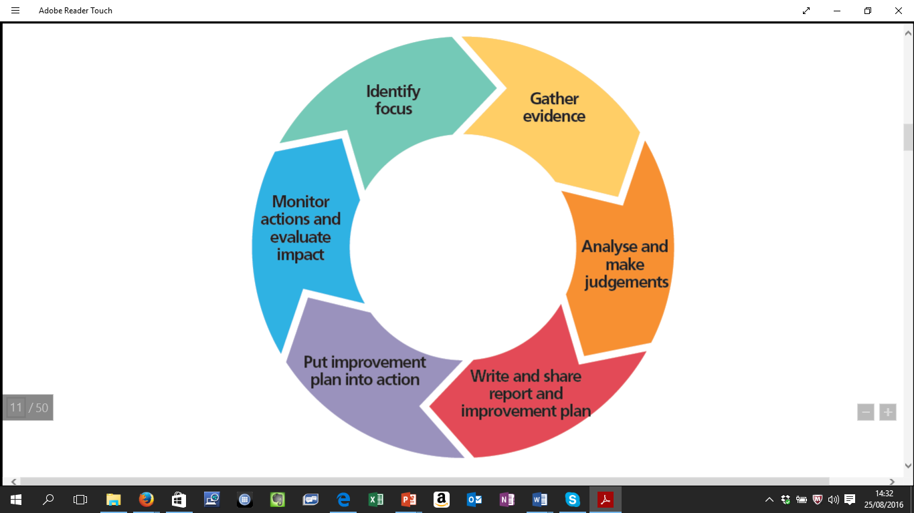
Ensuring professional collaboration is at the heart of our quality frameworks
Core belief: The most powerful factor in ensuring children’s learning is the quality of teachers’ individual and collective practice and how school leadership enables this to happen
Self-evaluation process aligns with good collaborative practice
School self-evaluation (SSE) and inspection value teachers’ collaboration and involvement of students’ in SSE
Inspection is for accountability and improvement

Slide 12
Standards for
Teachers’ collective/collaborative practice
Teacher value and engage in professional development and professional collaboration
Teachers’ collective/ collaborative practice
Teachers work together to devise learning opportunities for students across and beyond the curriculum
Teachers collectively develop and implement consistent and dependable formative and summative assessment practices
Teachers contribute to building whole-staff capacity by sharing their expertise

Slide 13
Leading teaching and learning – the standards
Promote a culture of improvement, collaboration, innovation and creativity, and maintain it through effective communication
Foster a commitment to inclusion, equality of opportunity and the holistic development of each student
Leading learning and teaching
Manage the planning and implementation of the school curriculum
Foster teacher professional development that enriches teachers’ and students’ learning

Slide 14
Standards and statements of quality
Standards | Statements of effective practice | Statements of highly effective practice
Promote a culture of improvement, collaboration, innovation and creativity in learning, teaching, and assessment | The principal and other leaders in the school work to promote a learning culture. They have generally high expectations for students and lead staff in striving for improved outcomes. They support reflective practice and promote a culture of improvement. The principal, with those leading the process, uses SSE to encourage teaching that is engaging and challenging, and to increase pupils’ interest in learning. The principal and other leaders in the school encourage teachers to develop their teaching, learning and assessment practices, and to share their practice. They encourage innovation and creativity. They recognise the value of individual and collective contributions and achievements. | The principal and other leaders in the school foster a culture in which learning flourishes. They lead the school community to continuously strive for excellence by setting high expectations for students. They promote a culture of continuous improvement by supporting colleagues to become reflective practitioners. The principal, with those leading the process, uses SSE very effectively to encourage teaching that is engaging and challenging, and to enable all pupils to become active and motivated learners. The principal and other leaders in the school expect and encourage teachers to develop and extend their teaching, learning and assessment practices, and to share those that have proven successful at improving learning. They actively promote innovation and creativity. They welcome and celebrate individual and collective contributions and achievements.

Slide 15
Avoiding the outfalls of over-reliance on numerical data and labelling
Emphasis on observation in classrooms and dialogue with practitioners
Avoid over-reliance on test and examination results as the sole or dominant measure of a school’s effectiveness
Inspection reports do not include statistical data on academic performance that could lead to the compilation of league tables
Use a range of evaluative language – quality continuum
No single overall judgement about the school

Slide 16
Innovation in inspection design 1

Slide 17
Traditional inspection development
Inspectorate identifies focus
Inspectorate develops proposals
Publish proposals and consult
Trial in schools
Amend model
Implement in school system

Slide 18
Development of Child Protection and Safeguarding Inspections
Inspectorate identifies focus
Inspectorate develops first draft proposals
CONSULT WITH PARTNERS
Trial in schools
REDESIGN MODEL
Implement in school system
LISTENING AND RESEARCH PHASE IN SCHOOLS
CONSULT WITH PARTNERS
TRIAL IN SCHOOLS
Amend and finalise

Slide 19
Child Protection and Safeguarding and Inspections
Published framework
Initial Inspection
Final Inspection
Initial Report
Final Report
Both Initial and Final Reports published simultaneously

Slide 20
Lessons from a collaborative design approach to inspection….
Schools can be insightful in designing good evaluation approaches
Coming to schools with shared questions rather than solutions reduces anxiety about inspections among teachers and school leaders – reduce the risks
School leaders had a positive influence on the views of management authorities, teacher unions towards the inspections – importance of partnership
Incorporating arrangements for two inspections created trust, encouraged improvement, and guaranteed necessary public accountability
Engaging in a deep collaborative approach deepens inspectors’ understanding of what they are evaluating and how their work is perceived
TIME: National engagement with teachers and school leaders on implementation

Slide 21
Innovation in inspection design 2

Slide 22
Children’s voice
Questionnaires and focus groups already used
But we determined to take a “children’s rights perspective” – and made investment in professional development
Worked with our Department for Children and Youth Affairs
Listened to views of children about inspection process: their right to be heard and their right to receive feedback in meaningful ways
Actions: booklets and videos to explain inspection to children; preparing focus groups; revised questionnaires; feedback to children
Prepare to feel uncomfortable and challenged; be open to learning

Slide 23
Can an inspectorate encourage innovation in schools?
We are supporting and evaluating Ireland’s School Excellence Fund

Slide 24

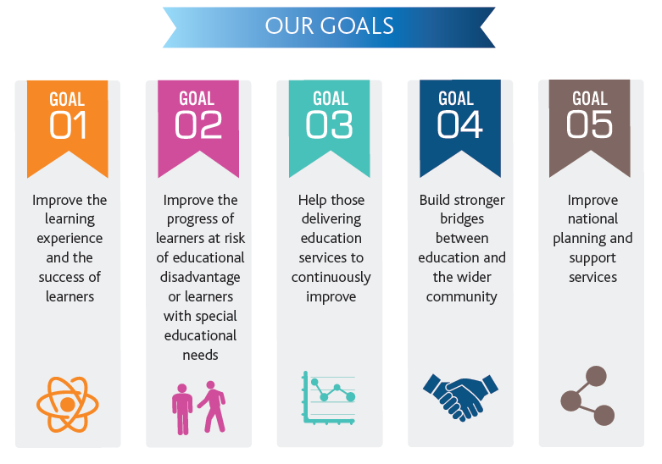
School Excellence Fund (SEF)
Launched as part of Minister’s Action Plan
Funding for innovative projects that would lead to better student outcomes
Challenge to Inspectorate: Could we help to foster innovation in schools and evaluate success of schools in the project?
Focussed initially on schools serving disadvantaged groups (DEIS)

Slide 25
School Excellence Fund (DEIS)
Built on advisory work to support school self-evaluation
Inspectorate advised on criteria for admission to scheme – emphasis on focus on learning, collaborative working among teachers and leaders, clustering, targets
Initially encouraged or facilitated clustering; stimulated effort; maintained contact; negotiated supports and made introductions
Wide range of projects involving cooperation between early years, primary and secondary level schools; related to the needs of learners in each setting
Inspectors currently moving into “critical friend” role
Inspectors will be conducting evaluation of success of the projects in each cluster
Complemented by external evaluation by Northern Ireland inspectorate

Slide 26
School Excellence Fund
Approach extended, all with Inspectorate involvement:
  School Excellence Fund DEIS – further groups of schools invited to join
  Gaeltacht Education Policy – to improve Irish-medium education in schools in Irish-speaking districts (c.150 schools)
  School Excellence Fund-Step-UP – a project, in conjunction with a teacher support service, to improve teachers’ practice in lower secondary education where significant curriculum change is occurring

Slide 27
School Excellence Fund: Outcomes so far
Initial evaluations suggest some success:
    SEF-DEIS : “Wide range of gains evident for learners”; “teachers across the clusters are benefitting from professional development”; “good start on approaches to assessment” [Evaluation by Northern Ireland Inspectorate]
    SEF-Gaeltacht: Increased implementation of immersion education in schools; high number of applicants for Irish-medium teacher education programmes; positive reactions from Gaeltacht communities [Initial Inspectorate report]
    SEF-Step-Up: Early days but already increased collaboration between teachers
Sharing of experiences and good practice – national/regional events
Feedback loop to policy makers – what is working

Slide 28
Lessons from School Excellence Fund
It’s relatively easy to evaluate and recommend; harder to implement!
Deepens further good professional linkages between inspectors and schools
Has provided opportunities to encourage self-evaluation in schools – helps embedding
Has suggested ways to improve and sharpen inspection and evaluation
Lot of learning between inspectorates – evaluation approaches, questions, data collection and perspectives
Sustainability of clusters without inspectors not guaranteed; inspectors need to learn when to stand back

Slide 29
Lessons from School Excellence Fund
EMBEDDING THE INNOVATION – MULTI-LEVEL APPROACHES
Evaluate: Is the change actually innovative? Is it valuable? Effect on learning?
Sharing practice: inspections; seminars for sharing of practice; publications; online resources; creating communities of practice; professional networks
Ask the system questions: Are the changes scalable? Are they sustainable?
Inspectorate also advises the Ministry: inspectors working alongside officials and Ministers making policy
Inspectorate also works with agencies: NCCA (curriculum and assessment policy); Teaching Council (which regulates initial teacher education)
Challenge of other ministries or agencies outside the education sphere

Slide 30
What can inspection do to encourage creativity and innovation in children’s learning?

Slide 31
Creativity
Growing body of research about importance and centrality of creativity
Creative Ireland Programme 2017-22 is five-year all of government programme
  Creative Children and Youth is one of the major pillars of the programme
Challenge for Inspectorate:
  Enhance the way inspectors provide advice to schools and EY settings about creativity in learning
  Provide good practice resources for schools to support practice and self-evaluation
  Report to the system on creativity in EY settings and schools
  Provide advice on curriculum design and teacher education

Slide 32
There are significant challenges for inspectors and evaluation:
For example:
Do we understand fully what an environment conducive to creative thinking looks like?

Slide 34
Bill Lucas & Ellen Spencer: Teaching Creative Thinking

Slide 35
Characteristics of creative learning environment
Paul Collard
Creative Culture and Education (UK)

Slide 36
We already have elements of creativity highlighted in our inspection frameworks

Slide 37
But we need to do more…..

Slide 38
Inspectorate strategy re creativity
Overall aim:
To support creativity in schools, early years settings and centres for education
Agreed a shared understanding and build on inspectors learning and expertise around creativity
Evaluate and report on creativity in schools, early years settings and centres for education
Provide resources for schools, early years settings and centres for education to support self-evaluation and development of creativity

Slide 39
So far example, we will be…
Investing heavily in professional development for inspectors regarding theories of creativity, how creativity is manifested in schools/settings
Making creativity more prominent in our evaluation frameworks for schools and early years settings
As models of inspection are reviewed or developed, their role in evaluating creativity will be examined
Inspectors will report more clearly on creativity in inspection reports
BUT A key challenge will be: Creativity (and softer skills generally) may not occur in defined periods in school – are less amenable to the evaluator’s observation

Slide 40
And finally, the future challenge that is already here….

Slide 41
Artificial intelligence is here
Can facilitate some aspects of children’s learning more effectively than a human teacher (reading, formative assessment, individualised learning)
UCL Knowledge Lab (Rose Luckin) – showing how AI can complement teaching; building a robot called Colin to take on a teaching assistant role
More significantly,
  Can AI provide truly personalised learning? – the goal of the child-centred educationalist
  Will more learning take place outside the classroom than in?
  Is the place of learning shifting from a physical place to become a set of relationships? – A future theme for a SICI seminar!

