Slide 1
FROM SUPERVISION TO INNOVATION The Basque Inspectorate of Education experience
BASQUE INSPECTORATE OF EDUCATION. MADEIRA, May 2019

Slide 2
WE WILL TALK ABOUT:
1. CONCEPT OF INNOVATION
2. INNOVATION IN THE BASQUE INSPECTORATE OF EDUCATION
3. CHANGES OF PARADIGM
4. HOW DO WE DO IT?
5. STRENGTHS, DIFFICULTIES, FUTURE PLANS
BASQUE INSPECTORATE OF EDUCATION. MADEIRA, May 2019

Slide 3
1. CONCEPT OF INNOVATION
TOOLS
IDEAS
OBJECTIVE
CHANGE
METHODOLOGIES
ORGANISATION
IMPROVEMENT
BASQUE INSPECTORATE OF EDUCATION. MADEIRA, May 2019

Slide 4
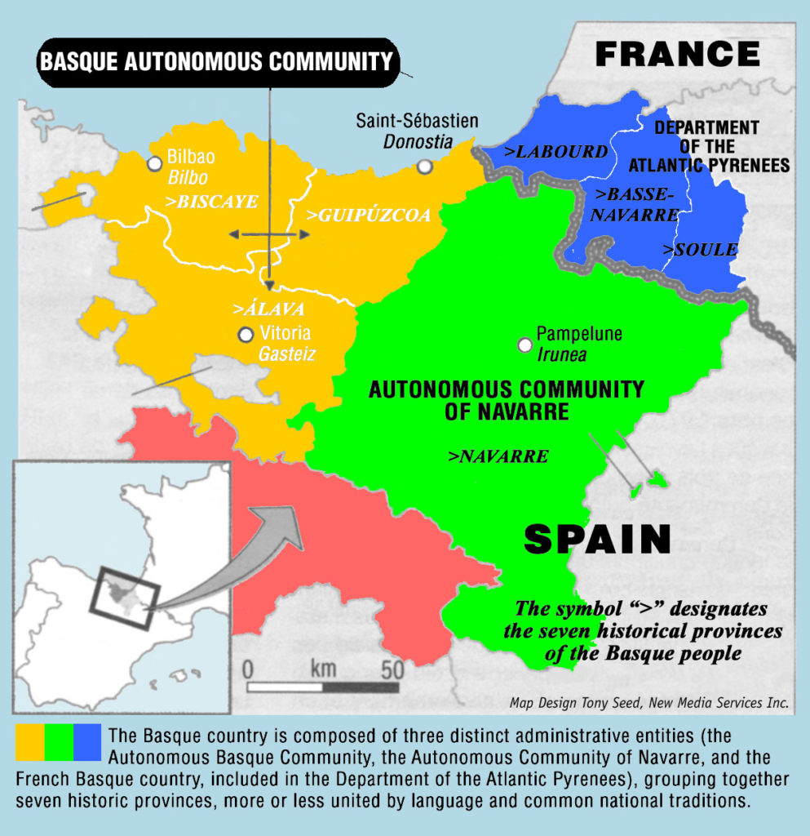
2. INNOVATION IN THE BASQUE INSPECTORATE OF EDUCATION
2.1 GEOGRAPHICAL DESCRIPTION
BASQUE INSPECTORATE OF EDUCATION. MADEIRA, May 2019

Slide 5
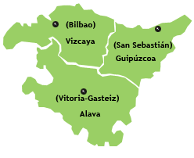
2.2 ORGANISATION CHART
VICE-MINISTER OF EDUCATION
CENTRAL INSPECTORATE (1+3)
REGIONAL HEAD (3)
REGIONAL DELEGATE OF EDUCATION
ZONE CHAIRPERSON
ZONE CHAIRPERSON
ZONE CHAIRPERSON
ZONE CHAIRPERSON
ZONE TEAM
ZONE TEAM
ZONE TEAM
ZONE TEAM
(BIZKAIA)
BASQUE INSPECTORATE OF EDUCATION. MADEIRA, May 2019

Slide 6
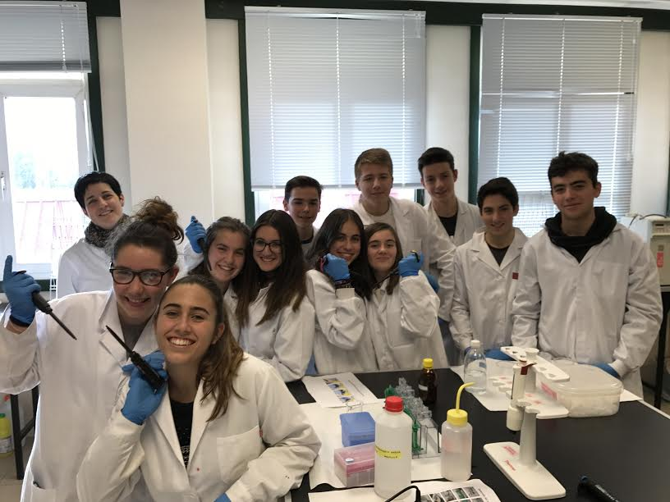
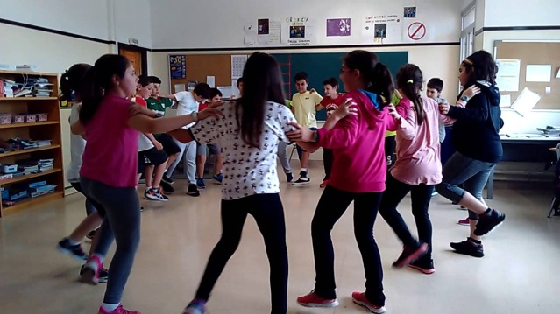
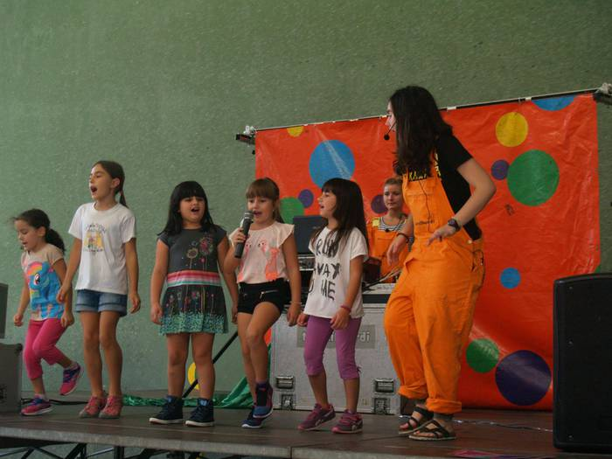
2.3 TYPE OF SCHOOLS EACH INSPECTOR SUPERVISE
PRE-PRIMARY SCHOOLS (0-6)
PRIMARY SCHOOLS (6-12)
SECONDARY SCHOOLS (12-16)
UPPER SECONDARY SCHOOLS (16-18)
VOCATIONAL SCHOOLS (14-99)
&&&&&&&
ALL SUBJECTS
ALL ISSUES
BASQUE INSPECTORATE OF EDUCATION. MADEIRA, May 2019

Slide 7
2. 4 FUNCTIONS
2/2006 LAW, 3rd May (LOE)
1/1993 LAW, 19th February, of the Basque State School
Decree 98/2016, 28th June, of the Education Inspectorate of the Basque Autonomous Community
BASQUE INSPECTORATE OF EDUCATION. MADEIRA, May 2019

Slide 8
2. 4 FUNCTIONS
TO PROVIDE ADVICE AND GUIDANCE
TO COLLABORATE
TO SUPERVISE, EVALUATE and CONTROL
TO REPORT TO THE ADMINISTRATION
IMPROVEMENT OF SCHOOL SYSTEM
BASQUE INSPECTORATE OF EDUCATION. MADEIRA, May 2019

Slide 9
2. 5 MISSION, VISION, VALUES UNE-EN ISO 9001: 2015
MISSION
To promote the achievement of a quality education system and to help ensure the rights of people who belong to the educational community.
Monitor, evaluate and provide advice to schools and other elements of the system in order to contribute to its improvement. Participate in evaluations of the system and inform educational administration through technical assessments of purposeful character.
Improve the internal organization of the inspectorate of education and the development of its duties to better respond to people and schools.
BASQUE INSPECTORATE OF EDUCATION. MADEIRA, May 2019

Slide 10
2. 5 MISSION, VISION, VALUES
VISION:
Become a key element in ensuring the right of all students to quality education and the rights of all members of the educational community.
Lead the process of improving the education system with a view for the future, monitoring, evaluating and assessing effectively the organization and performance of the schools, the programs and the educational and leadership management.
Be a reference for schools, for administration and society for its contribution to the improvement, and establish itself as a preferred service to inform and advise the Board on the educational system’s management.
Constituted by trained, informed and committed to a permanent updating professionals, who work together in a coordinated way and with unified criteria, promoting innovation processes and participation in the organization.
Act professional and ethically in schools and in the educational administration with technical criteria and independence from external pressures.
BASQUE INSPECTORATE OF EDUCATION. MADEIRA, May 2019

Slide 11
2. 5 MISSION, VISION, VALUES
VALUES:
Honesty, responsibility, loyalty, respect and empathy.
Efficiency and teamwork based on mutual compromise.
Autonomy and independent criteria, with critical and auto-critical spirit.
Participative and proactive attitude focused on continuous improvement.
Involvement and commitment to training and innovation.
BASQUE INSPECTORATE OF EDUCATION. MADEIRA, May 2019

Slide 12
MISSION, VISION, VALUES
THREE YEAR PLAN (2017-2020)
ANNUAL PLAN 2017-2018
ANNUAL PLAN 2018-2019
ANNUAL PLAN 2019-2020
BASQUE INSPECTORATE OF EDUCATION. MADEIRA, May 2019

Slide 13
3- CHANGE OF PARADIGM
HOLISTIC APPROACH
MORE IMPORTANCE TO EVALUATION
NEW REGULATIONS AND GUIDANCES
SOCIAL NEED TO IMPROVE STUDENTS RESULTS
INCREASE IN DEPARTMENT’S DEMANDS
DEVELOPMENT OF NEW PROTOCOLS
PROMOTE COLLABORATION (OTHER INSPECTORATES)
WHAT WHAT FOR
BASQUE INSPECTORATE OF EDUCATION. MADEIRA, May 2019

Slide 14
4- CHANGE OF PARADIGM: HOW
4.1 CHANGE IN THE SUPERVISION MODEL
4.2 CHANGE IN THE ACTIVITY ORGANISATION
4.3 CHANGE IN THE TOOLS WE USE
4.4 STRUCTURAL CHANGES
4.5 CHANGE IN THE FOLLOW-UP AND EVALUATION OF OUR ACTIVITIES. IMPACT ANALYSIS
BASQUE INSPECTORATE OF EDUCATION. MADEIRA, May 2019

Slide 15
4.1 CHANGE IN THE SUPERVISION MODEL
GLOBAL
PROACTIVE
ORIENTATED TO THE IMPROVEMENT
FOLLOW-UP AND IMPROVEMENTS REVIEW
EFFECTIVENESS AND EFFICIENCY
BASQUE INSPECTORATE OF EDUCATION. MADEIRA, May 2019

Slide 16
4.1 CHANGE IN THE SUPERVISION MODEL
SCHOOL EVALUATION
SCHOOL SUPERVISION
In depth
Defined and limited period.
Not continuous
Timely feedback
Continuous
Permanent feedback
Adapted to continuous change and school’s evolution
Over an extended period
BASQUE INSPECTORATE OF EDUCATION. MADEIRA, May 2019

Slide 17
WHAT DO WE DO IN EACH SCHOOL?
ACTION PLAN
PLANING
COORDINATION
PROJECTS
METHODOLOGY
MENTORING AND GUIDANCE
ORGANIZATION
PARTICIPATION
SCHOOL COEXISTENCE
EVALUATION
LEADERSHIP
ROLE OF TEACHERS
OTHERS
SCHOOL RESULTS
NON TEACHING STAFF
STUDENTS
FAMILIES
BASQUE INSPECTORATE OF EDUCATION. MADEIRA, May 2019

Slide 18
WHAT DO WE DO IN EACH SCHOOL?
PEDAGOGICAL DOCUMENTS ANALYSIS
STRATEGICAL PLANS
ANNUAL PLANS
EVALUATION RESULTS
ANNUAL REPORTS
PROJECTS
SCHOOL COMMUNITY
TEACHING LEARNING PROCESS
RESULTS
RIGHTS GUARANTEE
SCHOOL
TEACHERS
STUDENTS
PRACTITIONER TEACHERS’ EVALUATION
LEADERS EVALUATION
RIGHTS GUARANTEE
TRAINING
BASQUE INSPECTORATE OF EDUCATION. MADEIRA, May 2019

Slide 19
WHAT DO WE DO IN EACH SCHOOL?
KNOWLEDGE
ANNUAL PLAN INSPECTORATE
SUPERVISION OBJECTIVES
Annual proceedings
Bigger knowledge of the school
Improvement of actions
Annual assessments
Improvement proposals to school
Proposals to inspector
Follow-up of improvement proposals
BASQUE INSPECTORATE OF EDUCATION. MADEIRA, May 2019

Slide 20
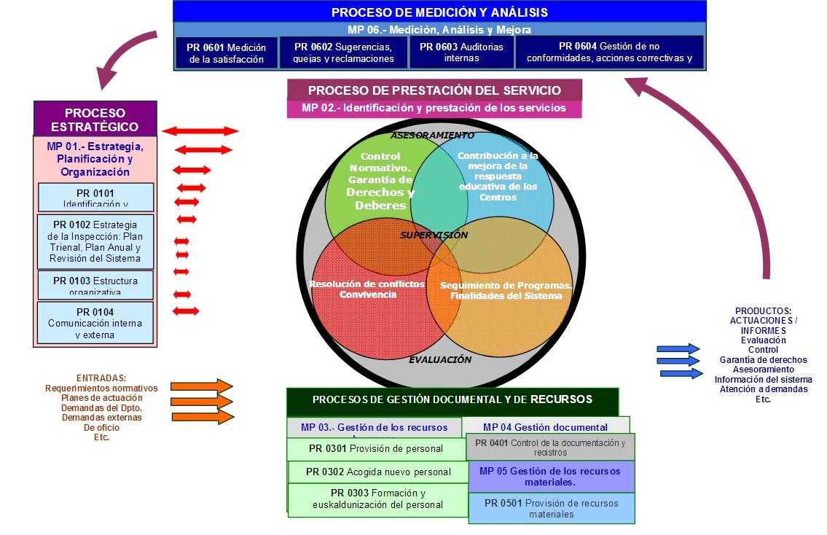
4.2 CHANGE IN THE ACTIVITY ORGANISATION
4.2 CHANGE IN THE ACTIVITY ORGANISATION
BASQUE INSPECTORATE OF EDUCATION. MADEIRA, May 2019

Slide 21
4.2 CHANGE IN THE ACTIVITY ORGANISATION
BEFORE
NOW
OLD CRITERIA:
TYPE OF ACTIVITIES
CONTROL
EVALUATION
ASSESSMENT
NEW CRITERIA:
AIM OF ACTIVITIES:
RIGHTS GUARANTEE
CONTRIBUTE TO SCHOOL IMPROVEMENT
INFORM AND ADVICE TO ADMINISTRATION
BASQUE INSPECTORATE OF EDUCATION. MADEIRA, May 2019

Slide 22
4.2 CHANGE IN THE ACTIVITY ORGANISATION
BEFORE
Gather data about school leaving
Change of results
NOW
To contribute to reduce the school leaving:
Interview with the family
Giving advice to schools
Coordination with stakeholders
BASQUE INSPECTORATE OF EDUCATION. MADEIRA, May 2019

Slide 23
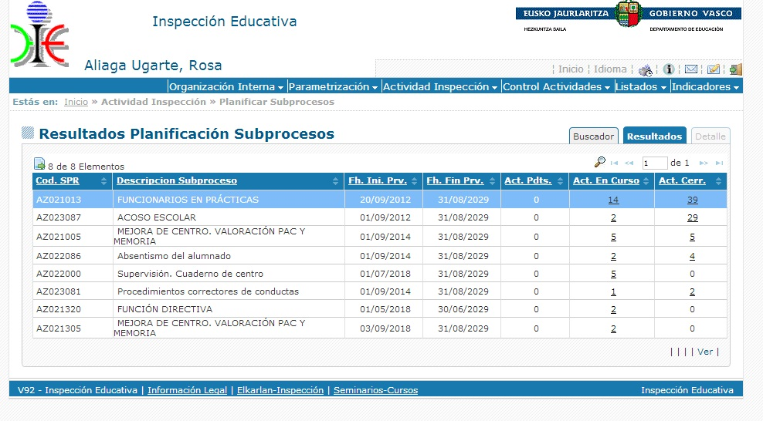
4.3 CHANGE IN THE TOOLS WE USE
BASQUE INSPECTORATE OF EDUCATION. MADEIRA, May 2019

Slide 24
4.4 STRUCTURAL CHANGES
COMMUNITY TEAM (4)
DESIGN AND GENERAL EVALUATION
REGIONAL TEAM (3/4)
DISSEMINATION
ZONE TEAM
APPLICATION
FOLLOW UP
ALL THE INSPECTORS TAKE PART IN ONE OR MORE OF THESE TEAMS
BASQUE INSPECTORATE OF EDUCATION. MADEIRA, May 2019

Slide 25
4.5 CHANGE IN THE FOLLOW-UP AND EVALUATION OF OUR ACTIVITIES. IMPACT ANALYSIS.
SCHOOL SUPERVISION
EDUCATION SYSTEM SUPERVISION
INFORM AND ASSESS TO ADMINISTRATION
School Knowledge
Review Assessment
Improvement proposals for schools
Educational system Global data
General results
Improvement proposals for educational system
x 1000 schools
DEFINE INSPECTORATE ACTION PLANS
BASQUE INSPECTORATE OF EDUCATION. MADEIRA, May 2019

Slide 26
5- STRENGTHS
HIGH RATING IN SATISFACTION SURVEYS (8/10)
TRUST AND RECOGNITION FROM THE ADMINISTRATION
COORDINATION AMONG ALL THE INSPECTORS
UNIFIED ANSWERS TO SCHOOLS
BASQUE INSPECTORATE OF EDUCATION. MADEIRA, May 2019

Slide 27
5- DIFFICULTIES
CHANGE OF PARADIGM THAT REQUIRES TRAINING AND AWARENESS IN THE STAFF. NOT EVERYBODY AGREES.
WORKLOAD FROM ADMINISTRATION DEMANDS
LACK OF TIME TO DEDICATE TO SCHOOLS
BASQUE INSPECTORATE OF EDUCATION. MADEIRA, May 2019

Slide 28
FUTURE PLANS
5- FUTURE PLANS
TRAINING AND AWARENESS
CONTINOUS REVIEW OF OBJECTIVES IN EACH ACTIVITY, PROCESS, TOOLS
IDENTIFY AND START WITH PROCEDURES THAT GATHER IMPACT EVIDENCES (IN SCHOOLS, IN THE ADMINISTRATION, IN OUR PROFESSIONAL DEVELOPMENT, IN SOCIETY)
MANTAIN AND FOSTER OPPORTUNITIES TO SHARE KNOWLEDGE, EXPERIENCES, GOOD PRACTICES WITH OTHER INSPECTORATES AND ORGANISATIONS (NATIONAL AND INTERNATIONAL)
BASQUE INSPECTORATE OF EDUCATION. MADEIRA, May 2019

Slide 29
Eskerrik asko
Muchas gracias
BASQUE INSPECTORATE OF EDUCATION. MADEIRA, May 2019

