Slide 1
e-Portfolio The modern path for professional development of teachers and students
Dragan Stankovski 29.03.2019

Slide 2
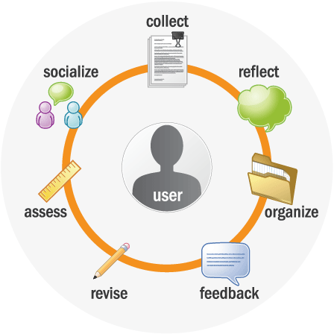
Steps to follow

Slide 3
e-Portfolio
Portfolio for Students
Portfolio for Teachers

Slide 4
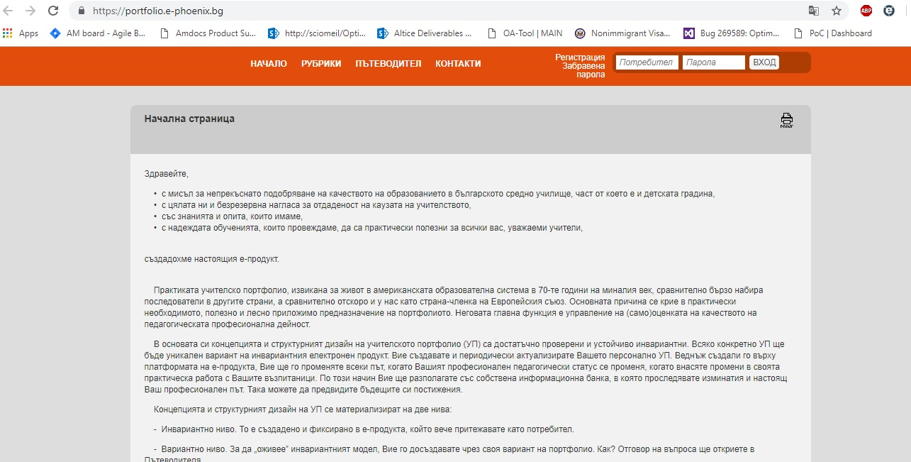
e-portfolio main page – NCDPS (NCKPS)

Slide 5
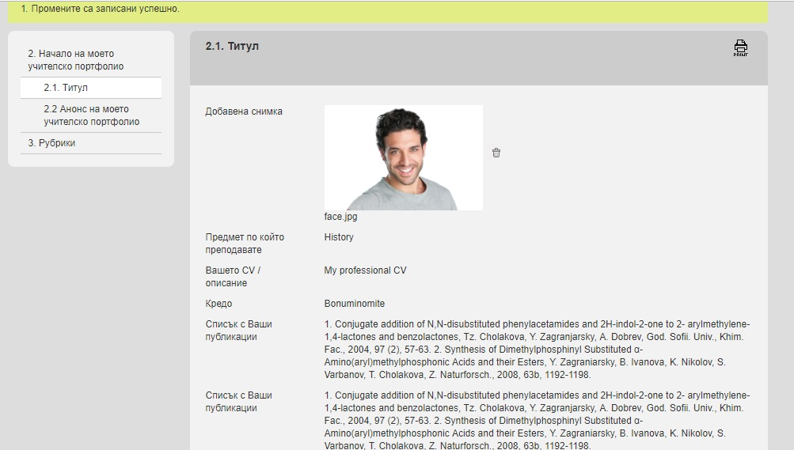
e-portfolio personal page

Slide 6
01
Personal Information
02
Professional carrier development
03
Trainings and additional development
04
POI
05
06
Sharing
Achievements
Core information

Slide 7
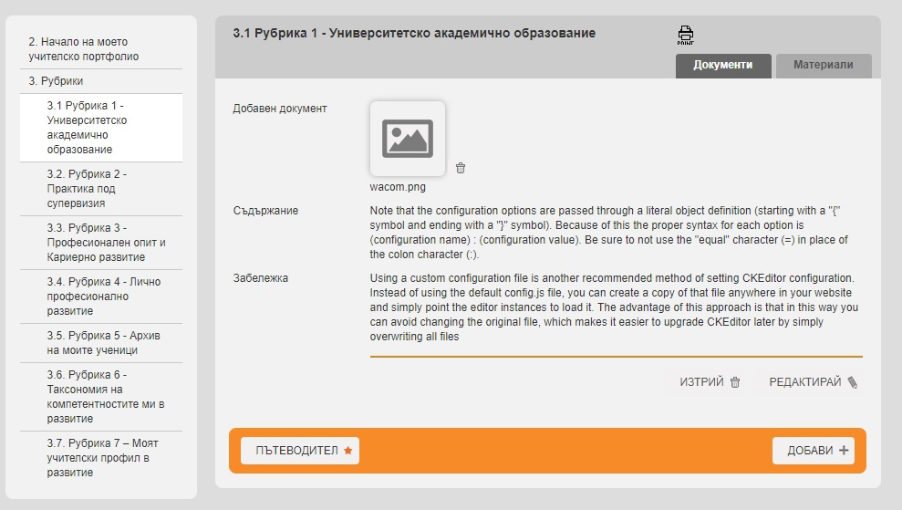
Tabs

Slide 8
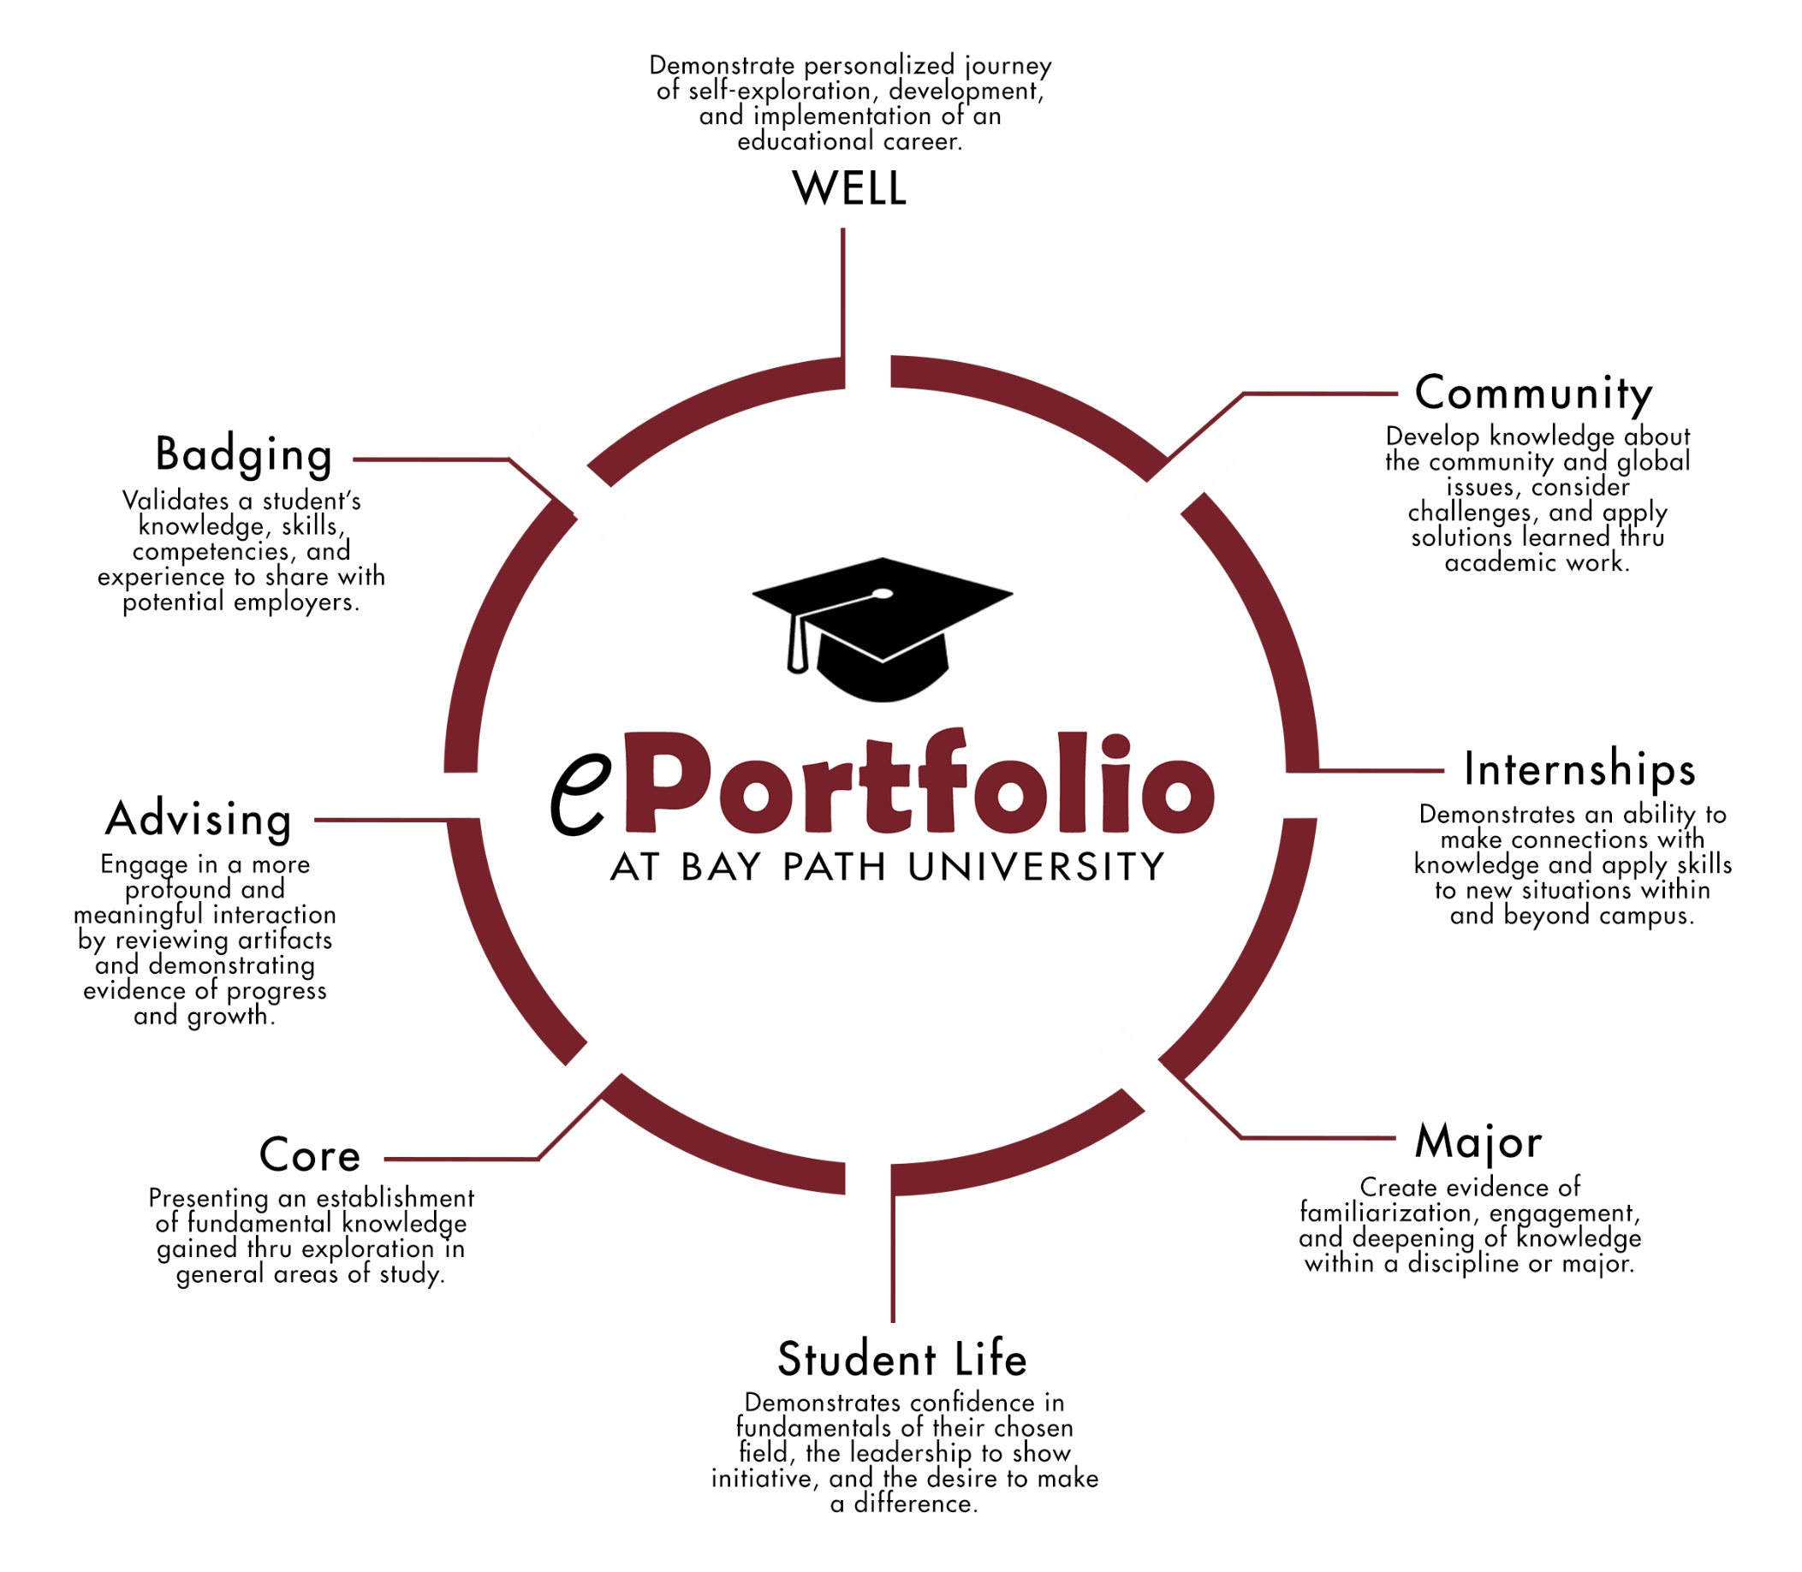

Slide 9
Benefits
Transparency;
Visibility of Professionalism;
Segmentation of professional fields and expertise;
Monitor and Control;
Integration of Schools, Universities, Institutions and Business;
Less stress and more Confidence.

Slide 10
Thank you for you attentions.
Q&A

