Slide 1
SURVEY AND ASSESSMENT OF EDUCATIONAL RESULTS AS PART OF THE CZECH SCHOOL INSPECTORATE'S ACTIVITIES
Tomáš Zatloukal
Chief School Inspector
March 29, 2017 | International SICI seminar | Prague

Slide 2
ACT No. 561/2004 Coll. The Education Act Section 174, subsection 2), letter b)
The Czech School Inspectorate shall determine and assess the conditions, course and results of education in accordance with relevant school educational programmes

Slide 3
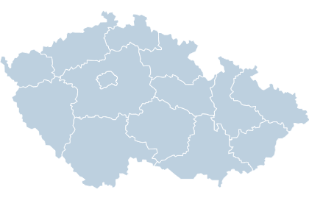
Czech School Inspectorate Nowadays
Administrative body with a nation-wide power established by law
14 regional inspectorates
Selection, appointment and dismissal of the Chief School Inspector is stated by The Act on Civil Service
National authority for evaluation and quality and effectivity control of initial education in schools (pre-schools, primary schools, secondary schools, vocational schools and school facilities) and the education system as a whole
Activities in international institutions: European Commission (EC), Centre for Educational Research and Innovation (CERI-OECD), International Association for the Evaluation of Educational Achievement (IEA), Standing International Conference of Inspectorates (SICI) …

Slide 4
Areas of the CSI Evaluation Related to Educational Outcomes
National and international level
Acquiring and analysing information on education, observing and evaluating the effectiveness of the educational system for the government and MEYS
Evaluation of conditions, course and outcomes of education in schools
International surveys PISA, PIRLS, TIMSS, ICILS and TALIS

Slide 5
Current Trends in Educational Assessment
Evaluation of major educational goals
Evaluation of the performance of teachers and school managements with an aim of providing them with quality feedback
Evaluation of schools in order to provide effective assistance where it is needed
Evaluation of systems with an aim of grounding the decision-making on facts and not on beliefs of politicians – evidence-based policy
The need to link assessment to set aims and objectives
EVALUATION AND ASSESSMENT FRAMEWORKS FOR IMPROVING SCHOOL OUTCOMES
Synergies for Better Learning: An International Perspective on Evaluation and Assessment

Slide 6
Assessment of Educational Evaluation in the Czech Republic
OECD expert team in 2012
A series of recommendations was proposed
Summarized in OECD Reviews of Evaluation and Assessment in Education: Czech Republic 2012
Analysis of the current systems of monitoring and evaluation of quality and efficiency in education

Slide 7
Policy Recommendations
OECD Reviews of Evaluation and Assessment in Education: Czech Republic 2012
Better articulate learning goals
Develop educational standards
The evaluation and assessment framework needs to be completed and made coherent
Strengthen external school evaluation
Improve the alignment between external and self-evaluation
Develop standards for the teaching profession; strengthen teacher appraisal for improvement purposes; establish a system of teacher certification
Improve the instructional leadership skills of school principals

Slide 8
Development of Evaluation since the Beginning of Millennium
2000 Reform of the public administration
2005 Implementation of two-level curriculum
Impact: The education system in the Czech Republic became one of the most decentralized in Europe. The extent of school autonomy did not correspond to the level of development of the education system as a whole.
There were no centrally designed assessment tools for evaluating results in lower or upper secondary education.
Schools could only use tests prepared by commercial companies.
Individual schools set their own requirements for the school-leaving examinations.

Slide 9
Evaluation of Educational Achievement in the Czech Republic by other institutions
At the level of secondary education
2011 → New school-leaving examination introduced - standardised
Centrally administered tests (mandatory for Czech language; compulsory-optional either a foreign language or mathematics
Implemented by CERMAT (Centre for the Evaluation of Educational Achievement)
2014/2015 → Final examination leading to a vocational certificate
Standardised assignment for each field of study
Since 2014/2015 mandatory, voluntary before
Practical examination is part of the final exam
Implemented by National Institute for Education
Since 2017 compulsory entrance exams to secondary schools with school-leaving examination
Czech language and Mathematics
Implemented by CERMAT

Slide 10
The CSI as Implementer of National and International Surveys
Synergy of external and internal views on educational system evaluation
Data from international surveys are complemented by national survey
Secondary analyses are carried out
Comparison of characteristics of less successful and very successful classes – secondary analysis of PIRLS 2011 and TIMSS 2011 international surveys.
Differences between schools in mathematical literacy – secondary analysis of PISA international survey.

Slide 11
CSI and Realization of International Surveys
Overview of the Czech Republic participation
PISA
2000 continuously
TIMSS
1995 continuously
Last cycles only the 4th grades
PIRLS
2001
2016
ICCS
ICILS
TALIS
2011
2013
2013
2009
Survey
Participation from

Slide 12
The Czech School Inspectorate’s Concept of Evaluation of Educational Achievement on the National Level
Every four years national testing at key stages of the schooling (5th and 9th grades of basic school)
Every two years, three literacies alternate
Testing of other educational fields in different grades and different levels of education

Slide 13
The Concept provides information on the different levels of the education system
National survey on a representative sample of pupils tests educational achievement and serves as information to support teaching.
• At the level of the education system, it provides information on how successfully the expected outcomes of curricula are fulfilled.
At the school level, how the school is performing in comparison with other schools working under the same conditions
At the level of a specific class, the teacher can form an idea about the educational progress of each student and set goals accordingly.

Slide 14
2017 National Survey
May 2017
5th a 9th grades of basic schools and corresponding grades of Gymnasium → Czech language, Mathematics, foreign language + 13 tests in other subjects (sample selection)
May 2017
5th a 9th grades → science information literacy
November 2017
2nd grades of secondary schools and 9th grades of basic schools → reading, mathematical and social literacy

Slide 15
Results of Education Set in the Context of Evaluating the Quality of School
Educational outcomes are determined by the conditions and the course of education
Qualitative statement about the results of education must be accompanied by evaluation of these areas

Slide 16
SCHOOL QUALITY MODEL Tool for External and Internal Evaluation
School’s conception and framework
Pedagogical leadership in school
Quality of teaching staff
Educational outcomes of pupils
Learning and teaching
Pupils’ support during learning and teaching as a cross-curricular subject for the support of equal opportunities

Slide 17
Indicators for Evaluation - External Evaluation
Four-level evaluation scale
Excellent level
Unsatisfactory level
Level requiring improvement
Expected level

Slide 18
Outcomes of Inspection Activity
School reports – for schools, which are included in the sample of a particular survey
Methodical tools for teachers developed on basis of accessible test questions and outcomes both from testing and questionnaires
Test questions allowed to access
Annual report
Secondary analyses
Data files and questionnaires

Slide 19
Use of the Quality School Criteria
One of the sources for school self-evaluation
Synergies in the process of improving the quality of education

Slide 20
The CSI and Methodological Support to Schools www.csicr.cz

Slide 21
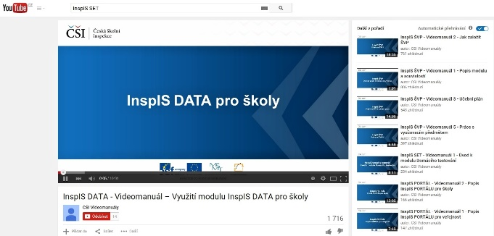
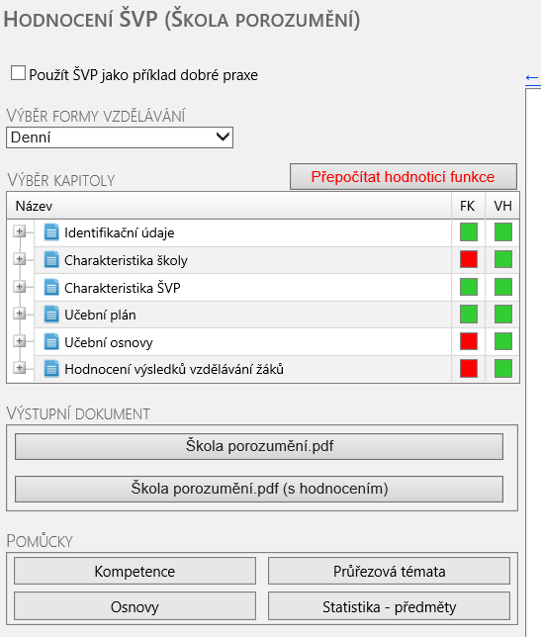
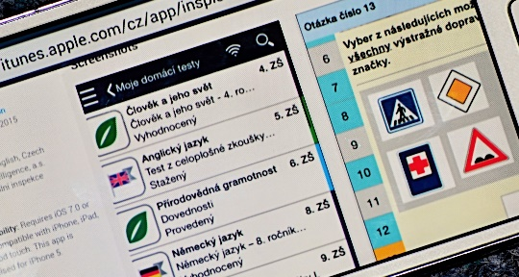
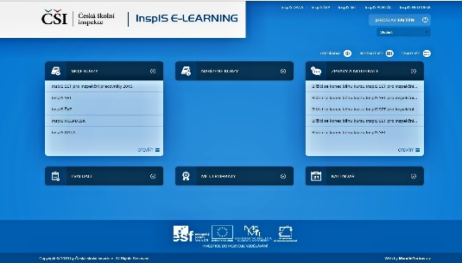
Information Systems

Slide 22
The CSI Direction in the Coming Years - Evaluation of Achieving Educational Goals
Assessment of key competencies
Data analysis
Monitoring of fairness and equity in education

Slide 23
Assessment of Key Competencies
In the national curriculum documents, key competencies represent educational goals.
In our education system, evaluation tools both at the school level and the system level are not available.
Key competencies are difficult to evaluate by using common tools for the evaluation of educational achievement
Our ambition is to implement this area into routine inspection activities
Inspiration from abroad

Slide 24
Data Analysis
Use the available data to more detailed analyses which will allow evaluating educational outcomes of students with respect to the conditions in which a particular school works
Analyses will bring insight into the current level of equity in education

Slide 25
Monitoring Equity in Education
In comparison to OECD and the EU countries, the CR displays relatively high level of educational inequity.
Characteristics of the environment in which a particular school operates and which it cannot influence will be monitored.
Indicators will be prepared to monitor the characteristics.
To assess the level of fulfillment of these indicators, specific tools and methodologies will be used.
The methodology will be developed in co-operation with government institutions, non-profit and academic organizations and professional associations; the development process will therefore have a desired educational effect.
Use of experience from abroad will be vital in this area.

Slide 26
Conclusions
Highly selective education is a problem in the Czech Republic.
Ministry of Education, Youth and Sport created legislative preconditions which will result in reducing selectivity and thus increased fairness and equity.
The challenge for the Czech School Inspectorate lies in assessing the conditions, course and results of education and providing schools and education system with feedback on how they are performing.

Slide 27
Tomáš Zatloukal
Chief School Inspector
Fráni Šrámka 37, 150 21 Praha 5
Tel.: +420 251 023 106
Email: tomas.zatloukal@csicr.cz ǀ www.csicr.cz

