Slide 1
How we both introduce and evaluate innovation in Ofsted. Building on evidence and having a broader evaluation programme
Daniel Muijs
Deputy Director | Research and Evaluation
Ofsted

Slide 2
The English school system – the international image

Slide 3
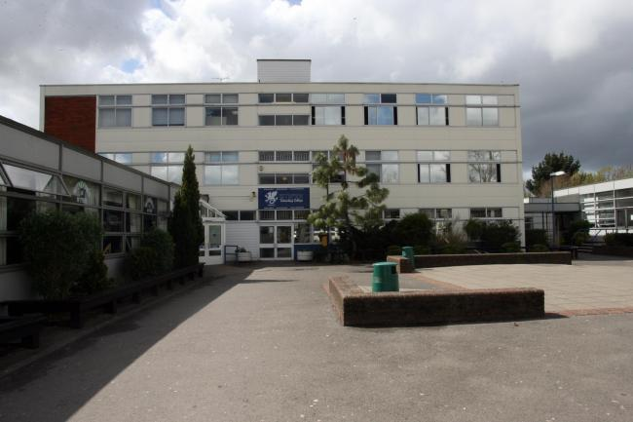
The English school system – the reality

Slide 4
The English school system
Six years of primary school from ages 5/6 -10/11
Five years of secondary school from ages 10/11-15/16
From two years of further education after that
Compared to other countries:
Diverse school system with large proportion of schools outside of LA control
High levels of freedom to act for headteachers and highest level of curricular freedom in OECD
Young staff profile

Slide 5
Accountability in England
High-stakes accountability system
Two pillars of accountability:
Assessment
Inspection
National assessments at end of primary and end of secondary school published by school
Progress measures published by school

Slide 6
The role of Ofsted
The inspection pillar of school accountability
An inspectorate, not an improvement agency
Schools inspected on average on a five-year cycle, with a risk-assessed element
Inspection based on frameworks
Four point grading scale: outstanding, good, requires improvement, inadequate. 85% are good or better
Government takes action on the basis of Ofsted grades

Slide 7
Our strategy: putting children and young people first
Intelligent
Valid measures
A skilled workforce
Informative grading
Aggregation of insight
Responsible
Responsive and engaged
Understanding the consequences
Responsible intervention
Addressing our audience
Focused
Prioritising inspection
Keeping children safe
Keeping pace
Groups
Right framework

Slide 8
How we innovate
A collective and collaborative process
HMCI initiates
Directorates and policy teams lead policy development
Data and Insight provides data analysis
Research and evaluation provide underpinning research and evaluations of implementation and impact

Slide 9
Research, evaluation and policy
Research and evaluation programme
Research contribution
Evaluation points
Policy review
Policy design
Piloting
Policy implementation
Policy development

Slide 10
Research practice
HMCI expects us to conduct research and evaluation that is comparable to the best educational research organisations in the country if not the world
This means adhering to the professional standards within the discipline. Including:
Projects are underpinned by literature reviews and data analysis, and informed by expert advisory groups
Scoping is detailed and fully documented
Our work is transparent, scrutinised by managers, and is published
Ethical, safeguarding, legal and equalities considerations are considered fully and policies strictly upheld

Slide 11
Our approach
No one method – mix of qualitative and quantitative approaches depending on project needs
Our projects are usually co-produced between researchers and inspectors…
Projects co-lead by a research lead and an Inspector lead
Inspectors collaborate on instrument development, lead on visits, and provide key insight and work collaboratively with the research team
We analyse data from our inspection evidence base
We outsource some evidence

Slide 12
Evaluating our work
As well as innovation, it is important to know whether what we are doing is having the intended outcomes
All our frameworks are being evaluated:
Are they being implemented as planned?
Are they having the intended impact on the system?
Attention paid to unintended consequences, validity and reliability
Work undertaken with same level of rigour as research programme
Evaluation team set up to deliver
Evaluation reports are published

Slide 13
An example of our approach – developing the Education Inspection Framework
Developing the case for change
Our theory of action
Developing the effectiveness construct
Research on content
Research on methods
Consultation
Piloting
Evaluating implementation
Evaluating impact

Slide 14
The case for change
Analysing the issues in our education system, and what our role was
Emphasis on data and pupil progress
The two pillars growing together
Developing a theory of action – how can inspection impact the system for the better?

Slide 15
Theory of action
There will be a robust effectiveness construct grounded in research evidence.
We will evaluate the quality of provision against that effectiveness evidence.
We will provide information to providers to enable them to develop their capacity for self-evaluation and to understand and adopt the findings.
We will report to users and other actors in a way that enables them to make informed decisions and engage with providers.
Providers and other actors will take action that leads to improved quality.

Slide 16
Developing our effectiveness construct
We conducted a review of educational effectiveness research
Evidence reviewed on
Teaching
Leadership
Other school-level factors (e.g. behaviour, culture)
Strength of evidence in different areas
Matched onto current framework and shadowing of inspections
Directly informing development of criteria
Not a review of all possible evidence, but that directly related to the framework

Slide 17
Doing research – the content of the framework
Large-scale research programme on curriculum
Three phases to date
Curriculum research phase 1: 40 schools visited in the summer term 2017
Key findings:
Schools often lacked knowledge and expertise in curriculum design
No common language around curriculum
Curriculum narrowing
Teaching to the test
Curriculum access not always for all

Slide 18
Doing research – the content of the framework
Curriculum research phase 2: 23 schools visited as part of a purposive sample
Criteria 1: School must be ‘particularly invested in curriculum development’
Criteria 2: Good or outstanding at last routine inspection
Two hour discussion with curriculum experts in the school
Questions focused on curriculum management and development (primarily intent)

Slide 19
Doing research – the content of the framework
Curriculum research phase 3 – 64 schools visited, maximum variation sampling
Key factors:
The curriculum being at least as ambitious as the National Curriculum
Subject leaders having clear roles and good subject knowledge
Effective curriculum planning
All pupils having access to the curriculum
The curriculum having sufficient depth and coverage of knowledge
A thought out model of progression through each subject’s curriculum
This research fed into the development of the criteria in the framework

Slide 20
Doing research – the methodology of inspection under the new framework
Research on curriculum also included a methodology – conversations with school leaders, subject leaders, teachers and pupils, lesson observation and scrutiny of pupils’ work
We conducted research into the validity and reliability of lesson observation and work scrutiny
This led the policy team and R&E to develop a methodology for inspecting the curriculum, the ‘deep dive’ approach.

Slide 21
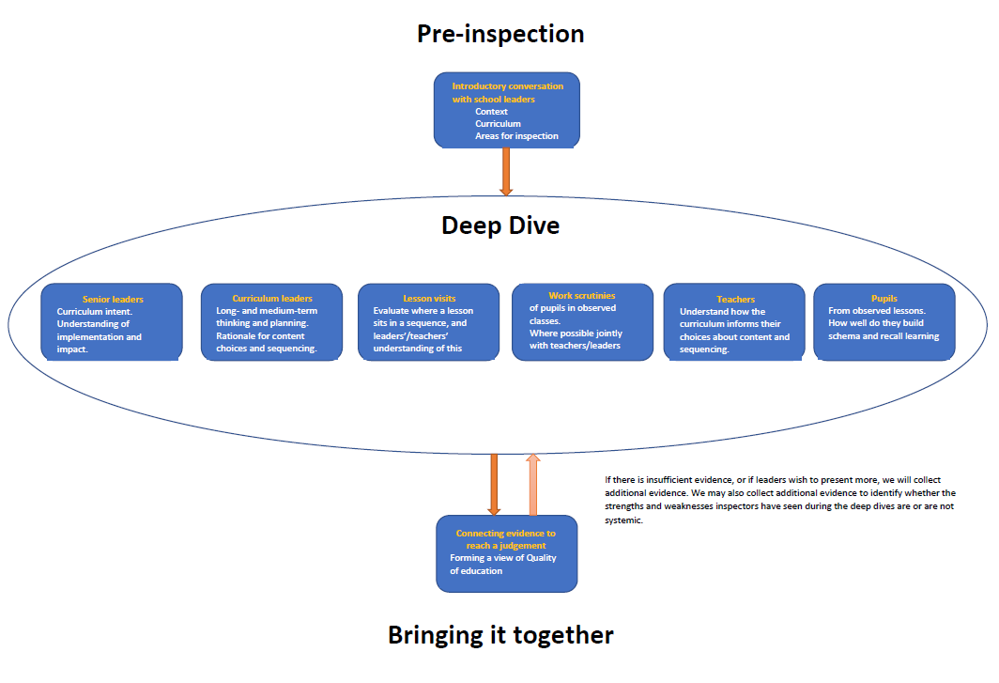

Slide 22
Consultation – finding out what the sector thinks
Before introducing the new sector, we carried out a consultation exercise, asking providers and the public to comment
We published draft frameworks, handbooks, the underlying research and the methodology
We received over 15,000 responses – our largest consultation ever
Very positive response, though some tweaking required

Slide 23
Piloting and testing
Once we had revised, we conducted extensive piloting of the framework, handbooks and methodology
We did friendly inspections in over 150 providers
Broad range of different school types, testing variations of the model
Allowed us to refine and be ready for launch

Slide 24
Evaluating what we do
Large-scale evaluation to run alongside launch
Baseline data collected in term prior to launch
Two parts:
Implementation evaluation
Impact evaluation
Implementation evaluation:
Are we implementing the framework as intended?
Have we created a framework and inspection methodology that is sufficiently valid and reliable?​
How have stakeholders experienced EIF?
How far do our inspection reports and feedback from inspection meet the needs of parents and providers?

Slide 25
Evaluating what we do
Impact evaluation
Still to be scoped!
Next step: is the new framework having the intended impact?
Is it having a positive impact on the system?
Are there unintended consequences?
Both evaluations are using a variety of methods, including analysis of existing inspection evidence
This dual evaluation approach is used across our framework evaluations

Slide 26
Conclusion: thoughtful innovation and rigorous evaluation
Innovation is needed to ensure that our inspection frameworks and methodologies remain fit for purpose in a changing world
However, too often innovation is done for the sake of it and without sufficient attention to impact and unintended consequences
At Ofsted, our model is to innovate with rigour, and to evaluate what we do, as innovation too needs to be effective!

Slide 27
Ofsted on the web and on social media
www.gov.uk/ofsted
https://reports.ofsted.gov.uk
www.linkedin.com/company/ofsted
www.youtube.com/ofstednews
www.slideshare.net/ofstednews
www.twitter.com/ofstednews

