Slide 1
Impact of the State of Education
Equity in Dutch Education
SICI Paris, Nov 13-14
Dr. Arnold Jonk
Inspectorate of Education

Slide 2
"The most difficult moment of my time in office was the report of the inspectorate on inequality"
Former Minister of Education

Slide 3
This presentation
The state of education
Theme from 2015 & 2016: inequality in education
What works with the State of Education?
Impact

Slide 5
The State of Education (SoE)
Constitution, art. 23.8:
The government reports every year on the state of education to the parliament
Since 1817
National report made by the Inspectorate of Education

Slide 6
Characteristics SoE
description of developments
students perspective
inspectors knowledge, research & literature
transparant; infographics, open data
independent

Slide 7
The making of the SoE
Output:
short and long report (30 & 200 pages)
website
conference
With:
interdisciplinary team of 20 inspectors and researchers (parttime, total: 9 fte)
200K euro

Slide 8
Example: inequality in education
Equity-problem?
signals of inspectors
academic discussions
other reports
previous monitoring in SoE
unique dataset (combining register data)
combination quantative research & inspectors

Slide 9
Our report: Inequality increases in education
Increasing inequality:
at initial tracking (end of primary education)
in lower secondary education
at the start of higher education
At the labour market entrance

Slide 10
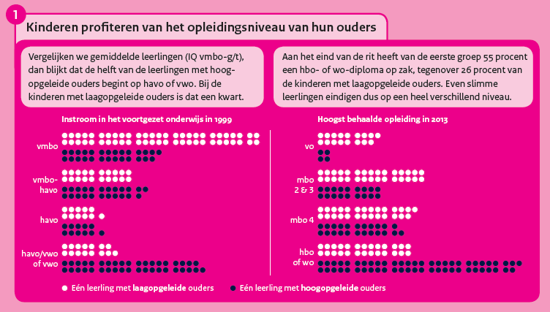

Slide 11
What works with the SoE?
A. Independent report, broad perspective, student perspective
B. Research quality, academic partners, transparant (open data, technical info)
C. Coproductions, partners (other ‘ States’), alliances, conference

Slide 12
And effective communication
focus on 1-3 theme’s
visualisations, infographics
active participation in public debate
always open for dialogue, be vulnerable
communication never stops

Slide 13
Effect
One of the main themes of the new government agreement
Partial rollback of budget cuts
Many conferences, new research, renewed policy focus on inequality

Slide 14
Questions

