Slide 1
From InspIS to EPIS
Kamil Melichárek
Czech School Inspectorate

Slide 2
From InspIS to EPIS
2006 – 2014 InspIS
2013 – ? EPIS
Information system for:
Multicriterial school evaluation
Storing and processing outputs and outcomes of Czech School Inspectorate activities
Activities planning (including HR and nonHR sources)
School self-evaluation

Slide 3
Inspection tools/methods
Evaluation:
Audit and evaluation of school documentation
Meeting goals evaluation (school plan/programme)
Evaluation of support efficiency (EU projects, etc.)
Observation
Interview (headmasters, teachers, pupils, parents…)
Surveys (headmasters, teachers, pupils, parents…)
…
… with using data from external sources (ministry of education, statistical office, etc.)

Slide 4
Tool as a form, indicator as a questions
Every tool can be represented as a form (electronical).
Every indicator can be represented as a question or item of some electronical form.
EPIS demonstration

Slide 5
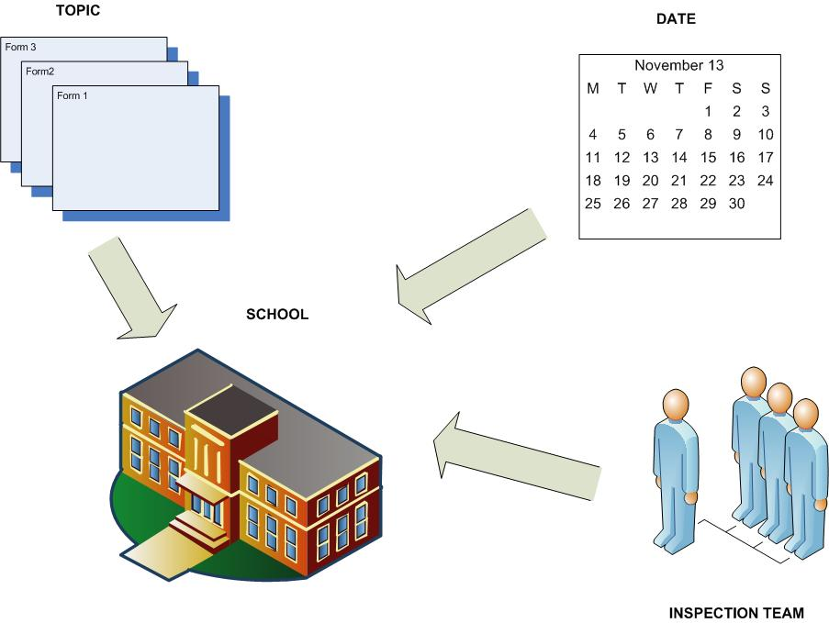
Processes - Events

Slide 6
Workflow
Various types of inspection activities have different process models – workflow.
Examples of workflow parametres:
Unlimited number of steps and statuses
Unlimited complexity of steps and statuses diagram
Rules for passing between steps (user privilegs, content conditions, etc.)
E-mail notification to any participant by defined type of message
EPIS demonstration

Slide 7
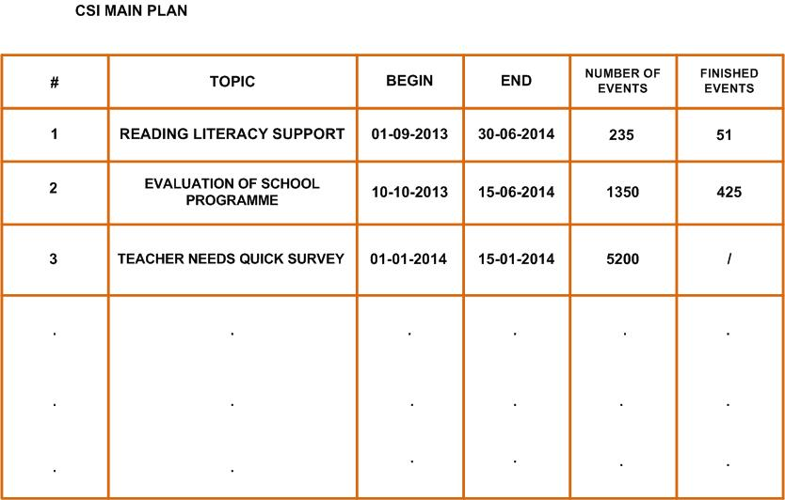
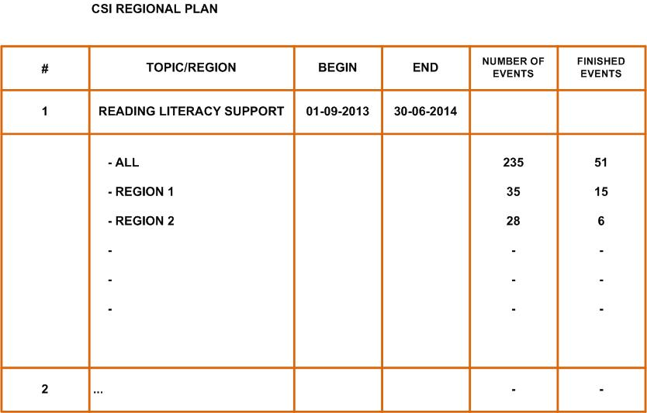
Event planning support

Slide 8
HR and nonHR-source planning
Detailed HR overview
Including all activities (task assignment)
Integration with time-attendance system
EPIS demonstration

Slide 9
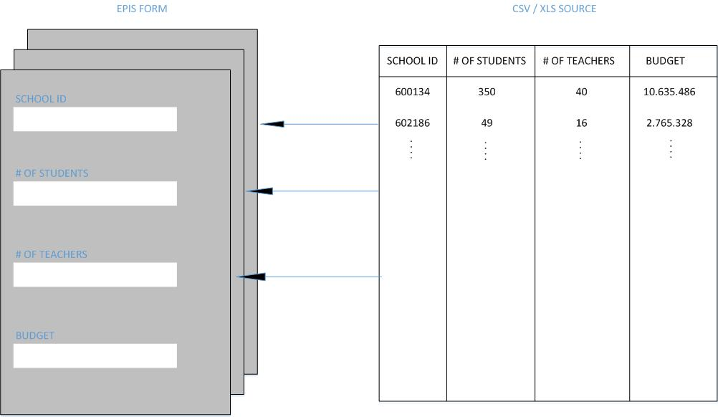
External data input – data pump

Slide 10
External data input – direct integration

Slide 11
General Reporting and Statistics
Summary on demand as a preparation for inspectors before entering the school
Auxiliary tool for the final evaluation at the end of inspection
Headmaster’s tool for self-evaluation and comparison by using inspection tools and methods
Regional and national statistics

Slide 12
Thank you for your attention.
Kamil Melichárek
Czech School Inspectorate
tel. +420 251 023 225
e-mail: kamil.melicharek@csicr.cz

