Slide 1

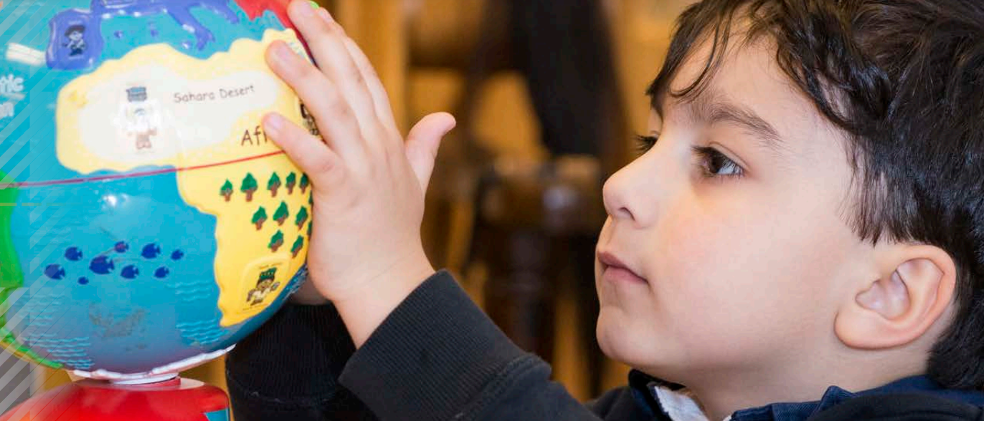
Early Learning and Childcare in
Scotland 2022
Sandra Kehoe HMI and Patricia Madden HMI
For Scotland’s children, with Scotland’s educators
Notes:
Good morning and thank you for the opportunity to share the current landscape of early learning and childcare in Scotland.
The Scottish Government’s priority is for all children, regardless of their background, to get the same start in life.
Combatting the impact of poverty has been a priority in Scotland, including the offer of free early learning and childcare. This is a key element in addressing the early education gaps.

Slide 2

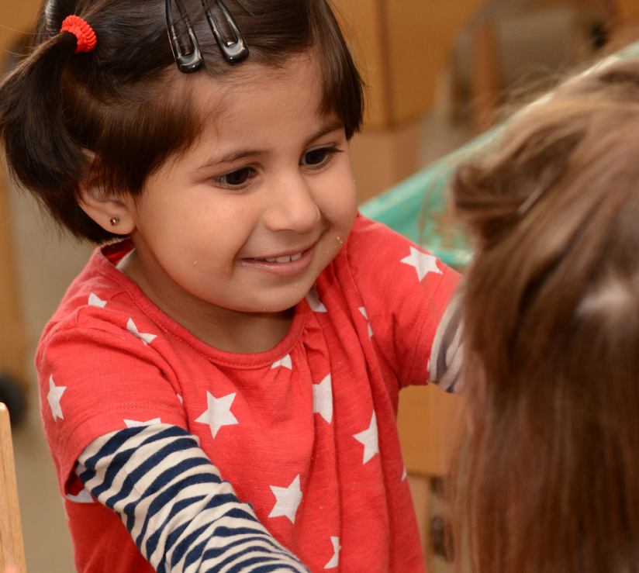

Early Learning and Childcare in Scotland 2022
Definition of early learning and childcare
Statutory duty on education authorities
Notes:
The term early learning and childcare, seeks to emphasise the holistic and seamless provision of nurture, care and development of social, emotional, physical and cognitive skills, abilities and wellbeing.
The Children and Young People (Scotland) Act 2014 removed the artificial divide between pre-school education for 3 and 4 year olds and childcare for 3 and 4 year olds. There is recognition of the role that responsive care, regardless of how it is funded, plays in supporting children’s development.
There is a statutory duty on education authorities in Scotland to ensure that the statutory funded early learning and childcare entitlement is made available for all eligible children in its local area
While early learning and childcare is an entitlement – it is not statutory in terms of attendance, however, the statutory duty is on education authorities to provide for that entitlement. Parents may choose not to use their entitlement or only use part of it.

Slide 3
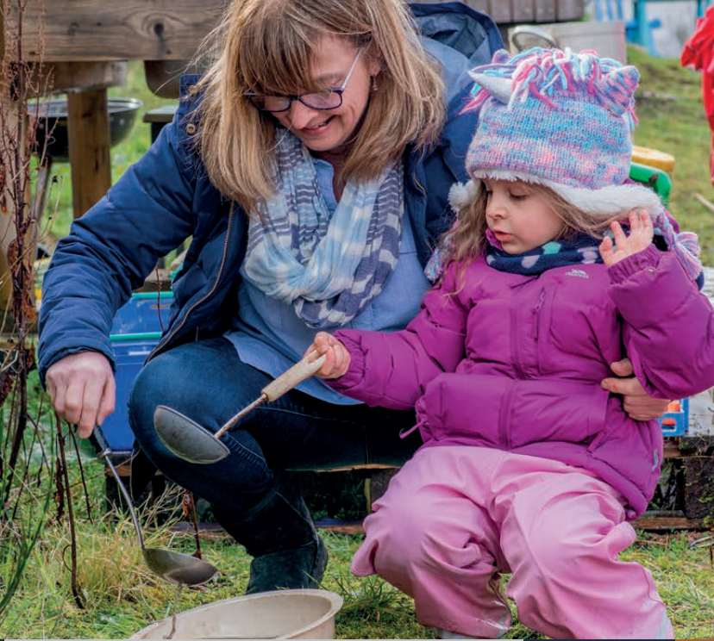
Early Learning and Childcare Sector
Types of ELC settings
The workforce
Notes:
In Scotland early learning and childcare is provided through public, private, voluntary and independent sectors. Children may also access their entitlement through, what we call, a blended placement between two providers. We have settings attached to schools often referred to as nursery classes, we also have early learning and childcare centres, playgroups and childminders who operate from their home. A parent can choose to use their funded entitlement between two provides, for example a nursery class or centre and a childminder.
The Scottish Government recognises that access to highly qualified practitioners with expertise in early childhood learning and development plays a key role in realising our ambitions for our youngest children. This is particularly true for young children who face the greatest disadvantages, where additional support may be required to ensure equity of outcomes.
Early learning and childcare is now a degree led sector. All senior managers must hold a degree qualification. Some may be teacher qualified or hold a Childhood Practice degree.
More recently, we have introduced excellence and equity leads in early learning and childcare settings in the most disadvantaged areas of Scotland.
The role of the equity and excellence lead is primarily focused on leading support for the most disadvantaged children to close the attainment gap. This involves working directly with children to support and extend their learning focusing on key areas of literacy and numeracy. They will also lead and support pedagogy and the upskilling of fellow practitioners.
By ensuring settings comprise of staff with the knowledge and skills to provide high quality, child-focused experiences, we are able to support children in reaching their potential and improve their lifelong outcomes.
An early learning and childcare setting will also have practitioners, support workers and modern apprentices who are working as part of their studies.

Slide 4

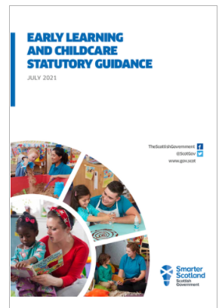
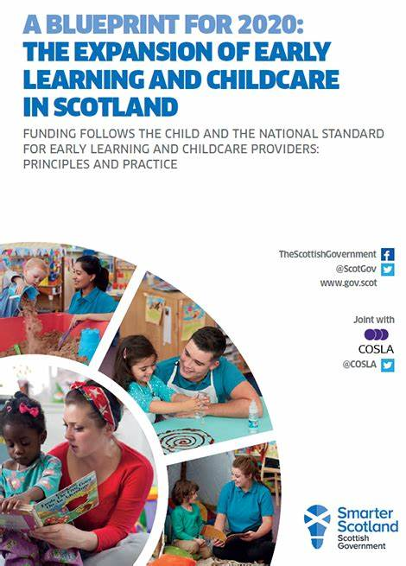
Expansion of Early Learning and Childcare (ELC)
Child is aged 3 and not yet started
primary school
For some 2 year olds
1140 hours of ELC
Funding follows the child
Gaelic Medium ELC
Notes:
In recent years early learning and childcare has undergone expansion. Transformational change has taken place and we now offer all children aged 3 and over and 2 year olds from low-income families ,one thousand and one hundred and forty hours of free early learning and childcare per year.​ This has resulted in individual settings having to change the hours each day that children can attend and/or extend the length of year that they operate. For example a nursery class previously would have operated during school term time, now they have had to extend their year to accommodate the additional hours.
​
There are 4 key principles of the expansion, quality, accessibility, flexibility and affordability. We also have a national standard to support the expansion, which each early learning and childcare setting must follow. This standard sets out what children and families should expect from their early learning experience regardless of where they access their child’s funded hours.​
​
The expansion was fully implemented in August 2021, 1 year later than expected due to COVID-19. In August 2021, almost​
91,000 children were accessing their funded entitlement.
2600 settings were providing funded early learning and childcare
Our private, voluntary and independent sectors provide 32% of the free entitlement.
The workforce has increased significantly to provide the extended hours​.
We have around one thousand three hundred childminders working from home to provide funded early learning and childcare.
These figures may have increased since August 2021.
​
Early learning and childcare can also be provided through the medium of Gaelic Language and we are delighted to see an increase in this offer for children in various areas of Scotland.​
​

Slide 5
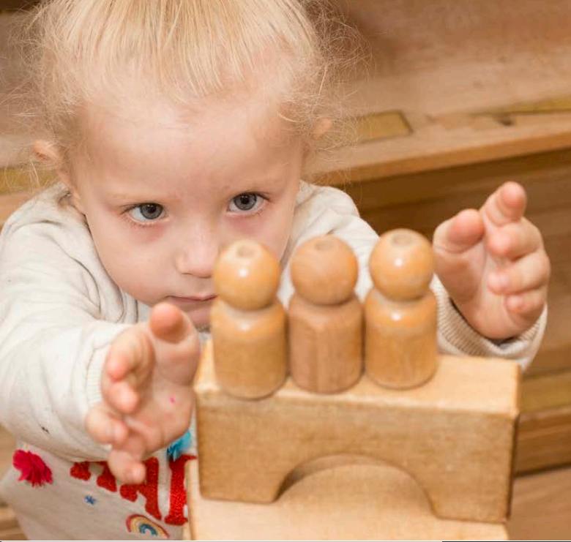
Inspection of Early Learning and Childcare
Education Scotland Inspections
Working with the Care Inspectorate
Notes:
​Education Scotland aims to promote and support improvement and innovation that enhances children's educational experiences. Our inspectors focus on the quality of children's learning and achievement and we have a particular interest in how each setting is developing children's skills and understanding in literacy, numeracy and health and wellbeing.​
​
We also work with the Care Inspectorate who are a regulatory body. During inspections, care inspectors will look at the quality of care in an early learning and childcare setting to ensure it meets the expected high standards. ​ We sometimes carry out our inspections jointly.
My colleague Patricia Madden will now share with you an overview of some of strengths and challenges that we find as part of our inspection work.

Slide 6
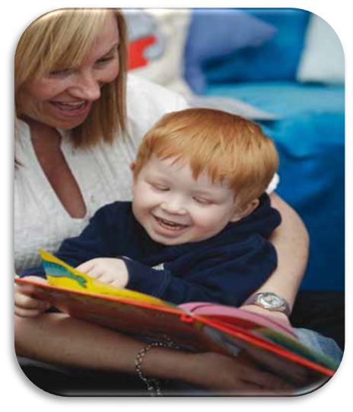

What does inspection tell us?
Strengths
Positive relationships
Context of families and the local community
Learning environments
Children's wellbeing
The majority of children are making good or better progress in literacy, numeracy and health and wellbeing.
Identification of potential barriers to learning, including collaboration with other agencies.
Notes:
These strengths were identified during our inspection of a sample of settings between 2018 and 2020 before early learning and childcare settings closed as a result of the global pandemic. During these inspections we found:
That there was positive relationships between practitioners and children, practitioners and parents, children and their peers;
Senior leaders and practitioners demonstrated a good understanding of the local context of families and their local community;
We also found exciting/interesting and well-considered learning environments which promote children's curiosity, inquiry and creativity;
During these inspections, children's wellbeing was at the heart of the early learning and childcare provision, with all practitioners focused on Getting it right for every child.
Our inspections tell us that the majority of children are making good or better progress in literacy, numeracy and health and wellbeing.
And we found that there was early Identification of potential barriers to learning, which enabled tailored interventions to be put in place to improve outcomes for children, including collaboration with support agencies such as social work departments, educational psychologist and speech and language therapists.

Slide 7
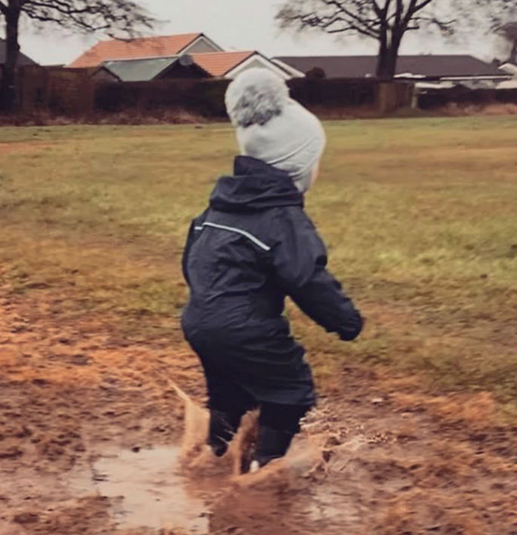
What does inspection tell us?
Challenges
Significant staffing changes
High-quality interactions
The collection and use of data
Notes:
These challenges were identified during our inspection of a sample of ELC settings 2018-2020.
We found that due to the recent expansion there has been significant staffing changes to senior leader and practitioner teams.
High-quality interactions between practitioners and children continues to be an area for improvement within our early learning and childcare settings, this could be connected to the significant changes with staffing and a range of expertise within team.
In a few of the settings visited, we found practitioners making effective use of data and information about children to ensure equity and positive outcomes for children and families. However, in most settings, the collection and use of data remains an area for development.
We are currently, creating professional learning modules that practitioners will be able to undertake to support them in this area.

Slide 8
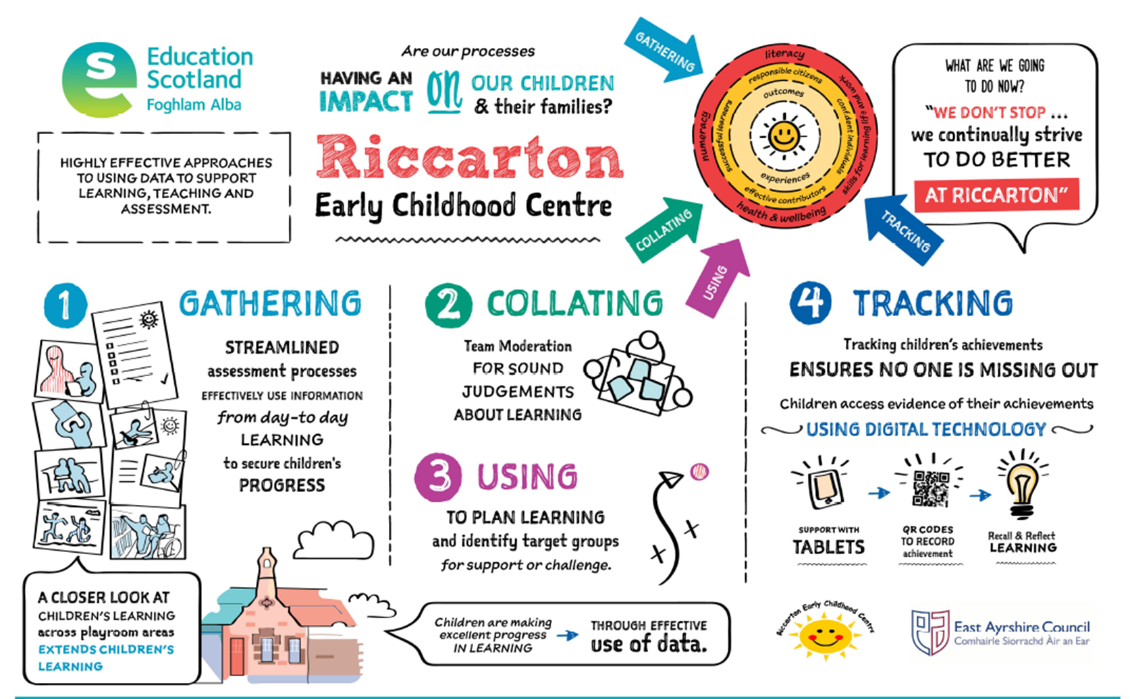
Sharing Effective Practice
Notes:
Part of our scrutiny work is to identify and share effective practice to support improvement. This early learning and childcare setting was awarded grades of excellent. In this setting, the manager and staff have this highly effective 4 step approach to gather, analyse and use data to inform their understanding of the lives of children and their families and to identify children who are experiencing barriers to their learning. They use this information along with high quality assessment to plan well-judged interventions to secure the best possible outcomes for children.
The headteacher and practitioners continuously evaluate the impact of strategies and meticulously monitor the progress children are making. As a result of this excellent practice within the setting, practitioners are actively working towards reducing the attainment gap.

Slide 9
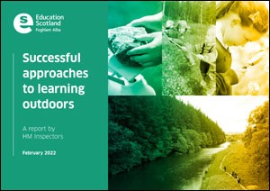
The impact of inspections
Thematic Inspections
Recovery visits
Successful Approaches to Learning Outdoors | National Thematic Inspections | HM Chief Inspector Report | Inspection and review | What we do | Education Scotland
Notes:
Our normal programme of inspection for schools and early learning and childcare settings has been postponed due to the pandemic.
However, since September 2021 our inspectors have undertaken 3 thematic inspections and a number of visits to support the education system during the pandemic and through recovery.
Our three thematic inspections undertaken are:
Successful approaches to outdoor learning
Wellbeing and
Recovery.
The first of these three, successful approaches to outdoor learning was published on 22 February .
Our visits have included:
hearing about current priorities for recovery or improvement;
finding out about what is working well, the challenges faced and solutions found, and
identifying and sharing examples of effective practice.

Slide 10

Realising the Ambition | Learning resources | National Improvement Hub (education.gov.scot)
Notes:
Realising the Ambition: Being Me is our national practice guidance for early years in Scotland. It was published in 2020 just before the pandemic closed our schools and settings. It covers children’s learning and development from birth into the early years of primary school.
The realising the ambition tartan featured on the cover, is not an official Scottish tartan – although we might argue that it should be. It’s a creation that was born out of the many deliberations that took place during the writing of the guidance. The different colours that make up the weft and warp of the tartan are used in each section to guide readers though each section of the guidance symbolising the notion of a tartan shawl. Our tartan shawl is strengthened by the inclusion of a golden thread - the thread of quality. The imagery intends to reflect the uniqueness of our Scottish culture and the value we place on supporting the developing child, keeping them safe and secure.
Realising the ambition is a philosophy for early childhood that:
•prioritises the image of the child and acknowledges the key role of family
•recognises the continuous development of the child from their earliest days
•gives prominence to the importance of relationships and wellbeing
•values the holistic nature of ELC from pre-birth and beyond into primary school
The guidance focuses on:
how the child grows and develops;
extending the reach to include teachers in the first classroom of school and beyond;
research and activities which provoke deeper thinking about how children learn best;
it raises the bar in terms of expectations of quality by providing clear messages for practitioners/teachers and others on pedagogy and play, and
Supports and extends professional knowledge and understanding to build capacity for improvement within and across early learning and childcare and primary schools.
Our children will undoubtedly benefit as our practitioners and teachers engage with and implement this guidance as they strive for excellence and equity in all aspects of their practice.
You can access a copy by following the link, including recordings of professional learning sessions giving an overview of realising the ambition.

Slide 11
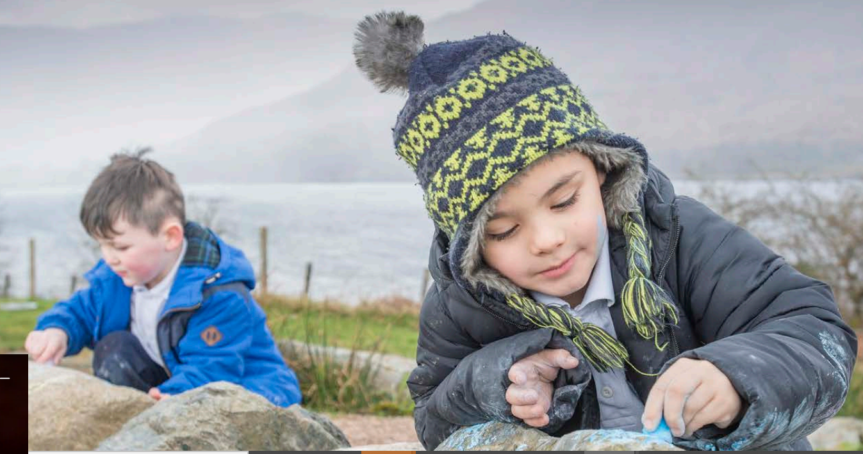
The Early Level of Curriculum for Excellence
“Children bring more than their backpacks to school.”
(Margetts, (2003:7)
Notes:
The early level of curriculum for excellence spans from 3 year olds to the end of primary 1 around the age of six or seven.
This quote from Kay Margetts demonstrates the importance of transition in supporting not only continuity of learning for children, but their wellbeing too. It is important that our schools are ready for children rather than children being ready for school.
In the current climate more than ever, we are focusing on the effectiveness of our transition programmes and the level of collaboration between practitioners in early learning and childcare and teachers within primary schools to support continuity within and across the ‘early level’ of curriculum for excellence.
.

Slide 12
Notes:
As we move through the transformational phase of early years education in Scotland, our ambition to improve outcomes for children and families will be realised.

Slide 13
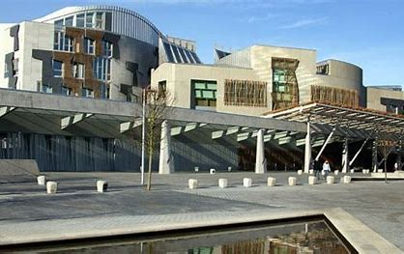
Excellence, equity and equality
In Primary Education in Scotland
Sadie Cushley HMI
SICI Presentation March 2022
For Scotland's learners, with Scotland's educators

Slide 14

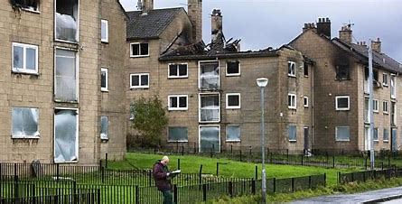
A Scotland of Two Halves
2001 Primary School in Scotland with 393,957 children
Mainly state schools with only 71 private / independent schools
1 in 4 children living in poverty
For Scotland's learners, with Scotland's educators

Slide 15
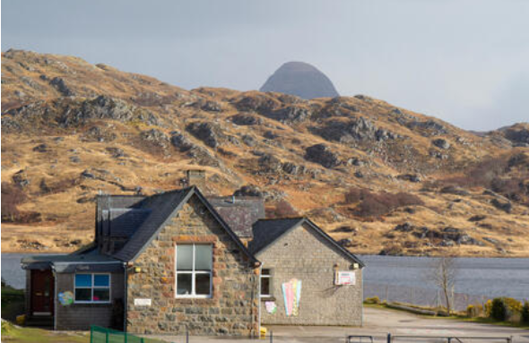
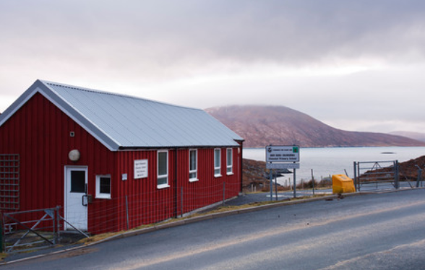
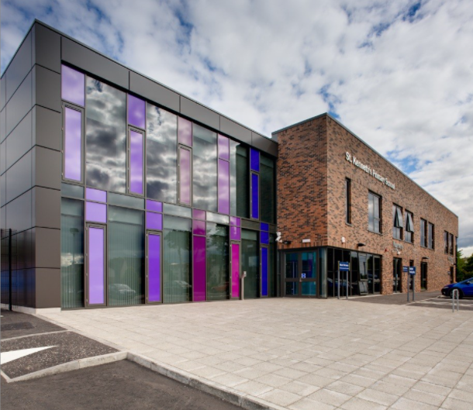
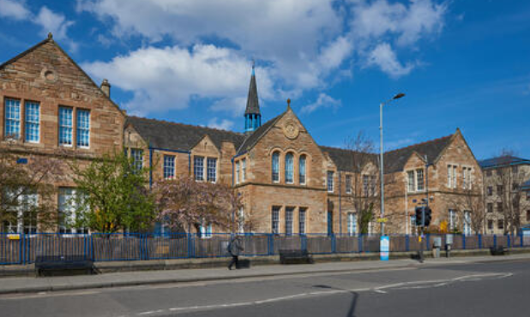

Range of locations and quality of provision across Scotland
For Scotland's learners, with Scotland's educators

Slide 16

Scottish Education is based on belief that education is a human right
Should tackle inequity in society and address the poverty related attainment gap.
Inclusive for all children
Presumption of mainstream for all

Slide 17
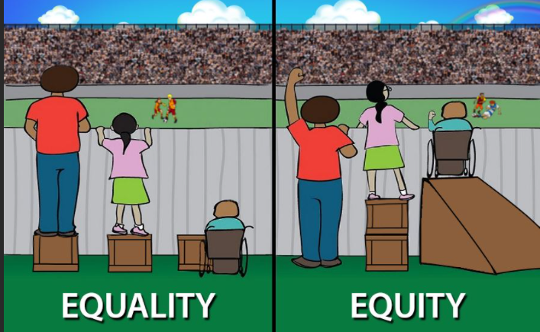
For Scotland's learners, with Scotland's educators
Notes:
Our vision for education in Scotland is set out in the National Improvement Framework:
Excellence through raising attainment: ensuring that every child achieves the highest standards in literacy and numeracy, set out within CfE level, and the right range of skills, qualifications and achievements to allow them to succeed, and:
Achieving equity: ensuring every child has the same opportunity to succeed, with a particular focus on closing the poverty-related attainment gap.
Equity (as defined in HGIOS) means treating people fairly but not necessarily the same. Equity in education means that personal and social circumstances such as gender, ethnic origin or family background are not obstacles to achieving educational potential and that all our young people are well supported to secure wellbeing, skills for learning, life and work and the best possible post-school definition.
Equality: relates primarily to the protected characteristics found in the Equality Act 2010. HGIOS defines it as- the removal of barriers and the widening of opportunities for whom access is limited. Where equality is embedded in practice, there will be no prejudice-based discrimination.
Equality v Equity example: " equality is giving everyone a shoe" v " equity is giving everyone a shoe that fits"
We need to deliver both excellence in terms of ensuring children and young people acquire a broad range of skills and capacities at the highest level, whilst also delivering equity so that every child and young person should thrive and have the best opportunity to succeed regardless of their social circumstances or additional needs.
NB: GTCS have added an EQUALITY and DIVERSITY HUB to their website (https://www,gtcs.org.uk/professional-update/equality-diversity-hub.aspx). Range of resources to support professional learning – not classroom resources.

Slide 18
Living in poor area . / FME / LAC
Results in poorer educational attainment, outcomes and lower proportions of young people in learning, training or work.
Migration
COVID - 19
Food and fuel poverty
Potential
barriers
Homelessness/temporary accommodation
Hidden poverty
Financial
Social capital
Domestic abuse
Access to transport
Bereavement
Problem drug and alcohol abuse
Parent/carer literacy/numeracy difficulties
Lower proportionsof young people in learning, training or work
Notes:
Here is a list of potential barriers – not exhaustive which - which may contribute to changes.

Slide 19
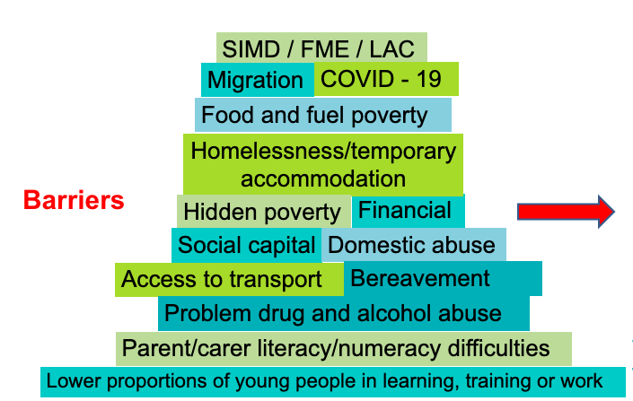
Impact
Poor attendance
Relationships
Change in behaviour: not completing tasks, lack of interest.
Low energy.
Physical appearance.
Cost of the school day- barrier
Health issues
Feeling loss of control
Anxiety impacting on learning
Potential barriers
Notes:
What does research tell us about the impact of these potential barriers?
We know that the most significant risk factors that affect children raised in poverty are: emotional and social changes, acute and chronic stressors, cognitive lags and health and safety issues.
Across a number of research projects, a recurring theme was that children from less advantaged backgrounds felt less in control at school, because
they are under pressure to perform required tasks in which they lacked confidence.
Research on social status: The quest for importance and social status. This is the quest to feel special. Students compete for attention and social elevation by choosing roles that will distinguish them (e.g., athlete, comedian, storyteller, gang leader, scholar, or style maverick). Kids are very interested in what other kids do, whether others like them, and how they rate on the social scale (Harris, 2006).
Bearing this in mind, and setting this within the current context of the pandemic:
We need to remember that Scotland is making very good progress in removing barriers to children affected by poverty.
Our response to the pandemic provides us with an opportunity to rethink, do things differently and make greater gains in closing the poverty related attainment gap.
We can learn from successful projects:
For example, a key feature of successful projects working with excluded children (a small minority of those facing social disadvantage) was to build close relationships, not just with young people but with their families, addressing the family circumstances as well as the child’s learning needs, and making education a shared enterprise between family, educator and child. This work relies on highly skilled and dedicated workers, often
without professional qualifications but able to put the required level of commitment into building productive relationships.

Slide 20

Our vision for education in Scotland is set out in the National Improvement Framework:
Excellence through raising
attainment:
Achieving equity
Achieving equality
For Scotland's learners, with Scotland's educators
Notes:
Our vision for education in Scotland is set out in the National Improvement Framework:
Excellence through raising attainment: ensuring that every child achieves the highest standards in literacy and numeracy, set out within CfE level, and the right range of skills, qualifications and achievements to allow them to succeed, and:
Achieving equity: ensuring every child has the same opportunity to succeed, with a particular focus on closing the poverty-related attainment gap.
Equity Equity in education means that personal and social circumstances such as gender, ethnic origin or family background are not obstacles to achieving educational potential
Equality: relates primarily to the protected characteristics found in the Equality Act 2010. HGIOS defines it as- the removal of barriers and the widening of opportunities for whom access is limited. Where equality is embedded in practice, there will be no prejudice-based discrimination.
Equality v Equity example: " equality is giving everyone a shoe" v " equity is giving everyone a shoe that fits"
We need to deliver both excellence in terms of ensuring children and young people acquire a broad range of skills and capacities at the highest level, whilst also delivering equity so that every child and young person should thrive and have the best opportunity to succeed regardless of their social circumstances or additional needs.
NB: GTCS have added an EQUALITY and DIVERSITY HUB to their website (https://www,gtcs.org.uk/professional-update/equality-diversity-hub.aspx). Range of resources to support professional learning – not classroom resources.

Slide 21

Scottish Attainment Challenge (SAC)
About achieving equity in educational outcomes
Particular focus on closing the poverty related attainment gap
Pupil Equity Funding
Notes:
Attainment Scotland Fund is about achieving equity in educational outcomes.
It has a particular focus on closing the poverty related attainment gap.
Equity can be achieved by ensuring that every child has the same opportunity to succeed.
It is connected to:
PEF: additional funding allocated directly to schools and targeted at closing the poverty related attainment gap.
CECYP: additional funding for local authorities to fund initiatives and interventions aimed at improving educational outcomes for care experienced children and young people (aged 0-26), with the overarching aim of closing the poverty related attainment gap.
(National operational guidance (2020-2021) has been relaxed to support the education, health and wellbeing and care of children and young people during the response to the coronavirus pandemic. This flexibility must remain consistent with the principle of equity in education.)
Closing the poverty related attainment gap needs the whole school community working together to:
Maximise access for learners to high quality learning and teaching
Develop learner’s independence
Build the capacity of families to support their child’s learning.

Slide 22
What is Pupil Equity Funding?
More than £250 million Pupil Equity Funding is being allocated over the next two years to over 95% of schools across every local authority in Scotland.

Slide 23
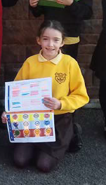
Pupil Equity Fund
Pupil Equity Funding is designed to support children in Primary 1 to S3 who are eligible and registered for free school meals.
Headteachers can also use their judgement to support other children in their school who are affected by poverty.

Slide 24


How does inspection promote equity and closing poverty related attainment gap ?
For Scotland's learners, with Scotland's educators

Slide 25
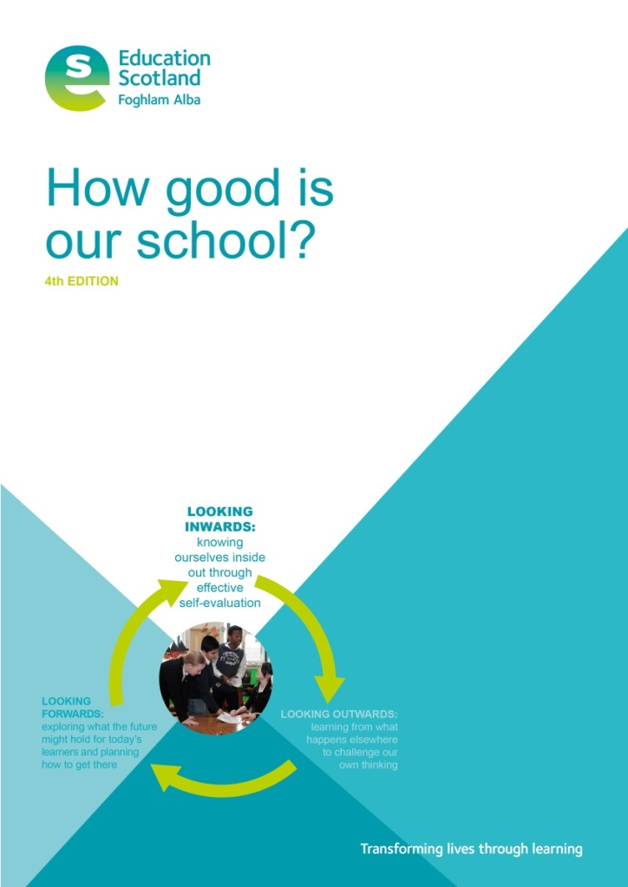


Main Drivers
Notes:
National Improvement Framework – the 2,4,6 overview
Two AIMS
Sets out the vision for education in Scotland: Excellence and equity
Empowered and collaborative system
Four PRIORITIES … the 'why'
At the heart of these priorities is ensuring that we improve outcomes for children and young people.
Six DRIVERS … the 'how'
School leadership / teacher professionalism/ parental engagement/ assessment of children’s progress/ school improvement/ performance information
All six drivers are of equal importance.
Links and connections across these are essential to enabling continuing improvement and minimising unexpected consequences.

Slide 26
Using quality indicators to evaluate how schools
Raise attainment
Close poverty gap
Use pupil equity funding (PEF)
Are inclusive of all children
Develop equity and equality
For Scotland's learners, with Scotland's educators

Slide 27
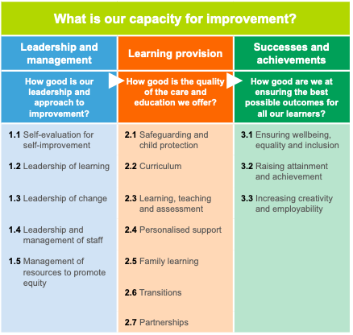
Self Evaluation Framework- How Good Is Our School 4
How good is our school? - HGIOS 4 |
Self-evaluation | National Improvement Hub (education.gov.scot)
Notes:
EMPHASISE the READ-ACROSS
Golden thread of equity

