Slide 1

The Big Listen: managing inspection change through sector engagement
Notes:
Hello and welcome. My name is Helen Matthews, Deputy Director inspection policy in education directorate at Ofsted.

Slide 2
Inspection in England
Notes:
So first of all, a little about Ofsted

Slide 3
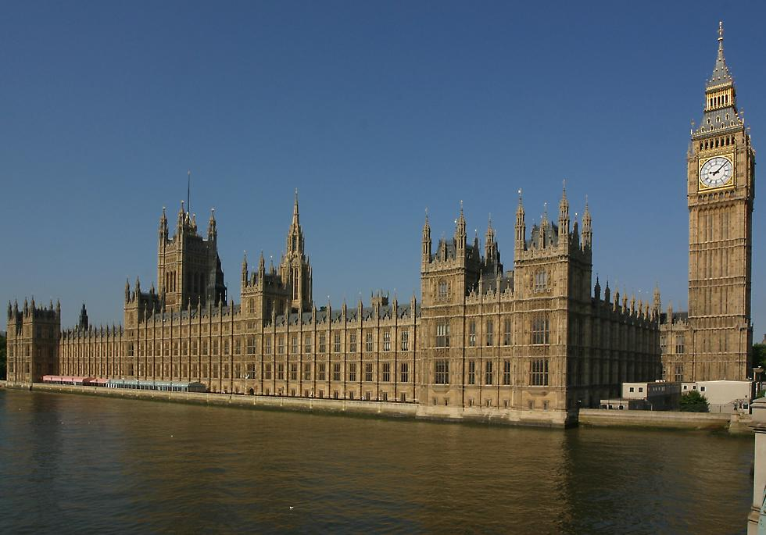
Ofsted is accountable to Parliament
Select committees 3. HMCI’s Annual Report
Parliamentary questions 4. Annual Report and Accounts
Notes:
BUT believe we are independent

Slide 4
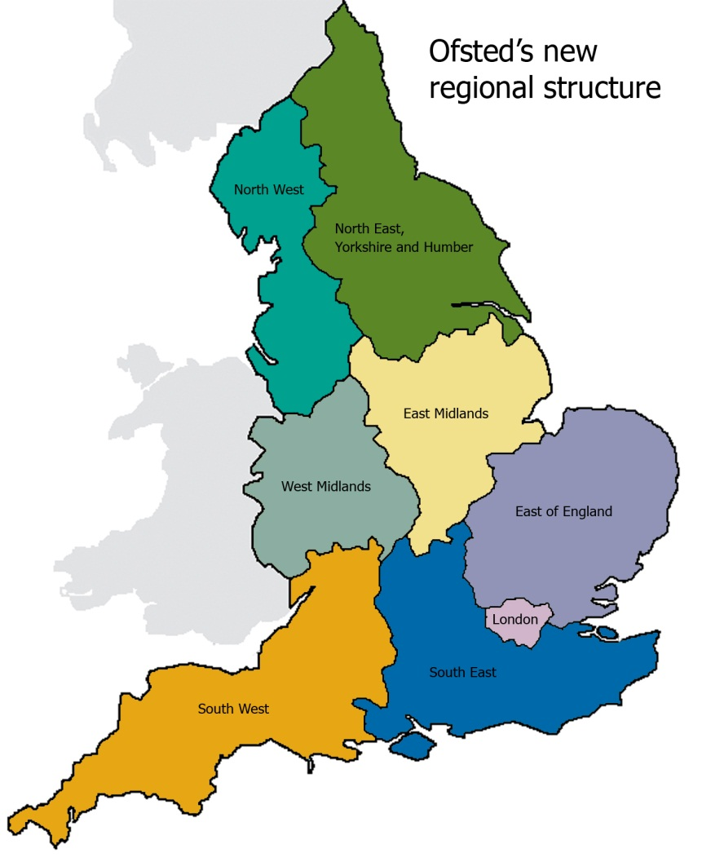
Regional Structure
The delivery of inspection is organised through eight regions, led by Regional Directors who are responsible for the quality and quantity of inspections in each region.
Notes:
Eight regions – eight directors – different challenges

Slide 5

Ofsted inspects…
Schools – maintained, academies, independent and faith
Nurseries and child minders
Colleges and universities
Teacher training and professional development
Social care – local authorities, children’s homes etc.
Prison education
Provision for SEND in a LA
Notes:
We inspect a wide range of provision and institutions across England including…

Slide 6
Serving children and learners
1.6 million children and their parents benefit from early years services.
8.1 million children and young people are in schools.
390,000 children receive social care services.
850,000 people receive training and support to help them find employment.
3.3 million learners aged 16+ receive education, training and apprenticeships provided by the FES sector.

Slide 7
School Landscape
Approx 24,000 state-funded schools:
  17,000 primary
  3,500 secondary
  1,000 special schools
Around 2,500 independent schools

Slide 8

Our values
Children and learners first
Independent
Accountable and transparent
Evidence-led
Notes:
Our values remain the same
Children and learners first
Our focus is on improving outcomes for children and learners. The defining test for Ofsted is whether our work helps keep children safe and allows learners to reach their full potential.
Independent
We judge standards and report our findings to the public without fear or favour. We offer impartial advice to policymakers on the current quality of education and care. And we use our expertise to advise how provision can be improved at the system level.
Accountable and transparent
We report to Parliament on how we carry out our inspection and regulatory functions and how we spend taxpayers’ money. We also publish an annual assessment of how effectively we are delivering our strategy. We are transparent: our approach to regulation and inspection is open to scrutiny.
Evidence-led
Our policies, frameworks, judgements and insights are rooted in evidence. We are proportionate and responsible in how we use our voice, providing the evidence to highlight significant issues.

Slide 9

Raising standards, improving lives: our guiding principle
“A force for improvement through intelligent, responsible and focused use of inspection, regulation and insights”.
Notes:
Our mantra stays the same
We use the phrase ‘a force for improvement’ to recognise that Ofsted’s work does lead to improved standards, but we are just one of many actors in education, training and care. We are not an ‘improvement agency’ – improvements are made by teachers, leaders, social workers, residential staff and others who work on the ground – but our inspection, regulation and insights contribute to these improvements.

Slide 10
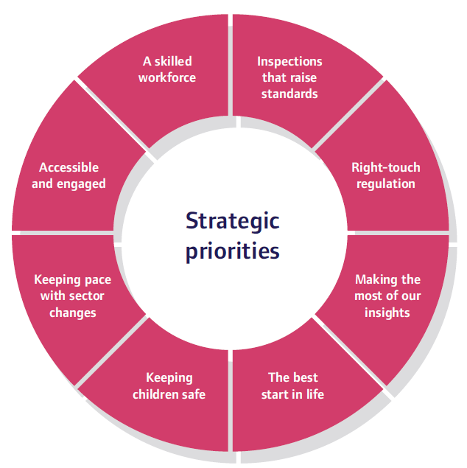
Our strategic priorities
To fulfil our aims, we have set eight strategic priorities:
Notes:
Our strategic priorities
Inspections that raise standards
Our inspections help education and social care recover and improve
Right touch regulation
Our regulation advances high quality care, education and safeguarding for children
Making the most of our insights
We share insights through our research ana analysis. Our insights inform practitioners, policymakers and decision makers and lead to improvements across the system.
The best start in life
We develop the evidence base about early years, education, including curriculum and pedagogy, and act on it.
Keeping children safe
We promote children’s’ safety and welfare in everything we do
Keeping pace with sector changes
We keep pace as the education and social care sectors evolve. We continually review our approach and advocate for additional powers where required.
Accessible and engaged
We are open and accessible to our different audiences, understanding their needs.
A skilled workforce
We make sure we have the tools. Knowledge and expertise we need to continue to be a force for improvement.

Slide 11
The Education Inspection Framework – research informed
Between 2017-19, our research activities led us to recognise:
The schools sector lacked coherence about ‘curriculum’
Focusing on published outcomes had negative consequences for curriculum design (such as ‘teaching to the test’)
Curriculum narrowing was a problem in schools in certain key stages
Foundation subjects suffered from a lack of teacher subject knowledge and professional development
A focus on curriculum and knowledge in our inspection work benefits pupils’ education

Slide 12




The Education Inspection Framework
Early years
Maintained schools and academies
Independent schools
Further education and skills
Notes:
We have one education inspection framework that provides the framework for inspection across these remits. This framework, developed in 2019, and based on extensive research, formed the basis of how we inspect different provisions. The framework looks in particular at the curriculum – what knowledge we want children and young people to learn and how the components of that knowledge are taught over time.

Slide 13

A Focus on:
The curriculum as the progression model
Notes:
We know that our focus on the curriculum – steeped in research – has had a significant impact on schools in their curriculum design, thinking and understanding.
However, Ofsted has a working definition, which is… ( click to next slide).

Slide 14

COVID-19
Safe, sensitive, sensible
Visits rather than inspections
Schools remained open for key workers’ children and the most vulnerable
Re-deployed many HMI
Huge gulf between the experiences of different children.

Slide 15

Positives of the EIF
Focus on the curriculum
Focus on early reading
Consistency across remits
‘Golden thread’ linking teacher training, teacher development and leadership qualifications
Engagement with the sector

Slide 16

Time for change
A change for…
‘Everyone we work with and work for’.
Notes:
But it is now time for a change. The new HMCI started in January 2024. He was clear from the start that he wanted to make changes and in order to do so, wanted to listen to the views of the sectors and the children, young people, parents, carers and leaders that we serve.

Slide 17

A time of development and change
A new His Majesty’s Chief Inspector
A select committee enquiry and coroner’s report
Reputational pressure from sections of the sector
Potential for political change
Definition of child
Notes:
So why change and why now? Talk through the 4 areas.

Slide 18

New leadership
New perspectives
New priorities
Notes:
So let us start with our new leader – Sir Martyn Oliver. With any change in leadership comes new perspectives and new priorities. Internally, the workforce can see the potential for change and with it, new opportunities, new structures. Externally, the education world can see the potential for influencing and shaping depending on their own views and perspectives.

Slide 19
Ofsted under Sir Martyn Oliver – Priorities
“I have set out two big priorities for my tenure. To fully utilise our position and make the most of our insights. And to make sure our focus is always on the most disadvantaged and vulnerable.”
ASCL Speech
Notes:
Sir Martyn Oliver has made his own perspective and priorities very clear. During Sir Martyn Oliver's speech at the 2024 Association of School and College Leaders Annual Conference Sir Martyn Oliver discussed his first two months as Chief Inspector, the challenges facing the education and care sectors, and what he and Ofsted hope to achieve in the coming months and years.

Slide 20
COVID-19 legacy
Parental buy-in to the system
Sporadic attendance
Missing from education 28,100.
More parents opting to home educate
Safeguarding incidents
Teacher/leader retention and recruitment.
Notes:
CME data Census day summer 2023

Slide 21

The Big Listen
Notes:
So we launched The Big Listen – a consultation to hear the views of as many people as possible.

Slide 22
The aims of the Big Listen
The Ofsted Big Listen seeks views across our work, from schools and children’s social care to teacher training and early years.
The Big Listen will be an opportunity for Ofsted to hear directly from parents, carers and the public, and professionals about the strengths and weaknesses of Ofsted’s current approach to inspection and regulation.
It is a demonstration of our determination to work openly and transparently with parents and the sectors that we inspect and regulate, while always maintaining a focus on ensuring the highest standards of education and care for children and learners.

Slide 23
The Big Listen strands
Formal public consultation
Commissioned research with parents/carers and professionals
Focus groups with children and young people in care and care-leavers
Notes:
We launched the formal public consultation in March and it closes at the end of May

Slide 24




The Big Listen areas
How we report on our education, early years and social care inspections.
Our inspection and regulatory practice and exploring ways we can make sure our processes and practices work equally well across all settings and remits.
The impact and consequences of our work for everyone our work touches – children, parents, leaders, providers and professionals.
Our culture and purpose – reviewing the way we approach and conduct our inspections and regulatory work.

Slide 25
Big Listen research
Research with parents and carers
Commissioned to Natcen
Surveys to 4,000 parents and carers
Focus groups with parents and carers across all remits
Research with professionals in providers and settings that we inspect and regulate
Commissioned to IFF Research
Surveys to 6,000 professionals
Focus groups with around 500 individuals
Questions focused on:
Overall views of Ofsted, e.g. trust
Experience of inspection, e.g. the process, methods, notice periods
Inspection reporting, e.g. timing, accuracy, language
Culture, e.g. inspector knowledge, conduct, raising concerns
Impact, e.g. improvement, workload, wellbeing

Slide 26
Big Listen timescales and outputs
March 2024
April – May 2024
May 2024
June - July
September 2024
Consultation launched
Research data collection
Consultation closes
Analysis and reporting
Final outputs published

Slide 27

The future
Looking Ahead
Notes:
What does the future hold? The honest answer is we don’t know.

Slide 28
The Big Listen
A demonstration of our determination to work openly and transparently with parents and the sectors that we inspect and regulate, while always maintaining a focus on ensuring the highest standards of education and care for children and learners.

Slide 29
Outcomes of the Big Listen
We may be restricted by:
Legislation
Department for Education policy
Ministerial asks – particularly with a potential change in government
Association and union pressure.

Slide 30
Time to consider changing the way we inspect
We need to:
Maintain high standards, consistency and expertise
Utilise research and insights
Secure the focus on the curriculum
Focus on the achievement and development of the learner.
Being mindful of:
Teacher workload
Pressure on leaders
Recruitment and retention issues

Slide 31
Safeguarding children and young people
We are reflecting on how we inspect and report on this area
We want it to be proportionate
We want it to be robust
We want to look at the setting and the system as a whole.

Slide 32
Single-word judgements
This is an area of debate.
Outstanding
Good
Requires Improvement
Inadequate

Slide 33

Notes:
Any questions?

Slide 34




Ofsted on the web and on social media
www.gov.uk/ofsted
https://reports.ofsted.gov.uk
  www.linkedin.com/company/ofsted
  www.youtube.com/ofstednews
  www.slideshare.net/ofstednews
  www.twitter.com/ofstednews

