Slide 1
How does the legal framework support and restrict the effectiveness of inspectorates?
The Luxembourg case - small country with huge challenges
SICI - conference
Tirana, 23th november 2016

Slide 2
Plan of the presentation
Luxembourg, not only banks
An overview of the education system
The framework : constitution and law
The actors : The Inspectorate
The reform … work in progress
Support, restrictions
The challenge … a chance for Luxembourg
Questions

Slide 3
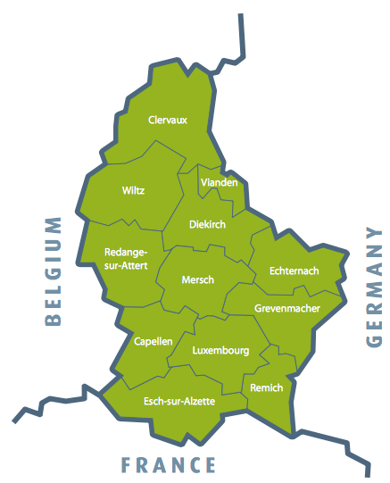
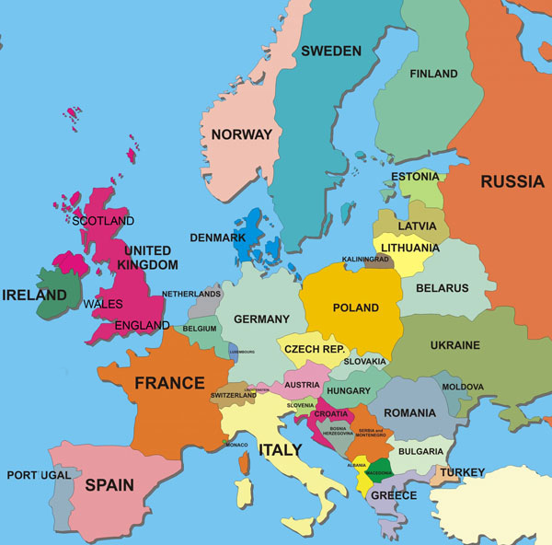
Luxembourg, not only banks
highly centralized administration
550.000 inhabitants
45 % foreigners
2.586 km2
logistics, research and innovation, digital economy, financial center, media and space

Slide 4
An overview of the education system
Highly centralized education - Primary education (national and local level) - Secondary education (national level) - Higher education (national and private level)
Compulsory education (12 years - 4 to 16)
154 fundamental (primary) schools
36 secondary schools
A plurilingual country
Luxembourgish – national language
French – legislative language
German, Luxembourgish and French – administrative et judiciary languages
Portuguese and English – spoken mainly by foreigners – growing in importance

Slide 5
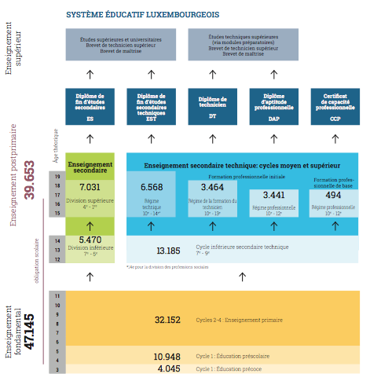
An overview of the education system

Slide 6
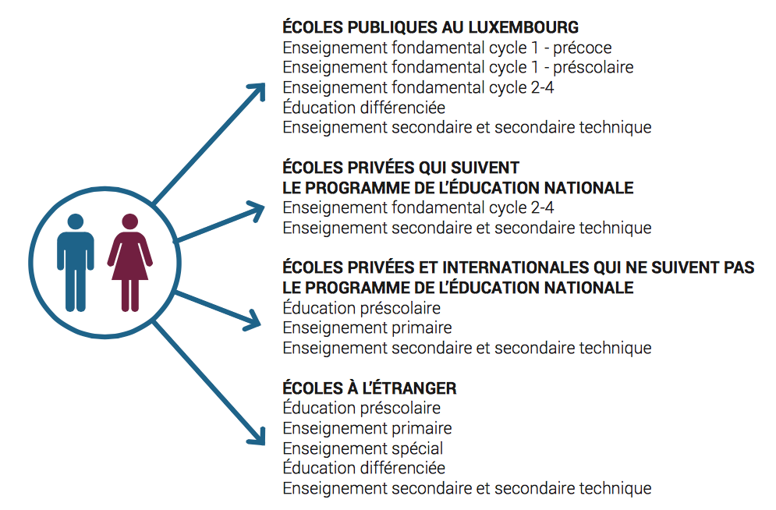
surveyed by inspection

Slide 7
The legal framework
constitution a. compulsory education (4 to 16 years); b. surveillance of the education system
law a. organization of the schools (teaching) b. human ressources c. services, coaching and steering (SCRIPT)
executive text

Slide 8
The Inspectorate
first inspectorate in 1769 under the reign of Maria-Theresa (Austrian Empire)
organized by local education areas 20 inspection areas
23 inspectors a. 20 area inspectors b. 1 inspector in charge of the luxembourgish teachers in a European School c. 2 « special mission »-inspectors
peculiarity : double role of the inspectorate a. school inspection (only for primary school level) b. hierarchical chief of the teacher in a given area c. responsible for the administration of the area d. president of the Inclusion Commission (special needs)

Slide 9
The Inspectorate
Ministry of Education, Children and Youth
Fundamental School inspector (5-10schools)
Secondary School Director
School President
School Committee
Deputy Director
Cycle Coordinators (4)
Teachers
Management staff
Teachers
No hierarchical authority but coordination role

Slide 10
Support and restriction
Support a. hierarchical power b. pedagogical autonomy (at area level)
Restriction a. interference by several law texts b. bicephal situation (director and inspector) c. hierarchical power limited by several exceptions d. no national criteria for local inspections e. no financial autonomy (responsability vs. budget) f. collaboration with the municipality depends on goodwill of the mayor

Slide 11
The reform … work in progress
new paradigm (governance model ?)
separation of the roles and the responsibilities;
increase of the responsibility of the schools
new organisation of decision taking
abolition of the actual inspection system
creation of a national observatory for school quality
reports to the attention of the minister AND parliament

Slide 12
The regional directorate
NEW
administration of the schools in a given region
management and surveillance of the HR
steering of the pedagogical actions of the schools
oversees the school development plans
president of the Commission for special needs

Slide 13
The national observatory
NEW
Missions
evaluation at different levels of the education system (primary and secondary schools)
national report (ministry and parliament)
Special missions given by the minister

Slide 14
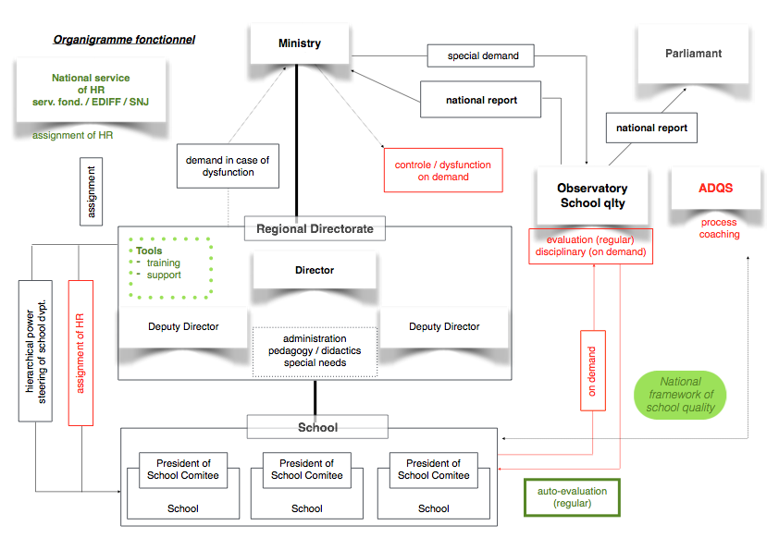

Slide 15
Support, restrictions
supports a. abolition of the two-role-model b. increasing of the responsibility of the schools
restrictions a. need of clarification of the responsibilities b. no accountability of the schools c. no power given to the school-president d. need of clarification for all decision takers e. no budget in accordance to the responsibility f. no real governance model

Slide 16
The challenge …
… a chance for Luxembourg
elaboration of a national framework for school quality
revisit the school development plan (PDS) to support schools in improving their quality
elaborate an organizational culture of accountability
make available to teachers and clearly communicate the
necessary tools and data to assess school performance
make visible, accessible et useful the performance results in national tests (ministry, school, class, student) concerned
accompany teachers in reading, interpreting and using student performance data.
transition from a half- to a full autonomy of the schools

Slide 17
Questions …
… thank you for your attention
Contact:
SICI - Luxembourg:
Joa Baum (joa.baum@inspectorat-men.lu)
Inspector, 8th Local Education Area,
City of Esch-sur-Alzette, Luxembourg

