Slide 1
Digital tools supporting the inspection process in Bulgaria
Radosveta Drakeva
AdminSoft
SICI WORKSHOP, 29 March 2019
SOFIA BULGARIA

Slide 2
Bulgarian Inspection Framework
Covers schools (all types) and kindergartens
Framework: inspection areas, criteria, indicators
Information collection:
  Documents and other information, provided by the school/ kindergarten (prior to the inspection visit)
  On-site inspection visit: meetings, class observation, focus groups with stakeholders
  Questionnaires for teachers, parents, students
Assessment: 4-levels scale, indicator-based

Slide 3
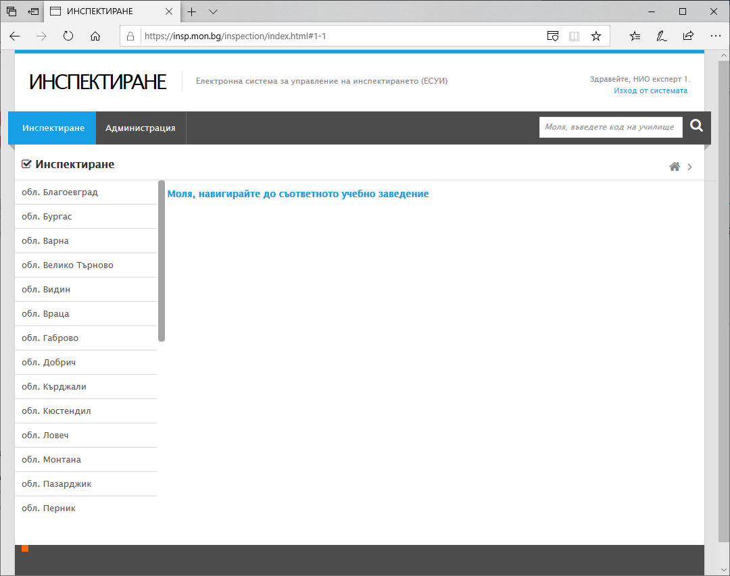
On-line platform to support the inspection process: http://insp.mon.bg
Web-based
Accessible for both schools/KGs, and for the inspectors (for the period of inspection)
Supports the collection of information + the initial calculations for each indicator
Can handle more than one inspection per school/ KG

Slide 4
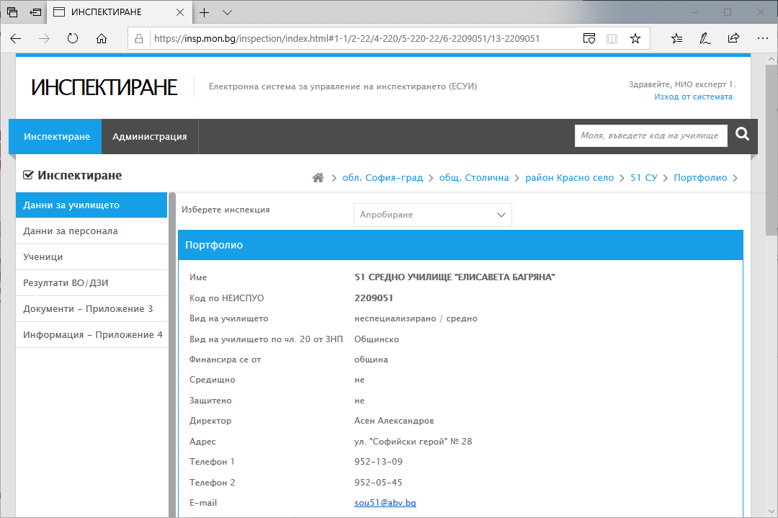
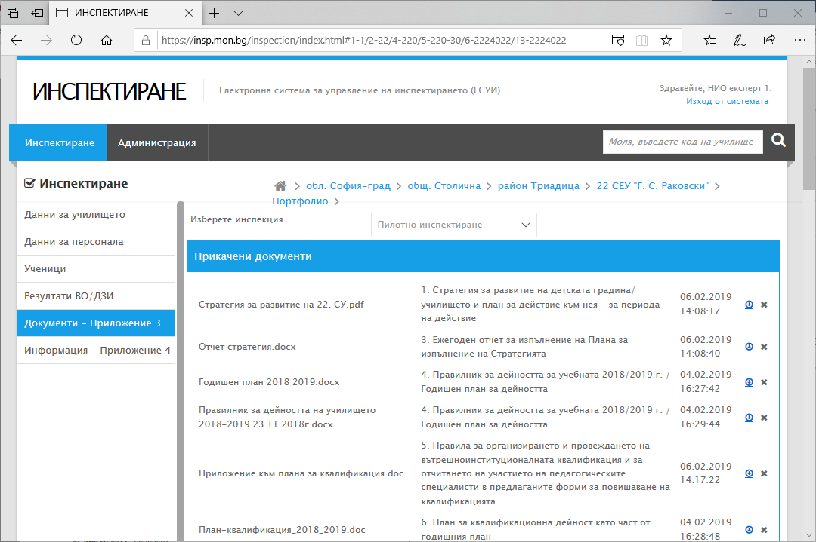
Data provided by the schools/ kindergartens
(integration with the databases of the Ministry of Education and Science)
General data: students, teachers, students’ results (automatically from MoES)
Additional info (free text)
Uploaded documents (as requested by the Inspectorate)
All the information is uploaded prior to the inspection visit
Contact data between the headmaster and the inspector available

Slide 5
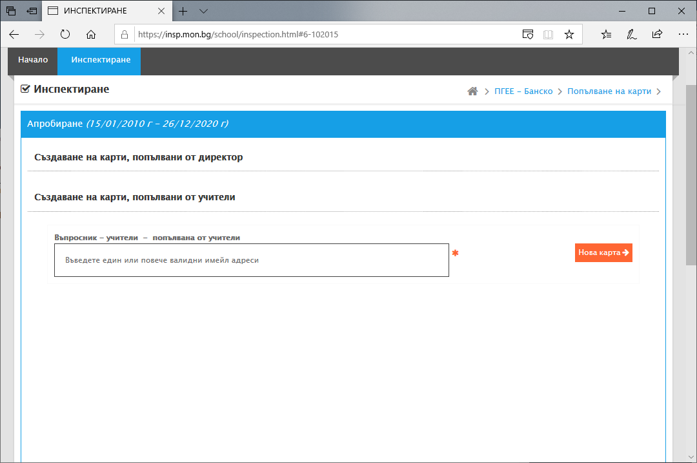
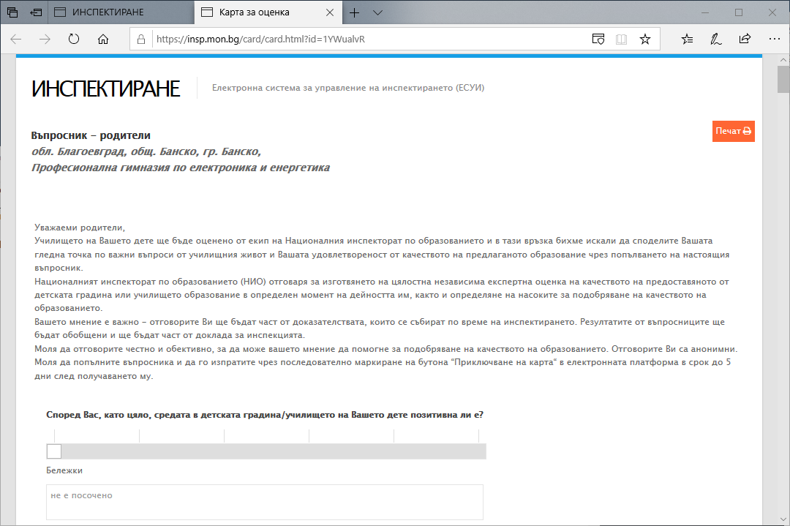
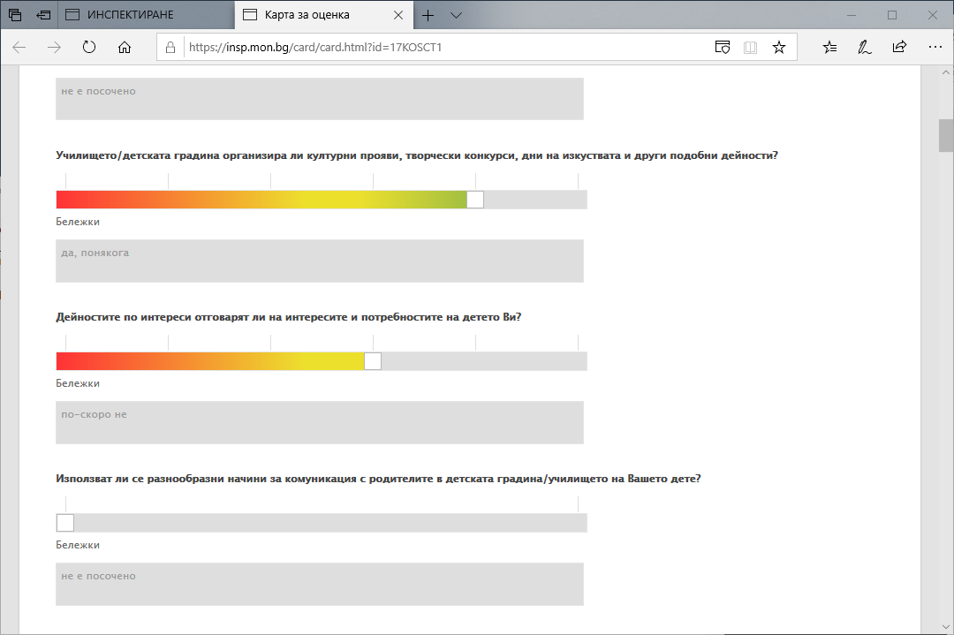
Questionnaires: for teachers, students, parents
Survey organized prior to the inspection visit
The headmaster generates the questionnaires through the platform (by e-mails)
The teachers, parents and students receive the link to the questionnaire by e-mail
No open answers, all questions are linked to the indicators
Results are summarized automatically

Slide 6
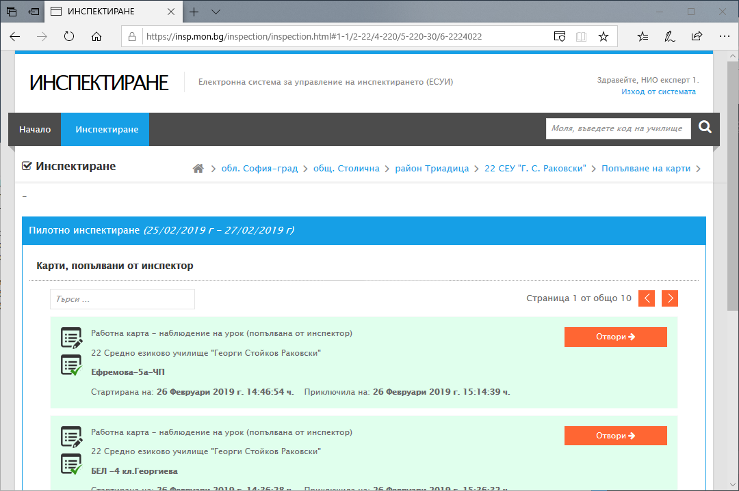
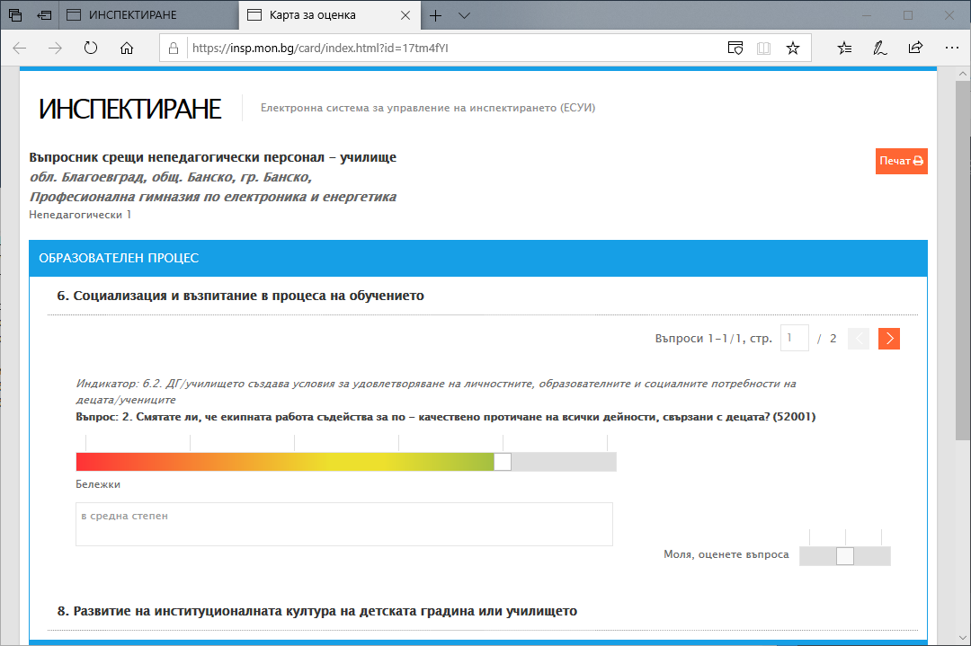
Assessment cards
Various types: for school observation, class observations, meetings, focus groups
Information inserted by the inspectors during the on-site visits
Based on indicators, with a possibility to add comments
Results are summarized automatically

Slide 7
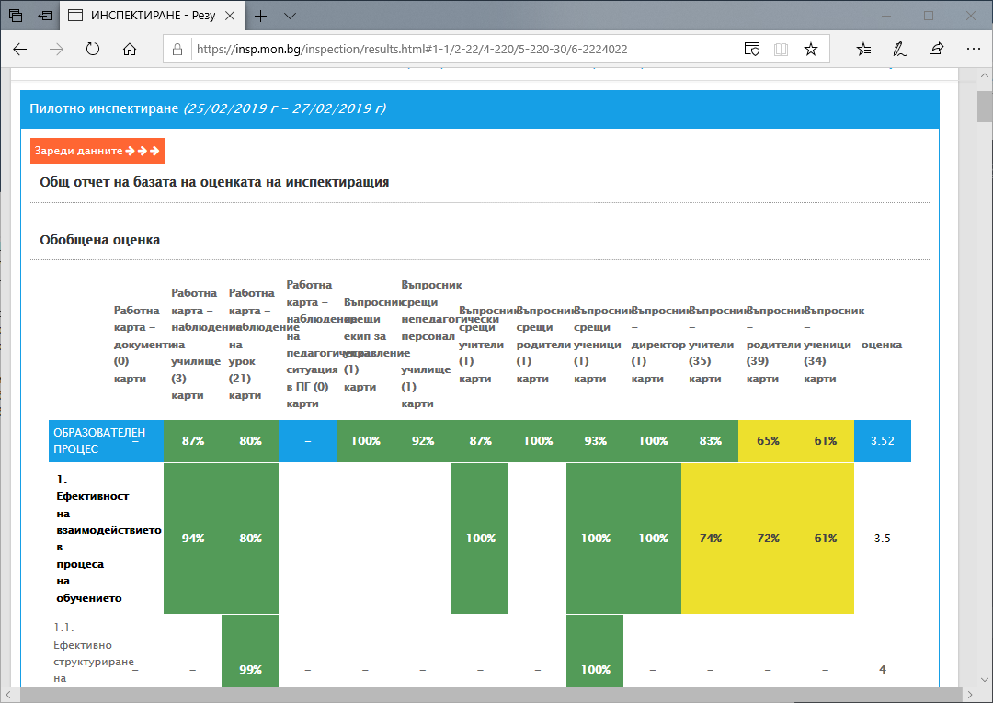
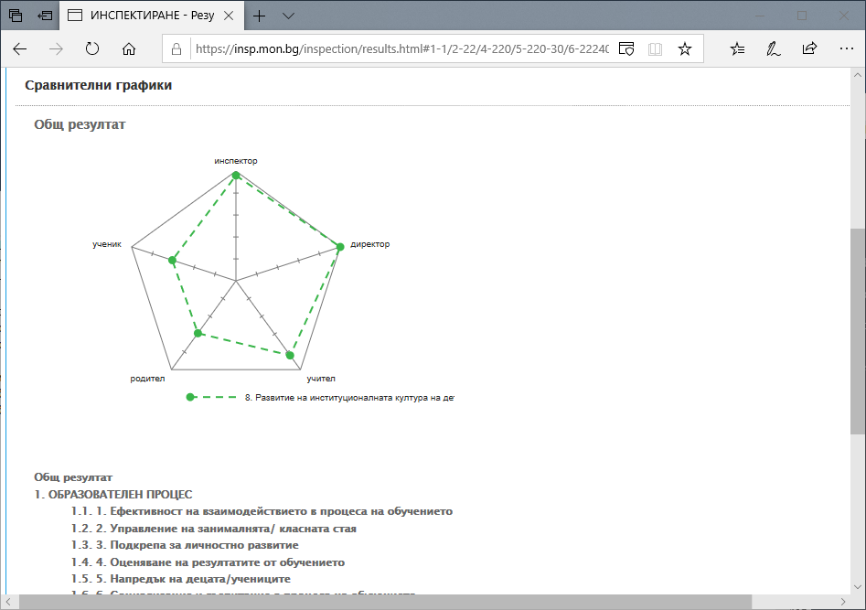
Results
Results by indicators:
Summarized result based on the individual inspector’s assessment cards
Summarized result based on all the assessment cards and questionnaires – grouped by stakeholders (variant of 360⁰ evaluation)
At the end of the inspection visit, the Inspectors assign the final rates

Slide 8
Potential further developments
For the schools/ kindergartens:
  Further integration with the databases of the Ministry of Education and Science: results from external evaluation exams, teachers’ qualification, financial issues etc.
  (might lead to automatic calculation of some of the indicators, based on statistical data)
For the NIE:
  Possibility to include specific questions depending on the school type specifics
  Automatic generation of inspection reports (based on templates)
  Generating statistics – annual, national, regional, per type of institution etc. – BI dashboards
  (Data comparison between two (or more) inspections in the same institution)

Slide 9

Radosveta Drakeva
AdminSoft
rdrakeva@adminsoft.bg

